Slide 1

Car Variables for Pricing Prediction
CS661
Group-4 : Harrison Yang and Shazia Khan

Slide 2
Why this data?
We took this data from Kaggle.
This dataset has numerous rows and columns to work on.
It comprises of 25 columns and 206 rows

Slide 3
Problem Definition:
Hypothesis: To understand the factors affecting the pricing of the cars in the market.
Which variables are significant in predicting the price of the car?
How well those variable describe the car?
How can we divide up this data to better view and reciprocate the information to others?
Goal:
Create a package to handle data manipulation and sorting.
Show our data graphically with EDA.
Implementing a prediction model.

Slide 4
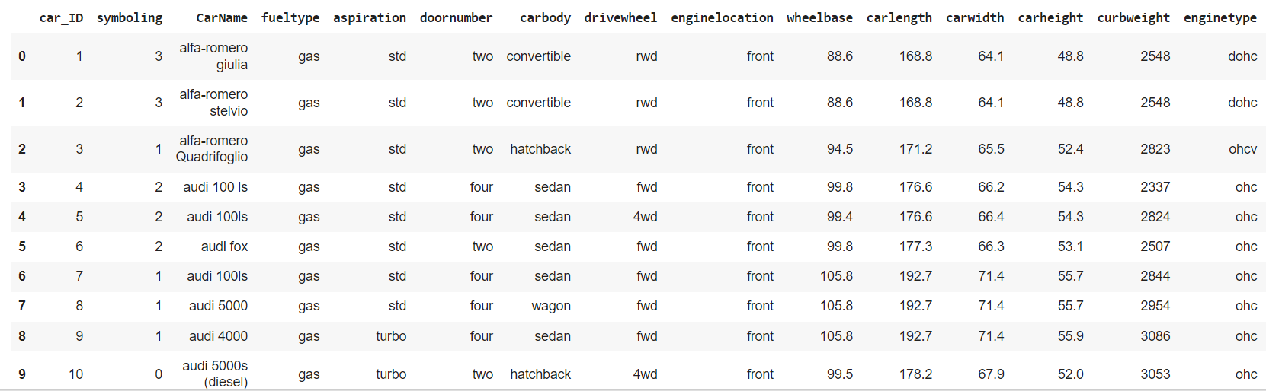
Exploratory Data Analysis:

Slide 5
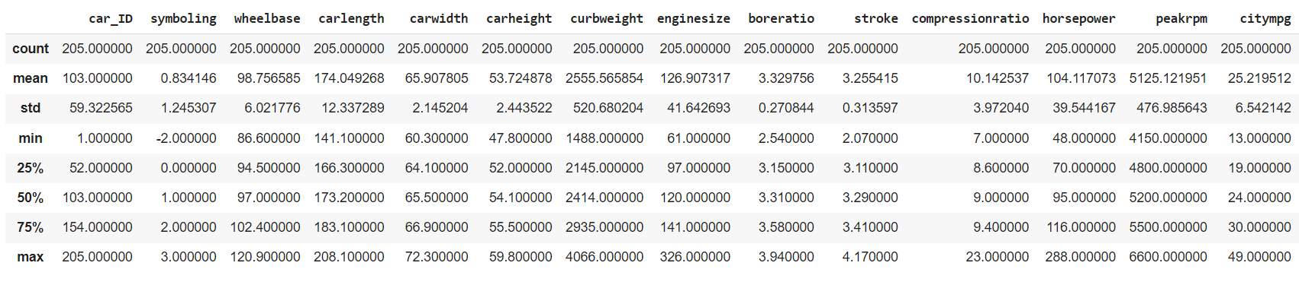
Evaluation of count, mean, etc:

Slide 6
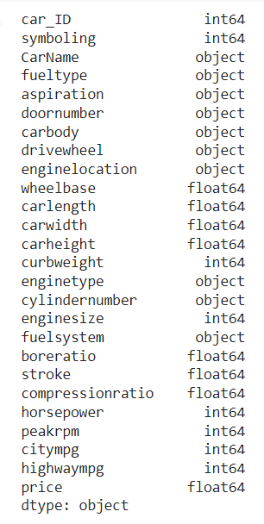
Showcasing Data types:

Slide 7
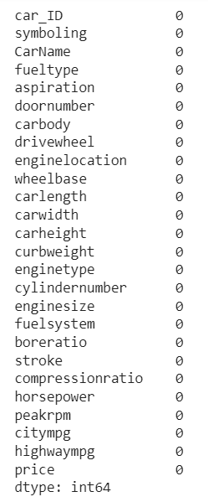
Count of null values:

Slide 8
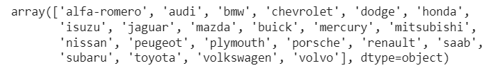
Various car brands:

Slide 9
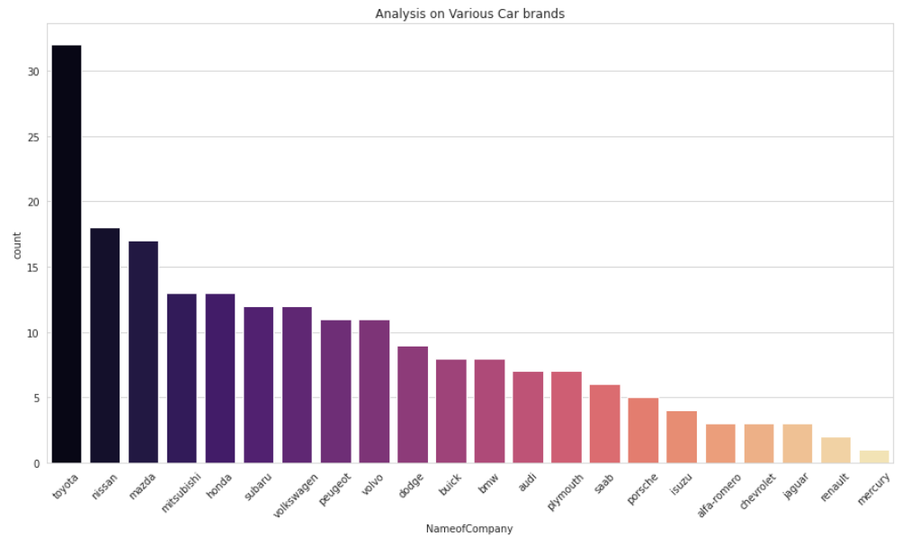
Analysis on different Car brands:

Slide 10
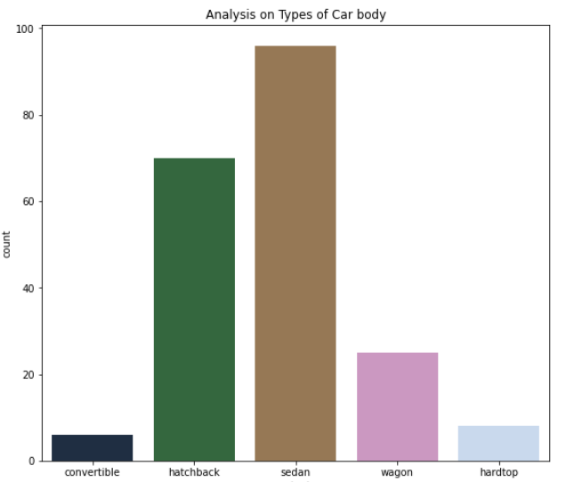
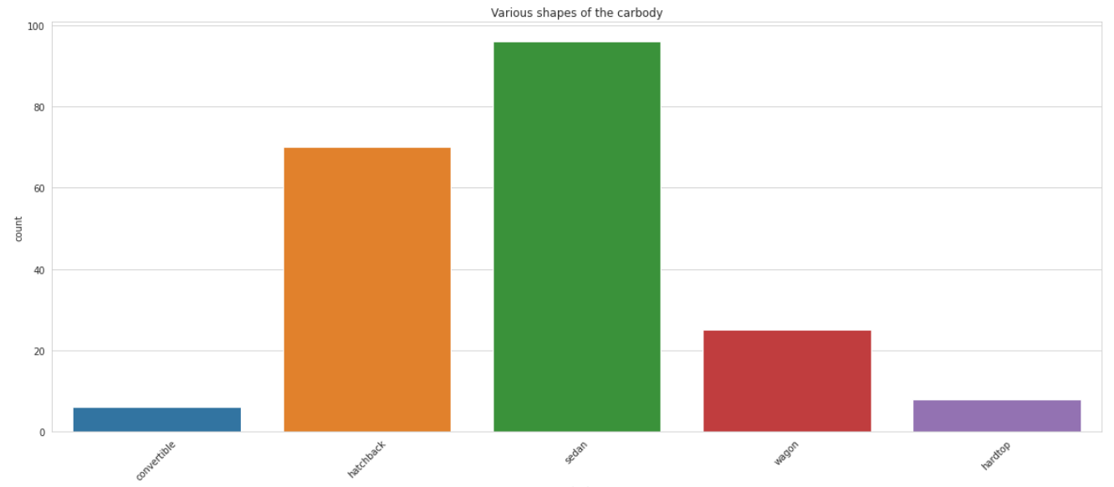
Visualizing the types of Car bodies:

Slide 11
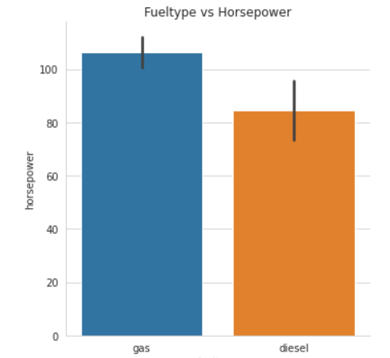
Fuel type vs Horsepower:

Slide 12
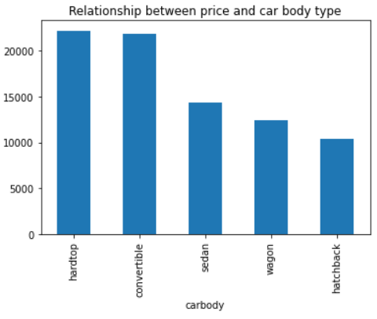
Relationship between price and car body type :

Slide 13
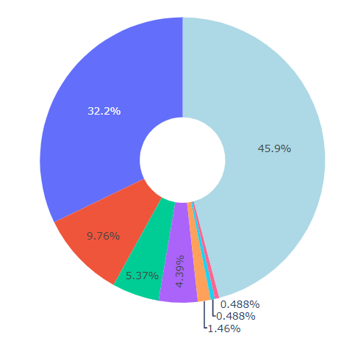
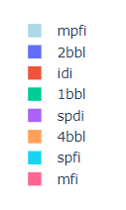
The Distribution of various fuel systems:

Slide 14
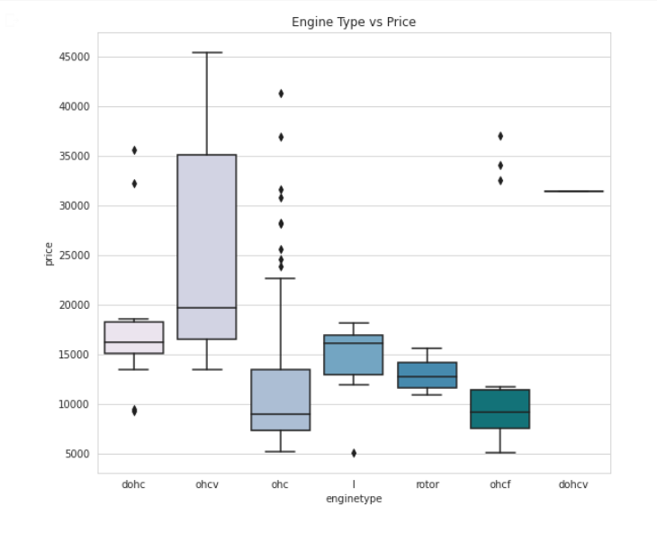
Engine type vs Price:

Slide 15
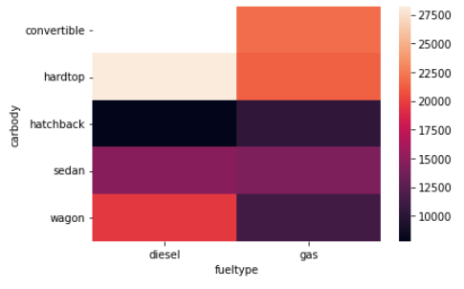
Analysis on car bodies against fuel type:

Slide 16
RFE – Recursive Feature Selection
RFE is an efficient approach for eliminating features from a dataset for feature selection. popular feature selection algorithm
Part of sklearn Library. We use this to determine what columns most correlate with pricing to find which columns statistically impact the pricing of a vehicle in our dataset
methods used:
RFE()
LinearRegression()
Fit()

Slide 17
RFE – Recursive Feature Selection
.support to first indicate which column had some relation with each other
curbweight, horsepower', 'fueleconomy', 'carwidth', 'hatchback’, 'sedan', 'wagon', 'dohcv', 'twelve', 'Highend’

Slide 18
OLS Regression Summary
OLS – Ordinary Least Square Model, most widely used model due to its efficiency.
Ordinary Least Squares regression (OLS) is a common technique for estimating coefficients of linear regression equations which describe the relationship between one or more independent variables and a dependent variable (simple or multiple linear regression).
This model gives best approximate of true population regression line
Principle of OLS is to minimize errors. Part of Statmodel Library

Slide 19
Modellib library
Build_model()
myVIF()

Slide 20
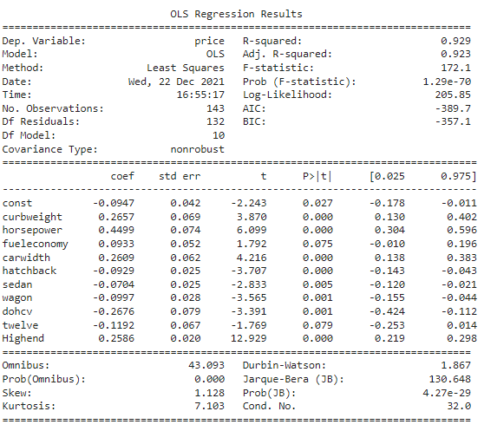
Const – Constant Term: intercept of the regression line. Tell us the average
Coef – Coefficient Term: describe the relationship between Independent and dependent variables. + indicates that Independent Variables increase so does dependent Variables. – indicates Independent Variables decrease so does dependent variables
P-Value: closer it is to 0 the higher correlation to the dependent variable which is our price
p-value less than significance level: correlation exists
p-value greater than significance level: correlation is less likely to existence
Significance level = 0.05
Remove “twelve”
First section is the overview of our dataset – most important is dependent variable

Slide 21
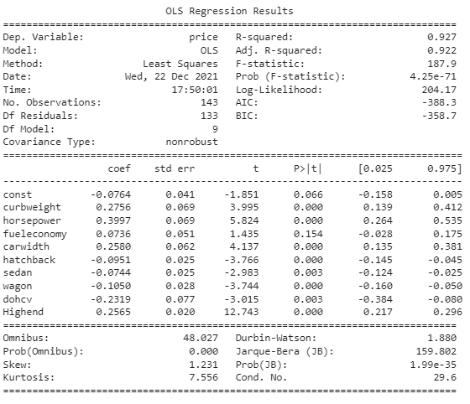
Remove “Fuel Economy”

Slide 22
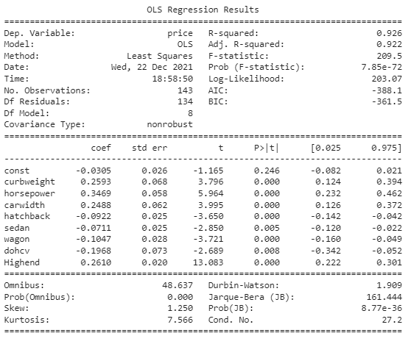

Slide 23

Variance Inflation Factor
Variance Inflation Factor – check correlation between Independent Variables. The VIF estimates how much the variance of a regression coefficient is inflated due to multicollinearity in the model. Part of statmodel library
A rule of thumb for interpreting the variance inflation factor:
1 = not correlated.
Between 1 and 5 = moderately correlated.
Greater than 5 = highly correlated.

Slide 24
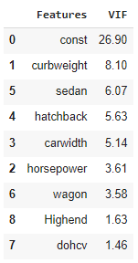
Remove curbweight

Slide 25
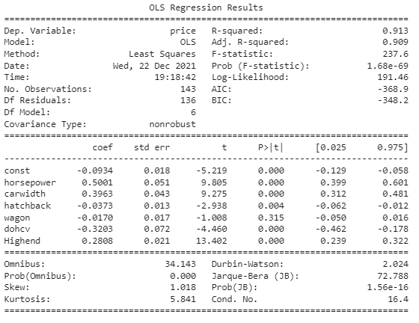
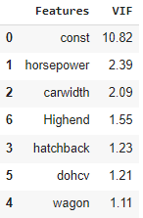
Remove wagon

Slide 26
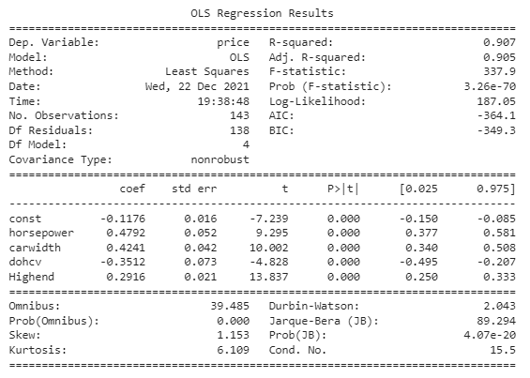
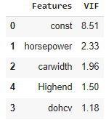
Results

Slide 27
The End.

