Slide 1
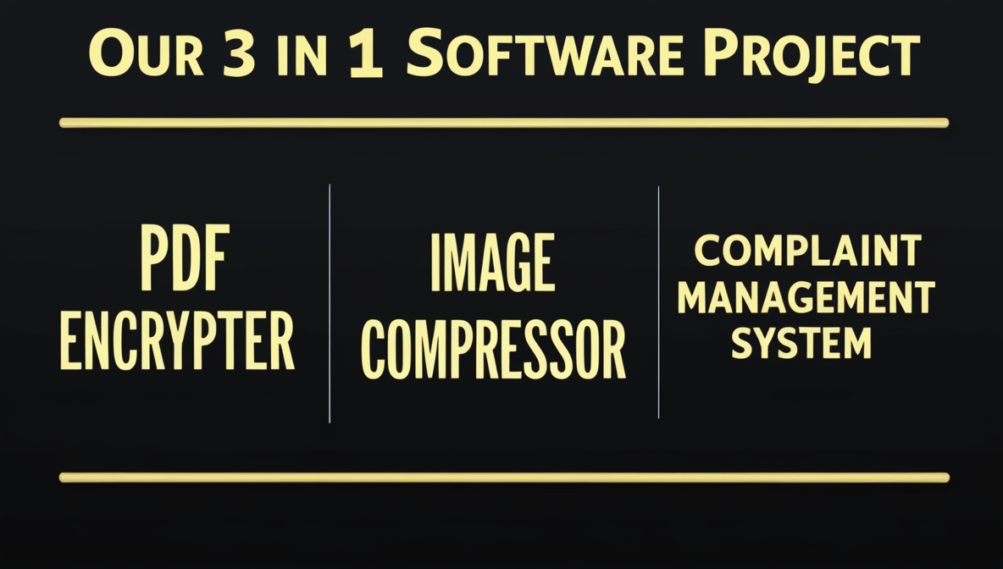
Welcome to our presentation
Shazidul Alam
ID No.: 0692220005101009
Batch : CSE 19
Anisur Rahman Naeem
ID No.: 0692220005101015
Batch : CSE 19
Faisal Morshed Akash
ID No.: 0692220005101007
Batch : CSE 19

Slide 2
Topics we going to discuss here
COMPLAINT MANAGEMENT SYSTEM Interface.
COMPLAINT MANAGEMENT SYSTEM functions.
COMPLAINT MANAGEMENT SYSTEM usage.
Combined Software Interface
Activity Diagram
Use Case Diagram
PDF ENCRYPTER Interface.
PDF ENCRYPTER functions.
PDF ENCRYPTER usage.
IMAGE COMPRESSOR AND PDF ENCRYPTER DIAGRAM
IMAGE COMPRESSOR options.
IMAGE COMPRESSOR usage.

Slide 3
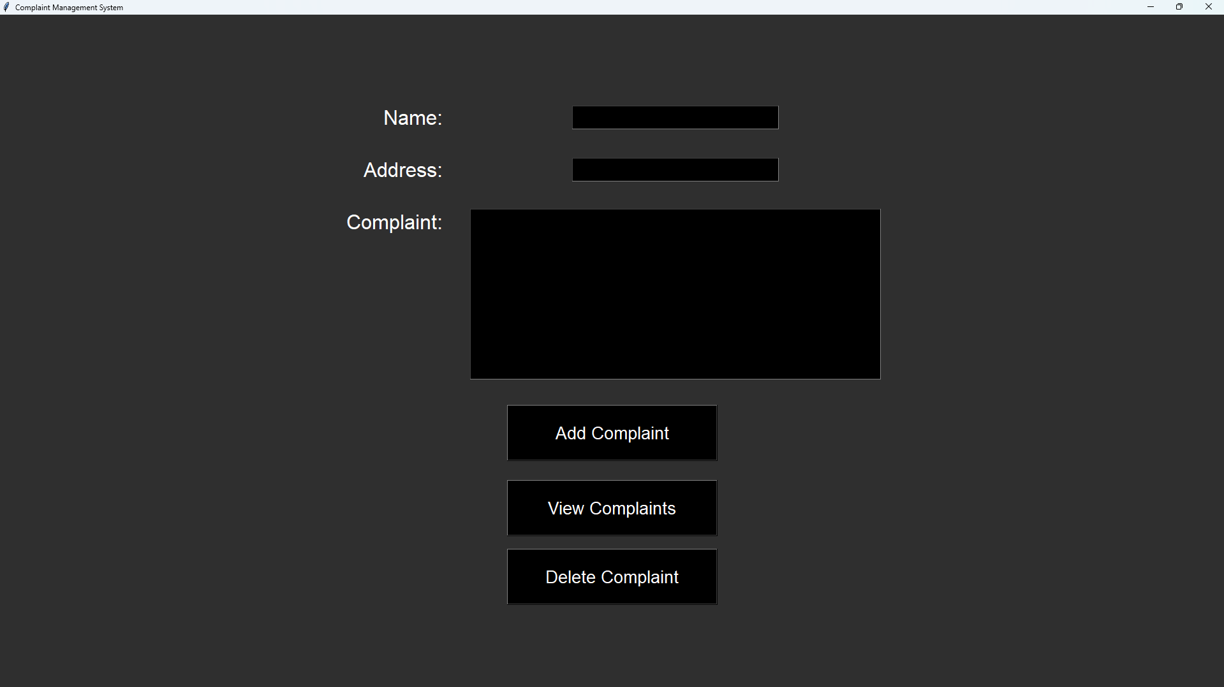
Complaint Management System Diagram
1

Slide 4
COMPLAINT MANAGEMENT SYSTEM FUNCTIONALITIES
FULL NAME : In this field the full name of the user will be given.
ADDRESS: In this field the user will select his/her address.
COMPLAINT: In this field the user will enter his/her complaint.
ADD COMPLAINT: Pressing this button will submit the complaint of the user.
VIEW COMPLAINTS: Pressing this button launches a new window where I will get to see the list of complaints done by the user.
DELETE COMPLAINTS: Pressing this button launches a new window where I will get to delete the desired complaints record.
2

Slide 5
Complaint Management System Usage
The Complaint Management System enables users to submit and view complaints easily. Users can record their complaints by entering their name, address and the complaint details, which the system then saves upon submission. By pressing the “View Complaints" button, users can view a complete list of their previously submitted complaints, including their personal information and the complaint text. This setup provides a straightforward approach to submitting issues and reviewing past complaints efficiently.
3

Slide 6
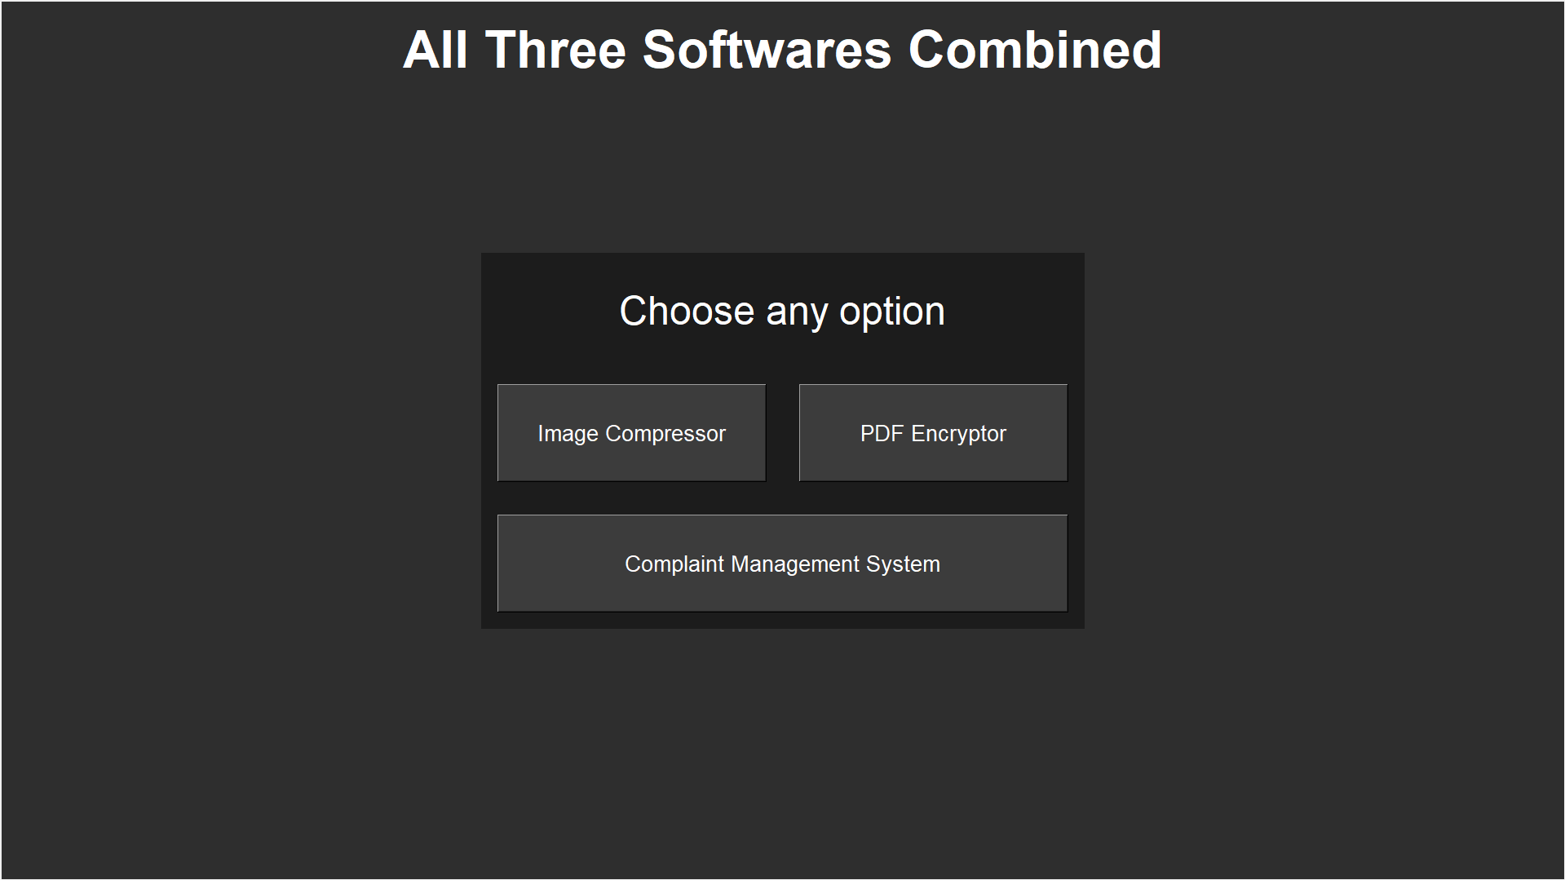
Our Combined Software
4

Slide 7
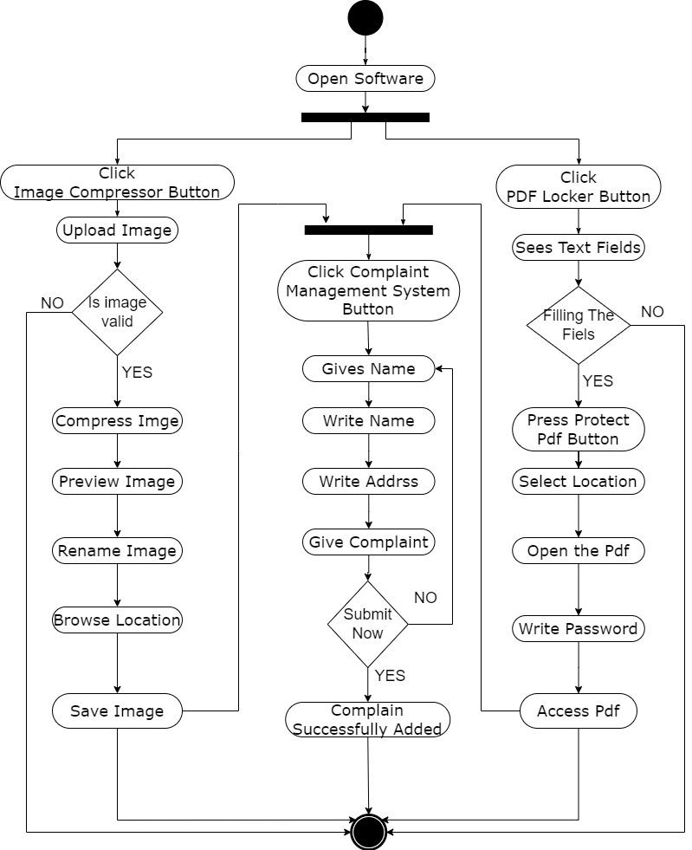
Activity Diagram
5

Slide 8
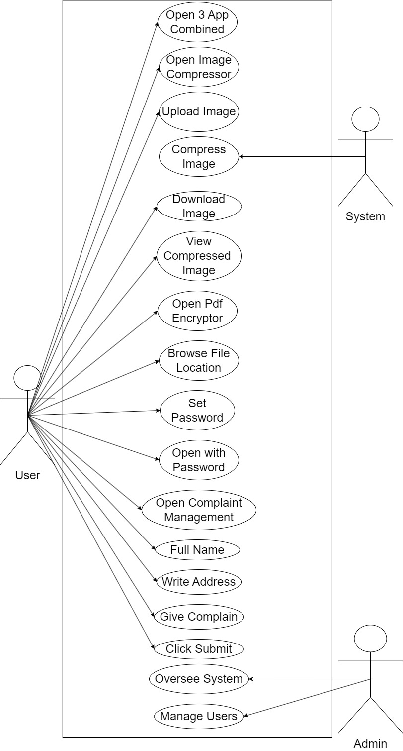
Use Case Diagram
6

Slide 9
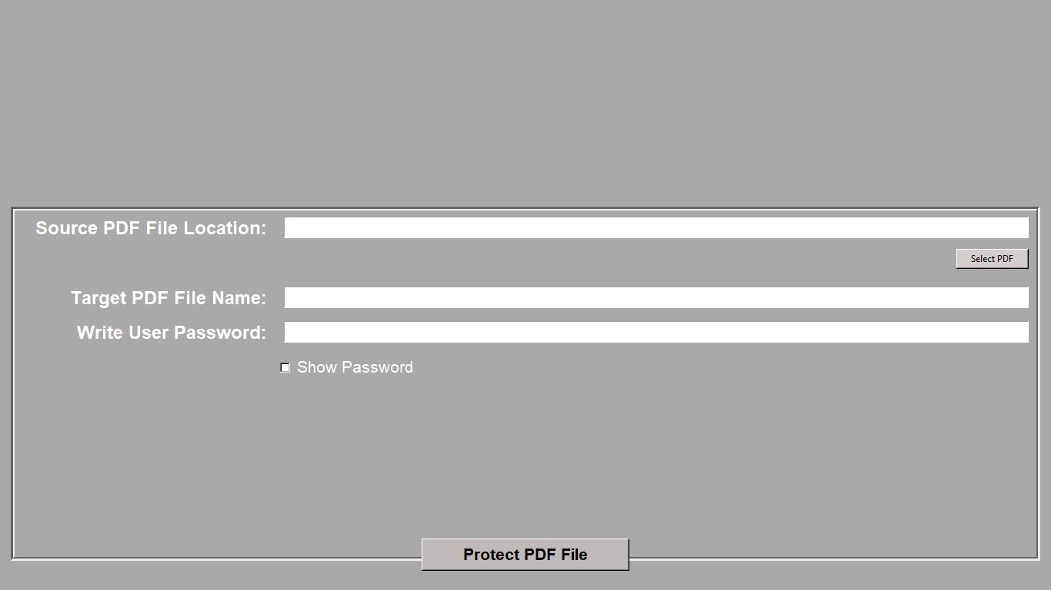
PDF ENCRYPTER DIAGRAM
7

Slide 10
PDF ENCRYPTER FUNCTION:
SOURCE PDF FILE LOCATION: This is the field where file path will be given using select pdf button.
TARGET PDF FILE NAME : In this field the name in which the encrypted pdf file will be created will be given.
WRITE USER PASSWORD: In this field the password to which the encrypted file can be accessed will be given. The password can be seen with show password button.
8

Slide 11
PDF ENCRYPTER USAGE
The PDF encryptor software allows users to securely encrypt PDF files by selecting a file, naming the output, and setting a password. Once encrypted, files can only be accessed with the correct password and are non-shareable, restricted to use on the originating device only. The software also supports custom naming for encrypted files, enhancing organization. If a user tries to encrypt a non-PDF file or skips the password entry, the software alerts them, ensuring smooth operation. Additionally, any failed password attempts prevent access, maintaining strong data protection.
9

Slide 12
IMAGE COMPRESSOR FUNCTIONALITIES
The main functionalities of these software is compressing image. Whenever we will click on its button it will launch a pop where it will take the image from the file manager. And then it will again launch a pop up where it will ask to show to path where the image will be saved. After showing the path the image will be saved.
10

Slide 13
IMAGE COMPRESSOR USAGE
The image compressor software enables users to reduce the size of selected images through a simple process. By clicking the compression button, a pop-up prompts users to choose an image from the file manager. After selection, another pop-up appears, allowing users to specify the save path for the compressed image. Once the path is confirmed, the software compresses the image and saves it in the chosen location, ensuring quick and organized access. This streamlined flow ensures that users can efficiently compress and save images without unnecessary steps.
11

Slide 14
Conclusion
Our software suite, encompassing the Complaint Management System, PDF Encrypter, and Image Compressor, offers a comprehensive solution for efficient complaint handling, secure document management, and optimized image handling. These tools are designed to streamline workflows, enhance productivity, and safeguard sensitive information.
12

Slide 15
Thank you for your patience
13

