Slide 1
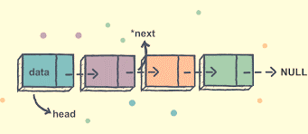
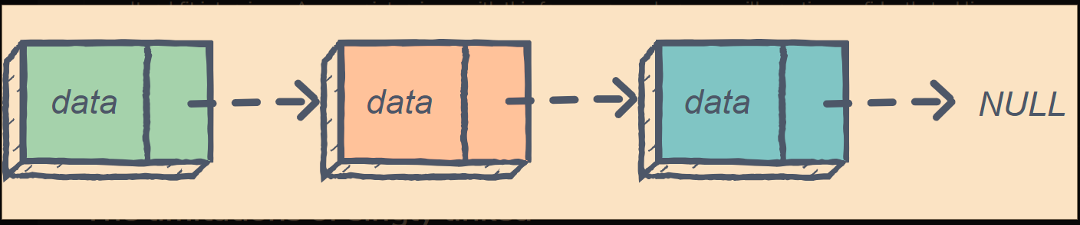
LINKED LISTS
PDSA COURSEWORK 2
KUHDSE23.2F-001 – E.M.C.S.B. Ekanayaka
KUHDSE23.2F-002 - R.M.C.N. Rathnayaka
KUHDSE23.2F-003 – M.S.F. Shazna
KUHDSE23.2F-004 – N.P.U.L. Nugawela

Slide 2
WHAT IS A LINKED LIST?
A linked list is a random access linear data structure.
It stores a collection of data elements dynamically.
Consists of nodes which has two parts, where each node contains data and a reference(link) to the next node.
data next
data next
NULL
HEAD

Slide 3
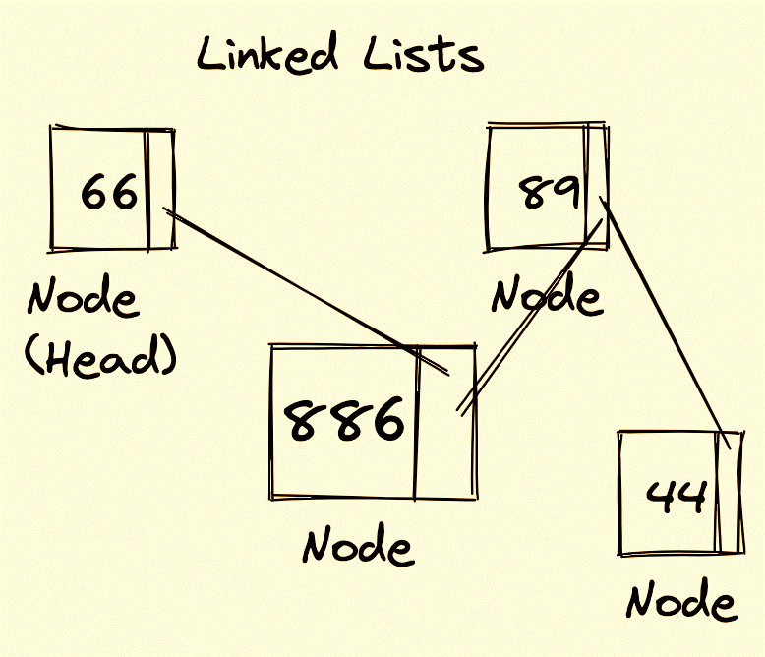
TYPES OF LINKED LIST
There are four types of linked lists:
Singly Linked lists
Doubly Linked lists
Circular Singly Linked lists
Circular Doubly Linked Lists

Slide 4
HOW DOES A LINKED LIST WORK?
HEAD
This is a NODE
This is the next
NODE
data next
data next
HEAD means this is the initial node
NULL
DATA is stored in values here
NULL means there are no more nodes
NEXT is contains the address and points to the next node

Slide 5
SINGLY LINKED LIST
Data structure consisting of nodes where each node points to the next node in the sequence.
Each node contains data and a reference (link) to the next node.
The last node's reference points to NULL, indicating the end of the list.
2180
1009
30 [1009]
40
NULL
HEAD
data
next
data
next

Slide 6

INSERTING A NODE IN SINGLY LINKED LISTS
#here the nodes are inserted one by one
linked_list = LinkedList()
linked_list.insert_at_beginning(1)
linked_list.insert_at_beginning(2)
linked_list.insert_at_beginning(3)
print("Linked List after inserting at the beginning:")
linked_list.display()
#initialization
class Node:
def __init__(self, data):
self.data = data
self.next = None
#initialling the head is null
class LinkedList:
def __init__(self):
self.head = None
# Insert at the beginning of the linked list
def insert_at_beginning(self, data):
new_node = Node(data)
new_node.next = self.head
self.head = new_node
def display(self):
current = self.head
while current:
print(current.data, end=" -> ")
current = current.next
print("None")
2180
1009
2 [1009]
1
NULL
3440
2180
1009
3 [2180]
2 [1009]
1
NULL

Slide 7
DELETING A NODE IN SINGLY LINKED LISTS
class Node:
def __init__(self, data):
self.data = data
self.next = None
#initialling the head is null
class LinkedList:
def __init__(self):
self.head = None
# Insert at the beginning of the linked list
def insert_at_beginning(self, data):
new_node = Node(data)
new_node.next = self.head
self.head = new_node
def delete_at_beginning(self):
if self.head:
self.head = self.head.next
def display(self):
current = self.head
while current:
print(current.data, end=" -> ")
current = current
.next
print("None")
linked_list = LinkedList()
# Insert nodes at the beginning
linked_list.insert_at_beginning(1)
linked_list.insert_at_beginning(2)
linked_list.insert_at_beginning(3)
linked_list.display()
#deleting the node
linked_list.delete_at_beginning()
linked_list.display()
3440
2180
1009
3 [2180]
2 [1009]
1
NULL
2180
1009
2 [1009]
1
NULL

Slide 8
ADVANTAGES
Dynamic Size
Efficient Insertions and deletions
Low memory overhead
No wasted memory
Space efficiency for small lists
DISADVANTAGES
No Random Access
Lack of Bidirectional Traversal
Additional Memory Overhead
Complex Insertions/deletions
Difficulty in finding last element
MORE ON SINGLY
LINKED LISTS
PLACES WHERE SINGLY LINKED LISTS
Implementing stacks and queues
Navigation in web browsers
Implementing symbol tables
Undo/Redo Functionality
Linear Data Sequences

Slide 9
DOUBLY LINKED LIST
Data structure consisting of nodes where each node points to both the previous and the next node in the sequence.
Each node contains data and a references (links) to the previous and next node.
Allows for efficient forward and backward traversal.
HEAD
2180
8907
4599
30 [8907]
[2180] 50 [4599]
[8907] 70
NULL
data
next
data
data
next
prev
prev
next
prev

Slide 10
INSERTING A NODE IN DOUBLY LINKED LISTS
class Node:
def __init__(self, data):
self.data = data
self.next = None
self.prev = None
class DoublyLinkedList:
def __init__(self):
self.head = None
self.tail = None
def insert_at_beginning(self, data):
new_node = Node(data)
if not self.head:
self.head = new_node
self.tail = new_node
else:
new_node.next = self.head
self.head.prev = new_node
self.head = new_node
def display(self):
current = self.head
while current:
print(current.data, end=" <-> ")
current = current.next
print("None")
doubly_linked_list = DoublyLinkedList()
# Insert nodes at the beginning
doubly_linked_list.insert_at_beginning(3)
doubly_linked_list.insert_at_beginning(2)
doubly_linked_list.insert_at_beginning(1)
("Doubly Linked List after inserting at the beginning:")
doubly_linked_list.display()
2
3
NULL
1
2
3
NULL

Slide 11
DELETING A NODE IN DOUBLY LINKED LISTS
class Node:
def __init__(self, data):
self.data = data
self.next = None
self.prev = None
class DoublyLinkedList:
def __init__(self):
self.head = None
self.tail = None
# Insert at the beginning of the doubly linked list
def insert_at_beginning(self, data):
new_node = Node(data)
if not self.head:
self.head = new_node
self.tail = new_node
else:
new_node.next = self.head
self.head.prev = new_node
self.head = new_node
def display(self):
current = self.head
while current:
print(current.data, end=" <-> ")
current = current.next
print("None")
doubly_linked_list = DoublyLinkedList()
# Insert nodes at the beginning
doubly_linked_list.insert_at_beginning(3)
doubly_linked_list.insert_at_beginning(2)
doubly_linked_list.insert_at_beginning(1)
print("Doubly Linked List before deleting from the beginning:")
doubly_linked_list.display()
doubly_linked_list.delete_at_beginning()
("Doubly Linked List after deleting from the beginning:")
doubly_linked_list.display()
1
2
3
NULL
2
3
NULL

Slide 12
ADVANTAGES
Bidirectional Traversal
Efficient Insertions and deletions
Enhanced Iterator Support
Reversing the list
Improved error handling
DISADVANTAGES
Complexity in implementation
Slower Traversal
Reducing Space efficiency
Slower iteration than arrays
Higher memory overhead
MORE ON DOUBLY
LINKED LISTS
PLACES WHERE DOUBLY LINKED LISTS
Text editors
Web Browser history
Operating systems
Database systems
Image editors

Slide 13
CIRCULAR SINGLY LINKED LIST
A circular linked list is a linked list where the last node's reference points back to the first node, creating a closed loop.
Each node contains data and a reference to the next node.
The last node's reference points back to the first node, forming a loop.
There is no NULL here, the last node's reference points back to the first node, forming a loop.
HEAD
2180
1009
30 [1009]
40 [2180]
data
next
data
next

Slide 14
INSERTING A NODE IN CIRCULAR SINGLY LINKED LISTS
def display(self):
if not self.head:
return # Empty list, nothing to display
current = self.head
while True:
print(current.data, end=" -> ")
current = current.next
if current == self.head:
break
print(" (Back to the beginning)")
circular_linked_list = CircularSinglyLinkedList()
circular_linked_list.insert_at_beginning(3)
circular_linked_list.insert_at_beginning(2)
circular_linked_list.insert_at_beginning(1)
print("Circular Singly Linked List after inserting at the beginning:")
circular_linked_list.display()
class Node:
def __init__(self, data):
self.data = data
self.next = None
class CircularSinglyLinkedList:
def __init__(self):
self.head = None
def insert_at_beginning(self, data):
new_node = Node(data)
if not self.head:
self.head = new_node
new_node.next = self.head
else:
current = self.head
while current.next != self.head:
current = current.next
current.next = new_node
new_node.next = self.head
self.head = new_node
1009
2 [1009]
1
3440
2180
3 [2180]
2 [1009]
1009
1

Slide 15
DELETING A NODE IN CIRCULAR SINGLY LINKED LISTS
class Node:
def __init__(self, data):
self.data = data
self.next = None
class CircularSinglyLinkedList:
def __init__(self):
self.head = None
def insert(self, data):
new_node = Node(data)
if not self.head:
self.head = new_node
new_node.next = self.head
else:
new_node.next = self.head.next
self.head.next = new_node
def delete(self, value):
if not self.head:
return # Empty list, nothing to delete
current = self.head
while True:
if current.next.data == value:
if current.next == self.head: # Last node in the list
self.head = None
else:
current.next = current.next.next
return
current = current.next
if current == self.head:
break
circular_singly_linked_list = CircularSinglyLinkedList()
circular_singly_linked_list.insert(3)
circular_singly_linked_list.insert(2)
circular_singly_linked_list.insert(1)
# Delete a node by value
circular_singly_linked_list.delete(2)
3440
2180
1009
3 [2180]
2 [1009]
1
1009
2 [1009]
1

Slide 16
ADVANTAGES
Dynamic Size
Efficient Insertions and deletions
Low memory overhead
No wasted memory
Space efficiency for small lists
DISADVANTAGES
Additional complexity
Lack of Bidirectional Traversal
Potential infinite loops
Less versatile than doubly linked lists
Reduced space efficiency
MORE ON
CIRCULAR SINGLY
LINKED LISTS
PLACES WHERE CIRCULAR SINGLY LINKED LISTS
Game Development
Image processing and Animation
Sensor Data Collection
Real time systems
Circular Navigation in GPS and maps

Slide 17
CIRCULAR DOUBLY LINKED LIST
Data structure containing data and references to both the next and previous nodes.
Each node contains data and a reference (link) to the previous and next node.
There is no NULL ,the last node's reference points back to the first node, forming a loop.
HEAD
2180
8907
4599
30 [8907]
[2180] 50 [4599]
[8907] 70
data
next
data
data
next
prev
prev
next
prev

Slide 18
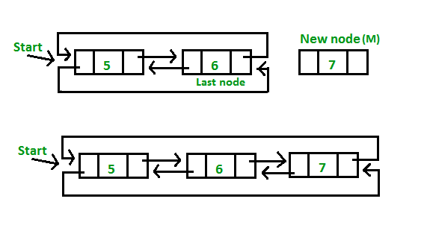
INSERTING A NODE IN CIRCULAR DOUBLY LINKED LISTS
class Node:
def __init__(self, data):
self.data = data
self.next = None
self.prev = None
class CircularDoublyLinkedList:
def __init__(self):
self.head = None
self.tail = None
def insert_at_beginning(self, data):
new_node = Node(data)
if not self.head:
self.head = new_node
self.tail = new_node
new_node.next = new_node
new_node.prev = new_node
else:
new_node.next = self.head
new_node.prev = self.tail
self.head.prev = new_node
self.tail.next = new_node
self.head = new_node
def display(self):
if not self.head:
return # Empty list, nothing to display
current_forward = self.head
current_backward = self.tail
while True:
print(current_forward.data, end=" <-> ")
current_forward = current_forward.next
if current_forward == self.head:
break
print(" (Forward)")
while True:
print(current_backward.data, end=" <-> ")
current_backward = current_backward.prev
if current_backward == self.tail:
break
print(" (Backward)")
circular_doubly_linked_list = CircularDoublyLinkedList()
circular_doubly_linked_list.insert_at_beginning(3)
circular_doubly_linked_list.insert_at_beginning(2)
circular_doubly_linked_list.insert_at_beginning(1)
# Display the circular doubly linked list
print("Circular Doubly Linked List after inserting at the beginning:")
circular_doubly_linked_list.display()

Slide 19
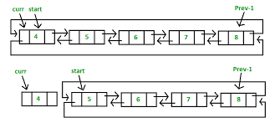
DELETING A NODE IN CIRCULAR DOUBLY LINKED LISTS
class Node:
def __init__(self, data):
self.data = data
self.next = self.prev = None
class CircularDoublyLinkedList:
def __init__(self):
self.head = None
def insert(self, data):
new_node = Node(data)
if not self.head:
self.head = new_node
new_node.next = new_node.prev = new_node
else:
new_node.next = self.head
new_node.prev = self.head.prev
self.head.prev.next = new_node
self.head.prev = new_node
self.head = new_node
def delete(self, value):
current = self.head
while current:
if current.data == value:
if current.next == current
self.head = None
else:
current.prev.next = current.next
current.next.prev = current.prev
if current == self.head:
self.head = current.next
return
current = current.next
if current == self.head:
break
circular_doubly_linked_list = CircularDoublyLinkedList()
# Insert nodes at the beginning
circular_doubly_linked_list.insert(3)
circular_doubly_linked_list.insert(2)
circular_doubly_linked_list.insert(1)
# Delete a node by value
circular_doubly_linked_list.delete(2)

Slide 20
ADVANTAGES
Easy traversal
Accessibility of a node
Efficient memory usage
Implementation of circular buffer
Enhanced iterator support
DISADVANTAGES
Complexity
Higher memory overhead
Complex Termination conditions
Possibility of an infinite loop
Difficulty in finding last element
MORE ON
CIRCULAR DOUBLY
LINKED LISTS
PLACES WHERE CIRCULAR DOUBLY LINKED LISTS
Dynamic data structures
Algorithm Design and analysis
Real time data processing
Caching mechanisms
Browser history

Slide 21

IN CONCLUSION…
In conclusion, linked lists are dynamic tools with versatile applications. Understanding their strengths and types is essential for effective data management and software development.
This is;
Flexible Data management
Versatile
Efficient

Slide 22
THANK YOU!

