Slide 1
Monte Carlo Simulation and Clustering for Customer Segmentation in Business Organization
By Abhishek Shastry.
Data Scientist

Slide 2
Introduction:
The process of grouping customers into sections of individuals who share common characteristics is called Customer Segmentation.
Demographic, Geographic, and Behavioral segmentation are the most common types of segmentation used.
Some of the market segmentation objectives include product, price, promotions, and place.
The advantages of marketing segmentation include creating stronger segmentation, Attract potential customers, Create a customer connection.

Slide 3
Introduction continued examples:
Demographic Segmentation – based on gender, age, occupation, marital status, income, etc.
Geographic Segmentation – based on country, state, or city of residence. Local businesses may even segment by specific towns or counties.
Behavioral Segmentation – based on actions or inactions, spending/consumption habits, feature use, session frequency, browsing history, average order value, etc.

Slide 4
Problem Statement:
How do we retain Customers in products with a subscription-based business model?
Examples of customer churn includes
Cancelation of a subscription
Closure of an account
Non-renewal of a contract or service agreement
The decision to shop at another store
Use another service provider

Slide 5
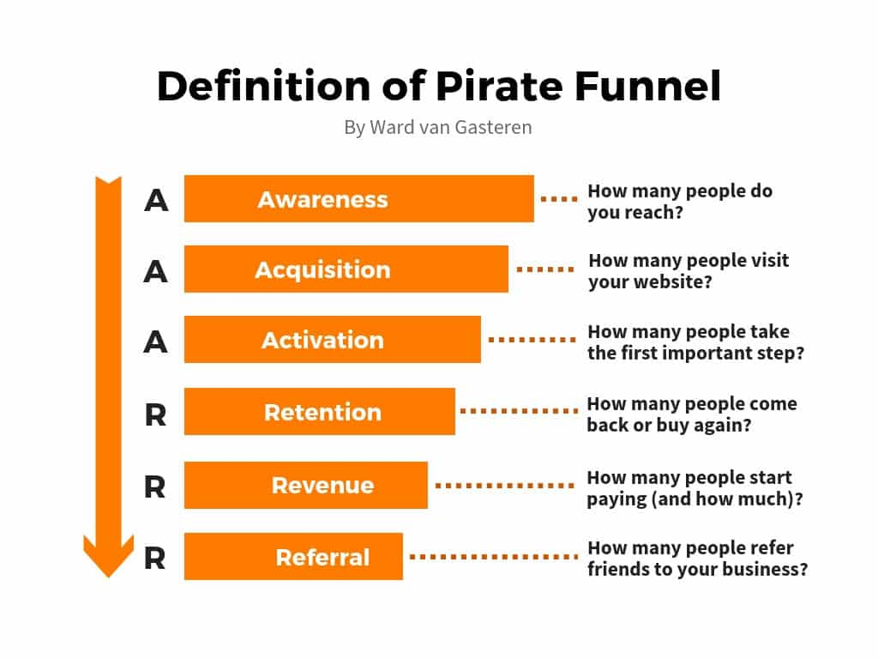
Terminologies and model:
The percentage of customers that discontinue using a company’s products or services during a particular time period is called a customer churn (attrition) rate.

Slide 6
Approach
The Data of churned customers and existing customers should be considered.
k means Unsupervised machine learning generates clusters and identifies the high-risk churn customers i.e existing customers and churned customers display similar characteristics.
Supervised classification techniques can be used to predict on the new sets of data.(Unknown data)

Slide 7
Sample Data
ZipCode | Income | Gender | Occupation | Frequency of Purchase | Payment Methods | Time of Day/Season of Purchase
60616 | ? | F | CA | Regular | Credit | Night

Slide 8
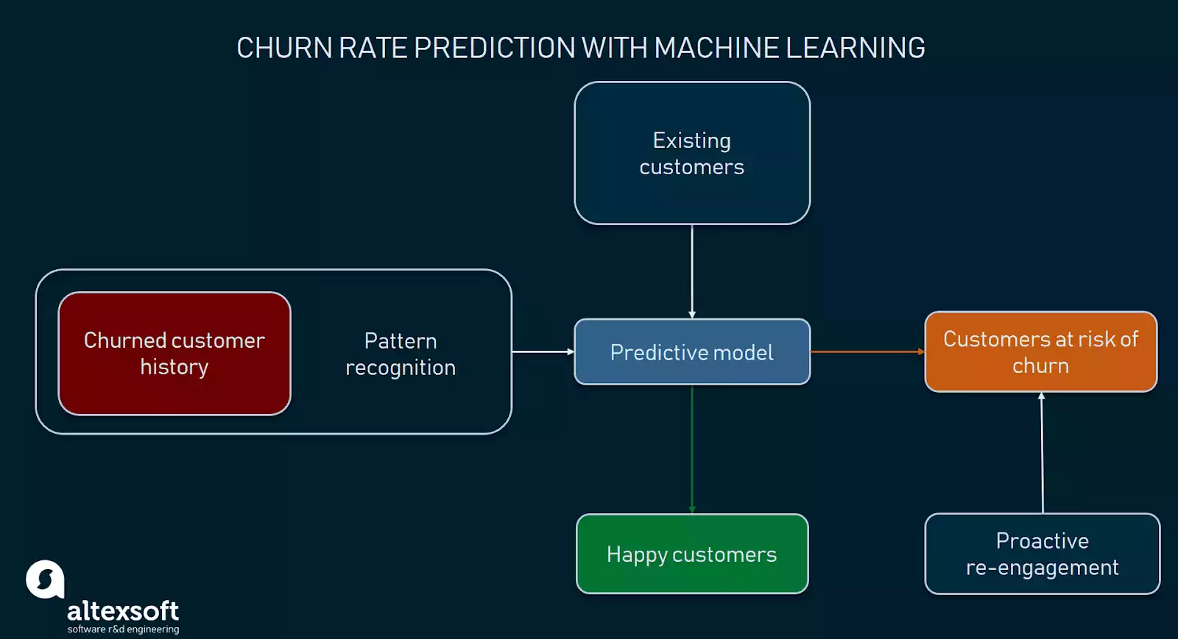
Diagram

Slide 9
Generate customer’s income data through Monte Carlo Simulation.
Step 1: Available Data
The mean (x̄ ) values are produced from BPS data that is processed to obtain an average per capita income value in 14 sub-districts. Standard deviation values are determined in a random manner until we get a number that generates random number which closest to the condition of a minimum per capita income in each district based on the observation
Sub districts | Average per capita income | Standard Deviation
BIRINGKANAYA | 3.308.472 | 0.7

Slide 10
STEP 2: Generating the Random Number of Per Capita Income
The random number is generated of per capita income in each sub-district that refers to the value of mean and standard deviation number.
Xn = f (p, x̄ sub-district, σsub-district)
Random number generation can be finished with the normal inverse function, which calculates the inverse of the cumulative normal distribution function, for a given number of probability, mean and standard deviation of the set.

Slide 11
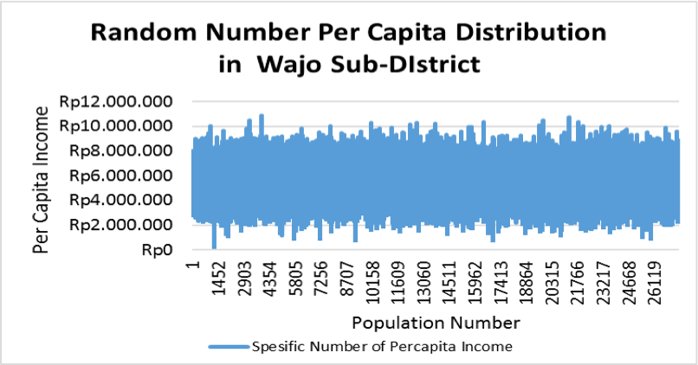
STEP 2continued.
Iterations of random number simulation are done based on the population number for each sub-district.

Slide 12
STEP3: Generating Customer’s Income Value
XCustomer = [(Xn)1 + (Xn)2 + ... + (Xn)q]
A home segment customer is a home user so the customer income is assumed to be a household income.
Which are X customer is a specific simulation value of per capita income variable, and q is as the average population number in a house at each sub-district.

Slide 13
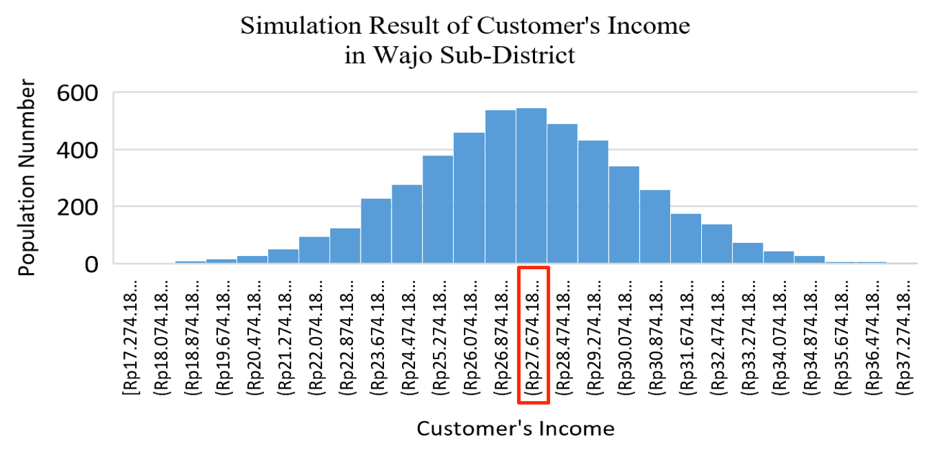
Simulation Result

Slide 14
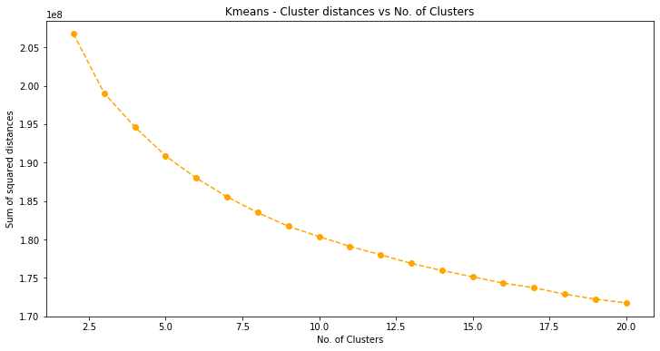
Elbow method

Slide 15
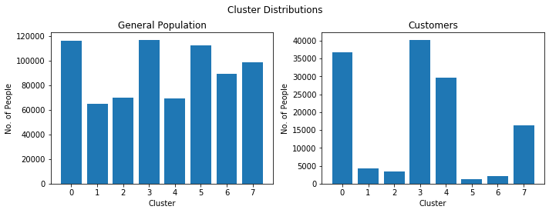
Comparing similar clusters

Slide 16
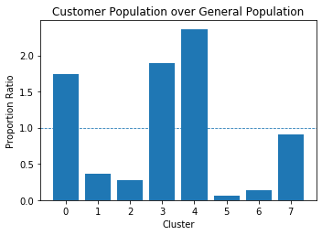
Ratio of Proportion of Customers to Proportion of General Population in each cluster
The ratio > 1 indicates that the cluster contains more customers, and there is a scope of the prople belonging to these clusters being future customers.

Slide 17
Challenges
It is required to run the algorithm multiple times for sub-optimal solutions because K-Means does not behave very well when the clusters have varying sizes, different densities, or non-spherical shapes.
Pre-enter the number of clusters (K).
3. Hence hierarchical clustering can be a good alternative.
4. Python can be used here but can it cannot generate a value by itself. Hence monte Carlo becomes useful.

Slide 18
Thank you

