Slide 2
Intro to Node Part I: How does it work?
Instructors: Alejandra Q. & John C.
GitHub handle: @alequetzalli & @johncokos
Website: http://shecodesnow.com

Slide 3
In Part 1, we covered...
History of how we came to use Node.js.
What are the top benefits of Node?
You can make your own server.
You can become a full-stack/back-end developer with your knowledge of JavaScript. (JavaScript developers no longer are forced to learn a new language such as Java to do back end programming!)
You don't need to use bash scripts (which won’t work in a windows machine), and simply write those scripts in JS.
How do servers work anyway?
Built a simple "HELLO WORLD" app and HTTP server.

Slide 4
What are the top benefits of Node ?
Previous Front-End JS person who could before only work in the browser, can now do all kinds of things. (EX: command line application)
It can be used to make your own web server; node servers are self contained.
It’s asynchronous; you are just waiting for the slowest JS function to finish v.s. running One. At. A. Time.

Slide 5
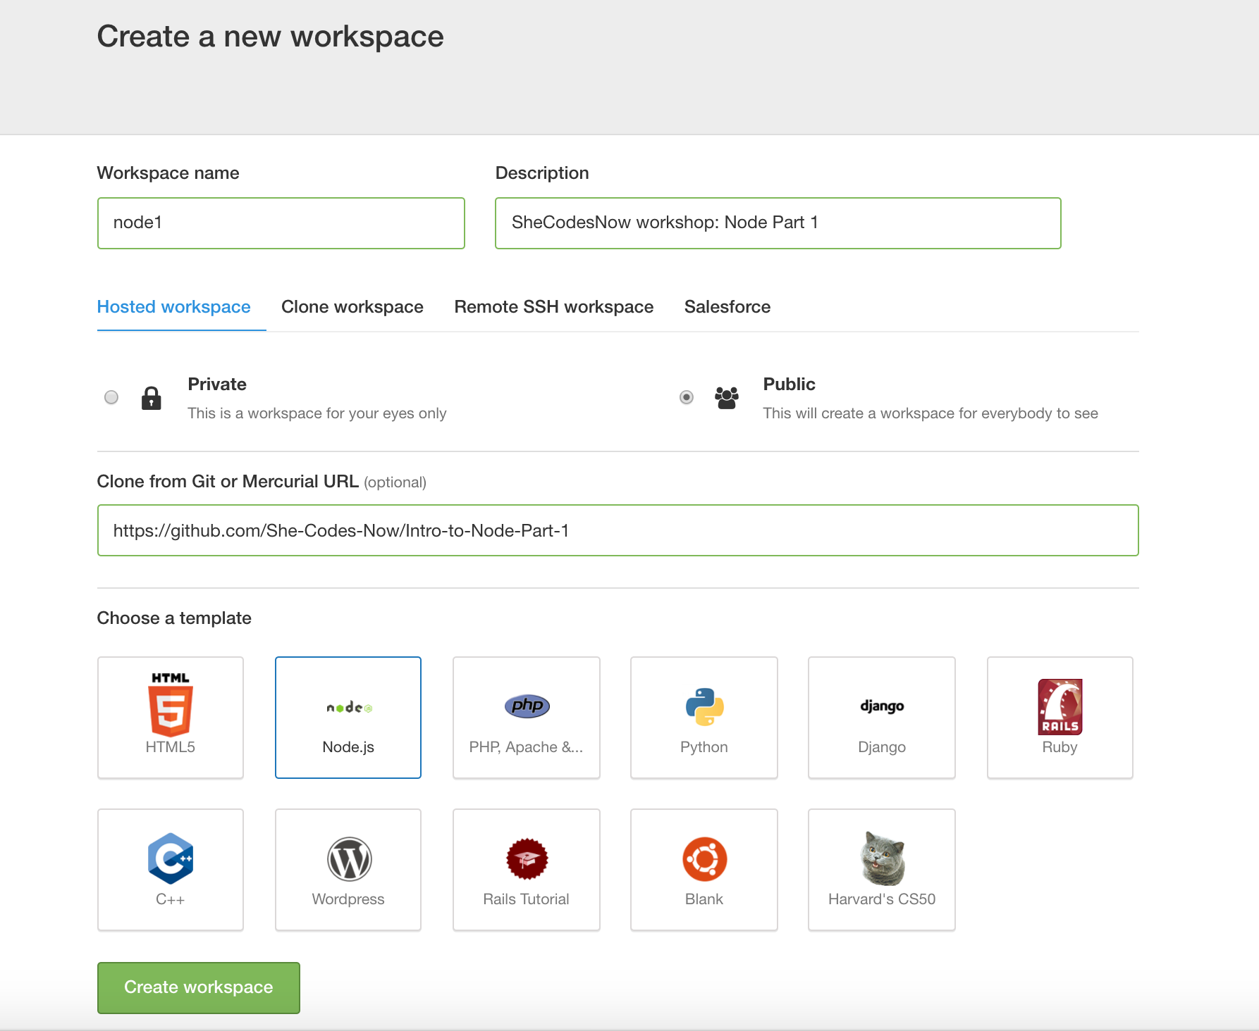
Go to Cloud9; online tool
Cloud 9: https://ide.c9.io
GitHub repo for this class:
https://github.com/She-Codes-Now/Intro-to-Node-Part-2

Slide 6
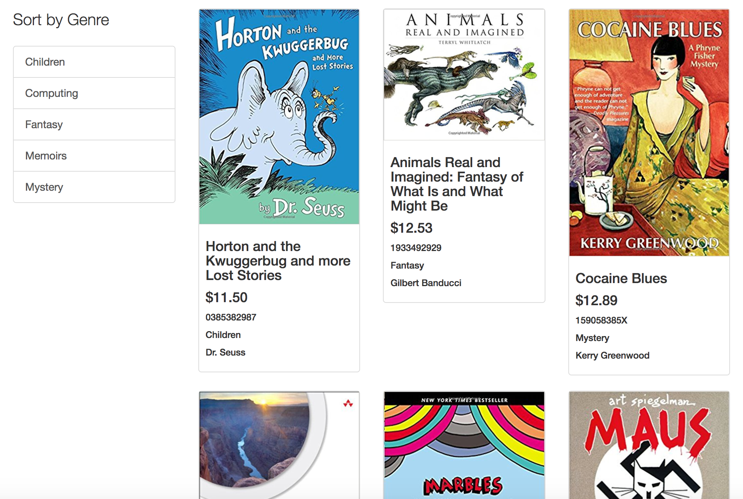
Our goals for this workshop
Learn about…
• JavaScript Promises
• Asynchronous Behavior
• Data Services
• Fetching remote data from a service
• Data Structures in Templates
Build a sample app!

Slide 7
Concepts we’ll go over tonight…
Learn about…
• JavaScript Promises
• Asynchronous Behavior
• Data Services
• Fetching remote data from a service
Mocky.io
• Data Structures in Templates
Build a sample app!

Slide 8
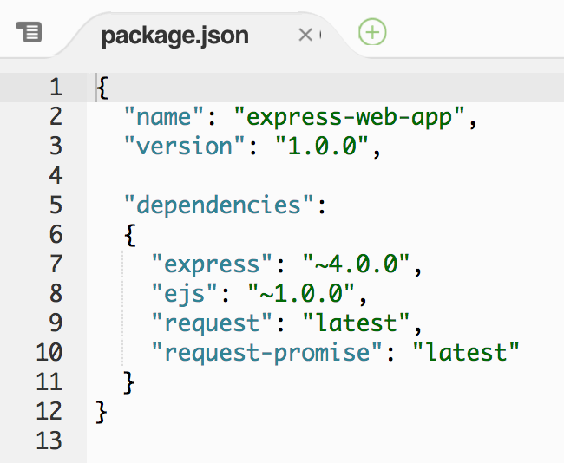
In your package.json file…
A framework imposes structure upon your code in order to address a particular problem. (A library is a generic set of tools that aids you in various tasks, without necessarily addressing the same problem.)
- Source
A promise represents the eventual result of an asynchronous operation. It is a placeholder into which the successful result value or reason for failure will materialize.
Express is a framework for Node.js.
EJS is a templating language that generates HTML markup with JavaScript.
"E" is for "effective.”
Request-Promise is a library for making HTTP requests and returning the results as promises.

Slide 9
Let’s divide into teams and make our own app!

Slide 10
Categories to pick from:
music
Zoo animals
Collector item of choice!
cars
clothing
Don’t forget you will need to pick both..
Categories
Sub Categories

Slide 11
Extra Learning Sources:
http://www.node-console.com/script/code
http://www.tutorialspoint.com/codingground.htm

