Slide 1
Introduction to Data Analysis with Python Why can’t I just use Excel?
Presented By: Sylvia Vargas
email: sqlsylvia@outlook.com.com

Slide 2
What will we cover today?
Topics
Introduction | What is data analysis?
What DOES PYTHON have to do with THIS | Why use Python for Data Analysis
CODE AND RUN | Running example in repl.it
Questions | ??

Slide 3
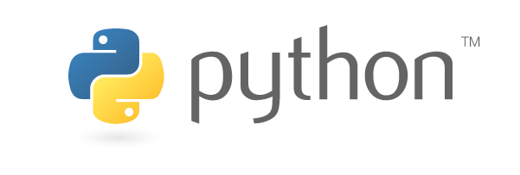
What is Data Analysis?
Step 1: Get the data ( Data Acquisition)
Step 2: Transform the Data
Step 3: Analyze the Data
Step 4: Visualize the data
Notes:
These step are very basic steps in analysis

Slide 4
Why use Python for Data Analysis?
For large data sets
(Gigabytes, Terabytes, Petabytes, --→ Zettabytes)
To automate minimizing/eliminating need for manual work to run on a scheduled or adhoc basis.
For complex mathematical computation
Data Science uses Python or R. Because Python is a general purpose language, most data analysis functionality is available through packages like NumPy and pandas.

Slide 5
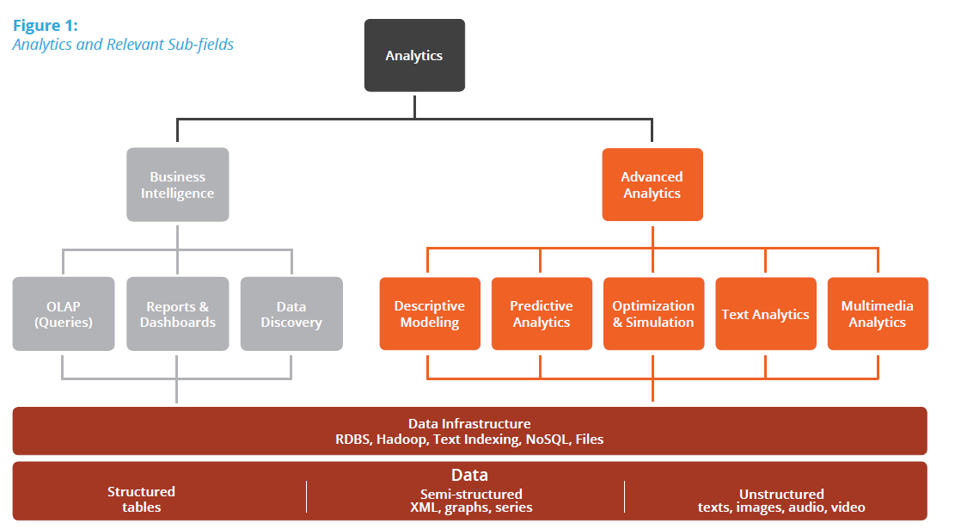
FAQ: Can’t you do Data Analysis in Excel?
Yes for small datasets.
For manual results by one person.
FAQ: What is the difference between BI and Analytics
Notes:
https://www.codeschool.com/blog/2016/01/27/why-python/
https://pydanny-event-notes.readthedocs.io/en/latest/socalpiggies/20110526-wda.html

Slide 6
Data Analysis Example
Go https://github.com/She-Codes-Now/Intro-to-Python-MESA
Data from Wall Street Journal
Your parents might have worried when you chose Philosophy or International Relations as a major. But a year-long survey of 1.2 million people with only a bachelor's degree by PayScale Inc. shows that graduates in these subjects earned 103.5% and 97.8% more, respectively, about 10 years post-commencement. Majors that didn't show as much salary growth include Nursing and Information Technology.

Slide 7
Recap
What did you learn?
Notes:
What did you Learn?
What is Data Analysis
Why Python is used in Data Analysis and Data Science
Running and dissecting the Python example :https://repl.it/Mbts/1

Slide 8
Appendix

Slide 9
Additional Resources, References
Acquiring and Transforming data with Pandas
http://pandas.pydata.org/pandas-docs/version/0.20/10min.html
Statistics with Python Tutorials
https://community.modeanalytics.com/python/tutorial/python-histograms-boxplots-and-distributions/
Visualization with Python – Tutorials
https://www.udacity.com/wiki/plotting-graphs-with-python
Notes:
There are a lot more resources out there but these are some of my favorites to start experimenting with Python and Data Science.

