Slide 1
UnderStand Tool with SonarQube
Unrestricted

Slide 2
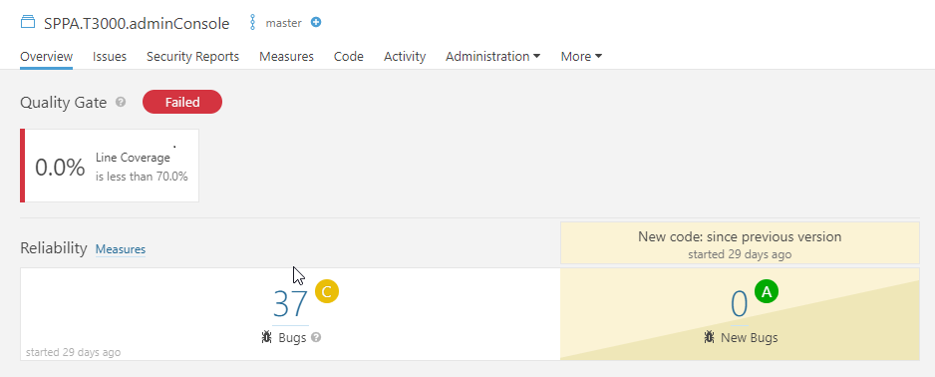
Overview Page:

Slide 3
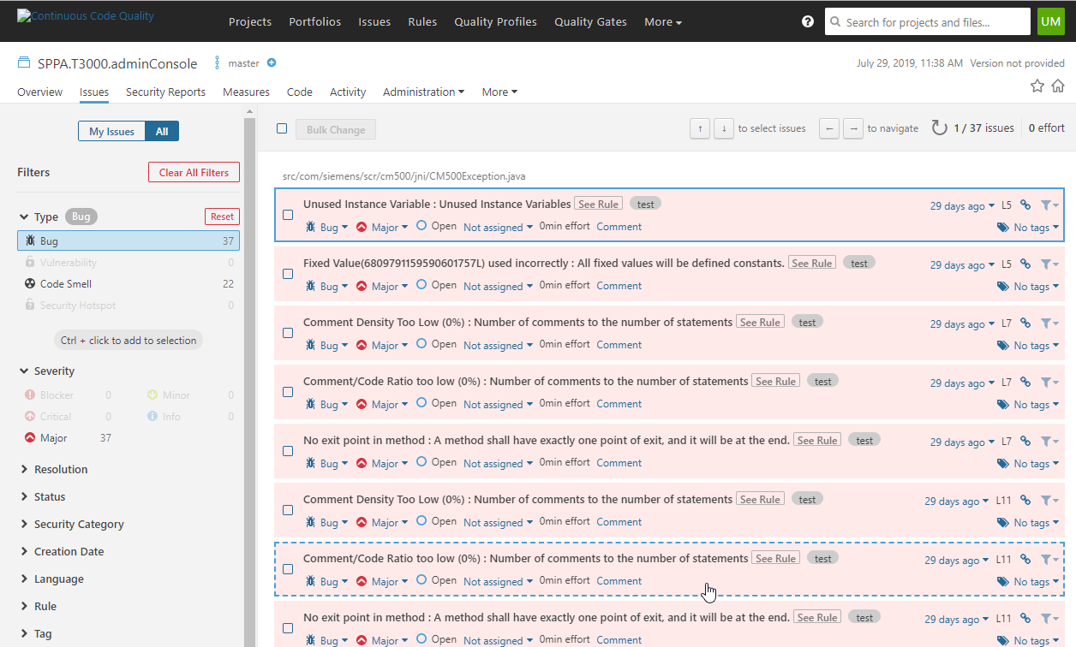
Detailed view of Issues:

Slide 4
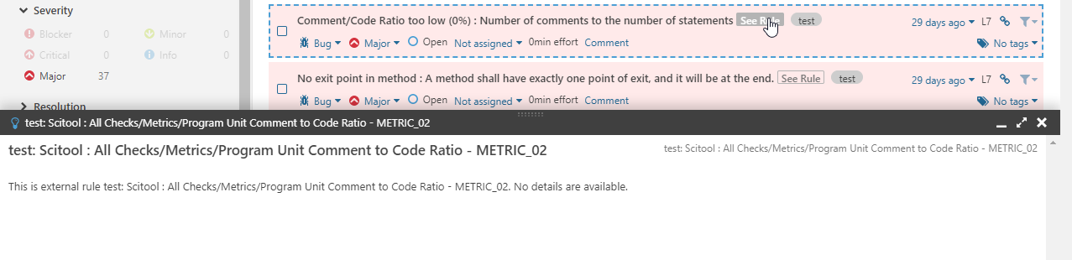
Rule Description :

Slide 5
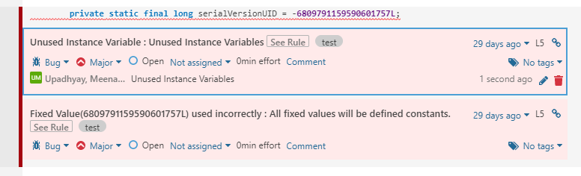
Comment :

