Slide 1

She@TECH
Topic Modelling of SGES survey comments
5th March, 2020

Slide 2
Project Idea and Usecase
Project Idea:
Topic modelling of the SGES survey comments
Use case:
In the SGES survey, lots of comments are provided by the employees which are the crucial data in order to understand the employee thoughts and feelings. Because they are subjective so interpretation may vary person to person. Also, reading the comments to understand the concerned topics and segregating the data topic wise need more time and effort.
Topic modelling helps to develop a common understanding and quick analysis about the concerned topics and segregating the data topic wise.

Slide 3
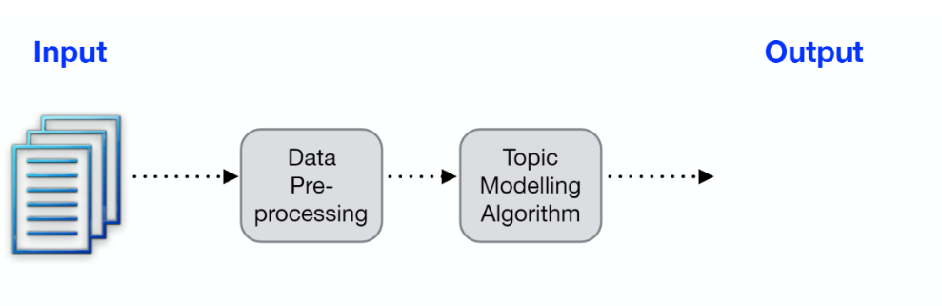
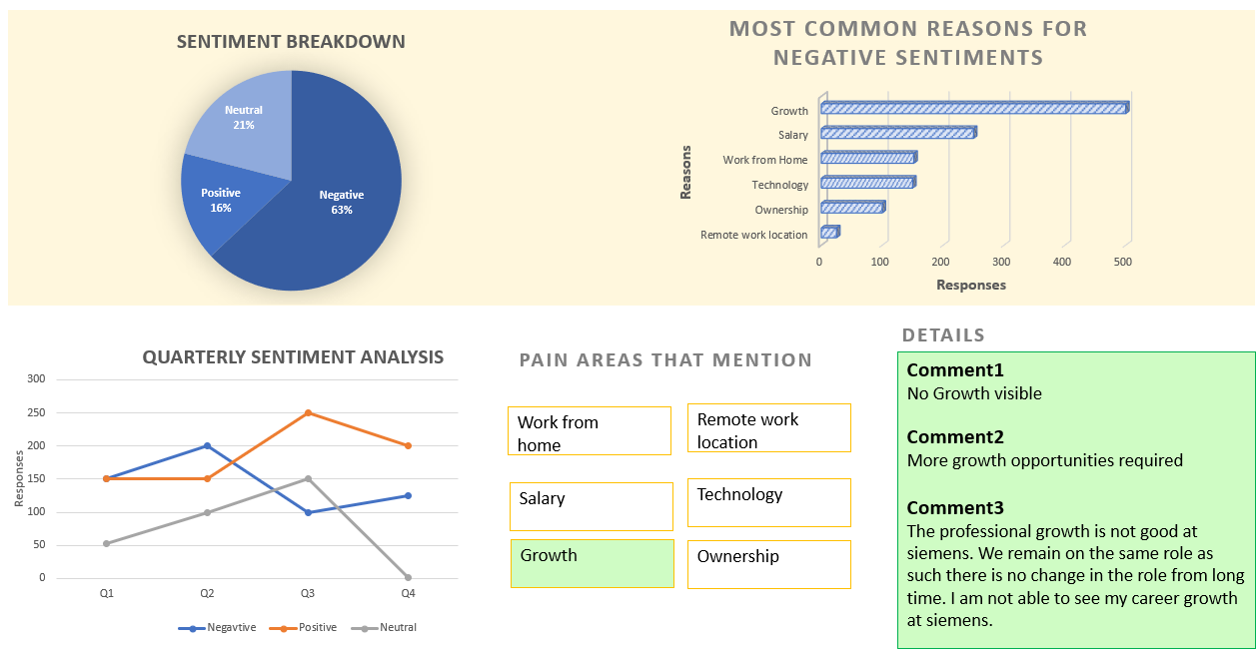
Architecture / Concept & Approach
PHASE 1
SGES comments in the *.csv file format
Library used
- Spacy
- NLTK
Library used
- Spacy
- Gensim
FLASK Framework
PHASE 2
- Data Comparison of different teams or LoBs or Bus
- Auto suggestions to improve the negative sentiments
- Analysis of multiple sentiments from one comment

Slide 4
Advantages / Opportunities
Advantages / Benefits
Discovers hidden topical patterns that are present across the comments
Help to understand employee’s sentiments and pain areas
Provides analysis on the basis of subjective feedback instead of objective
Help in creating better action plans
Business Opportunity / probable model (if any)
HR
Team leaders/ LoB heads/BU heads/ CEO

Slide 5

Thank you
Team Name : I Understand
Team Members: Vandana Bishnoi, Pratibha Raghav, Aishwarya Donekal
siemens.com

