Slide 1
BANK LOAN ANALYSIS
Power BI Dashboard Project
Syntecxhub Data Analysis Internship • Week 4 Project
Poweide Abigail Edonkumoh
Data Analyst

Slide 2
Project Overview
2
A practical Power BI analysis of loan applications, funding, repayments, and borrower characteristics.
PROJECT CONTEXT
Internship Requirement
• The project analyzes bank loan applications, funded amounts, and repayments.
• The analysis classifies loans into Good Loan, Bad Loan, and Rejected categories.
• The dashboard combines portfolio, risk, regional, and customer-level analysis.
• The final deliverable is a three-page interactive Power BI dashboard.
The Syntecxhub brief requires KPI calculation, loan-quality classification, trend analysis by time/region/customers, identification of factors affecting approval and repayment, and a Power BI dashboard.
Portfolio Goal
Demonstrate practical skills in Power Query, data modeling, DAX, visualization, dashboard design, and business-oriented insight generation.
Syntecxhub Data Analysis Internship • Bank Loan Analysis

Slide 3
Objectives & Business Questions
3
The dashboard was designed around measurable business questions.
Portfolio
How large is the loan portfolio?
Applications, requested amount, funded amount, and payments received.
Risk
Loan quality, credit grade, DTI, interest rate, and rejection levels.
What proportion of loans are good vs bad?
Trend
Monthly applications, funding, and payment recovery trends.
How does activity change over time?
Geography
Region and state-level application and funding analysis.
Where are applications and funding concentrated?
Customers
Income, DTI, employment length, home ownership, and loan purpose.
What borrower factors are associated with loan outcomes?
Syntecxhub Data Analysis Internship • Bank Loan Analysis

Slide 4
Dataset Overview
4
The source dataset contains 5,000 loan records across 21 fields.
Loan Records
Customers
Fields
Application Period
5,000
3,500
21
2021–2023
Unique Loan_IDs
Unique Customer_IDs
Loan and borrower attributes
Application dates
KEY DATA DOMAINS
Important Data Characteristic
• Loan activity: application date, issue date, last payment date
• Financials: requested amount, funded amount, investor funding, payment received
• Borrower profile: annual income, DTI, employment length, home ownership
• Risk attributes: grade, interest rate, term, loan status
• Segmentation: purpose, region, state, customer ID
Customer_ID is not unique because a customer can have multiple loans. Loan_ID is the unique loan-level identifier used for duplicate checks.
Syntecxhub Data Analysis Internship • Bank Loan Analysis

Slide 5
Data Preparation & Quality
5
Cleaning and transformation were completed in Power Query before dashboard development.
01
Profile
02
Types
03
Text Cleaning
Reviewed column quality, distribution, and profile across the dataset.
Assigned correct data types to text, dates, decimal, and whole-number fields.
Trimmed and cleaned text fields to improve consistency.
04
Date Handling
05
Missing Dates
06
Duplicates
Created Application Year, Month, Month Number, and Year-Month fields.
Retained 197 missing Issue_Date and Last_Payment_Date values because they correspond to rejected loans.
Confirmed 5,000 unique Loan_IDs and no duplicate complete rows.
Syntecxhub Data Analysis Internship • Bank Loan Analysis

Slide 6
Data Modeling & DAX
6
A simple star-style structure supports time analysis and reusable measures.
MODEL STRUCTURE
Bank_Loan_Dataset
Loan-level fact table
Date_Table
Application date dimension for Year, Month, Quarter and Year-Month.
DAX_Measures
Centralized measures for KPIs, funding, repayment and loan quality.
Core calculated logic
Core measures
Loan_Quality classifies Fully Paid + Current as Good Loan, Charged Off as Bad Loan, and Rejected separately.
Applications, requested amount, funded amount, payment received, good/bad loan percentages, funding rate and payment recovery rate.
Syntecxhub Data Analysis Internship • Bank Loan Analysis

Slide 7
Executive KPI Summary
7
Headline measures from the completed dashboard.
Total Applications
Requested Amount
Funded Amount
Payments Received
5,000
$75.47M
$66.16M
$67.78M
Loan applications
Total amount requested
Total funded
Total recorded payments
Average Loan
Average Interest
Average DTI
Payment Recovery
$15.09K
13.83%
18.75
102.45%
Average requested amount
Average interest rate
Average debt-to-income ratio
Payments received ÷ funded amount
Interpretation note
The 102.45% payment recovery figure reflects the dataset's recorded payments relative to funded amounts; it should not be interpreted alone as a profitability measure.
Syntecxhub Data Analysis Internship • Bank Loan Analysis

Slide 8
Three-Page Dashboard Architecture
8
Each page answers a different part of the bank loan business question.
PAGE 1
PAGE 2
PAGE 3
Loan Portfolio Overview
Loan Quality & Risk Analysis
Customer & Regional Analysis
Overall portfolio size, monthly activity, status distribution, loan purpose and region.
Good/bad loan mix, funding, recovery, credit grade, interest rate, DTI and purpose-level quality.
Borrower profile, regional funding/recovery, state applications, employment and home ownership patterns.
Syntecxhub Data Analysis Internship • Bank Loan Analysis

Slide 9
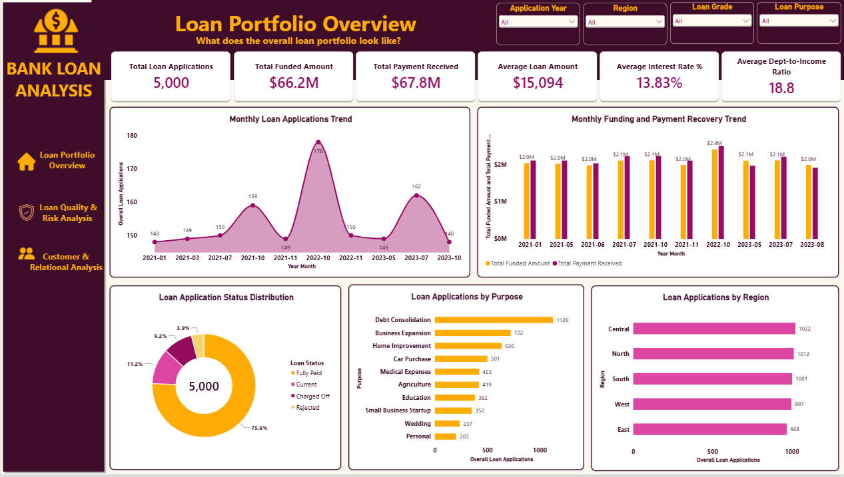
Dashboard Page 1 — Loan Portfolio Overview
9
The portfolio-level view provides the executive snapshot.
Syntecxhub Data Analysis Internship • Bank Loan Analysis

Slide 10
Page 1 — Portfolio-Level Findings
10
What the overview page reveals from the dataset.
• The dataset contains 5,000 loan applications across 3,500 unique customers.
• Total requested loan amount is approximately $75.47M, while $66.16M was funded.
• Monthly application activity varies over the 2021–2023 application period, supporting time-based monitoring.
• Fully Paid loans represent 75.6% of all applications; Current loans account for 11.2%.
• Charged Off loans account for 9.2% and Rejected applications for 3.9%.
• Debt Consolidation is the largest loan purpose by application volume in the dashboard.
Portfolio Scale
$66.16M funded across 5,000 applications.
Application Mix
The majority of applications are Fully Paid or Current, while Charged Off and Rejected records form smaller segments.
Use Case
Supports monitoring of portfolio volume, funding activity and loan demand.
Syntecxhub Data Analysis Internship • Bank Loan Analysis

Slide 11
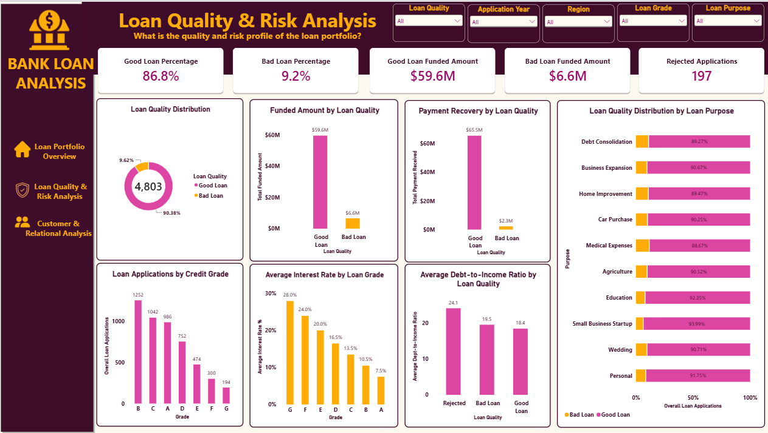
Dashboard Page 2 — Loan Quality & Risk Analysis
11
The risk page focuses on loan outcomes and borrower risk indicators.
Syntecxhub Data Analysis Internship • Bank Loan Analysis

Slide 12
Page 2 — Loan Quality & Risk Findings
12
Loan-quality analysis separates rejected applications from the good/bad loan classification.
• Among non-rejected loans, 90.38% are classified as Good Loans and 9.62% as Bad Loans.
• Good Loans account for approximately $59.57M in funded amount, compared with about $6.60M for Bad Loans.
• There are 197 rejected applications in the dataset.
• Credit Grade B has the highest application volume in the dashboard.
• Average interest rate declines from higher-risk grades toward lower-risk grades in the displayed grade analysis.
• The dashboard allows users to compare loan quality across loan purposes using 100% stacked bars.
Good Loan Mix
90.38% of non-rejected loans are classified as Good Loans.
Bad Loan Exposure
$6.60M was funded to loans classified as Bad Loans.
Risk Lens
Grade, interest rate and DTI provide complementary risk signals.
Syntecxhub Data Analysis Internship • Bank Loan Analysis

Slide 13
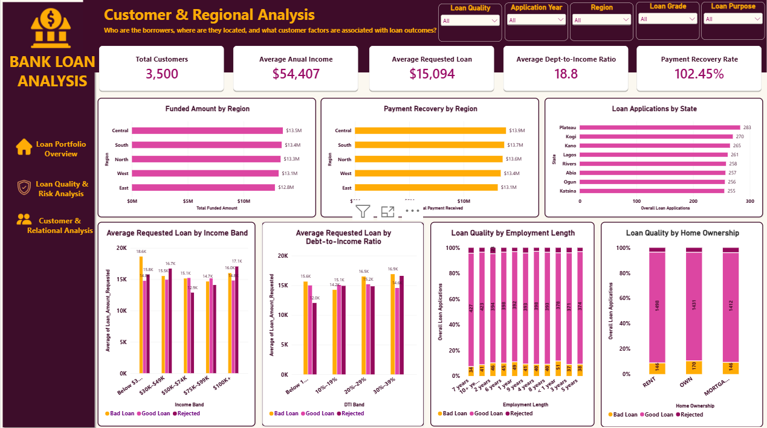
Dashboard Page 3 — Customer & Regional Analysis
13
The customer and regional page connects borrower characteristics with loan outcomes.
Syntecxhub Data Analysis Internship • Bank Loan Analysis

Slide 14
Cross-Dashboard Insights & Business Actions
14
Evidence from the three pages can be translated into monitoring priorities.
EVIDENCE-BASED INSIGHTS
RECOMMENDED MONITORING
Portfolio monitoring
Track monthly applications, funded amounts and payment recovery to identify changes in activity.
• Review high-risk loan segments using grade, DTI and loan quality.
• Investigate regions or states with materially different funding or repayment patterns.
• Monitor loan purposes with high application volumes alongside their quality mix.
• Use monthly trend monitoring to identify changes early.
• Refresh the dashboard as new loan records become available.
Loan quality
Monitor the Charged Off segment separately from Rejected applications to distinguish repayment risk from approval outcomes.
Credit risk
Use grade, interest rate and DTI together rather than relying on a single risk indicator.
Regional performance
Compare funding and payment recovery by region and drill into state-level application volume.
Customer segmentation
Use income, employment length, home ownership and loan purpose to understand borrower segments.
Syntecxhub Data Analysis Internship • Bank Loan Analysis

Slide 15
PROJECT CONCLUSION
The Bank Loan Analysis project transforms raw loan records into an interactive three-page Power BI dashboard that supports portfolio, risk, regional, and customer analysis.
Power Query
Data Cleaning
Data Modeling
DAX
Power BI
Data Visualization
Business Insights
Thank you
Poweide Abigail Edonkumoh • Data Analyst

