Slide 1
STUDENT PERFORMANCE ANALYSIS
Data Analysis Internship Project 2
Turning student data into practical insights
Power Query • Power BI • Data Storytelling
SYNTECXHUB INTERNSHIP
Project presentation • 16 slides

Slide 2
Project Overview
2
What this analysis set out to understand
PROJECT GOAL
TOOLS USED
MAIN OUTPUT
Understand student academic performance and identify patterns across subjects and student groups.
Excel Power Query for cleaning and Power BI for analysis, DAX measures, visuals and interactive reporting.
A three-page Power BI dashboard covering overview, performance factors, and key insights with recommendations.
Questions behind the analysis
• Which subject has the strongest average performance?
• How are students distributed across performance categories?
• Do performance levels differ by gender?
• What patterns appear across test preparation, lunch type, parental education and race/ethnicity?
Student Performance Analysis • Syntecxhub Data Analysis Internship

Slide 3
Data Preparation
3
Cleaning was completed before the Power BI analysis
Cleaning workflow
1
Import
Loaded the student performance CSV into Power Query.
2
Quality checks
Checked data types, missing values, text consistency and score fields.
3
Duplicate removal
Removed the duplicate record; the cleaned dataset contains 999 students.
4
Calculated fields
Prepared Average Score and Performance Category for analysis.
5
Load to Power BI
Loaded the cleaned table for DAX calculations and dashboard visuals.
Student Performance Analysis • Syntecxhub Data Analysis Internship

Slide 4
What the Dashboard Measures
4
The analysis focuses on the fields available in the dataset
Performance measures
MATH SCORE
READING SCORE
WRITING SCORE
AVERAGE SCORE
Individual student math result.
Individual student reading result.
Individual student writing result.
Combined average across the three subjects.
Grouping and comparison fields
Why this matters
• Gender
• Race/Ethnicity
• Parental Level of Education
• Lunch Type
• Test Preparation
• These fields allow the dashboard to compare performance across different student groups.
• The analysis describes patterns in this dataset; it does not claim that any single factor causes the observed differences.
Student Performance Analysis • Syntecxhub Data Analysis Internship

Slide 5
Dashboard Structure
5
Three pages, each with a clear purpose
PAGE 01
PAGE 02
PAGE 03
Overview
Performance Factors
Insights
KPIs, subject performance, performance categories and gender comparison.
Test preparation, parental education, lunch type and race/ethnicity comparisons, with slicers.
Key findings, practical recommendations and the main takeaways from the analysis.
Student Performance Analysis • Syntecxhub Data Analysis Internship

Slide 6
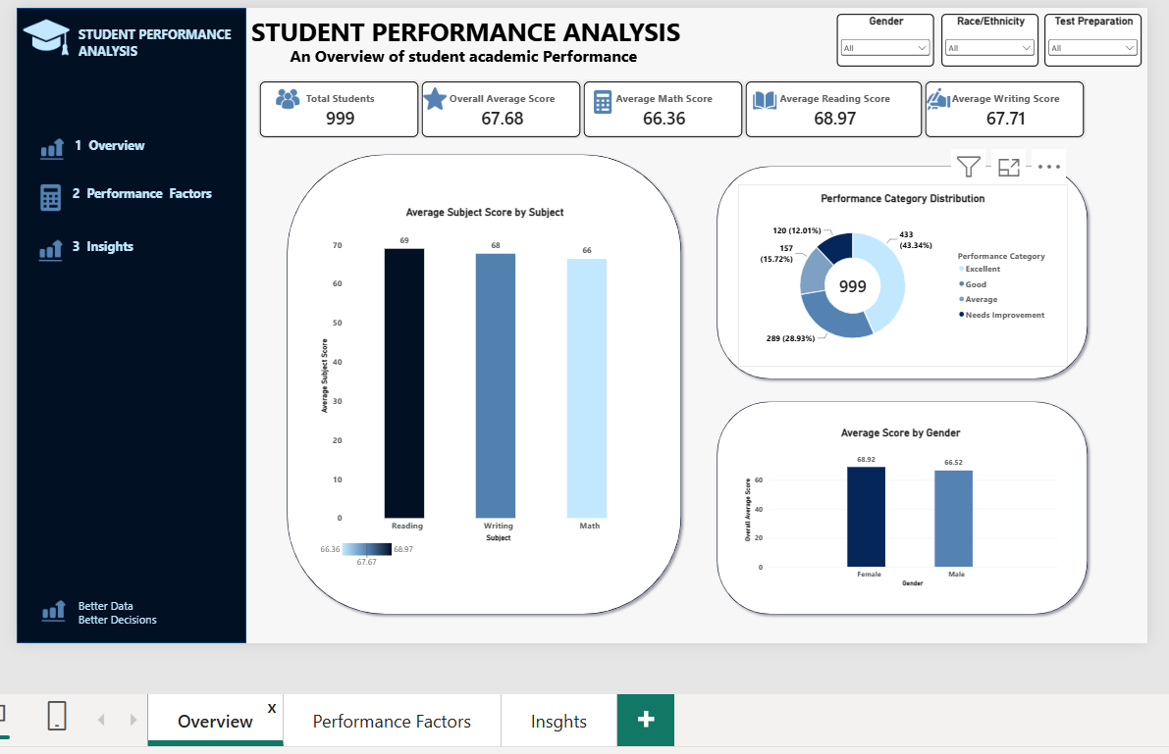
Page 1 — Overview Dashboard
6
A quick view of the overall student performance picture
Student Performance Analysis • Syntecxhub Data Analysis Internship

Slide 7
Page 1 — What the Overview Shows
7
The headline numbers from the dashboard
TOTAL STUDENTS
OVERALL AVERAGE
MATH AVERAGE
READING AVERAGE
WRITING AVERAGE
999
67.68
66.36
68.97
67.71
Key observations
• Reading has the highest subject average at 68.97.
• Math has the lowest subject average at 66.36.
• The gap between the highest and lowest subject averages is about 2.61 points, so subject performance is relatively close.
• Female students average 68.92 compared with 66.52 for male students.
Student Performance Analysis • Syntecxhub Data Analysis Internship

Slide 8
Performance Category Distribution
8
How the 999 students are distributed across the performance bands
EXCELLENT
AVERAGE
GOOD
NEEDS IMPROVEMENT
43.34%
28.93%
15.72%
12.01%
433 students
289 students
157 students
120 students
What stands out
• Excellent is the largest category, representing 43.34% of students.
• 40.94% of students fall into the Average or Needs Improvement categories.
• That lower-performing share is large enough to justify targeted academic support.
Student Performance Analysis • Syntecxhub Data Analysis Internship

Slide 9
Gender Comparison
9
A small but visible difference in overall average score
FEMALE AVERAGE
MALE AVERAGE
OBSERVED DIFFERENCE
68.92
66.52
2.40
Observed overall average score.
Observed overall average score.
Female average is higher by 2.40 points.
Interpretation
• Female students recorded a slightly higher average score than male students.
• The difference is modest compared with the larger gaps seen for some other factors.
• Gender alone does not explain why the difference exists; additional variables would be needed for deeper investigation.
Student Performance Analysis • Syntecxhub Data Analysis Internship

Slide 10
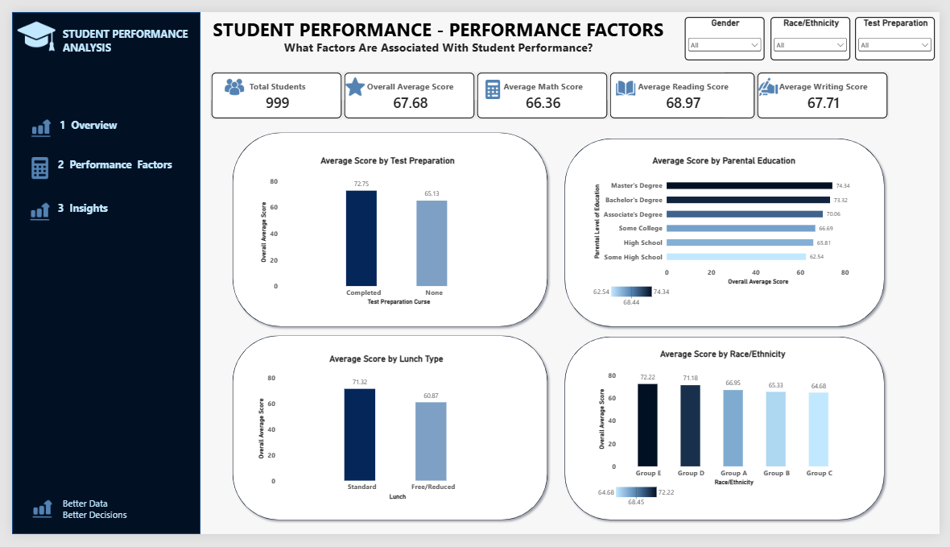
Page 2 — Performance Factors Dashboard
10
Moving from 'what is happening?' to 'where do we see differences?'
Student Performance Analysis • Syntecxhub Data Analysis Internship

Slide 11
Test Preparation and Performance
11
One of the clearest differences in the dashboard
COMPLETED
NONE
DIFFERENCE
72.75
65.13
7.62 POINTS
Average score among students who completed test preparation.
Average score among students who did not complete test preparation.
Observed gap between the two groups.
What this suggests
• Students who completed test preparation had the higher average score.
• The size of the difference makes test preparation an important area for further attention.
• This is an association in the dataset, not proof that test preparation caused the difference.
Student Performance Analysis • Syntecxhub Data Analysis Internship

Slide 12
Lunch Type, Parental Education and Race/Ethnicity
12
The dashboard also reveals wider group-level performance gaps
Lunch Type
Parental Education
Race/Ethnicity
• Standard: 71.32
• Free/Reduced: 60.87
• Observed gap: 10.45 points
• Master's Degree: 74.34
• Some High School: 62.54
• Observed range: 11.80 points
• Group E: 72.22
• Group C: 64.68
• Observed gap: 7.54 points
A careful interpretation
• These differences show where performance varies across the available groups.
• They should be used as signals for further investigation rather than labels about the students themselves.
• The dataset does not contain enough information to establish the causes of these gaps.
Student Performance Analysis • Syntecxhub Data Analysis Internship

Slide 13
Key Insights — Putting the Numbers Together
13
The strongest patterns from the three dashboard pages
Reading leads the subjects
01
Reading has the highest average score at 68.97; Math is lowest at 66.36.
Test preparation stands out
02
Completed preparation is associated with a 7.62-point higher average score.
Lunch type shows a large gap
03
The Standard group averages 71.32 versus 60.87 for Free/Reduced.
Parental education varies
04
Average scores range from 74.34 to 62.54 across education groups.
Performance support is still needed
05
40.94% of students are in Average or Needs Improvement categories.
Student Performance Analysis • Syntecxhub Data Analysis Internship

Slide 14
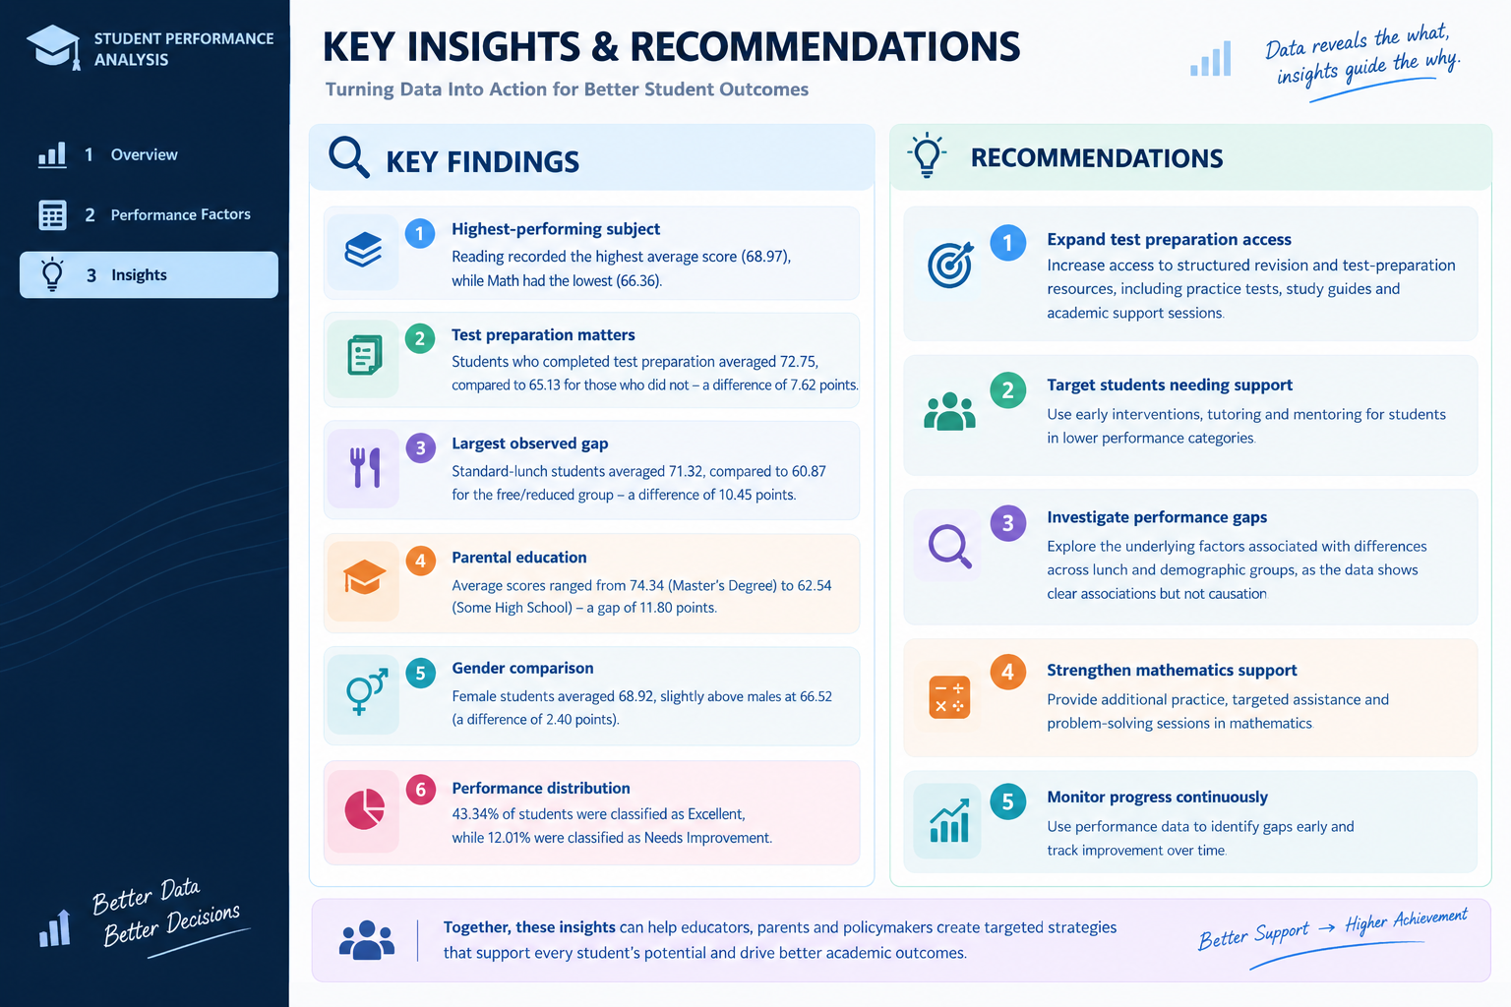
Page 3 — Insights & Recommendations
14
A concise summary of what the analysis means in practice
Student Performance Analysis • Syntecxhub Data Analysis Internship

Slide 15
Recommendations
15
Practical actions that follow from the findings
Expand test preparation access
1
Increase access to structured revision, practice tests, study guides and academic support.
Target students needing support
2
Use tutoring, mentoring and early intervention for students in lower performance categories.
Investigate performance gaps
3
Explore the factors behind lunch and demographic differences instead of assuming causation.
Strengthen mathematics support
4
Provide additional practice, targeted assistance and problem-solving sessions in Math.
Monitor progress continuously
5
Use performance data to identify gaps early and track improvement over time.
Student Performance Analysis • Syntecxhub Data Analysis Internship

Slide 16
FINAL TAKEAWAY
The dashboard shows that student performance is fairly strong overall, but meaningful differences appear across preparation, lunch type, parental education and other groups.
The next step is not just to report the differences, but to use them to guide targeted support and better decisions.
BETTER DATA → BETTER SUPPORT → BETTER STUDENT OUTCOMES
Thank you

