Slide 2
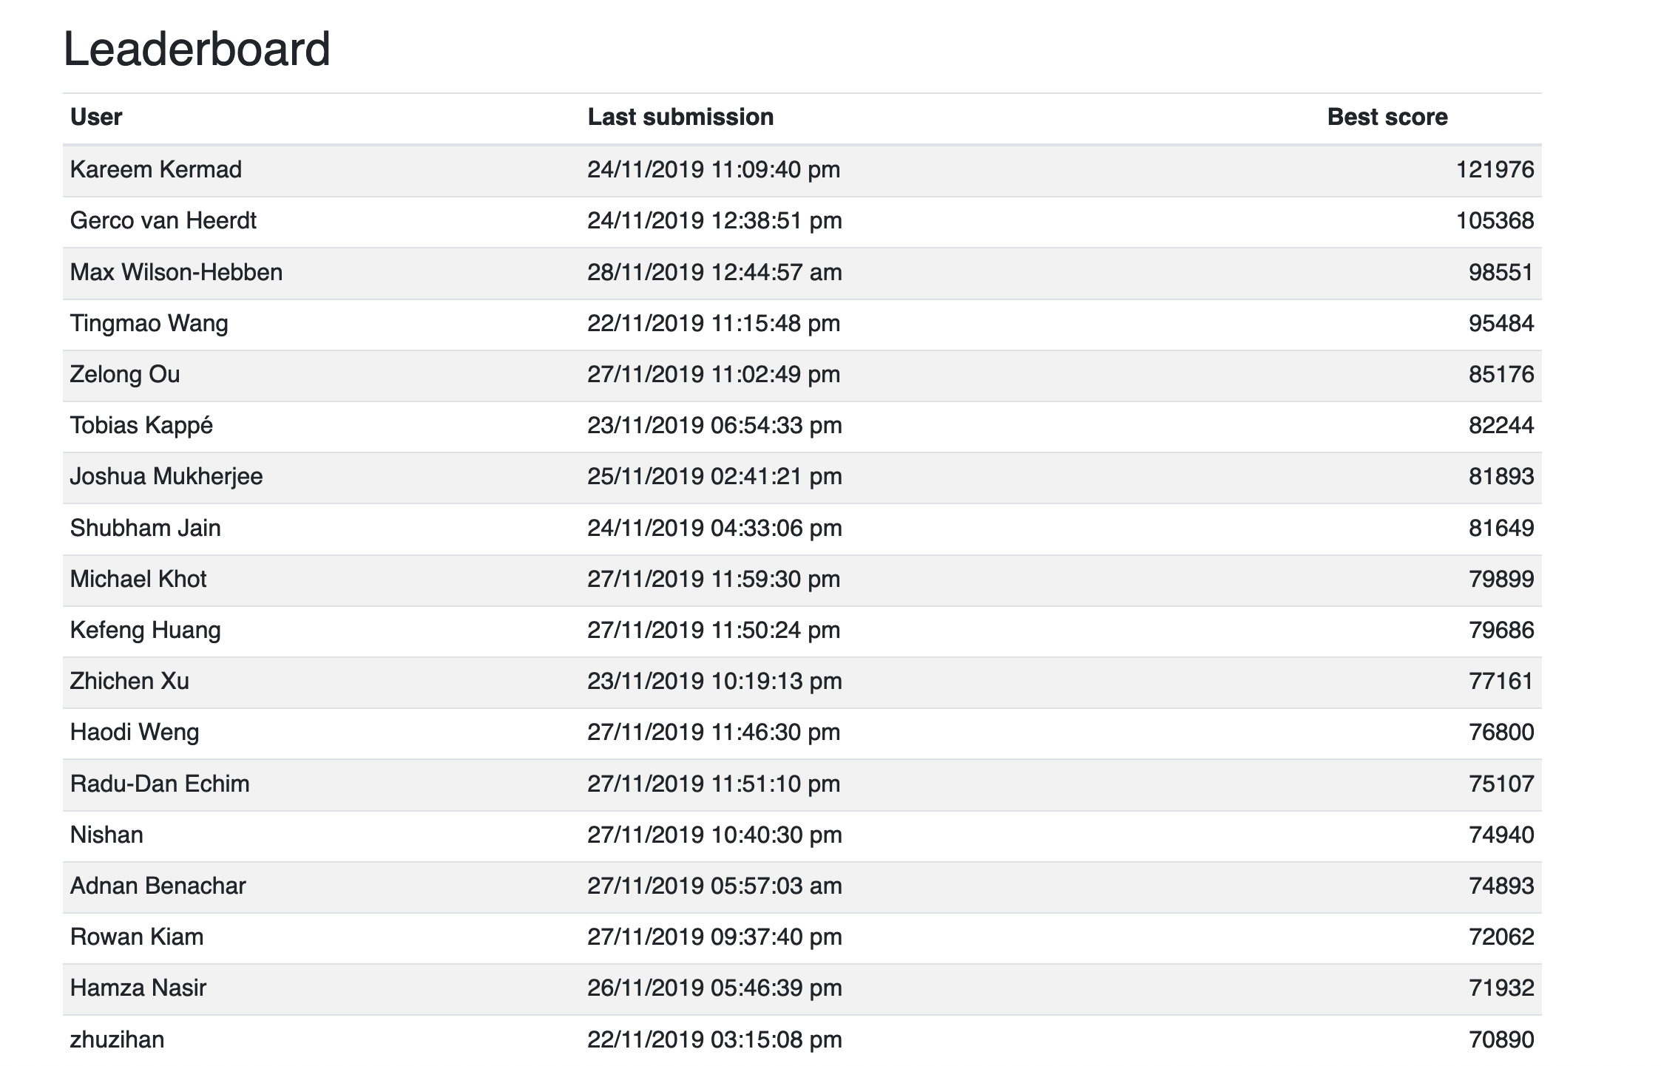

Slide 3
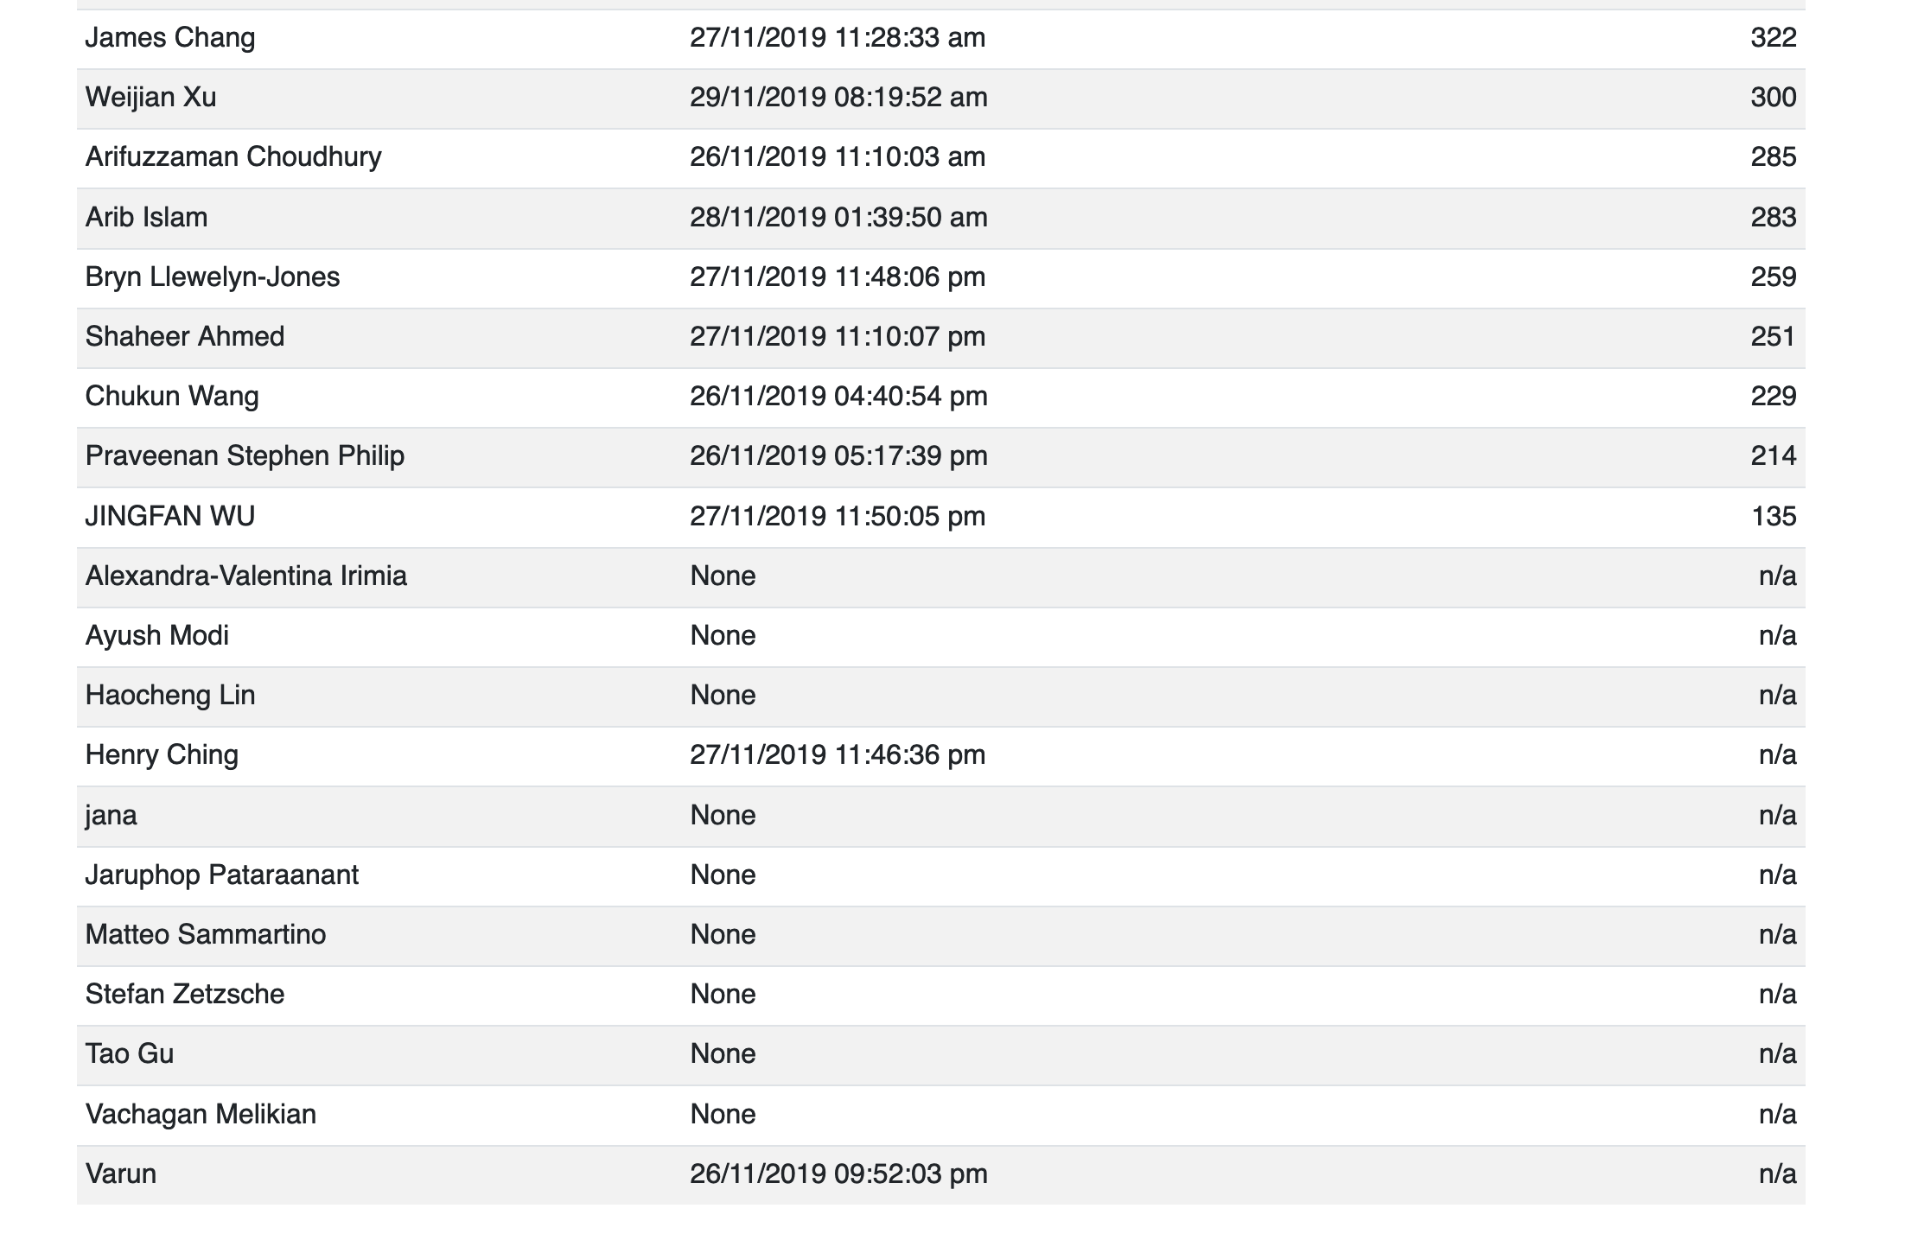

Slide 4
Fatal bug of the week

Slide 5

Patriot Missile Failure

Slide 6
Patriot Missile Failure
February 25, 1991, Gulf War.
An American Patriot Missile battery in Dharan, Saudi Arabia, failed to track and intercept an incoming Iraqi Scud missile.
The Scud struck an American Army barracks, killing 28 soldiers and injuring around 100 other people.

Slide 7
Cause: bad software
Missile radar system tracks speed and position of incoming missile.
Needs to predict where it will be, and fire at the right moment.
How to maintain time?
Internal clock ticks every 1/10th of a second.
Time in seconds obtained by multiplying clock value by 0.1
Time maintained in 24 bit fixed point register.

Slide 8
Rounding error
Problem: can’t maintain 0.1 exactly in binary.
1/10 = 1/2⁴+1/2⁵+1/2⁸+1/2⁹+1/2¹²+1/2¹³+..
In binary:
0.0001100110011001100110011001100....
In Patriot’s 24 bit register, rounds down to:
0.00011001100110011001100
Rounding error is about 0.000000095 decimal for each 1/10th second.

Slide 9
Cumulative Error
Patriot system had been up for ~100 hours.
Rounding error = 100 * 60 * 60 * 10 * 0.000000095 = 0.34 seconds.
Wouldn’t have been a problem, except some other systems had been upgraded to use more accurate time representation. Patriot subtracted rounded time from accurate time, and launched 0.34 seconds late.
Scud missile travels at about 1,700 metres/second.
Travelled nearly 600 metres in 0.34 seconds.
Patriot missed.

Slide 10

Effect of a 0.0000095 % error…

Slide 11
Ping of death (1995, reprise in 2013)
Send one malformed packet.
Crash or lock up nearly any computer on the Internet.
Send one malformed broadcast packet.
Crash every computer on your local network.
Lots of fun!

Slide 12
Weird bug of the week

Slide 13
Ubuntu Bug 255161: Openoffice can’t print sometimes
Symptom: intermittent inability to print from OpenOffice
Some comments from AdrianB on bug tracker:
"When I click print I get nothing." -Tuesday, August 5, 2008
"I downloaded those updates and Open Office Still prints." -Friday, August 8, 2008
"Open Office stopped printing today." -Tuesday, August 12, 2008
"I just updated and still print." -Monday, August 18, 2008
"I stand corrected, after a boot cycle Open Office failed to print." -Tuesday, August 19, 2008
A few others report similar symptoms, but no consistent pattern, so problem remains unresolved.

Slide 14
Ubuntu Bug 255161: Openoffice can’t print on Tuesdays
Steve wrote on 2009-04-28:
“What a fascinating bug!! My wife has complained that open office will never print on Tuesdays!?! Then she demonstrated it. Sure enough, won't print on Tuesday. Other applications print. I think this is the same bug.”
Finally a pattern!

Slide 15
Ubuntu Bug 255161: Openoffice can’t print on Tuesdays
Openoffice generates postscript files to send to print service. First few lines of ps file include:
%%CreationDate: (Tue Mar 3 19:47:42 2009)
Other apps don’t bother with CreationDate.
Files containing “Tue” in this position won’t print. Change “Tue” to “tue” and it will print!
So, not an OpenOffice bug, but a print service bug that is only triggered by OpenOffice, but why?

Slide 16
Ubuntu Bug 255161: Openoffice can’t print on Tuesdays
CUPS uses “file” utility to identify the file type of the temporary file.
Normally it would return:
PostScript document text conforming at level 3.0
But there is another check that happens before the PostScript check. If “Tue” is at a certain place in the file, it returns:
Jan 22 14:32:44 MET 1991\011Erlang JAM file - version 4.2
So, actually a bug in the heuristics that “file” utility uses to determine file type.

Slide 17
Ubuntu Bug 255161: Openoffice can’t print on Tuesdays
Lessons:
Intermittent bugs are hard.
You can’t fix a bug you can’t reproduce.
Gather data, look for patterns. Add logging if necessary to automate data collection.
Once you find a pattern, you may be able to reproduce the symptom.
If you can reproduce it, you can understand it, and then you can fix it.
Don’t dismiss user reports, even if they’re weird.

Slide 18
The case of the 500-mile email
https://www.ibiblio.org/harris/500milemail.html

Slide 19
Tech support call from Head of Department
We're having a problem sending email out of the department.
What's the problem?
We can't send mail more than 500 miles
Come again?
We can't send mail farther than 500 miles from here, a little bit more, actually. Call it 520 miles. But no farther.
Um... Email really doesn't work that way, generally

Slide 20
What makes you think you can't send mail more than 500 miles?"
It's not what I think, you see, when we first noticed this happening, a few days ago
You waited a few DAYS?
And you couldn't send email this whole time?
We could send email. Just not more than
500 miles, yes, I got that
But why didn't you call earlier?
Well, we hadn't collected enough data to be sure of what was going on until just now.

Slide 21
Gathering information
Verified that the claim was true.
Also that couldn’t send to someone local whose mail server was more than 500 miles away.
The mail server had had an OS upgrade, but that mail config file was unchanged.
Aha moment: telnet direct to mail server, and sees sendmail banner for older version of sendmail than expected.

Slide 22
Cause found
Sendmail 5 could read sendmail 8 config files, but didn’t understand all the config options. Defaulted to zero for unspecified options.
Connection timeout value defaulted to zero. Experimentation showed that in practice, timeout was around 6 milliseconds.
Allowing for round trip, there and back, can reach server 3ms away before timeout.
$ units
1311 units, 63 prefixes
You have: 3 millilightseconds
You want: miles
* 558.84719
/ 0.0017893979

