Slide 1
Kaggle Innovation Progress Report
Trend Analysis and Future Forecast
Presented by Michel M. Nzikou

Slide 2

Introduction
Kaggle is a leading platform for data science competitions.
Historical trends help guide future innovation and engagement.
This report includes platform evolution, community behavior, competition dynamics, and strategic forecasts.
Notes:
This report analyzes visual and textual data from the Kaggle Innovation to derive key insights, highlight emerging trends, and provide actionable recommendations for strategic growth and platform enhancement.

Slide 3
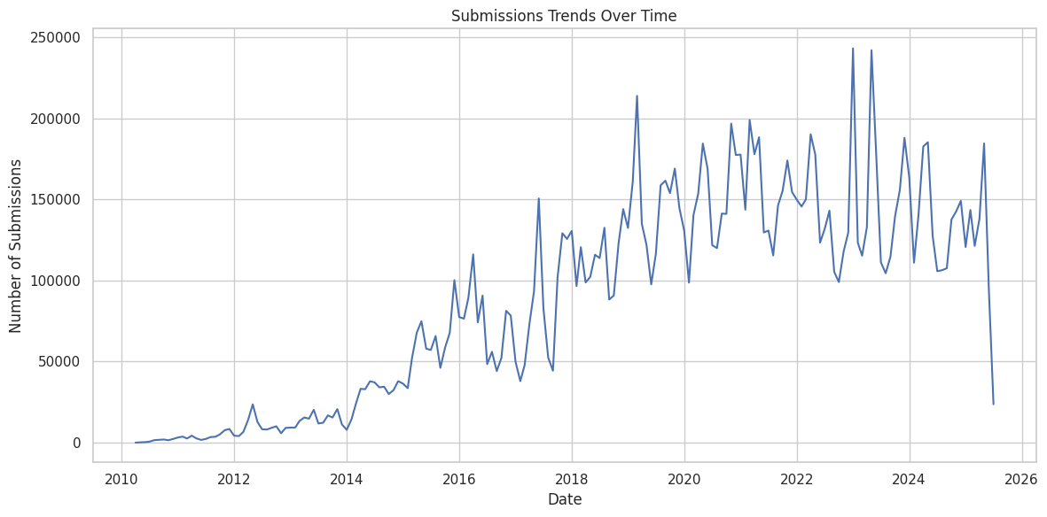
Competitions Over Time
Analysis: The chart suggests a steady increase in the number of submission over time, peaking in recent years. A sharp-rise post 2015 with major sponsors and public sector entries.
Interpretation: Indicates growing industry and academic reliance on Kaggle as a problem-solving and benchmarking platform.
Trend: Increasing diversity of problems tackled which align with growing access to machine learning and data.

Slide 4
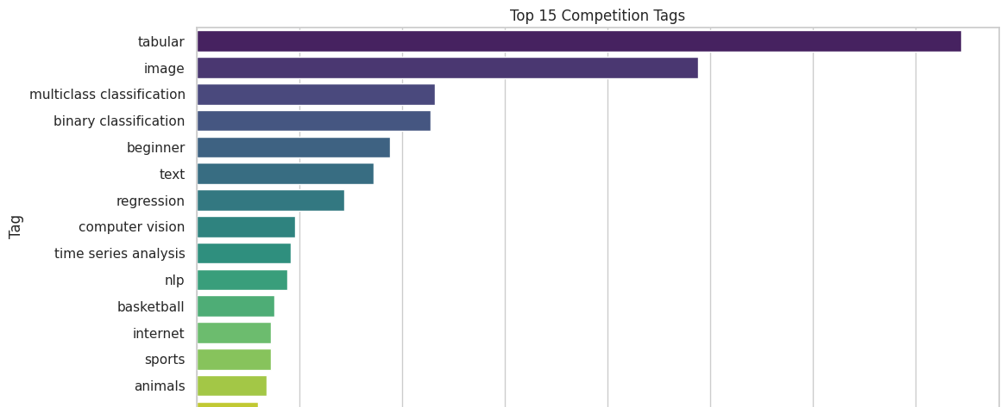
Popular Competition Themes
Top Themes: Tabular data, tabular, image, and multiclass classification challenges dominate.
Trend: Shift toward domain-specific and high-impact areas.
Implication: Reflects Kaggle’s role in applied AI and the public interest in solving real-world problems.

Slide 5
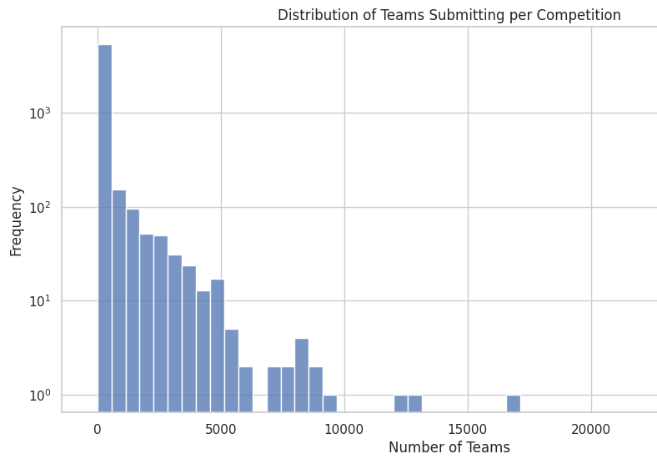
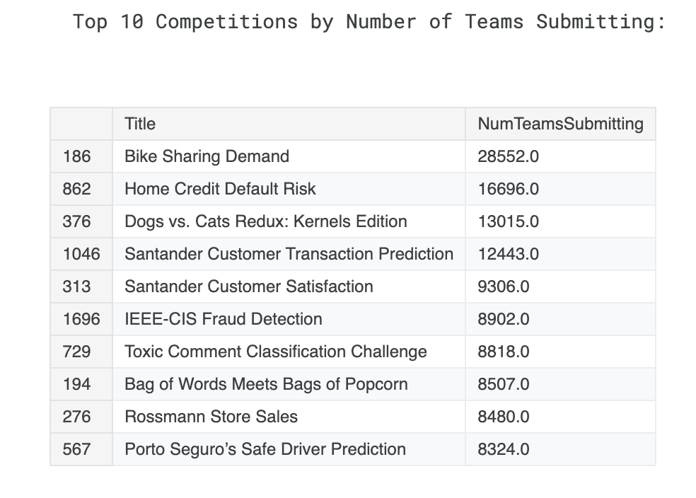
Participation Insights
Some competitions attract thousands of teams, others remain niche.
Average team participation increases over time.
Strategic competitions drive broader engagement.
Notes:
Observations:
More users from non-traditional data science backgrounds.
Increase in collaborative teams over solo submissions.
Insight: Community-learning is a major engagement driver.

Slide 6
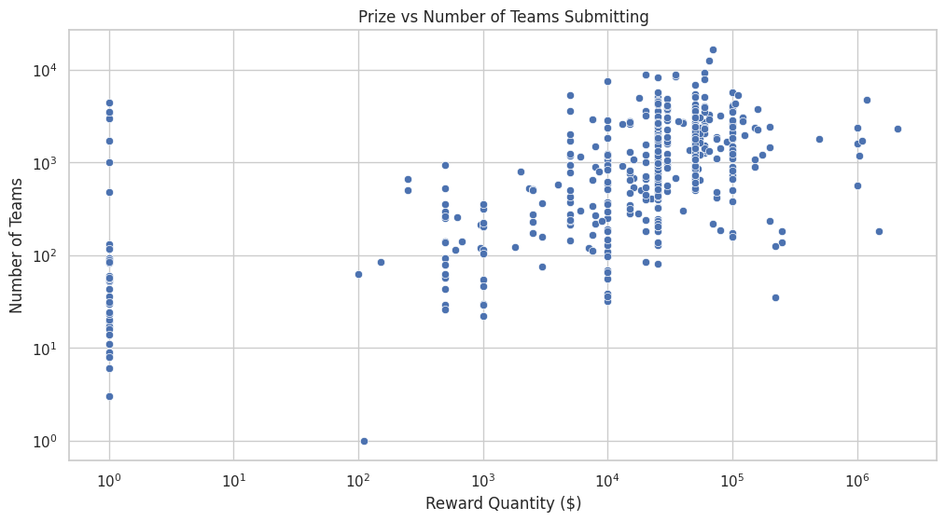
Incentives and Submissions
Higher prize pools often correlate with greater participation.
Submission spikes occur near deadlines.
Insight: Educational value and community recognition are powerful motivators beyond monetary rewards.
Trend: Shift from prize-seeking to skill-building and portfolio development.
Notes:
Key Finding: High reward challenges tend to have more submissions but not necessarily better solutions.
Insight: Educational value and community recognition are powerful motivators beyond monetary rewards.
Trend: Shift from prize-seeking to skill-building and portfolio development.

Slide 7
Emerging Trends
Focus growing on Explainability, Fairness, and Real-Time ML.
Community shows interest in tabular, healthcare, geospatial data.
Adoption of Notebooks, AutoML, APIs rising.

Slide 8
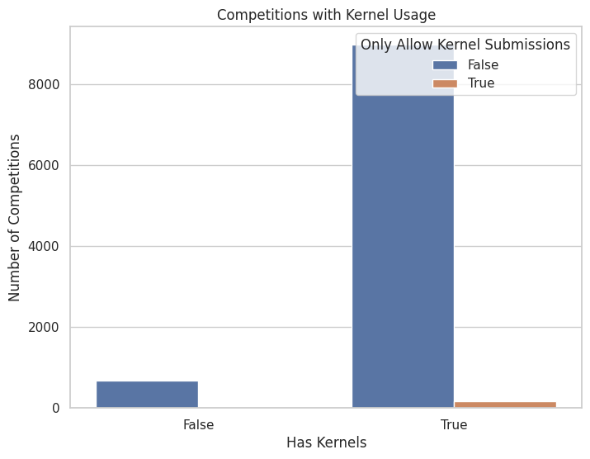
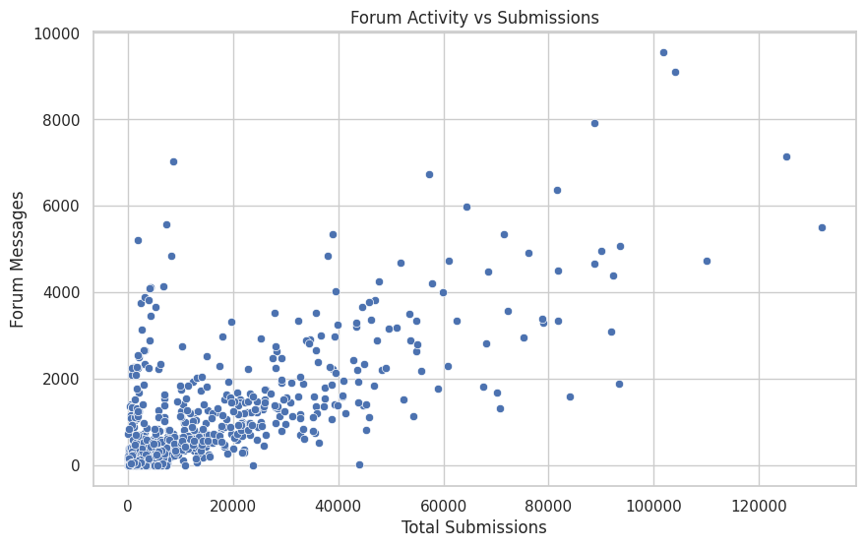
Short-Term Forecast
Continued growth in participation and competition types.
LLM integration in kernels and tutorials to accelerate.
Rise of micro-competitions with fast turnarounds.
Multilingual support and regional hackathons expanding.
Emerging Focus: Notebook-centered competitions and model performance audits.

Slide 9
Long-Term Forecast
Growth may plateau without new verticals and FORMATS
Shift towards model packaging, deployment, and ML Ops.
Recommend integration with GitHub, Docker, pipelines.
Real-time decision-making challenges likely to increase.
Notes:
Long-Term Forecast
Risk: Plateau in engagement unless new verticals and formats are introduced.
Expected Trends:
Shift to model packaging and deployment.
Rise of ML Ops and real-time streaming challenges.
Opportunity: Integration with GitHub, Docker, and CI/CD for end-to-end ML workflows.

Slide 10
Strategic Recommendations
Incentivize high-quality, educational kernels.
Create Educational Tracks with staged difficulty.
Use LLM-assisted feedback during competitions.
Launch regional-focused challenges.
Promote reusable ML pipelines and meta-learning competitions.
Notes:
Launch educational tracks with increasing complexity to support user growth.
Use LLM-assisted feedback to improve submissions and learning during competitions.
Promote region-specific challenges to diversify participation.
Incentivize high-quality, reusable pipelines through meta-learning formats.
Partner with cloud providers to streamline model deployment and evaluation.

Slide 11
Conclusion
Kaggle leads open innovation in data science.
Historical trends show a thriving ecosystem.
With innovation, Kaggle can lead real-time and explainable AI competitions.
Notes:
Kaggle continues to be the leading platform for open AI innovation.
With strategic expansion into real-time, explainable, and deployable ML, Kaggle can future-proof its ecosystem and maintain community growth.

Slide 12
References
https://www.kaggle.com/code/michelnzikou/kaggle-trend-over-time
https://github.com/ShebMichel/kaggle-innovation-trends

