Slide 1
Kaggle Innovation Progress Report
Trend Analysis and Future Forecast
Presented by Michel M. Nzikou

Slide 2

Introduction
Kaggle is a leading platform for data science competitions.
Historical trends help guide future innovation and engagement.
This report includes platform evolution, community behavior, competition dynamics, and strategic forecasts.

Slide 3
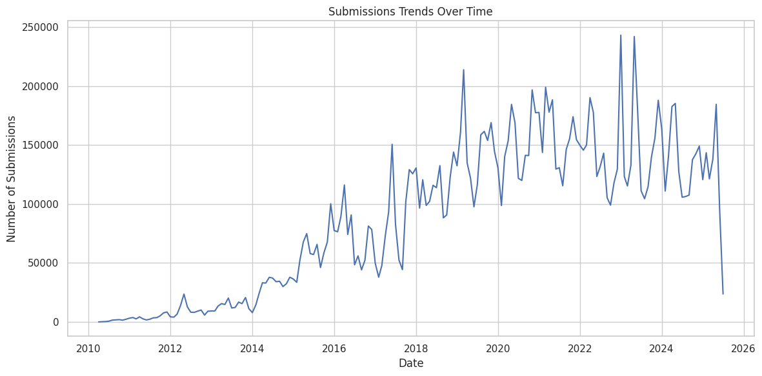
Competitions Over Time
Number of competitions steadily increased year over year.
Sharp rise post-2015 with major sponsors and public sector entries.
Trends align with growing access to machine learning and data.

Slide 4
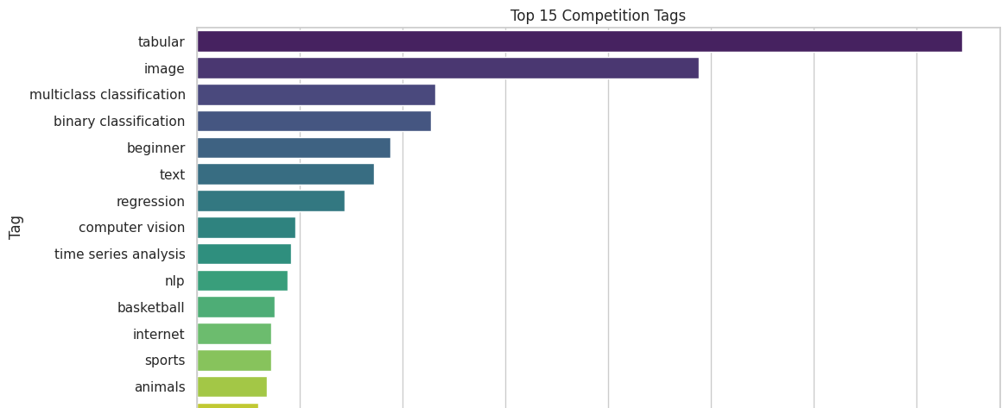
Popular Competition Themes
Dominant tags: tabular, image, multiclass classification.
Computer Vision leads in frequency and participation.
NLP gaining momentum with transformers and LLMs.

Slide 5
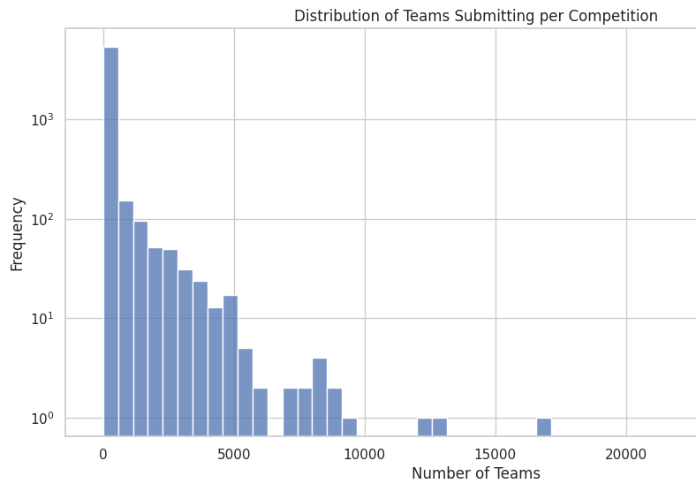
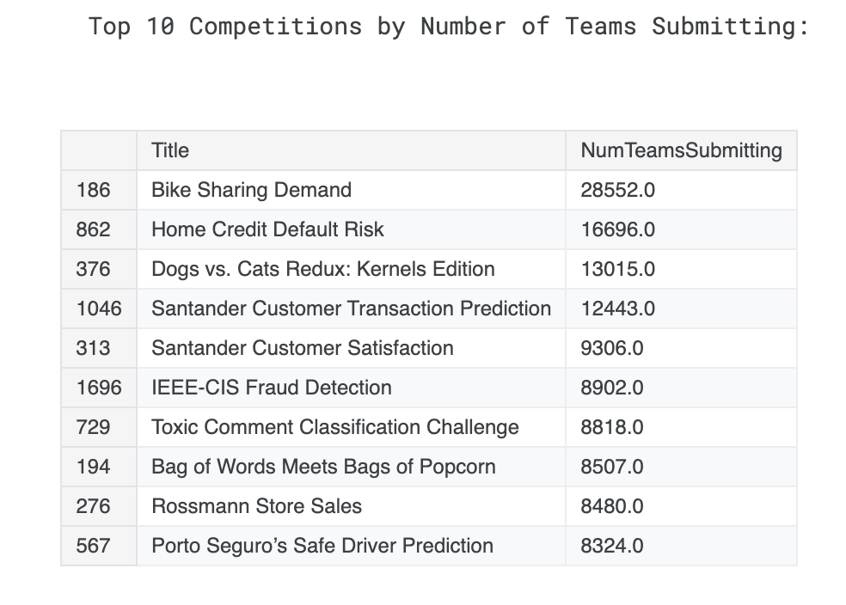
Participation Insights
Some competitions attract thousands of teams, others remain niche.
Average team participation increases over time.
Strategic competitions drive broader engagement.

Slide 6
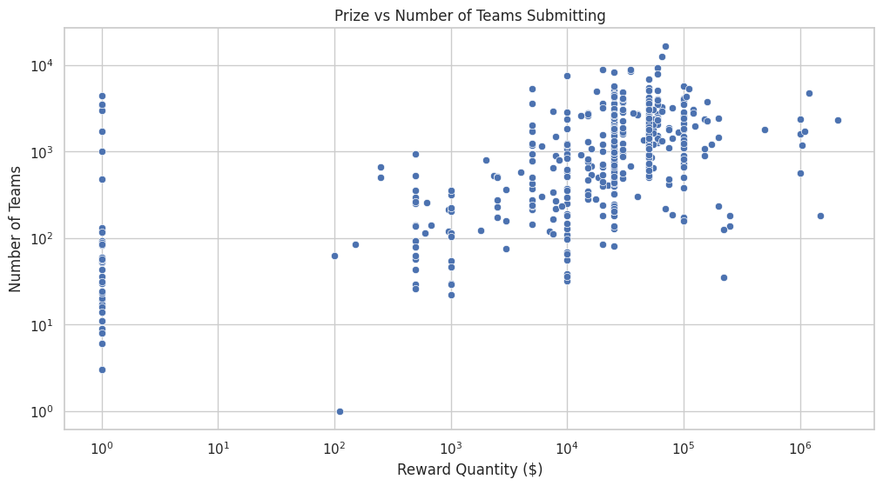
Incentives and Submissions
Higher prize pools often correlate with greater participation.
Submission spikes occur near deadlines.

Slide 7
Emerging Trends
Focus growing on Explainability, Fairness, and Real-Time ML.
Community shows interest in tabular, healthcare, geospatial data.
Adoption of Notebooks, AutoML, APIs rising.

Slide 8
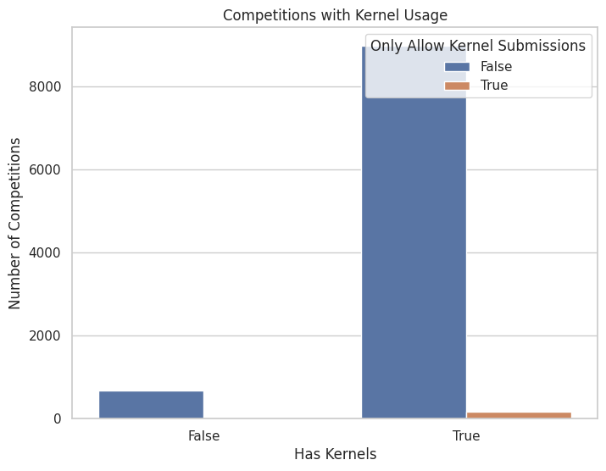
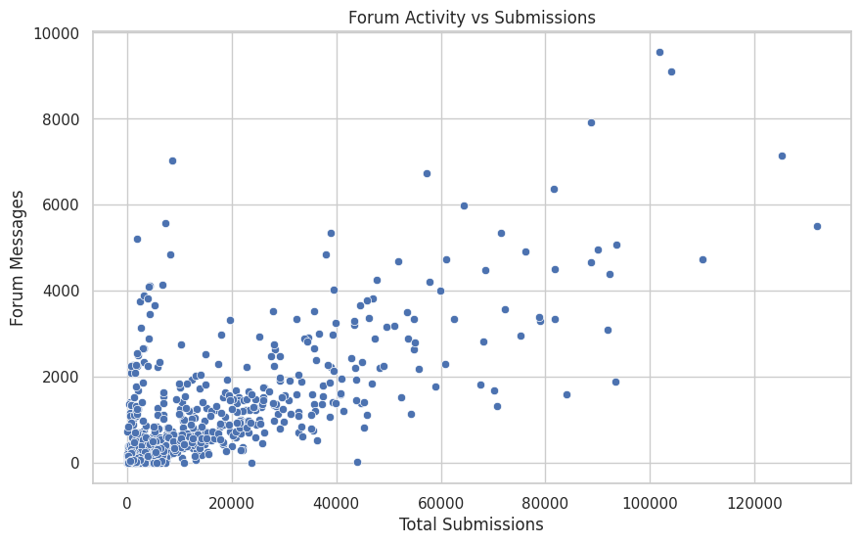
Short-Term Forecast
Continued growth in participation and competition types.
LLM integration in kernels and tutorials to accelerate.
Rise of micro-competitions with fast turnarounds.
Multilingual support and regional hackathons expanding.

Slide 9
Long-Term Forecast
Growth may plateau without new verticals.
Shift towards model packaging, deployment, and ML Ops.
Recommend integration with GitHub, Docker, pipelines.
Real-time decision-making challenges likely to increase.

Slide 10
Strategic Recommendations
Incentivize high-quality, educational kernels.
Create Educational Tracks with staged difficulty.
Use LLM-assisted feedback during competitions.
Launch regional-focused challenges.
Promote reusable ML pipelines and meta-learning competitions.

Slide 11
Conclusion
Kaggle leads open innovation in data science.
Historical trends show a thriving ecosystem.
With innovation, Kaggle can lead real-time and explainable AI competitions.

Slide 12
References
https://www.kaggle.com/code/michelnzikou/kaggle-trend-over-time
https://github.com/ShebMichel/kaggle-innovation-trends

