Slide 1

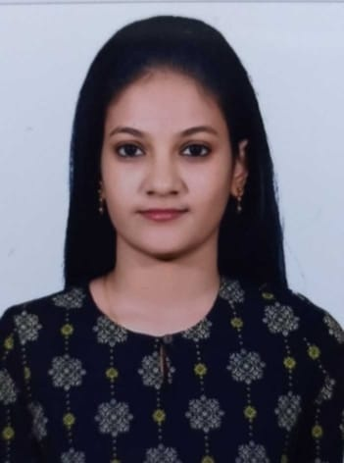




Shebaa F
Education and certificates
Master of Computer Science: 2019 - 2021
Analyst/Software Engineer
Skills Oracle
PL/SQL
SQL Server
Apex
Visualforce
Base Location: Bangalore
Email ID:
Shebaa.f@capgemini.com
_{Mobile No:+91 6374419933}
Grade:
A4
Achivement
Dock Check Application
Backend
Oracle
PL/SQL
MongoDB
Oracle Developer
Oracle PL/SQL Developer in Analysis, Design and Implementation of Business Applications using the Oracle (RDBMS).
Have knowledge on SDLC from analysis, design, development,testing,implementation and maintenance.
Hands on experience with Data flow diagrams, Data dictionary, Database normalization theory techniques, Entity relation modeling and design techniques.
Expertise in Client-Server application development using Oracle 11g/10g, PL/SQL, Oracle Enterprise Manager, SQL DEVELOPER.
Effectively made use of Table Functions, Indexes, Collections, Analytical functions, Materialized Views.
Created Tables, Views, Constraints, Index and also developed Complex database objects like Stored Procedures, Functions, Packages, Triggers, Synonyms and Exception handling using SQL and PL/SQL.
Hands on experience with Bulk collection, scheduled jobs.
Have developed Dock Check application for Project intended to track all dock check and Enterprise Dock Check Interface application will categorize shipments based on recent shipment movement activity and maintains shipment locations within R&L operational systems according to the application and business requirements
Database
SQL database – MySQL, PL/SQL, Oracle
No SQL database – MongoDB
Web Technologies
HTML
CSS
Airline Reservation System
It was one of the earliest changes to improve efficiency. It is used for reservations of a particular airline and interfaces.Designing the database, developing the queries and basic reports required for ARS
Add On Skills GitHub
JVM Admission Application
Additional Details
Excellent communication skills Experience working with client
Self Learner
Have developed JVM Admission application for College Management which contains Salesforce Tabs. Designed Custom Objects, Custom fields, Custom Page Layouts, Relationships, Look-ups and Validation Rules, Custom Tabs, Record Types and Field Dependencies according to the application and business requirements.
Check out my work on GitHub & Video Profile
Presentation Title | Author | Date © Capgemini 2017. All rights reserved | 1

