Slide 1


Milk ‘n’ Bread
Java Boot Camp
Team 1.
Mārtiņš Klevs
Guntars Bērziņš
Roberts Stašķevičs
Jānis Lazda
Lauris Lazda
Ernests Auziņš
Jēkabs Aizpurvs

Slide 2
Business analysis and analysis of given input (actuality of the chosen problem)
Android application et cetera....

Slide 3
Used workload management approach

Slide 4
Used tools
Java
Balsamiq Mockup
Androdi Studio
Mysql Workbench
Eclipse
PHP
Windows/Lubuntu
Android 6.0 and Higher

Slide 5
System overall design (chosen frameworks, libraries and high level code structure)

Slide 6
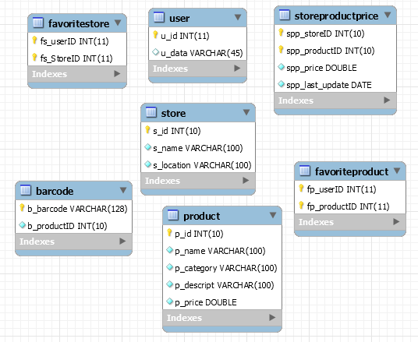
System data model (persistence in general, particularly, database)
TODO: Reverse Engineering – create UML Diagram from database!!!

Slide 7
Automated unit and/or system tests (Junit, Selenium, etc.)
TODO: Junit, SQLite (Local database)

Slide 8
System building and deployment (compiling, testing, and deployment)
Manual testing
Debuging
Junit tests for local DB

Slide 9
User, administrator guides and other documentation

Slide 10
System demonstration, execution and maintenance

Slide 11
Final overview:
URL to project resources (if available):
https://github.com/bricht/piens-un-maize
https://github.com/ErnestsA/SQLite_Test
https://github.com/LaurisLazda/WebDataReader
Main features of the project (which is usually written in something like readme.txt),
List of team members and their main contribution to project,
Biggest challenges in the project and lessons learned.

Slide 12
Future work
1. Overcome RIMI app;
2. Sell Milk'n'Bread to RIMI;
3. Earn first million;
4.

