Slide 1


Milk ‘n’ Bread
Java Bootcamp
Team 1.
Mārtiņš Klevs
Guntars Bērziņš
Roberts Stašķevičs
Jānis Lazda
Lauris Lazda
Ernests Auziņš
Jēkabs Aizpurvs

Slide 2
Business analysis and analysis of given input (actuality of the chosen problem)
Android application about grocery shopping list.

Slide 3
Used workload management approach
SCRUM

Slide 4
Used tools
Java
Git
Balsamiq Mockup
Androdi Studio
Mysql Workbench
Eclipse
PHP
Windows/Lubuntu
Android 6.0 and Higher

Slide 5
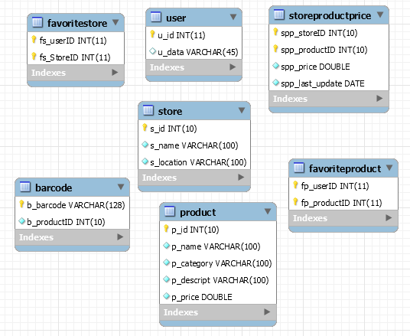
System data model (persistence in general, particularly, database)
Database table constraints secured
At Java code level.

Slide 6
System building and deployment
Manual testing
Debuging
Junit tests for local DB

Slide 7
Final overview:
URL to project resources (if available):
https://github.com/bricht/piens-un-maize
https://github.com/ErnestsA/SQLite_Test
https://github.com/LaurisLazda/WebDataReader
Main features of the project (which is usually written in something like readme.txt),

Slide 8
Biggest challenges in the project and lessons learned
First time Android application development;
Web scraper;
Local database (unresolved);
Remote database;

Slide 9
List of team members and their main contribution to project
Mārtiņš Klevs - Front-end (Search activities, Barcode implementation)
Guntars Bērziņš – Back-end (remote database)
Roberts Stašķevičs – Front-end(UI managment, Git management)
Jānis Lazda – Back-end (Web Scraper, remote database population)
Lauris Lazda – Back-end (Web Scraper) + Front-end (Shopping list activities)
Ernests Auziņš – Back-end (local SQLite database)
Jēkabs Aizpurvs – Front-end (UI planning and managment, Favorites activities)

Slide 10
Future work
Implement Categories;
Get Maxima and other shop prices;
Implement multiple user database usage;

