Slide 1


Bread ‘n’ Milk
Java Bootcamp
Team 1.
Mārtiņš Klevs
Guntars Bērziņš
Roberts Stašķevičs
Jānis Lazda
Lauris Lazda
Ernests Auziņš
Jēkabs Aizpurvs

Slide 2
Business analysis and analysis of given input (actuality of the chosen problem)
Android application about grocery shopping list.

Slide 3






Used tools
Used workload management approach
Java
Git
Balsamiq Mockup
Androdi Studio
Mysql Workbench
Eclipse
PHP
Windows/Lubuntu
Android 6.0 and Higher
SCRUM

Slide 4
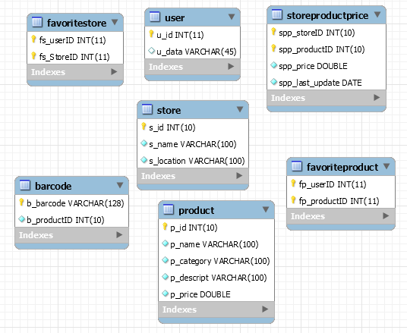
System data model
Database table constraints secured
At Java code level.

Slide 5
System building and deployment
Manual testing
Debuging
Junit tests for local DB

Slide 6
Final overview:
URL to project resources (if available):
https://github.com/bricht/piens-un-maize
https://github.com/ErnestsA/SQLite_Test
https://github.com/LaurisLazda/WebDataReader
Main features of the project (which is usually written in something like readme.txt),

Slide 7
Biggest challenges in the project and lessons learned
First time Android application development
Web scraper
Local database (unresolved)
Remote database
Documentation

Slide 8
List of team members and their main contribution to project
Mārtiņš Klevs - Front-end (search activities, barcode implementation)
Guntars Bērziņš – Back-end (remote database)
Roberts Stašķevičs – Front-end (UI managment, git management, share activity layouts)
Jānis Lazda – Back-end (web scraper, remote database population)
Lauris Lazda – Back-end (web scraper) + Front-end (shopping list activities)
Ernests Auziņš – Back-end (local SQLite database)
Jēkabs Aizpurvs – Front-end (UI planning and managment, favorites activities)

Slide 9
Future work
Implement Categories;
Get Maxima and other shop prices;
Implement multiple user database usage;
Sort list of products by price;

Slide 10
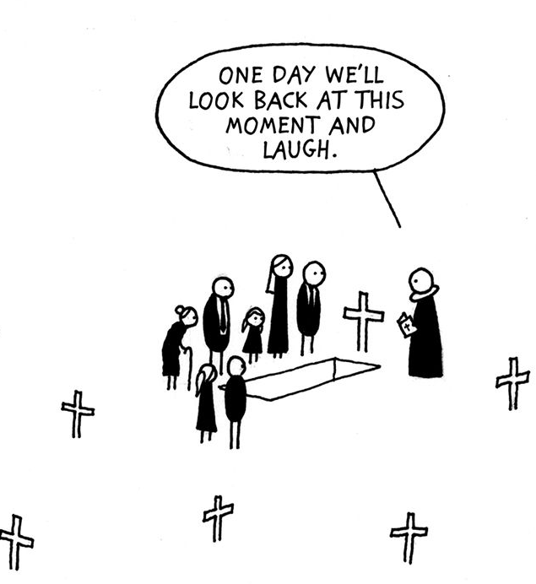
Thank you for your attention!

