Slide 1
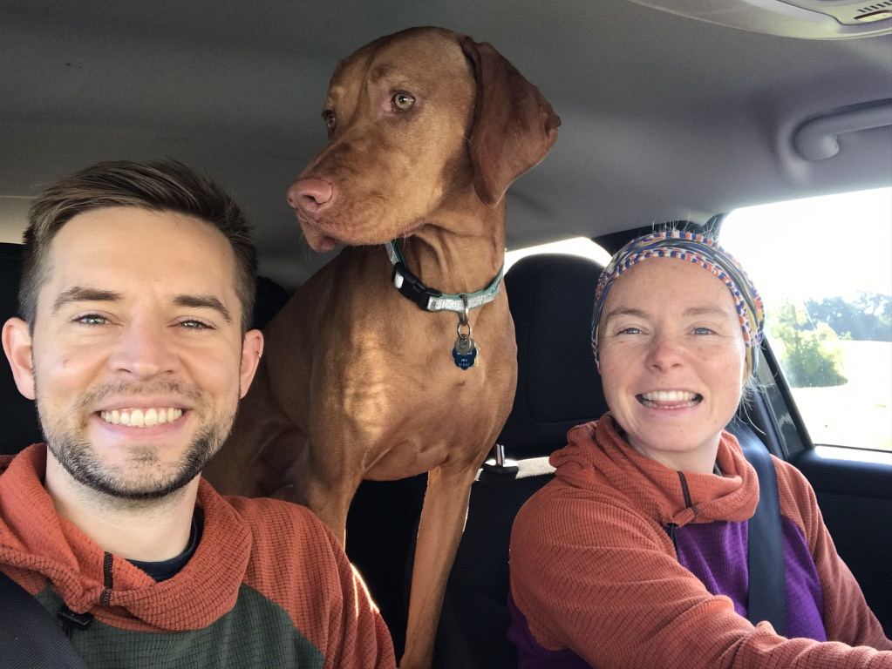
Jacob Roth
Things about me:

Slide 2
Topics to discuss
Common issues with data analysis and reproducibility of experiments
What to consider in terms of rigor and reproducibility as you interpret your data and prepare figures
Data management and preservation of data for the next person coming into the lab

Slide 3
Common issues with data analysis and reproducibility of experiments

Slide 4
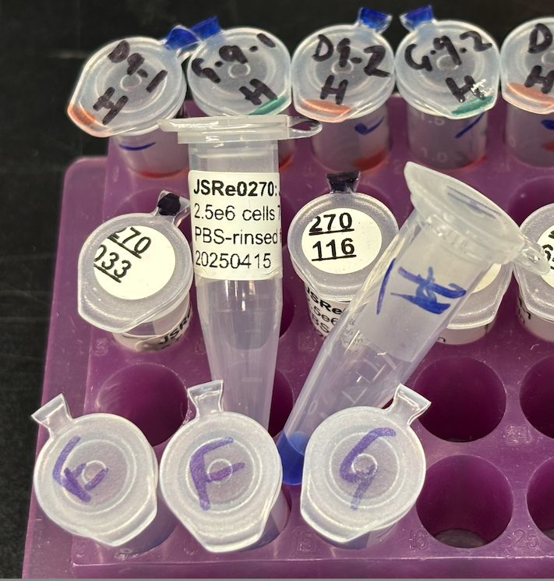
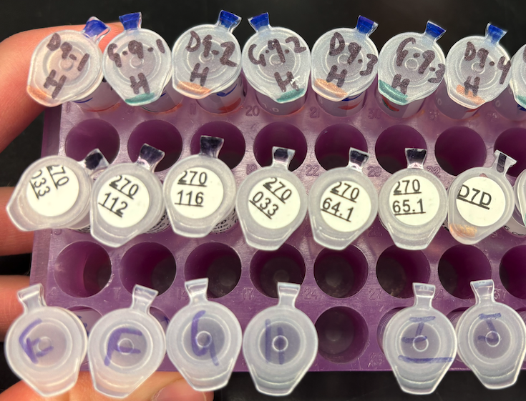
Labels… are critical – use them well or just give up

Slide 5
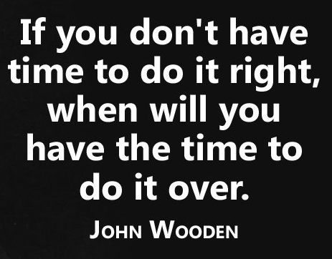
Develop and adopt systems to reduce variability
- Jacob’s parents

Slide 6
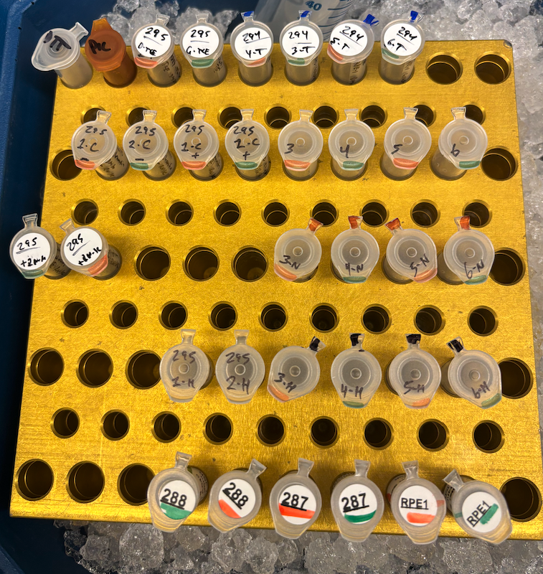
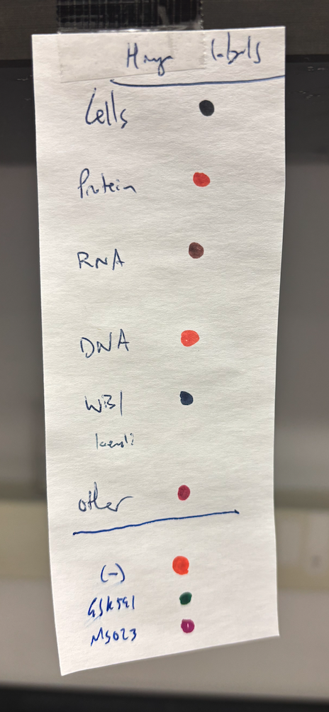
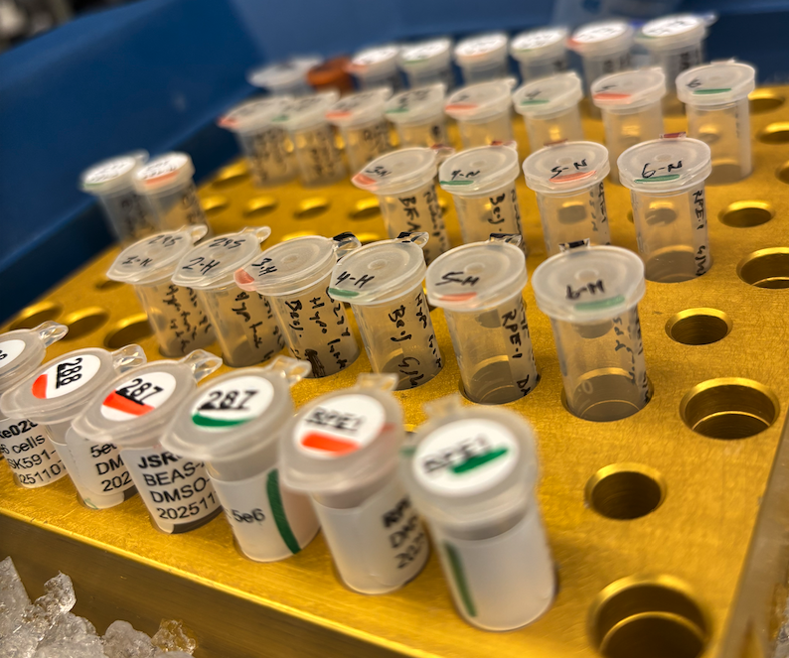
Labels
A minimally-sufficient label:
2x: Top and side
Experiment number
Source (cell line, etc)
Consider a color-code
Treatment
Consider a color-code
Concentration/Quantity
Date
Initials

Slide 7

My system to reduce variability
…has developed out of my desire to do less work, better.
Inventory Sheet
Very simply code: “mkdir"
Written protocols
Digital, but also a physical notebook
Rmarkdown processor
Fewer clicks, please!
https://github.com/rothjs-PhD/DataManagement

Slide 8
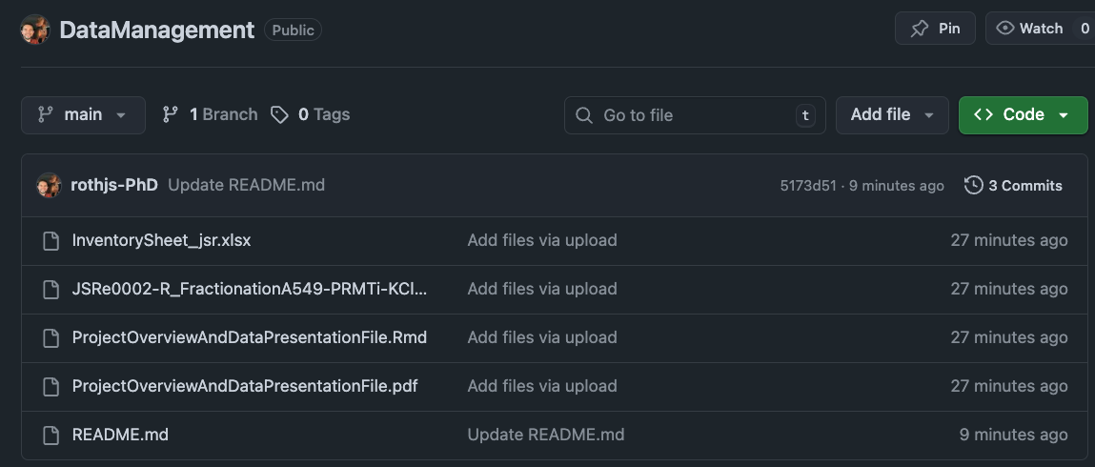
My system to reduce variability

Slide 9
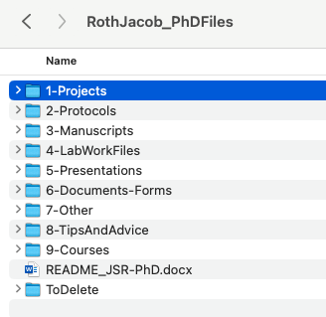
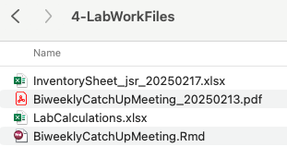
My PhD OneDrive for lab data

Slide 10
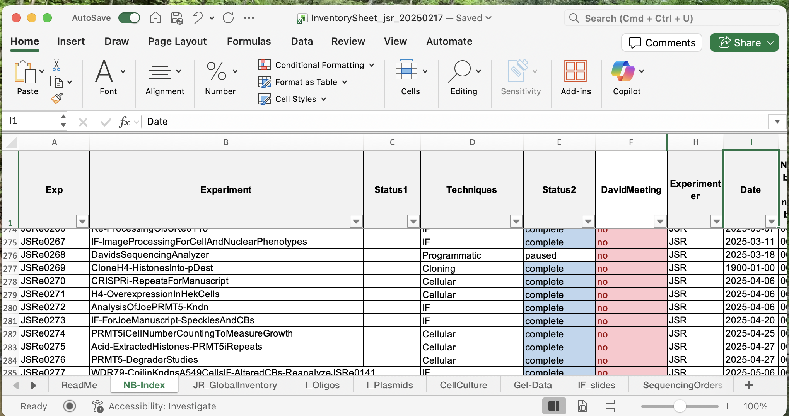
My PhD OneDrive for lab data: Inventory Sheet
Notes:
As we’ll talk about at the end,

Slide 11
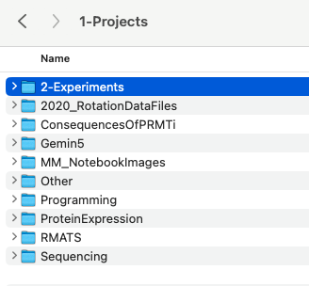
My PhD OneDrive for lab data

Slide 12
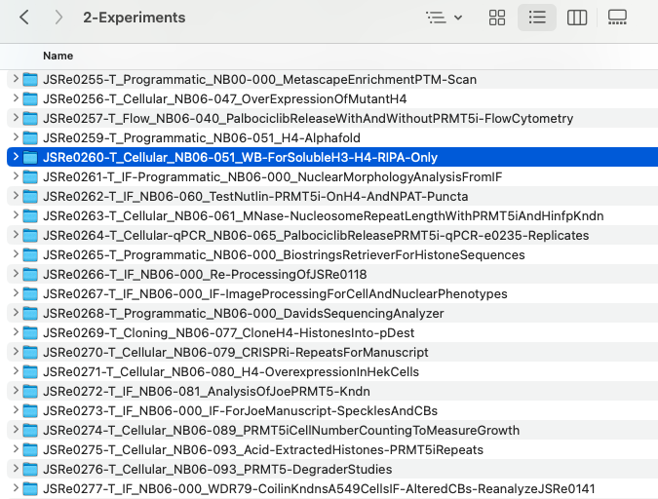
Notes:
JSRe0293-T_Enzymatic_NB06-000_DotBlotForHistone-Rme-AntibodyValidation

Slide 13
Every new experiment starts with an entry into my inventory excel file:
mkdir -p ~/OneDrive/RothJacob_PhDFiles/1-Projects/2-Experiments/
JSRe0260-T_Cellular_NB06-051_WB-ForSolubleH3-H4-DetergentExtraction/{1-notes,2-data_raw,3-code,4-data_processed,5-figures}

Slide 14
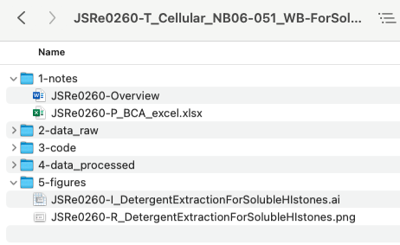
One line of code creates a standardized folder system:
mkdir -p ~/OneDrive/RothJacob_PhDFiles/1-Projects/2-Experiments/
JSRe0260-T_Cellular_NB06-051_WB-ForSolubleH3-H4-DetergentExtraction/{1-notes,2-data_raw,3-code,4-data_processed,5-figures}
Notes:
Data long after doing the experiment → more likely to make mistakes
Having a summary of an experiment will save you time, so much time.
Beware of data placeholders…
mkdir -p ~/OneDrive/RothJacob_PhDFiles/1-Projects/2-Experiments/JSRe0260-T_Cellular_NB06-051_WB-ForSolubleH3-H4-DetergentExtraction/{1-notes,2-data_raw,3-code,4-data_processed,5-figures}

Slide 15
Clear and unique naming examples:
Within my folders I include these calls in file names:
JSRe####-T | “Top” folder; useful to search “JSRe####-T” for any experiment to immediately navigate to an experiment of interest
JSRg### | Any gel I have ever run has a unique ID; agarose gels, western blots, Coomassie stains, everything. Massively simplifies keeping track of western blots as well. Save this name with every image for the named gel (along with the experiment number)
JSRp### | Any plasmid I’ve ever collected
JSRi### | Any oligo I order: primers/DNA sequences, RNA, etc
JSRs#### | Immunofluorescence slides; I add more meta data to each slide, with with this code + an excel file with the metadata, a singular annotation on a slide is sufficient to communicate all data (so long as excel file is updated)
JSRe####-I | “Illustrator” file; useful to search “JSRe####-I” for any experiment to immediately navigate to an adobe illustrator data sheet of interest.
JSRe####-G | Graphpad Prism file for a project
JSRe####-R | “Results” file; useful to search “JSRe####-R” for any experiment to immediately navigate to the summary results of an exp. This is so helpful when talking to David and I want to quickly pull up the digital results of an experiment to show him in lab meeting. Once I have found that file, the filename will also have the NB##-### reference number to immediately navigate to the relevant physical NB page. If coded into Rmd file, better to have png vs pdf images. Further, png images in illustrator will retain quality over time, whereas pdf lose quality (unless linked to source image, which is another issue)

Slide 16
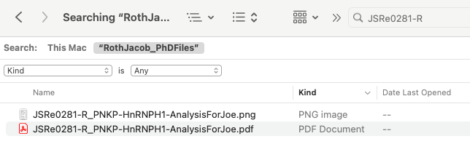
What were the results from that e0281 again??
“cmd+F” → “JSRe0281-R”

Slide 17
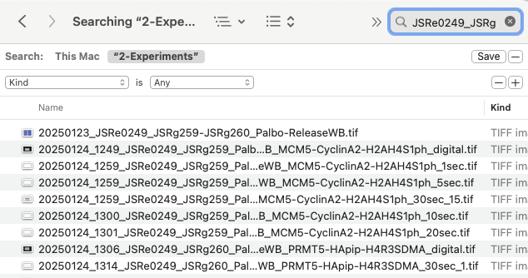
What gels did I run for JSRe0249 again?
“cmd+F” → “JSRe0249_JSRg”

Slide 18
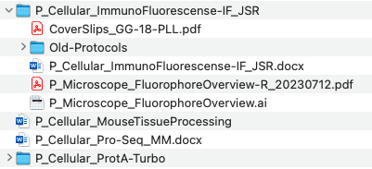
Protocols
All my protocol documents start with a “P_” call so that I can search for them quickly with cmd+F
In my protocols folder I keep a living/continuously updated protocol
Save archived versions with a date from when it was archived
Then when I use it for an experiment, I copy it into the “1-notes” folder for that experiment, renaming it “JSRe####-P_...” to enable me to rapidly search and pull up the protocol for that exp.
Within my protocol, I heavily employ citations to relevant literature (start using Endnote now if you haven’t already) and include any/all relevant footnotes to supplement the protocol.

Slide 19
2. What to consider as you interpret your data and prepare figures for publication and/or your thesis

Slide 20
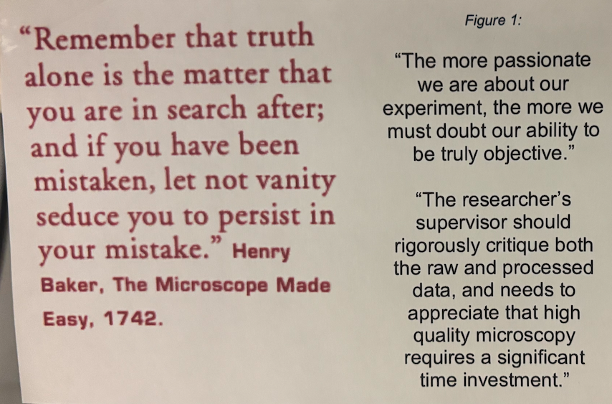
On data interpretation:
Simply put, plod along and move from one positive piece of data to the next.

Slide 21
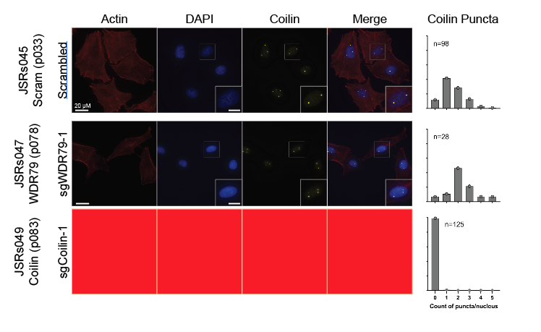
On data presentation:
On intermediate results:
Be explicit about replicates
Beware of data placeholders
Utilize cohesive color schemes and formatting/styles
Finalize data presentation as you go:
- You’ll never know the data better than now

Slide 22
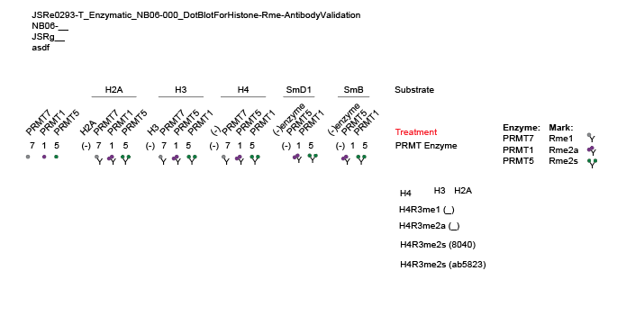
Lay up your data as you go
JSRe0293-I = Processing
JSRe0293-R = Final figures
Notes:
Data long after doing the experiment → more likely to make mistakes
Having a summary of an experiment will save you time, so much time.
Beware of data placeholders…

Slide 23
3. Data management and preservation of data for the next person coming into the lab
Notes:
When you develop a process, then you’re integrating organization and data preservation for the next person already – there isn’t an overwhelming transition at the end!

Slide 24
Adopt a pervasive system early and stick to it = no massive workload for transitioning…

Slide 25
Questions?
Time for a few (more) suggestions?

Slide 26
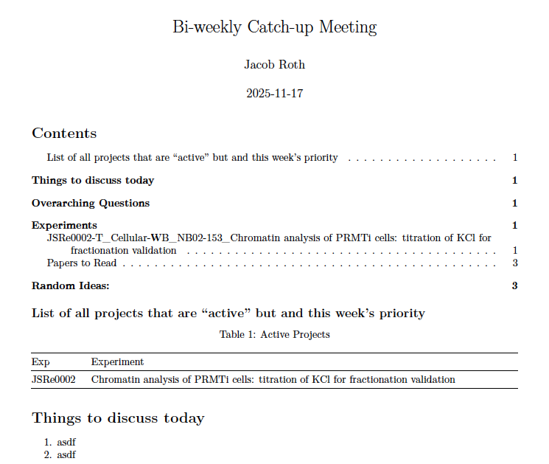
Weekly catch-up meeting Rmarkdown
https://github.com/rothjs-PhD/DataManagement
https://rmarkdown.rstudio.com/articles_intro.html

Slide 27
On sample storage…
Experiment vs Sample Type?
Sample Type worked best for me

