Slide 1
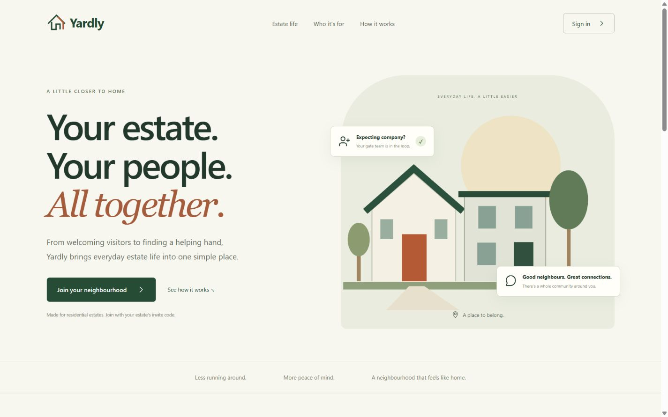
YARDLY / ESTATE PILOT PROPOSAL
Estate life, a little easier.
A shared home for residents,
management and gate security.
Investment proposal:
fund a focused estate pilot.
Live product • yardly-alpha.vercel.app
01
Notes:
Proposal prepared 6 October 2026. Screenshots captured from https://yardly-alpha.vercel.app/ on 6 October 2026. Dashboard views use existing test accounts; all displayed counts and payment amounts are test data, not evidence of adoption or revenue. Proposed pilot scope and outcomes require agreement with estate management.

Slide 2
YARDLY / ESTATE PILOT PROPOSAL
Make everyday estate work easier to follow.
01
Resident records
Know which household belongs to each unit.
02
Dues & receipts
Make payment status easier to verify and explain.
03
Visitors & deliveries
Give the gate a clearer invitation and arrival process.
04
Notices & repairs
Keep updates visible and give issues a clear owner.
These are the workflows the pilot will validate with your estate team.
02
Notes:
Proposal prepared 6 October 2026. Screenshots captured from https://yardly-alpha.vercel.app/ on 6 October 2026. Dashboard views use existing test accounts; all displayed counts and payment amounts are test data, not evidence of adoption or revenue. Proposed pilot scope and outcomes require agreement with estate management.

Slide 3
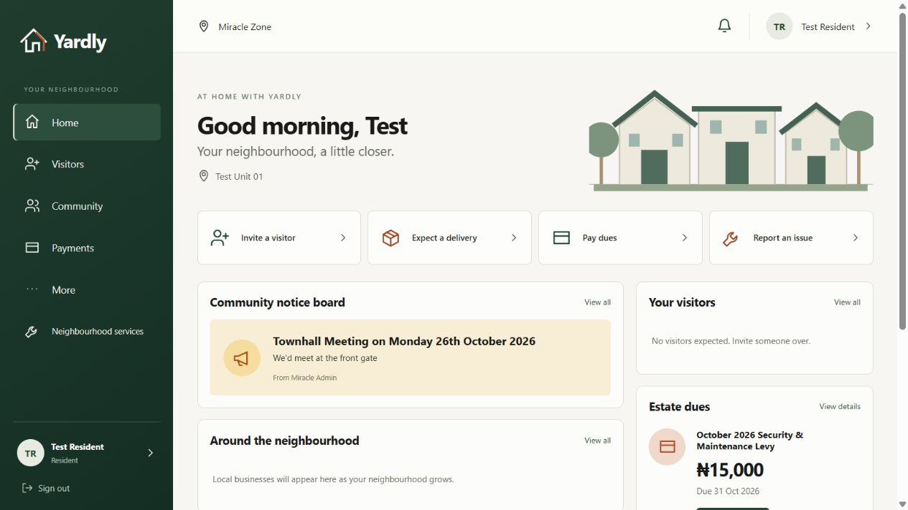
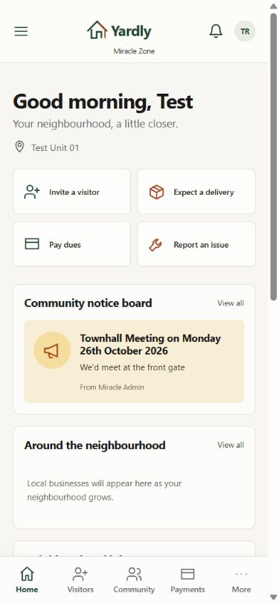
YARDLY / ESTATE PILOT PROPOSAL
One front door for residents.
Visitors • deliveries • estate notices • dues • issue reporting
Current product using a test account. Desktop and mobile views.
03
Notes:
Proposal prepared 6 October 2026. Screenshots captured from https://yardly-alpha.vercel.app/ on 6 October 2026. Dashboard views use existing test accounts; all displayed counts and payment amounts are test data, not evidence of adoption or revenue. Proposed pilot scope and outcomes require agreement with estate management.

Slide 4
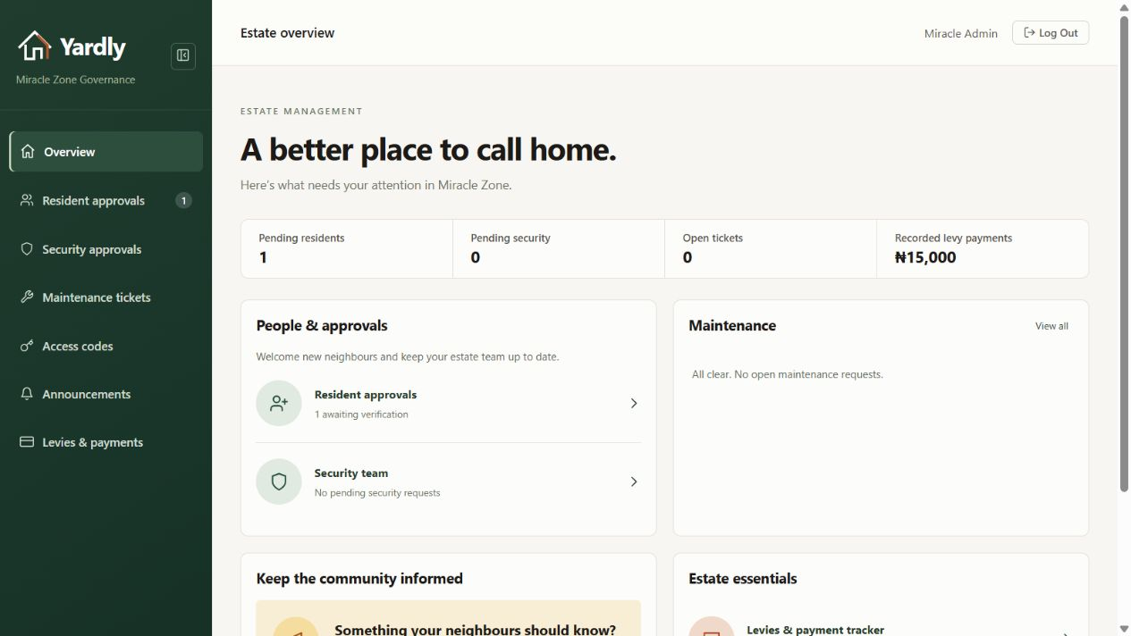
YARDLY / ESTATE PILOT PROPOSAL
Give management a shared operating view.
CURRENT PRODUCT
Review membership
requests
Publish estate
announcements
Review tickets, dues
and access codes
Test account and sample records; figures are not operating results.
04
Notes:
Proposal prepared 6 October 2026. Screenshots captured from https://yardly-alpha.vercel.app/ on 6 October 2026. Dashboard views use existing test accounts; all displayed counts and payment amounts are test data, not evidence of adoption or revenue. Proposed pilot scope and outcomes require agreement with estate management.

Slide 5
YARDLY / ESTATE PILOT PROPOSAL
Fund the foundation for a dependable pilot.
ALREADY IN THE PRODUCT
PROPOSED INVESTMENT SCOPE
Role-based dashboards
Resident approval workflow
Visitor invitation forms
Estate notices and maintenance requests
Structured property and unit records
Verified dues, reconciliation and receipts
Targeted notices and tracked issue updates
Hosting, monitoring and staff onboarding
Online payment collection is not yet integrated. Final scope and budget will be agreed before rollout.
05
Notes:
Current product has levy display and recorded receipt foundations; do not present this as a completed financial ledger or online checkout. Investment scope is proposed work, not shipped functionality. Agree priorities, access permissions, data retention, support and acceptance criteria with management before rollout.

Slide 6
YARDLY / ESTATE PILOT PROPOSAL
Start small. Measure before expanding.
01 / AGREE
02 / OPERATE
03 / REVIEW
Choose a pilot group.
Confirm workflows, budget
and responsible staff.
Onboard households.
Train management and security.
Run real daily workflows.
Compare against the baseline.
Resolve issues.
Decide whether to expand.
Measure: resident participation, gate verification time, payment reconciliation time
and issue resolution time. Benefits must be demonstrated during the pilot.
06
Notes:
Proposal prepared 6 October 2026. Screenshots captured from https://yardly-alpha.vercel.app/ on 6 October 2026. Dashboard views use existing test accounts; all displayed counts and payment amounts are test data, not evidence of adoption or revenue. Proposed pilot scope and outcomes require agreement with estate management.

Slide 7
YARDLY / ESTATE PILOT PROPOSAL
Let’s make your estate the pilot.
The decision we’re asking for
Commit funding for an agreed pilot scope.
Nominate a management lead and a security lead.
Approve household onboarding and success criteria.
Next step: a scoping meeting and a costed pilot proposal.
Explore the live site: yardly-alpha.vercel.app
07
Notes:
Proposal prepared 6 October 2026. Screenshots captured from https://yardly-alpha.vercel.app/ on 6 October 2026. Dashboard views use existing test accounts; all displayed counts and payment amounts are test data, not evidence of adoption or revenue. Proposed pilot scope and outcomes require agreement with estate management.

