Slide 1
Intentional Homicide: Exploratory Data Analysis (Group 10)
Most recent year analyzed: 2023 | Group 10

Slide 2
Objectives and Questions
  • Understand dataset and compute homicide rates per 100k
  • Answer 8 preliminary EDA questions (country extremes, trends, regions, concentration, sex/age patterns)

Slide 3
Methods
  Data: UNODC homicide counts
  Population: World Bank (SP.POP.TOTL) merged by ISO3 and Year
  Analysis: Aggregation to totals, compute rates per 100k, visualize with bar/line/hist plots

Slide 4
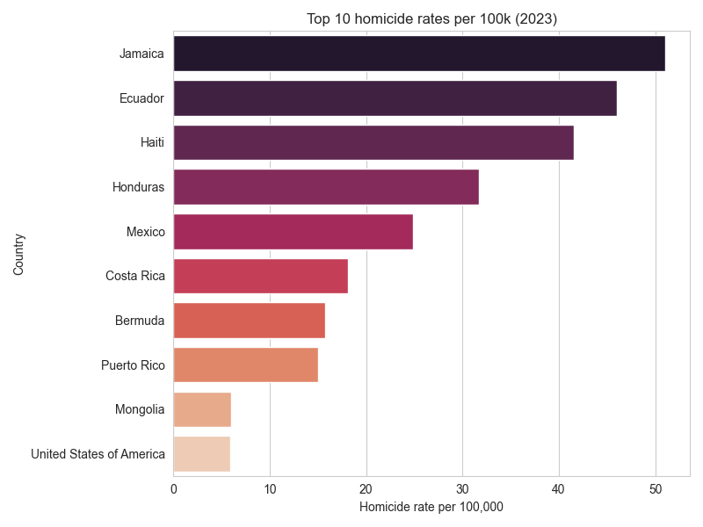

Slide 5
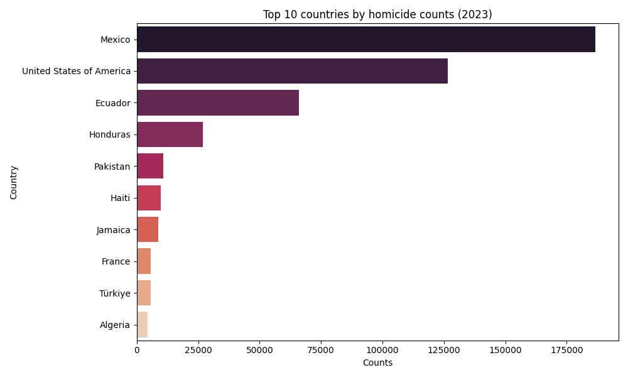

Slide 6
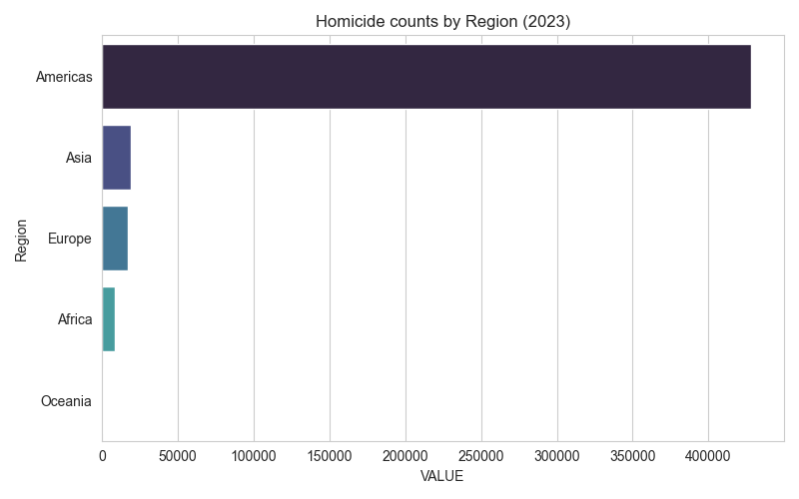

Slide 7
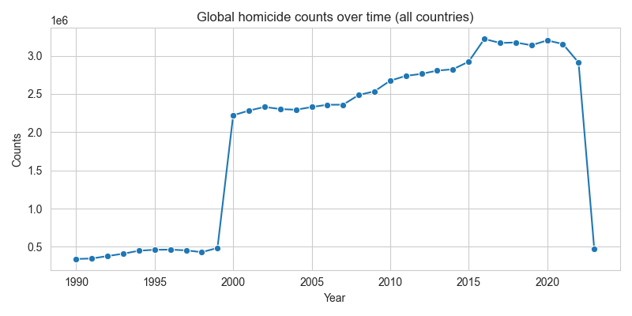

Slide 8
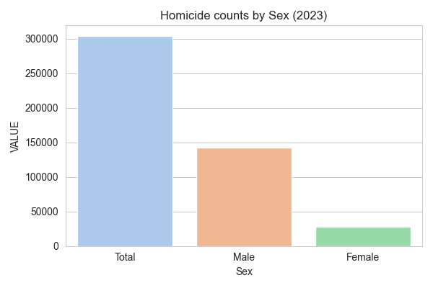
Sex and Age highlights
  Leading age group (most recent year): Total with 473,623 victims

Slide 9
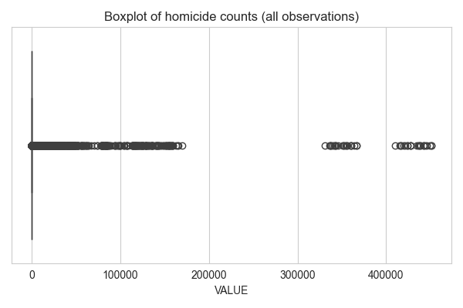
Concentration: Top 10 countries accounted for 95.2% of counts in 2023. Outliers identified in boxplots.

Slide 10
Next steps and References
  • Validate and clean remaining missing population entries
  • Add maps and deeper country case studies
References: UNODC Data Portal; World Bank population (SP.POP.TOTL)

