Slide 1
Similac Isomil Scientific & Medical Affairs, ANI

Slide 2
IMPORTANT NOTICE: MOTHER’S MILK IS BEST FOR THE BABY
The content of this presentation is meant for internal training purpose only
Not intended for circulation.

Slide 3
Important notice
Breastfeeding provides the best nutrition and protection from illnesses of infants. For infants, breast milk is all that is needed for the first 6 months. Breastmilk is the best and most economical food for baby.
Warning / Caution: Infant milk substitute is not the sole source of nourishment of an infant. Careful and hygienic preparation of infant milk substitute is most essential for health. Lactose- free infant milk substitute should only be used in case of diarrehea due to Lactose intolerance. Lactose- free infant formula should be withdrawn, if there is no improvement in symptoms of intolerance.
Continued use of infant milk substitute should not be recommended to avoid any difficulties in reverting to breastfeeding of infants after a period of feeding by infant milk substitute. In the event recommending infant milk substitute in addition to breastmilk or its replacement during the first 6 months, keep the costs in mind before recommending use of infant milk formula. Un-boiled water, un-boiled bottles or incorrect dilution can make a baby ill. Always advise to follow instructions exactly.
Unnecessary introduction of partial bottle-feeding or other foods and drinks will have negative effect on breastfeeding.
Characteristics of breastmilk : Immediately after delivery, breastmilk is yellowish and sticky. The milk is called Colostrum, which is secreted during the first-week of delivery. Colostrum is more nutritious than mature milk because it contains more proteins, more anti-infective properties, which are of great importance for the infant’s defense against dangerous neo-natal infections. It also contains higher levels of Vitamin ‘A’.
Advantages of breastfeeding : (A) Breastfeeding is much cheaper than feeding an infant milk substitute as the cost of extra food needed by the mother is negligible as compared to cost of feeding infant milk substitute; (B) Breastmilk is always available; (C) Breastmilk needs no utensils or water (which might carry germs) or fuel for is preparation; (D) Mothers who breastfeed usually have longer periods of infertility after child birth than non-lactators.
Management of breastfeeding, as under:
i. Breastfeeding
A. Immediately after delivery enables the contraction of the womb and helps the mother to regain her figure quickly.
B. Is successful when the infant suckles frequently and the mother wanting to breastfeed is confident in her ability to do so.
ii. In order to promote and support breastfeeding the mother's natural desire to breastfeed should always be encouraged by giving, where needed,
practical advice and making sure that she has the support of her relatives.
iii. Adequate care for the breast and nipples should be taken during pregnancy.
iv. It is also necessary to put the infant to the breast as soon as possible after delivery.
v. Let the mother and the infant stay together after the delivery, the mother and her infant should be allowed to stay together (in hospital, this is
called "rooming- in").
vi. Give the infant Colostrum as it is rich in many nutrients and its anti-infective factors protect the infants from infections during the few days of its birth.
vii. The practice of discarding Colostrum and giving sugar water, honey water, butter or other concoctions instead of Colostrum should be very strongly
discouraged.
viii. Let the infants suckle on demand.
ix. Every effort should be made to breastfeed the infants whenever they cry.
x. mother should keep her body and clothes and that of the infant always neat and clean.

Slide 4
Content
Incidence of Common tolerance issues
Protein digestion and metabolism
Lactose digestion and metabolism
Clinical Indications for use of Isomil
Safety of soy formulas during infancy
Competitors profile

Slide 5

Feeds Post Birth
Breast Milk
Milk Formula
Cow milk
Notes:
Breast milk is the ideal and best source of nutrition for infants.
The next best possible way to feed the majority of infants is infant formula & unmodified cow’s milk in the first year of life due to various reasons (inadequate lactation, working mother, contraindication to breastfeeding etc.).

Slide 6
Formula/Lactose Intolerance
Formula/Lactose Intolerance may lead to
Diarrhea
Excessive crying
Vomitting
Spit up
Fussiness
Gassiness
Notes:
In infants, most formula switching is due to intolerance rather than allergy. For some reason, these infants do not tolerate certain feedings or foods. They exhibit signs and symptoms similar to immune reactions that are not related to the immune system at all. These reactions are termed “food intolerance”:
Crying
Fussiness
Gas
Spit-up
Diarrhoea
Colic symptoms
Food intolerance is defined as an adverse event without a clear immune mechanism. Metabolic disorders, toxins or components with pharmacological activity and enzyme deficiency fit into this category. An example is lactase deficiency due to diarrhoea or other GI anomalies that have caused the production of lactase to stop or decrease significantly, but only temporarily. For a period of time, the infant will not be able to tolerate lactose and is said to have a transient lactase deficiency. Lactose intolerance is usually due to a deficiency of the enzyme lactase, which is rare in infants.
Lactose intolerance
Primary and secondary lactase deficiency may result in lactose intolerance in infants (very rare), children, and adolescents. Children with suspected lactose intolerance can be assessed clinically by dietary lactose elimination or by tests including noninvasive hydrogen breath testing or invasive intestinal biopsy determination of lactase (and other disaccharidase) concentrations. Treatment consists of use of lactase-treated dairy products or oral lactase supplementation, limitation of lactose-containing foods, or dairy elimination.
The American Academy of Pediatrics supports use of dairy foods as an important source of calcium for bone mineral health and of other nutrients that facilitate growth in children and adolescents. If dairy products are eliminated, other dietary sources of calcium or calcium supplements need to be provided (American Academy of Pediatrics 2006).

Slide 7
Intolerance
Causes of Intolerance
Immaturity of baby’s digestive system (will outgrow many issues)
Cow milk intolerance (not well understood)
Lactose intolerance (usually temporary, after diarrhea)
Colic (not well understood)
Notes:
Causes of Intolerance
Immaturity of baby’s digestive system (will outgrow many issues)
Cow milk intolerance (not well understood)
Lactose intolerance (usually temporary, after diarrhea)
Colic (not well understood)

Slide 8
Suspected reasons for common tolerance issues
Reasons
Possible Remedy
Cow Milk Protein Intolerance
Lactose Intolerance
Soy Protein formula
Lactose free formula
Notes:
Suspected reasons for common tolerance issues
1) May be due to protein intolerance such as Cow’s milk protein intolerance (CMPI).
In case of CMPI, avoidance of cow’s milk protein is recommended and is replaced by alternative protein source like Soy protein
2) May be due to Carbohydrate intolerance such as lactose intolerance (LI)
In case of LI, avoidance of lactose is recommended and is replaced by alternative carbohydrate source like maltodextrin and sucrose.

Slide 9
Lactose digestion
Lactose, a disaccharide of 2 different monosaccharide i.e. glucose and galactose
Unique carbohydrate present only in mammalian milk,
Mature human milk: 7.2 g / 100 mL,
Cow’s milk: 4.7 g / 100 mL
For effective utilization, lactose requires hydrolysis by the enzyme lactase and, during infancy, provides an excellent source of energy at a time of rapid growth and development
Heyman M. PEDIATRICS 2006; Volume 118, Number 3, Hyams et al. The Journal Of Pediatrics 1981; 99: 916-918 Lomer et al. Aliment Pharmacol Ther 27, 93–103
Notes:
Lactose, a disaccharide of 2 different monosaccharide i.e. glucose and galactose
Unique carbohydrate present only in mammalian milk,
Mature human milk: 7.2 g / 100 mL,
Cow’s milk: 4.7 g / 100 mL
For effective utilization, lactose requires hydrolysis by the enzyme lactase and, during infancy, provides an excellent source of energy at a time of rapid growth and development

Slide 10
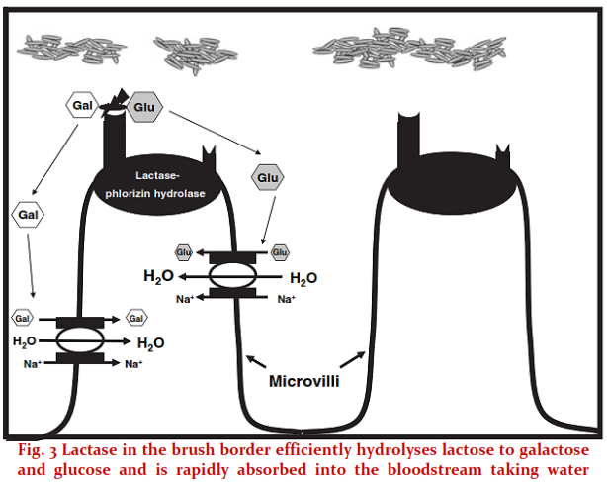
Understanding lactose digestion and metabolism
Lactase is present on the apical surface of intestinal cells
Heyman M. PEDIATRICS 2006; Volume 118, Number 3,Hyams et al. The Journal Of Pediatrics 1981; 99: 916-918Lomer et al. Aliment Pharmacol Ther 27, 93–103
Notes:
The enzyme lactase is responsible for the breakdown of lactose to the monosaccharides, glucose and galactose. These are absorbed from intestinal cells called enterocytes into the bloodstream (See the Figure) Glucose is ultimately utilized as a source of energy and galactose becomes a component of glycolipids and glycoproteins.
Lactase is present on the apical surface of enterocytes in the small intestinal brush border with the highest expression in the mid-jejunum. By week 8 of gestation, lactase activity can be detected at the mucosal surface in the human intestine.
Activity increases until week 34 and by birth, lactase expression is at its peak. Hypolactasia or lactase deficiency, exists in three distinct forms: Congenital, primary and secondary.
Lactase is present on the apical surface of enterocytes in the small intestinal brush border with the highest expression in the mid-jejunum. By week 8 of gestation, lactase activity can be detected at the mucosal surface in the human intestine. Activity increases until week 34 and by birth, lactase expression is at its peak. However, within the ﬁrst few months of life, lactase activity starts to decrease (lactase non-persistence). In most mammals, it declines at variable rates following weaning to undetectable levels as a consequence of the normal maturational down-regulation of lactase activity

Slide 11
Lactase deficiency- Clinical presentation
The term lactose intolerance refers to “the symptoms experienced when the dose of lactose exceeds the digestive capacity of intestinal lactase.”
Symptoms varies with: amount of lactose ingested, degree of lactase deficiency and form of food substance in which lactose is consumed
For effective utilization of lactose without symptoms of intolerance, only 50% of lactase activity is necessary
Heyman M. PEDIATRICS 2006; Volume 118, Number 3,Hyams et al. The Journal Of Pediatrics 1981; 99: 916-918Lomer et al. Aliment Pharmacol Ther 27, 93–103
Notes:
The term lactose intolerance refers to “the symptoms experienced when the dose of lactose exceeds the digestive capacity of intestinal lactase.”
Symptoms varies with: amount of lactose ingested, degree of lactase deficiency and form of food substance in which lactose is consumed
For effective utilization of lactose without symptoms of intolerance, only 50% of lactase activity is necessary

Slide 12
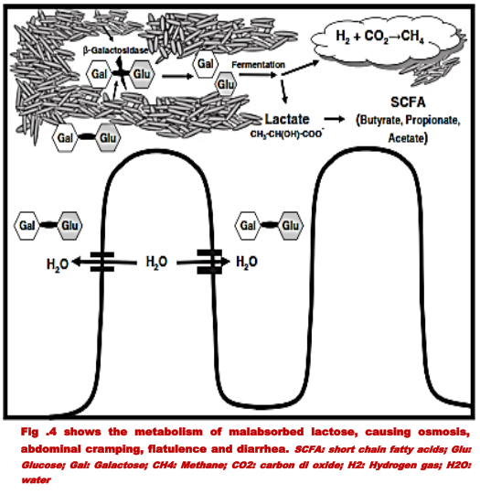
Lactose intolerance
Malabsorbed lactose generates;
An osmotic load- loose stool.
Production of fatty acids and gases causing flatulence, intestinal distention and abdominal cramping
Heyman M. PEDIATRICS 2006; Volume 118, Number 3,Hyams et al. The Journal Of Pediatrics 1981; 99: 916-918Lomer et al. Aliment Pharmacol Ther 27, 93–103
Notes:
Malabsorbed lactose generates an osmotic load that draws fluid and electrolytes into the intestinal lumen, leading to loose stool. unabsorbed lactose is a substrate for intestinal bacteria, especially in the colon. Bacteria metabolize lactose, producing volatile fatty acids and gases (methane, carbon dioxide, and hydrogen), leading to flatulence. The fatty acids lower the fecal pH, making the fecal pH test a nonspecific but sometimes helpful marker for lactose (or other carbohydrate) malabsorption. When sufficient intestinal gas is produced by the bacterial metabolic processes to cause stimulation of the intestinal nervous system by intestinal distention, visceral (abdominal) cramping/pain results

Slide 13
Lactose intolerance- Clinical presentation
Lactose intolerance in infants can present as a clinical syndrome of 1 or more of the following:
colic
abdominal pain,
diarrhea,
ﬂatulence, and/or
bloating; after the ingestion of lactose or lactose containing food substances.
Heyman M. PEDIATRICS 2006; Volume 118, Number 3,Hyams et al. The Journal Of Pediatrics 1981; 99: 916-918Lomer et al. Aliment Pharmacol Ther 27, 93–103
Notes:
Lactose intolerance- Clinical presentation
Lactose intolerance in infants can present as a clinical syndrome of 1 or more of the following after the ingestion of lactose or lactose containing food:
Colic
Abdominal Pain
Diarrhoea
Flatulence
Bloating

Slide 14
What is the incidence of lactose intolerance during diarrhea?
Prevalence of secondary lactose intolerance following infectious diarrhea has been reported to be present in 25% of children.
This slide is only for healthcare professionals. Not for circulation
Notes:
Prevalence of secondary lactose intolerance following infectious diarrhea has been reported to be present in 25% of children.

Slide 15


Nutritional management of diarrhea
Oral rehydration therapy
Zinc supplementation
Energy Dense lactose free formula
In addition to breast-feeding are key actions to reduce diarrhea in infants
Available from: https://www.unicef.org/media/files/Final_Diarrhoea_Report_October_2009_final.pdf. Accessed on November 26, 2016.
Notes:
Because diarrhea can develop for numerous reasons, the nutrition prescription depends on the medical diagnosis and severity of the condition. The dietary treatment initially recommended is a low-fiber, low-fat, lactose-free diet. The diet limits foods that contribute to stool volume, such as those with significant amounts of fiber, resistant starch, fructose, sugar alcohols, and lactose (in lactose-intolerant individuals). Fructose and sugar alcohols, which are poorly absorbed, retain fluids in the colon and contribute to osmotic diarrhea. Similarly, milk products may worsen osmotic diarrhea in persons who are lactose intolerant.
Avoidance of fatty foods is recommended because they can sometimes aggravate diarrhea. Gas-producing foods (those with poorly digested or malabsorbed carbohydrates) can increase intestinal distention and cause additional discomfort.

Slide 16
Why is refueling with energy-dense food required?
Nutrition during diarrhea
Reduction in food intake
Decrease in absorption of nutrients
Increase in catabolism of nutrient reserves
Increased energy requirements during recovery by ~25% of the RDA
^During recovery, an intake of at least 125% of recommended dietary allowances (RDA) should be attempted with nutrient dense food, and this should continue until the child reaches preillness weight and ideally until the child achieves a normal nutritional status¹ In OP Ghai’s Essential Pediatrics, 8th Edition; 2015, chapter 11; page 295
https://www.ncbi.nlm.nih.gov/books/NBK219100/
Abbott Confidential. For Training Purpose only
This slide is only for healthcare professionals. Not for circulation
Notes:
Nutrition during diarrhea is required because:
Reduction in food intake
Decrease in absorption of nutrients
Increase in catabolism of nutrient reserves
Increased energy requirements during recovery by ~25% of the RDA

Slide 17
Why should early re-feeding be started?
Improves absorption of Nutrients
Benefits of Early Re-feeding within 24 hours of Diarrhea²
Reduces duration of Diarrhoea & improves nutritional outcomes
Enhances Enterocyte regeneration
Promote recovery of disaccharidases
Canadian Paediatric Society Nutrition and Gastroenterology Committee Paediatr Child Health 2006;11(8):527-31.
Notes:
The most important management strategy for diarrhoea in infants is rehydration along with continued nutrition support. As diarrhoea leads to a state of transient lactose intolerance giving a cows milk formula which contains lactose and be detrimental. The WHO recommends avoidance of lactose-containing milks in children with persistent post infectious diarrhoea (diarrhoea lasting more than 14 days) when they fail a dietary trial of milk or yogurt. (Heyman 2006)
Early feeding should be started within 24 hrs of diarrhea for below benefits:
Enhances Enterocyte regeneration
Promote recovery of disaccharidases
Reduces duration of Diarrhoea & improves nutritional outcomes
Improves absorption of Nutrients

Slide 18
What is the Nutrition management in different situations?
Diarrhea
Exclusive
Breastfed
Continue breastfeeding
Breast feeding+ top feeding
Continue breastfeeding + lactose free nutrition
Exclusively top fed
Lactose free nutrition is beneficial
Predominant feed of child
Suggested feed
Ideal but may be difficult to meet the additional 25% requirement
Lactose free nutrition will help meet the additional 25% requirement
Rehydration first and then re-feeding with lactose- free nutrition should be started
This slide is only for healthcare professionals. Not for circulation
Notes:
Nutrition management in different situations

Slide 19
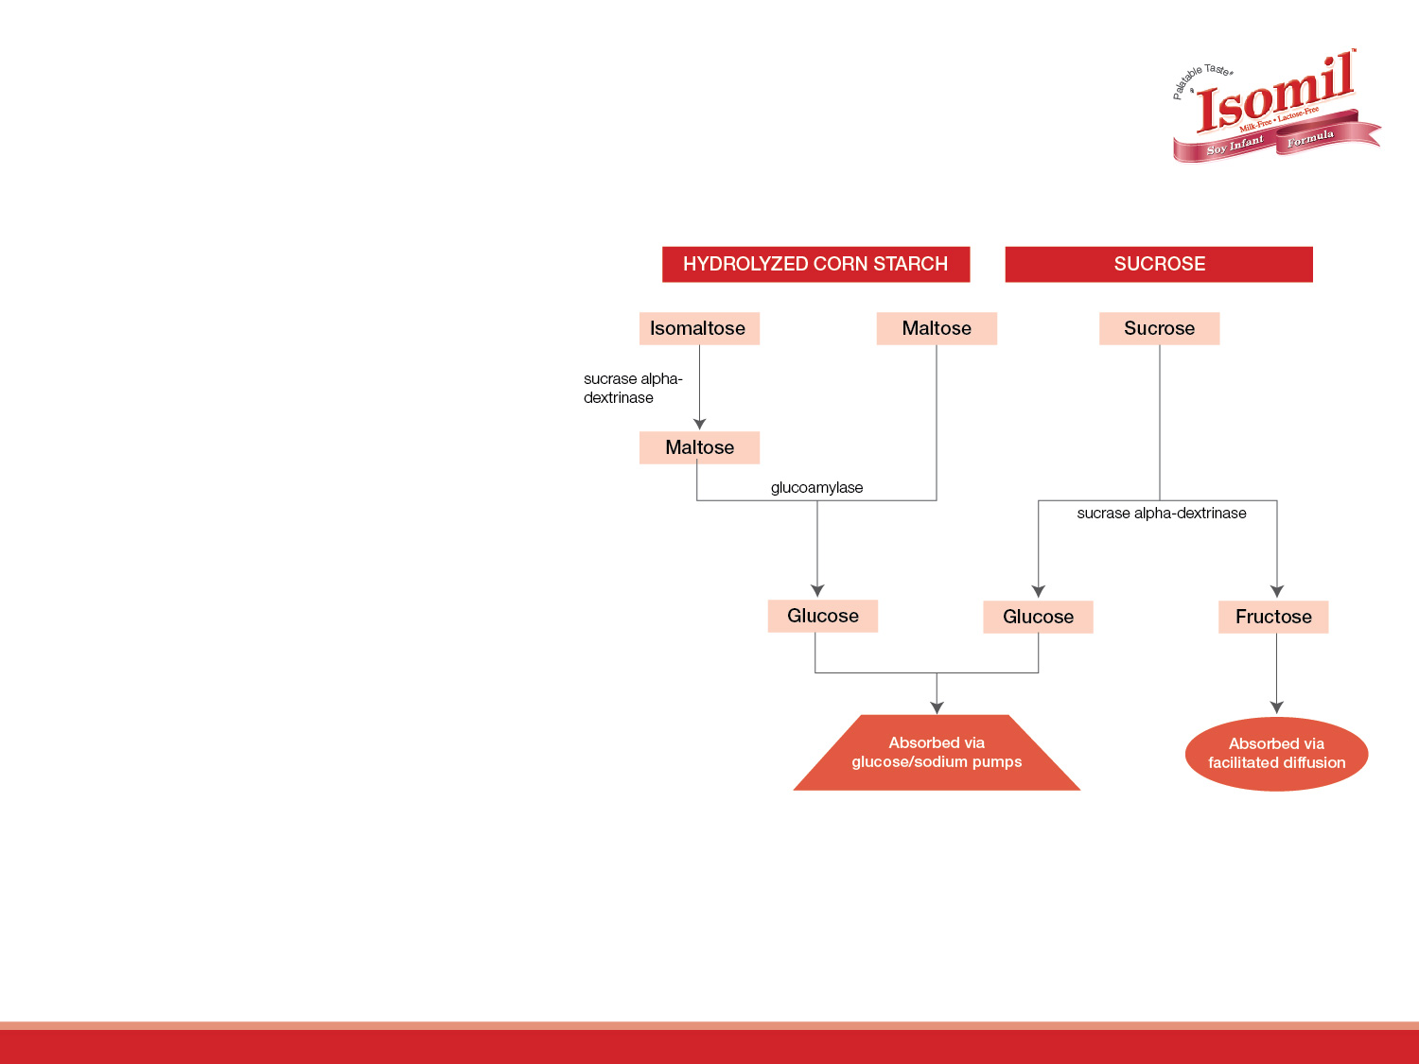
Dual carbohydrate blend in Isomil
The two carbohydrates are absorbed via two different, non-competing pathways
The benefit of having two carbohydrate sources is;
1. The overall absorption of carbohydrate is much higher than from each individual source.
2. If anyone enzyme is deficient/ absent due to a disease condition the dual source still helps in providing a good amount of carbohydrate
Figure demonstrates digestion and absorption of different types of carbohydrates in Isomil
Kerzner B et al. Pediatr Res. 1983;17:191A.
Notes:
The two carbohydrates are absorbed via two different, non-competing pathways
The benefit of having two carbohydrate sources is;
The overall absorption of carbohydrate is much higher than from each individual source.
If anyone enzyme is deficient/ absent due to a disease condition the dual source still helps in providing a good amount of carbohydrate.

Slide 20



Global recommendation for lactose free nutrition in Infantile diarrhea
Lactose Free Formula is recommended
This slide is only for healthcare professionals. Not for circulation
Notes:
All global organisations / bodies / societies recommend Lactose free formula for nutritional management of Diarrhea.

Slide 21
What is the evidence for the benefit of using lactose-free nutrition in diarrhea?
Is there any clinical evidence on the use of lactose-free formulas reducing the stool output?
This slide is only for healthcare professionals. Not for circulation

Slide 22
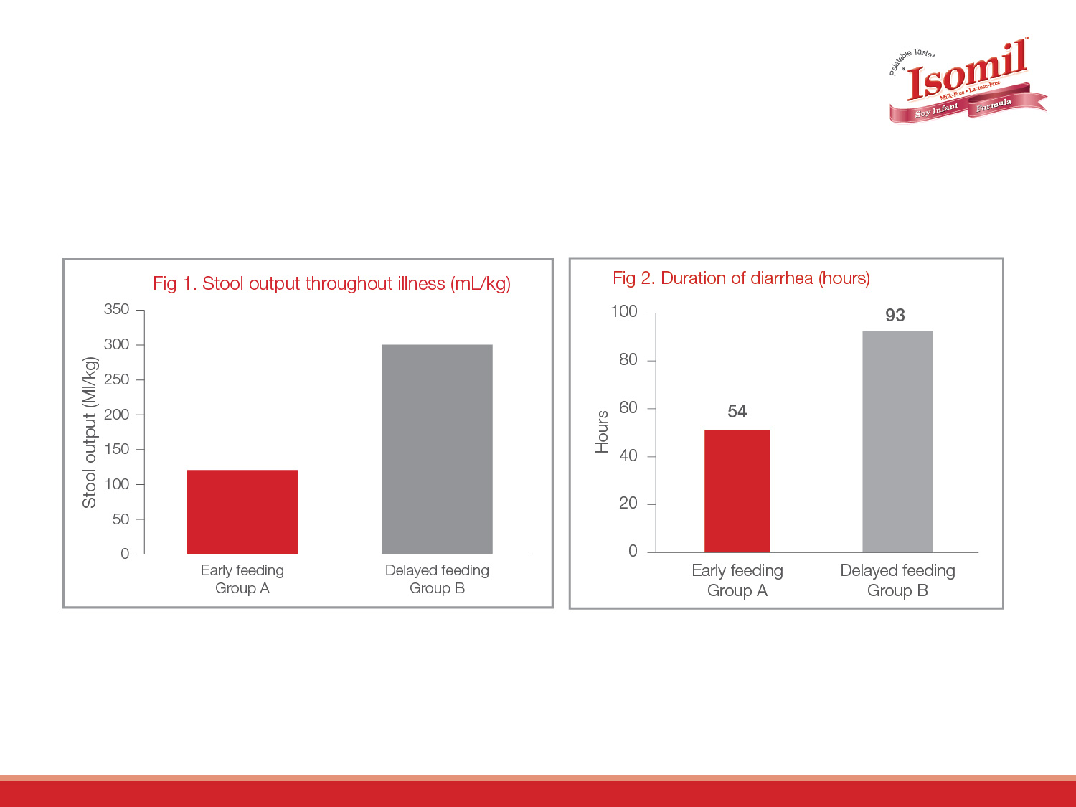
Group A patients showed less mean stool output (121 ± 129 (SD) mL/kg) than group B patients (299 ± 319 mL/kg) (P < .001) (Fig. 1)
The duration of illness was significantly shorter in group A patients (54 ± 28 hours v 93 ± 56 hours) (P<.001) (Fig. 2)
The introduction of a lactose-free formula during diarrheal illness shortens the duration of diarrheal and decreases stool output considerably
Santosham M, Goepp Julius et al. Pediatrics 1991;87:619-622.
This slide is only for healthcare professionals. Not for circulation
Notes:
In an early study, Santosham et al. compared the effects of delayed refeeding using diluted formula with early refeeding using full-strength formula.100 Infants up to 12 months of age, hospitalized with acute diarrhea, were randomly assigned to one of two refeeding groups. Prior to refeeding, severely dehydrated infants were given IV lactated Ringer’s solution until pulse rate and blood pressure returned to normal; rehydration was then completed within four hours by administering ORS. Minimally, mildly, and moderately dehydrated infants were rehydrated with ORS over a four-hour period. After the rehydration phase, infants in one group (n=44) were treated according to the then-standard timetable: They received ORS and water for the first 48 hours of hospitalization, half-strength Isomil for the next 24 hours, and full-strength Isomil until discharge from the hospital. In contrast, infants in the other group (n=43) were given full-strength Isomil beginning immediately after the rehydration phase and continuing until discharge from the hospital.
No significant differences in weight gain were seen at any time during the study, but infants who received full-strength Isomil immediately after the rehydration phase had significantly lower ORS intake during the first 24 hours of treatment, during the first 48 hours of treatment, and throughout the entire illness, as well as significantly less stool output during each time period (Table 4).100 In addition, infants who received full-strength Isomil immediately after the rehydration phase had a significantly shorter duration of diarrhea. Compared with delayed refeeding using diluted Isomil, early refeeding using full-strength Isomil reduced ORS intake and stool output by more than 40%, and also reduced the duration of diarrhea by more than 40%.

Slide 23
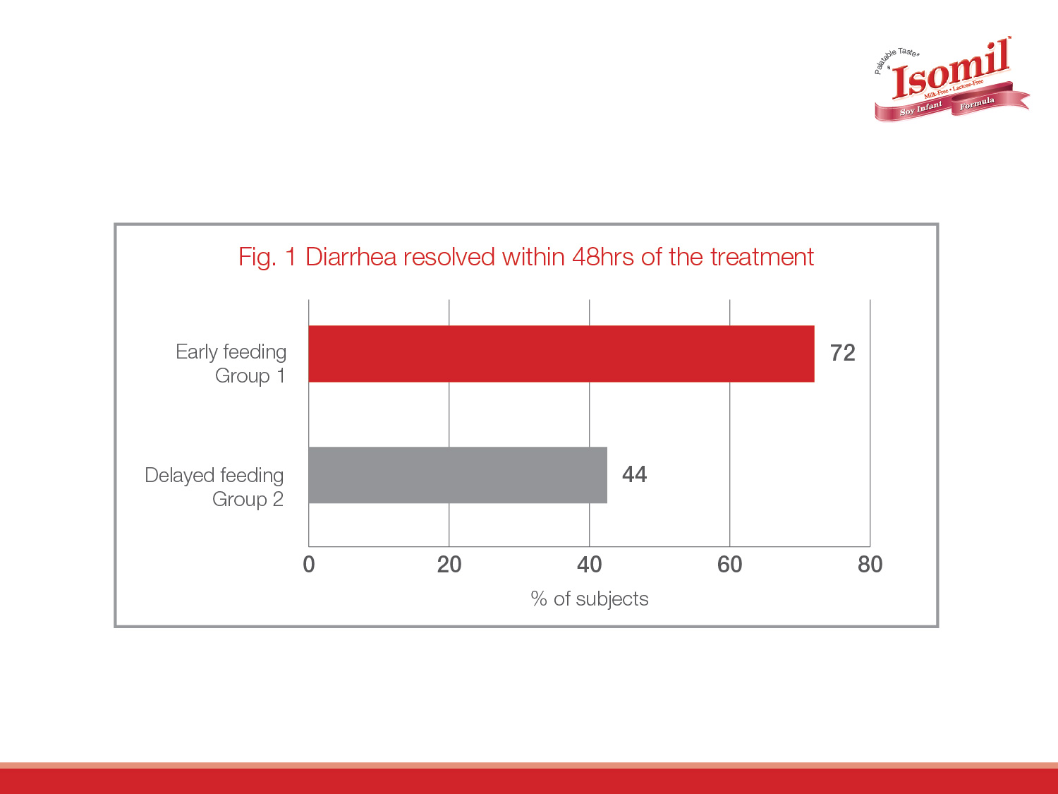
The introduction of a lactose-free formula during diarrheal illness shortens the duration of diarrhea
Santosham M, Goepp Julius et al. Pediatrics 1991;87:619-622.
This slide is only for healthcare professionals. Not for circulation
Notes:
In an early study, Santosham et al. compared the effects of delayed refeeding using diluted formula with early refeeding using full-strength formula.100 Infants up to 12 months of age, hospitalized with acute diarrhea, were randomly assigned to one of two refeeding groups. Prior to refeeding, severely dehydrated infants were given IV lactated Ringer’s solution until pulse rate and blood pressure returned to normal; rehydration was then completed within four hours by administering ORS. Minimally, mildly, and moderately dehydrated infants were rehydrated with ORS over a four-hour period. After the rehydration phase, infants in one group (n=44) were treated according to the then-standard timetable: They received ORS and water for the first 48 hours of hospitalization, half-strength Isomil for the next 24 hours, and full-strength Isomil until discharge from the hospital. In contrast, infants in the other group (n=43) were given full-strength Isomil beginning immediately after the rehydration phase and continuing until discharge from the hospital.

Slide 24
Nutrition management during formula Intolerance
Since the intolerance may happen in infants due to cow milk protein or lactose
A lactose free soy protein formula can be tried

Slide 25
Soy formula history
1909: First described as “cow’s milk substitute”
1929: Hill & Stuart described “soy flour formula for infants with milk idiosyncracy”
1960’s: Isolated soy protein formulas were made available
1970s: methionine and other complementary nutrients were added
1980s: added iodine, carnitine, taurine, choline, and inositol
1990s: meets AAP, Infant formula Act, 1980/86 requirement and U.S. FDA quality factors
Businco et al 1998 AJCN
Notes:
Ref Businco et al 1998 AJCN
1909: John Ruhra¨h published the first report of use of a soybean-based formula for infants
First described as “cow’s milk substitute”
1929: Hill & Stuart described “soy flour formula for infants with milk idiosyncracy” and recommended soy for infantile eczema
Pale tan in color with nutty odor
1960’s: Isolated soy protein formulas were made available
Similar in color to milk based formulas and nearly odorless
SPI was developed to have a high protein digestibility– corrected amino acid score. SPI is at least 90% protein on a dry-weight basis and has a digestibility of 97% or higher and a balanced high concentration of essential amino acids
1970s: methionine and other complementary nutrients were added to standard SBIFs
Later in 1980s: added iodine, carnitine, taurine, choline, and inositol
SBIF meets AAP, Infant formula Act, 1980/86 requirement for term infants and U.S. FDA quality factors of supporting normal growth and having a high PER

Slide 26

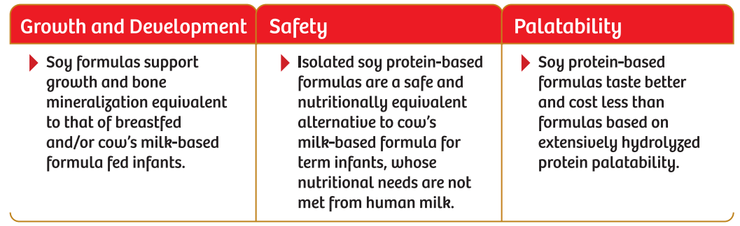
AAP, 2014 states
Pediatric Nutrition Handbook, AAP Committee on Nutrition, 7th edition 2914
Notes:
The American Academy of Paediatrics (AAP) suggest that, Lactose intolerance occurs in some infants as a result of acute gastroenteritis; and lactose free formulas are recommended for post diarrhoeal refeeding in patients who have signs and symptoms of clinically significant lactose intolerance
AAP and USFDA considers soy formulas as safe with no clinically proven adverse effects on infant’s health

Slide 27
Clinical Indications for Isomil
Lactose Intolerance
Diarrhea
Galactosemia
Vegan Diet
IgE mediated CMPA
Pediatric Nutrition Handbook, AAP Committee on Nutrition, 7th Edition; 2014
Notes:
Clinical indications:
Lactose Intolerance
Diarrhea
Galactosemia
Vegan Diet
IgE mediated CMPA

Slide 28
Role of Isomil
Isomil becomes an ideal choice for feeding an infant with diarrhoea or formula intolerance
Isomil provides a complete balanced nutrition for infants
Isomil is lactose free ,soy protein formula
Isomil has shown to support growth and development in infants similar to that of cow’s milk/ breast fed infants
Notes:
Diarrhoea Management- Role of Isomil
Isomil becomes an ideal choice for feeding an infant with diarrhoea or formula intolerance
Isomil provides a complete balanced nutrition for infants
Isomil is lactose free ,soy protein formula
Isomil has shown to support growth and development in infants similar to that of cow’s milk/ breast fed infants

Slide 29
Role of Isomil-Continued
Clinical trials suggest that infants fed Isomil during diarrhea have reduced stool output and duration of illness
Isomil has inherent polymeric nucleotides which provides support for immune function and immune system development
Isomil has better taste as compared to other brands in the category
Notes:
Diarrhoea Management- Role of Isomil
Clinical trials suggest that infants fed Isomil during diarrhea have reduced stool output and duration of illness
Isomil has inherent polymeric nucleotides which provides support for immune function and immune system development
Isomil has better taste as compared to other brands in the category

