Slide 1
OmniSight
Multimodal UI Self-Healing & RPA Agent
Final Review Presentation | Solo Internship Project
Project details
What the project demonstrates
Sheefa J Pathan • B.E. Artificial Intelligence & Data Science
Python 3.12 • FastAPI • Playwright • Chromium
Browser inspection, UI issue detection, user-approved temporary repair, post-repair verification and visual evidence.
The goal is not to change a website silently. OmniSight makes UI issues visible and demonstrates a controlled, reviewable repair.
Final project review • DR. D Y PATIL TECHNICAL CAMPUS

Slide 2
1. Problem and Objective
Why OmniSight is useful, and what this project actually covers
The problem
The objective
A page may load normally but still look broken. Buttons can overflow or become awkward to use on phones; manual checks across screen sizes take time.
Make UI defects easier to find, preserve visual evidence, and test a repair only after the user approves it.
The demonstrated scenario uses a reproducible oversized-button issue on the local ShopHub demo page.
1 • Inspect
2 • Detect
3 • Repair safely
Open the page in Chromium and capture a screenshot.
Use implemented DOM/layout inspection logic to flag the known issue.
Require approval, inject temporary CSS, then verify and compare.
Scope: this is a focused prototype, not a claim of universal automatic repair for every website.
OmniSight | Final Review
2/12

Slide 3
2. Architecture and Tools
How the components connect during one inspection run
Dashboard
FastAPI
Playwright + Chromium
Evidence + response
User enters URL
and selects an action
→
Routes requests
and validates inputs
→
Opens page, inspects layout
and captures screenshots
→
Returns issue details,
verification and evidence
Technology stack
Python 3.12 + FastAPI
Playwright + Chromium
HTML / CSS / JavaScript
Backend logic, API routes and request validation.
Real browser automation, page inspection and screenshots.
Dashboard and local ShopHub demo interface.
In simple words: the dashboard requests an action, FastAPI coordinates it, and Playwright performs the browser work.
OmniSight | Final Review
3/12

Slide 4
3. Complete Working Flow
Follow the steps from the target URL to the final comparison
1. Enter URL
2. Inspect
3. Detect
Local ShopHub demo page
Browser opens; initial screenshot
Return issue type and details
4. Approve?
5. Repair
6. Verify & compare
If no, stop; if yes, continue
Inject temporary CSS in session
Capture updated evidence
If approval is false
The repair endpoint rejects the request; no repair is applied.
If approval is true
The temporary CSS fix is applied in the active browser session and the page is checked again.
Important: session-level repair does not permanently edit the original website files.
OmniSight | Final Review
4/12

Slide 5
4. Live Demo: What to Click and What You Should See
A short walkthrough that makes the implementation easy to follow
1. Start backend
2. Open dashboard
Run Uvicorn; confirm /health responds.
Open /dashboard.
3. Inspect target
4. Detect issue
Use the local ShopHub URL and show the first screenshot.
Show the oversized-button result returned by the API.
5. Approve and repair
6. Verify and compare
Run /repair-ui with approved=true.
Show the post-repair result and before/after evidence.
API documentation
Demo store
http://127.0.0.1:8000/docs
http://127.0.0.1:8000/frontend/store.html
OmniSight | Final Review
5/12

Slide 6
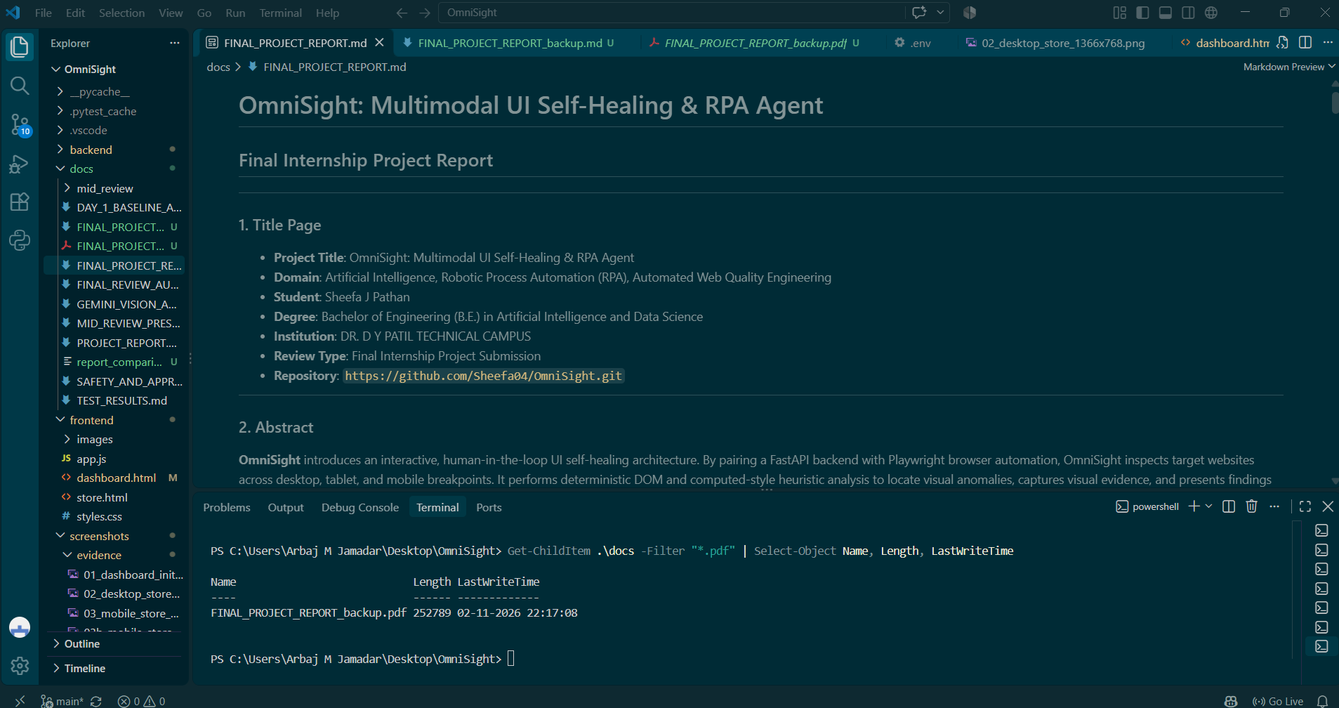
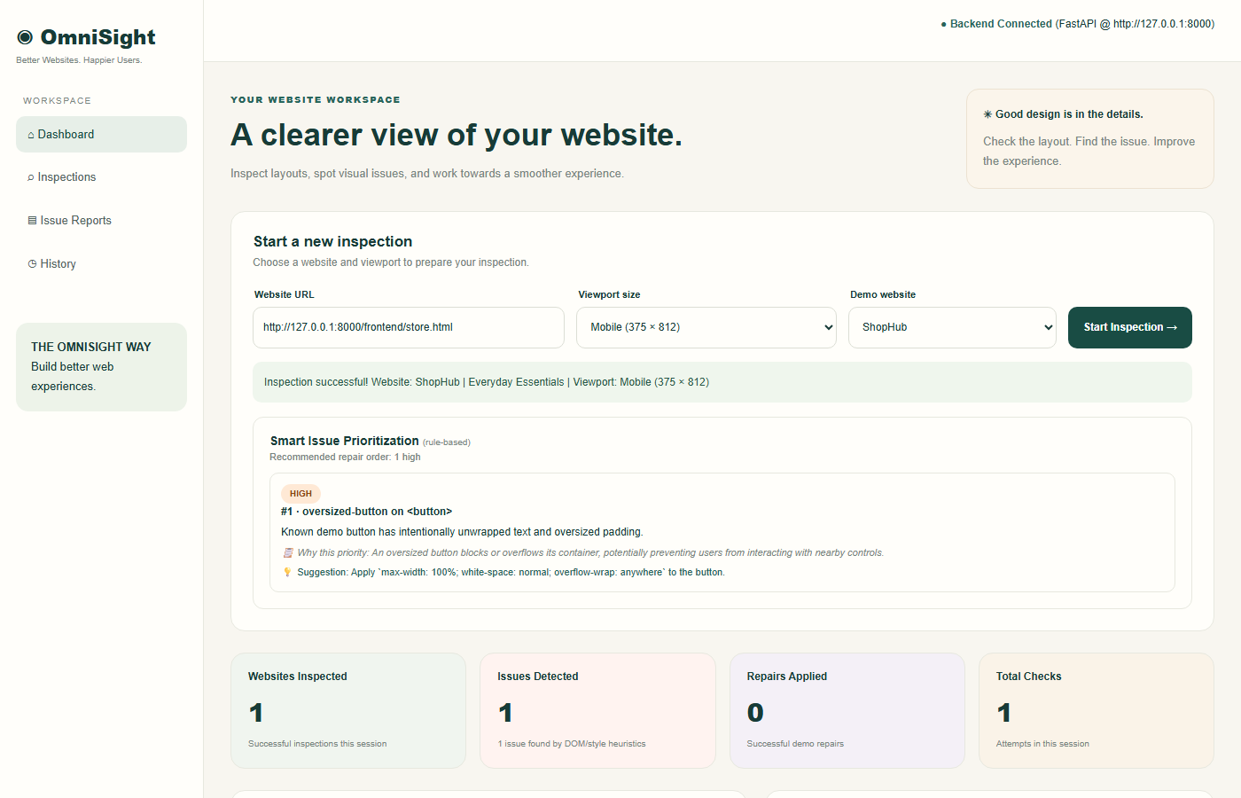
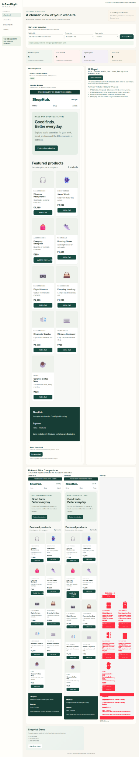
5. Evidence and Testing
Real project screenshots and the latest recorded test output
A. Dashboard
B. Issue / inspection
C. After repair
Test result
Coverage examples
Evidence set
74 passed | 0 failed | 6 warnings
65.50 seconds | 10 Nov 2026
API health • approval=false • invalid URL • responsive workflow
Desktop • tablet • mobile • issue detection • repair comparison
Latest complete test run: 74 passed, 0 failed, 6 warnings in 65.50 seconds (10 November 2026).
OmniSight | Final Review
6/12

Slide 7
6. UI Issue Detection
A known responsive layout defect is used to demonstrate inspection
Browser inspection
Issue identification
Visual evidence
Playwright opens the local ShopHub page at the selected viewport and captures a screenshot.
Implemented DOM/layout checks flag the known oversized-button issue and return details.
The screenshot makes the state reviewable before any repair is approved.
Project viewports
Desktop • 1366 × 768
Tablet • 768 × 1024
Mobile • 375 × 812
Mobile • 390 × 844
OmniSight | Final Review
7/12

Slide 8
7. Human-Approved Self-Healing
A repair is applied only after an explicit approval decision
Approval gate
Temporary CSS
Safety behavior
The repair request must explicitly carry approved=true. A rejected request does not proceed.
The repair is injected into the active browser session rather than permanently editing target-site source files.
The approval check is part of the API workflow and is covered by the project's safety tests.
Design principle: automation should be observable, reviewable and controlled by the user.
OmniSight | Final Review
8/12

Slide 9
8. Post-Repair Verification
The system checks the page again after the repair attempt
Re-check
Compare evidence
Show outcome
Run the post-repair verification flow to inspect the page again.
Capture updated screenshots and compare the before/after visual state.
Present the verification result in the dashboard for review.
A repair attempt is not automatically a success: the verification result must support that conclusion.
OmniSight | Final Review
9/12

Slide 10
9. Gemini Vision Integration Status
Screenshot-audit endpoint is integrated; successful live response is not yet confirmed
Implemented in the project
Observed validation result
• Gemini client initialization is configured.
• POST /vision-audit endpoint is registered.
• Endpoint accepts a screenshot filename and sends the image for analysis.
• Swagger request reached the backend.
• Google Gemini API returned 503 UNAVAILABLE (temporary high demand).
• Backend surfaced HTTP 502 to Swagger.
Presentation wording
“Gemini Vision screenshot-auditing integration is implemented. Live validation encountered a temporary model availability error.”
This is reported transparently; no successful Vision Audit output is claimed.
OmniSight | Final Review
10/12

Slide 11
10. Limitations and Future Work
What is implemented today, and what can be extended next
Current limitations
Future enhancements
• Demonstration centers on a known ShopHub layout issue.
• Detection uses implemented inspection / heuristic logic.
• Repair is temporary and session-scoped.
• Gemini endpoint is integrated, but live call returned Google API 503 UNAVAILABLE during validation.
• Retry the Vision audit when model availability is restored.
• Broaden defect coverage and viewport scenarios.
• Add richer repair patch review / export.
• Extend structured audit reporting and evaluation.
The final review distinguishes completed functionality from work that remains future scope.
OmniSight | Final Review
11/12

Slide 12
Conclusion
OmniSight demonstrates a controlled browser workflow:
1.
Inspect a web page and capture evidence
2.
Identify a known UI layout issue
3.
Request human approval before repair
4.
Apply a temporary, session-scoped CSS fix
5.
Verify the page again and review the comparison
Thank you • Sheefa J Pathan • B.E. Artificial Intelligence & Data Science

