Slide 1
OmniSight
Multimodal UI Self-Healing & RPA Agent
Mid-Review Presentation | Solo Internship Project
Project details
Sheefa J Pathan • B.E. Artificial Intelligence & Data Science
Python 3.12 • FastAPI • Playwright • Chromium
What the prototype does
It opens a web page, checks for a known layout issue, asks for approval, applies a temporary CSS fix, and captures the result.
The goal is not to change a website silently. The goal is to make a UI issue visible and demonstrate a controlled repair.
Project review deck • prepared in a simple technical format

Slide 2
1. Problem and Objective
Why OmniSight is useful, and what this prototype actually covers
The problem
A page may load normally but still look broken. A button can overflow or become awkward to use on a phone. Checking every screen manually takes time.
The objective
Make the defect easier to find, show evidence, and test a repair only after the user approves it.
The current prototype focuses on one reproducible example: an oversized button on the local ShopHub demo page.
1 • Inspect
Open the page in Chromium and capture a screenshot.
2 • Detect
Use DOM/layout rules to flag the known issue.
3 • Repair safely
Require approval, inject temporary CSS, and capture updated evidence.
Scope note: the current detector is heuristic-based. A trained vision-language model is a possible future enhancement, not a feature claimed as implemented.
OmniSight | Mid-Review
2/7

Slide 3
2. Architecture and Tools
How the pieces connect during one inspection run
Dashboard
User enters URL and chooses an action.
FastAPI
Routes requests and validates inputs.
Playwright + Chromium
Opens page, inspects DOM, takes screenshots.
Evidence + response
Returns issue details and screenshot location.
Technology stack
Python 3.12 + FastAPI
Backend logic and REST endpoints.
Playwright + Chromium
Real browser automation and screenshot capture.
HTML / CSS / JavaScript
Dashboard and demo store interface.
In simple words: the dashboard asks for an action, FastAPI coordinates it, and Playwright performs the browser work.
OmniSight | Mid-Review
3/7

Slide 4
3. Complete Working Flow
Follow the arrows from the target URL to the final comparison
1. Enter URL
Local ShopHub demo page
2. Inspect
Browser opens; initial screenshot
3. Detect
Return issue type + details
4. Approve?
If no, stop; if yes, continue
5. Repair
Inject CSS in current session
6. Compare
Capture updated screenshot
If approval is false
The repair endpoint rejects the request. No repair should be applied.
If approval is true
The temporary CSS fix is applied and a new screenshot can be reviewed.
Important: this is a session-level repair. It does not permanently edit the original website files.
OmniSight | Mid-Review
4/7

Slide 5
4. Live Demo: What to Click and What You Should See
A short walkthrough that makes the implementation easy to follow
1. Start backend
Run Uvicorn; check /health responds.
2. Open dashboard
Load /frontend/dashboard.html.
3. Inspect target
Use the local ShopHub URL; show the first screenshot.
4. Detect issue
Show the oversized-button result returned by the API.
5. Approve and repair
Run /repair-ui with approved=true.
6. Compare evidence
Show the updated screenshot and explain the temporary fix.
API documentation
http://127.0.0.1:8000/docs
Demo store
http://127.0.0.1:8000/frontend/store.html
OmniSight | Mid-Review
5/7

Slide 6
5. Evidence and Testing
Use your real screenshots and the latest test output
A. Before
B. Issue found
C. After
Dashboard / initial page
[Insert actual screenshot]
oversized-button result
[Insert actual screenshot]
Page after approved repair
[Insert actual screenshot]
Testing
Reported result
You previously reported 5 tests passing after the backend was started.
Before submission
Run pytest again and use the exact count from the terminal. Do not claim unverified results.
Command: .\backend\.venv312\Scripts\python.exe -m pytest -v
OmniSight | Mid-Review
6/7

Slide 7
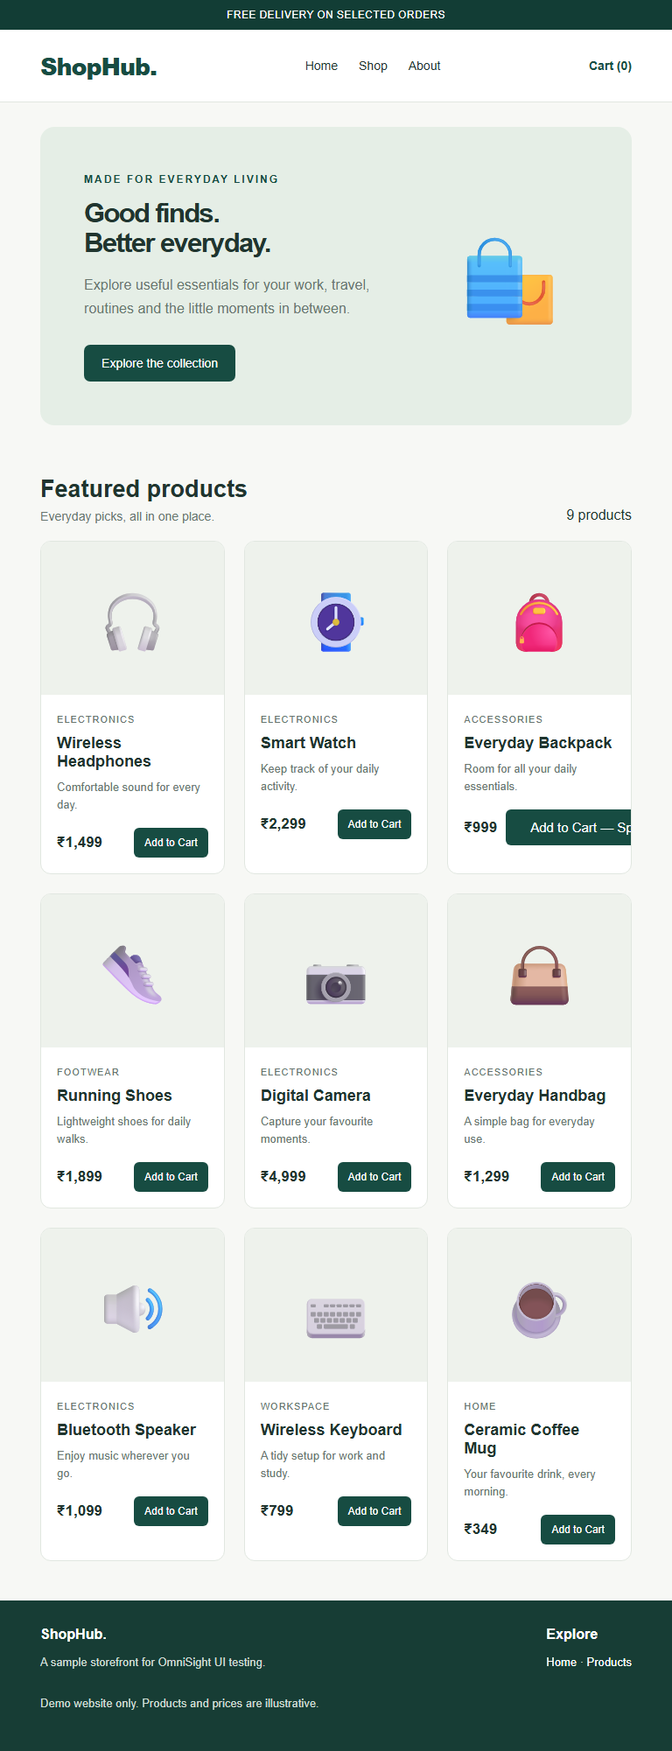
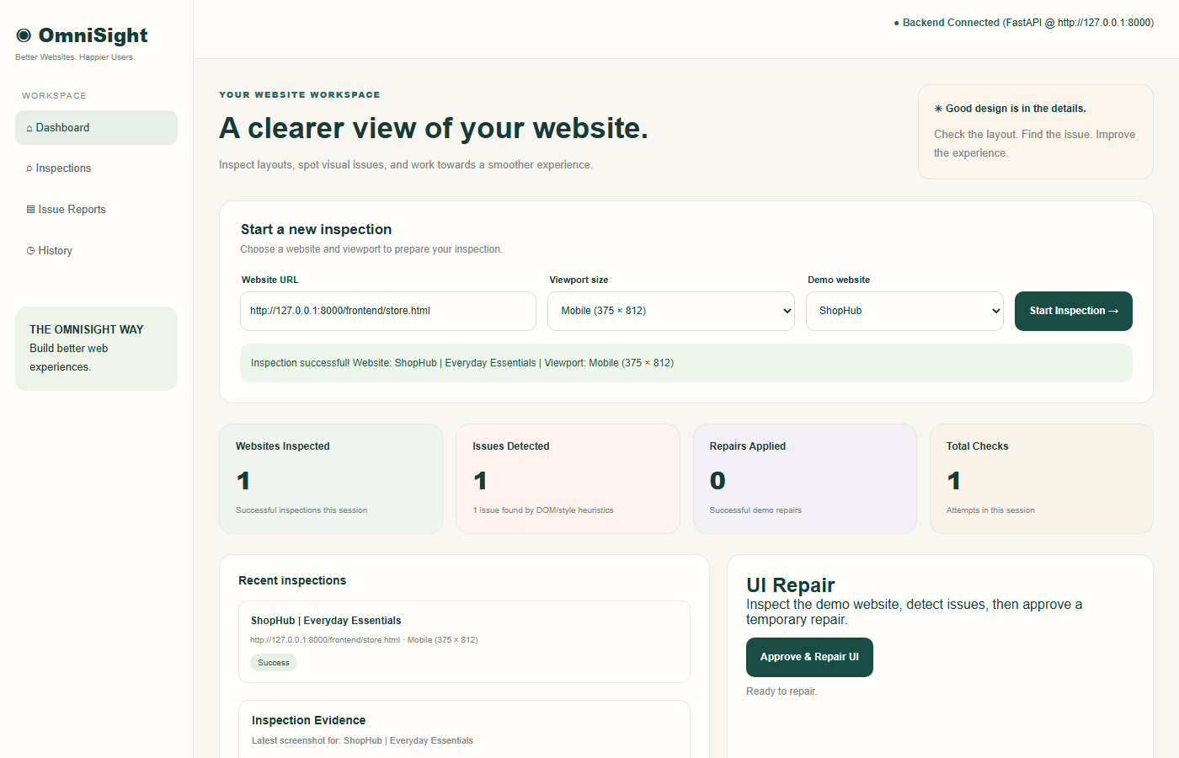
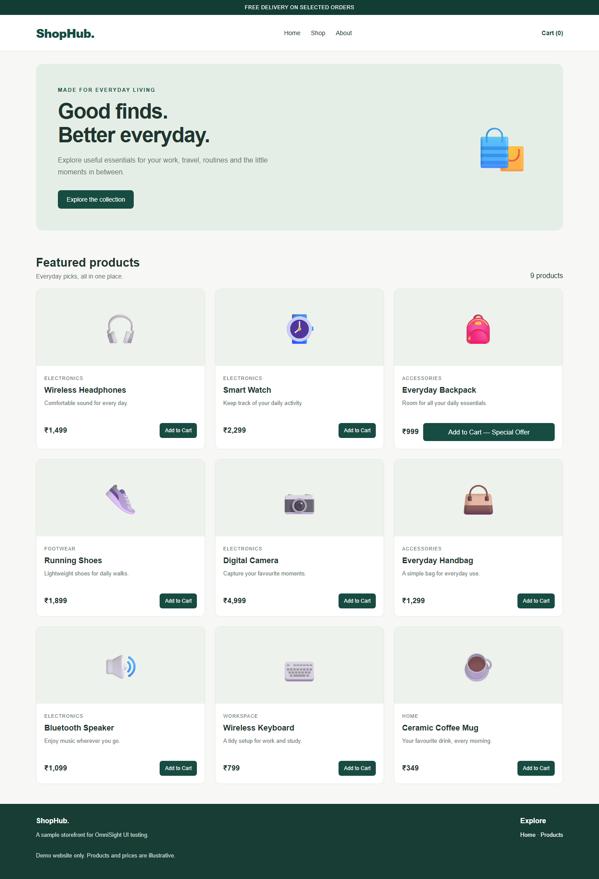
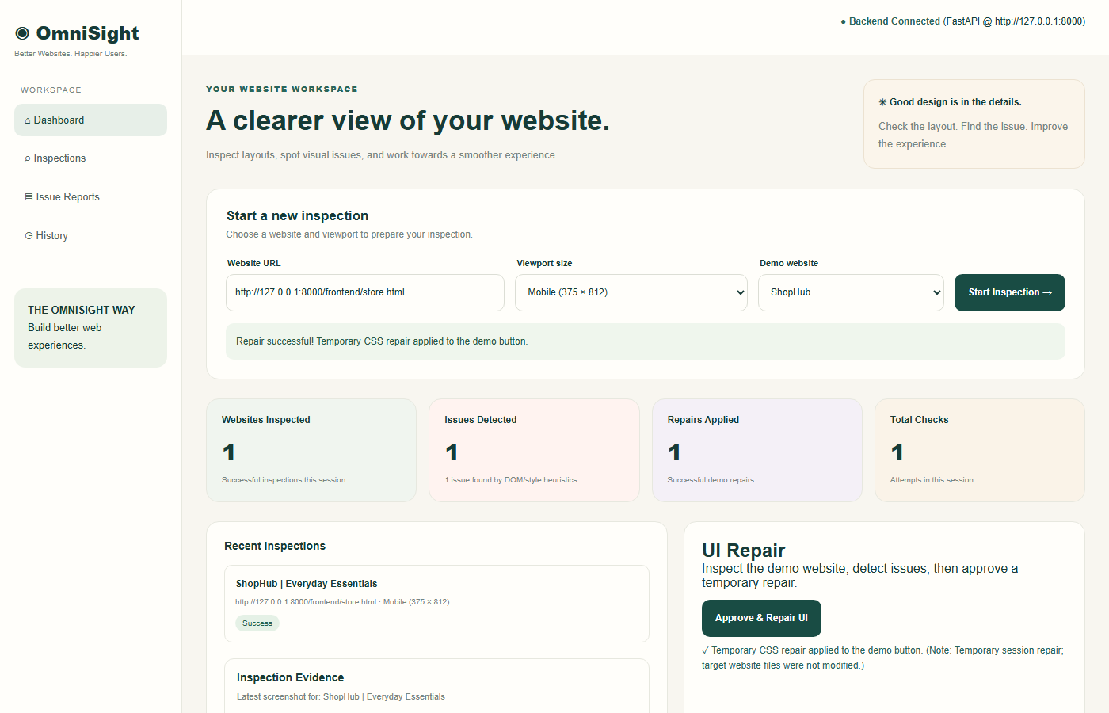

Slide 8
6. Limitations, Future Work and Conclusion
What is implemented today, and what can be added next
Current limitations
• Heuristic detection, not a trained vision model
• Repair is temporary in the active browser session
• Current demo focuses on a known oversized-button defect
Future work
• Optional vision-language-model analysis
• Verify the page again after repair
• Show proposed CSS diff before approval
• Export a structured audit report
Conclusion
OmniSight demonstrates a controlled browser workflow: inspect the page, identify a known UI issue, request approval, apply a temporary fix, and review the result with evidence.
Thank you • Sheefa J Pathan • B.E. Artificial Intelligence & Data Science
OmniSight | Mid-Review
7/7

