Slide 1

Team Squadron
Vijeta D Joshi [20MSM0072]
Sheekha Tripathy [20MSM0102]
Advait Vanikar [19ME0601]
Rajendran P [20BBT0198]
Breathe | In | Opportunity

Slide 2
Problem Statement
In this hectic pandemic period buying vegetables and groceries for households are the real crux of the matter so what will you propose to preserve the vegetables and groceries and ready to eat products bought and stored for a long time.
Breathe | In | Opportunity

Slide 3
Idea/Solution Description
Developing a machine which co-ordinates with refrigerator where the packed and raw food materials could be placed. It works based on sterilisation, rinsing within the machine, from where food is directly stored inside refrigerator without human spread contaminants, minimizing maximum microbes.
Breathe | In | Opportunity

Slide 4
USP
Fully automated functioning
Minimized human spread microbial contamination
First of it’s kind to be designed
Works on combination of refrigerator and steriliser equipment
Prolongs shelf life of the food products by about 3 times the original
Kills the food borne vectors and prevents food borne pathogenic diseases
Specially designed for the situations like present pandemic
For services we can use applications
Breathe | In | Opportunity

Slide 5
Market Research
Refrigerators of various principles regarding food and freshness protection have been produced. Sterilisation of vegetables, fruits, and food products has various liquid cleansers for operation. But, with the combination of these i.e. sterilisation facility equipped refrigerators have not been designed and reported. As people are looking forward for hygiene and health as a first priority, this will create a greater demand for prevention and storage of foods from any harmful microbes and spoilage as well. Everything can be operated using application.
Breathe | In | Opportunity

Slide 6
Technological Stack
The technological stack used here is completely designation of hardware based using machinery learning and 3D modelling.
It will have AI technologies in-bluid in them.
Breathe | In | Opportunity

Slide 7
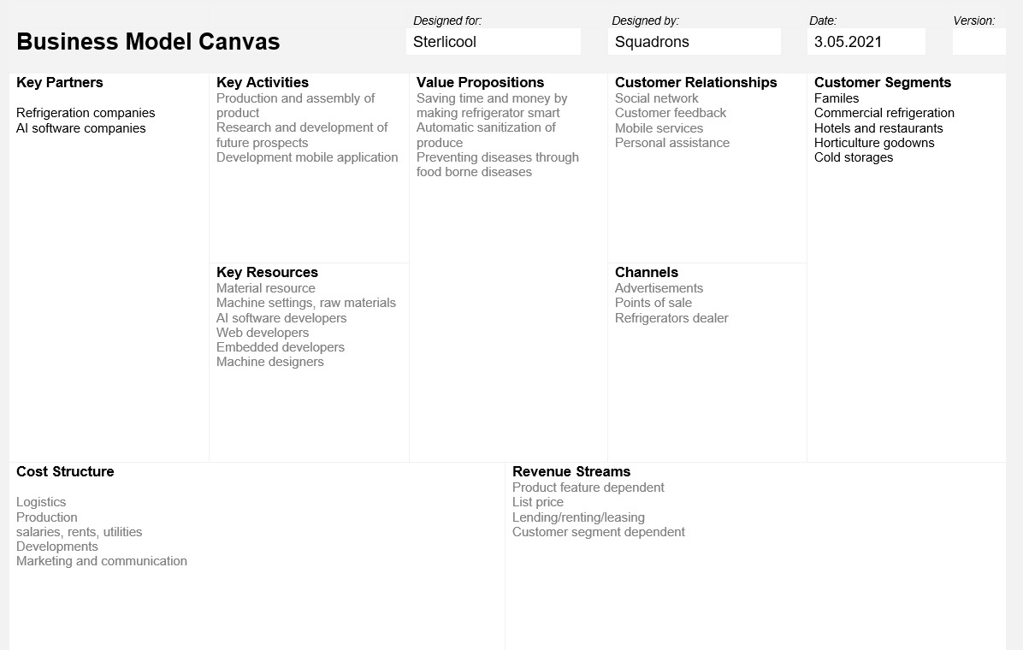
BMC
Breathe | In | Opportunity

Slide 8
Future Prospects
Not only in this pandemic situation but also in post pandemic situations this device will be helpful as pathogenic microbes are around everywhere and it can be used for industrial purpose in food based industries to store.
This device can be used for storing food items in a very large scale by enlarging it’s size.
It can work efficiently to cope up with food shortage during natural calamities.
Breathe | In | Opportunity

