Slide 1

ENTERPRISE TRACK A · PROJECT UDYAM DIGITAL
Udyam Digital
A small business goes live in one sitting: on a phone, in Hindi or English, with no salesperson in the loop.
Team IIITD
Sheel Gautam · Vikas Meena · IIIT Delhi · November 2026
LIVE PROTOTYPE udyam-digital-isyfatadrab4adtbqddzwp.streamlit.app
PROTOTYPE VIDEO Watch the 3-minute demo on Google Drive
CODE ON GITHUB github.com/Sheel23501/udyam-digital

Slide 2

₹35.6 lakh of ₹55.4 lakh went to leads that never activated
4,632 of 5,000 leads dropped last quarter. Half of those drops were the sales process itself, not the offer.
48%
₹53,026
Why 4,632 leads dropped (top 9 reasons)
Unreachable after 3 attempts
805
of drops: unreachable, no time for a visit, visit not scheduled, quote too slow or too complex
field-sales cost per activation on micro retail, for a ₹2,619/month customer
Owner had no time for a visit
531
Not interested on first call
470
17 days
719 → 9
Price too high
414
Locked in with current provider
325
median lead-to-activation; the quote alone takes 4 days
owners asked for 5G AirFiber 719 times; sales sold it 9 times
Wrong or invalid number
319
22
6% → 28%
Visit not scheduled by sales
296
Only wanted a mobile plan
280
customers activated last quarter with a cancelled or suspended GSTIN
6-month churn as the status calls a customer had to make rose from 1 to 5+
Competitor offered cheaper plan
207
Sales process (2,247)
Offer / price / fit (1,844)
Paperwork / data (541)
Source: smb_leads.csv, 5,000 leads (2026-04-01 to 2026-06-30); every figure reproduced by backend/scripts/make_charts.py.

Slide 3
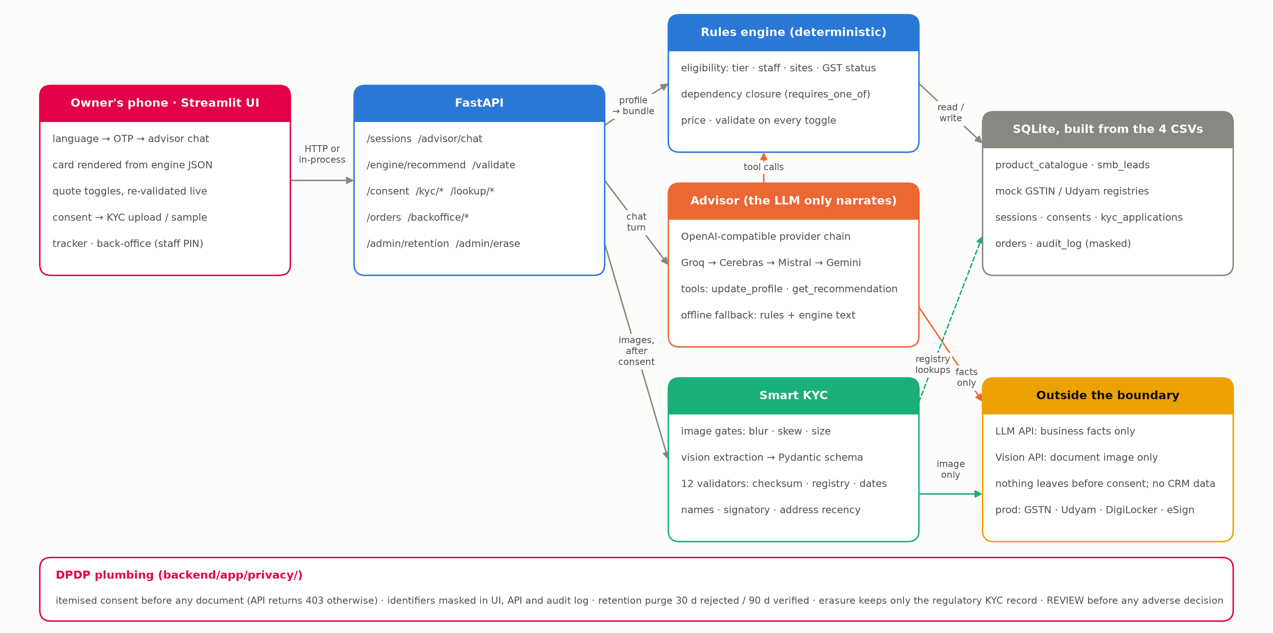
Our approach: rules decide, the LLM narrates
1
Enter
link, QR or WhatsApp; mobile + one-time code
2
Advisor
4 to 6 questions in Hindi or English
3
Quote
one monthly number, re-checked on every toggle
4
Consent
itemised DPDP notice before any document
5
Smart KYC
four photos, 12 checks in seconds
6
Tracker
dated stages, zero status calls
Consent gates every document; the engine still quotes if the model is down. Full-resolution diagram: docs/architecture.png (submitted separately).

Slide 4
Smart KYC: 12 checks in seconds, built around the DPDP Act
Vision extraction of four documents, then deterministic validators against the GST and Udyam registries. A photo problem is a REVIEW, never a rejection.
The 12 sample applicants as the prototype grades them: 12/12 match the key
22 → 0
FAIL
K01
REVIEW
K02
PASS
K03
GSTIN cancelled; Udyam number missing
GST certificate photo rotated
all documents consistent
activations with a cancelled or suspended GSTIN: the registry is checked live, before the order
REVIEW
K04
FAIL
K05
FAIL
K06
DPDP controls, each a code path, not a slide
GST certificate photo blurred
Udyam certificate missing
GSTIN check digit fails: tampered digit
Consent gate: documents are refused (HTTP 403) until the owner ticks four itemised purposes in their language
Minimisation: five facts for the quote; GST or Udyam path; no Aadhaar; only the image leaves the boundary
Masking: GSTIN as 27XXXXXXXXXX1ZP, names as 'Nisha A.' in UI, API and audit log
Retention: images deleted 30 days after a rejection, 90 after verification; erasure on request
Accuracy: REVIEW before any adverse decision; 'talk to a human' always available
FAIL
K07
PASS
K08
PASS
K09
legal name differs across documents
all documents consistent
all documents consistent
FAIL
K10
FAIL
K11
PASS
K12
signatory is not the person of record
electricity bill 257 days old (limit 90)
all documents consistent
Reproduce: cd backend && python scripts/kyc_report.py --key tests/kyc_answer_key_images.json. Privacy note: docs/privacy-note.md (submitted separately).

Slide 5
Competitive analysis: where Udyam Digital differs
Public sources only, reviewed November 2026. "Not public" means we found no published detail, not that the feature is absent.
 | Airtel today | Jio Business | Vi Business | Tata Tele (TTBS) | Udyam Digital
How an owner starts | Field visit or call-back. 48.5% of drops are the sales process | Plan page, then business details and KYC documents online (third-party summary) | Online form, then a rep calls back within 48 h (corporate postpaid) | Sales-led. No public self-serve flow found | Self-serve on the owner's phone, in Hindi or English
Price | Quote after a visit. The quote alone takes 4 days | Tiered plans, reported from ₹501 at the 2021 launch | Postpaid from ₹299 a line | Pay-as-you-grow. Prices not public | One monthly number in the chat, re-checked on every toggle
What is bundled | 25 products, sold one by one | Connectivity plus apps: Jio Online, Teams and Meet licences (2021) | Mobile plans, data pooling for small firms | Connectivity, cloud calling and security suites | A rules-checked bundle per segment with dependencies closed
KYC | Paper at the visit. 22 activations had a non-active GSTIN | GSTIN or PAN documents (third-party summary) | Assisted KYC at the doorstep. A DoT notice reported on business lines without end-user KYC | Not public | 12 checks in seconds against GST and Udyam, after consent
Language and tracking | Status by phone: 3.0 calls per customer | Not public | Not public | Not public | Hindi and English. Dated tracker, zero status calls
None of the public material we reviewed shows one phone journey from quote to registry-checked KYC to a validated bundle.
Sources: businesstoday.in (Jio, Mar 2021), myvi.in corporate postpaid pages, bharatnet.in (DoT notice), tatatelebusiness.com and tele.net.in. Airtel and Udyam Digital columns: smb_leads.csv and the prototype.

Slide 6
Impact: 12% activation at half the cost per customer
Two-quarter targets on the same lead volume and acquisition spend, measured weekly from tables the prototype already writes.
Lead to activation
Cost per activation
Who we win first, and what they buy
7.4% → 12%
₹15,053 → ≤₹7,500
Segment | Bundle, from ₹/month | Payback
Small multi-site | Multi-Store ₹21,579 | 0.5 mo
Small manufacturers | Factory Connect ₹14,377 | 0.8 mo
Professional offices | Clinic / Office Pro ₹5,487 | 1.6 mo
Micro retail & services | Dukaan Start ₹1,198 | 8.0 → 1.2 mo
Lead to live
Status calls per customer
17 days → ≤5 days
3.0 → under 0.5
Micro retail goes digital-only: at a ₹3,000 cost per activation its payback falls from 8.0 to about 1.2 months.
6-month churn
Non-active GSTIN activations
What it is worth. The same ₹55.4 lakh at 12% activation brings 600 customers a quarter instead of 368, 232 more. At today's segment mix and ₹12,351 average monthly value, that is about ₹28.7 lakh more monthly recurring revenue, before churn.
15.2% → ≤10%
22 → 0
Projection from the Apr to Jun 2026 leads file; it assumes the extra customers match today's segment mix. Targets are ours, not Airtel commitments.

Slide 7
Rollout, risks and proof
Start where the data says the money is, and say plainly what could go wrong.
Delhi and Mumbai, Hindi and English. Micro retail and professional offices. Live GSTN and Udyam APIs. Partner-code pilot.
Risk | What we built against it
The model suggests something the owner cannot have | The rules engine decides every item. 30 scenarios and 16 live chats, zero violations
KYC wrongly rejects a genuine owner | Photo problems become REVIEW with a plain fix. Every FAIL has a reason and a human hand-off
Telecom end-user KYC still applies to SIMs | Registry checks are added to the DoT-required step, not a replacement. A reported DoT notice to Vi shows the exposure
Model or API down mid-journey | Provider chain, cached replies, offline engine. The journey completes with no model
Channel conflict with partners and field sales | Partner code on every journey. High-value leads routed to humans
DPDP exposure | Consent gate, masking, retention purge, erasure, audit log
Q3 2026
Prove it
Gate: 12% activation, quote in under 5 minutes
Q4 2026
Tier-2 cities. Multi-site journeys. DigiLocker and eSign. Field team routed by the propensity queue.
Widen
Gate: cost per activation ≤ ₹7,500, KYC first pass ≥ 70%
Q1 2027
Manufacturers with field assist for leased line and SD-WAN. Serviceability at quote time. Regional languages.
Deepen
Gate: 6-month churn ≤ 10%, status calls under 0.5
2,050
automated tests green in CI
30 / 30
advisor scenarios pass
12 / 12
KYC verdicts match the key
16 / 16
live chats, zero violations
Live prototype and code are linked on the title slide. Step-by-step checks: docs/how-to-check.md. Privacy note and architecture diagram are submitted separately.

