Slide 1
GIT
~Ganesh Jadhav

Slide 2
What is a Version Control System
In software engineering, version control systems are a category of software tools that help a software team (multiple developers, designers, and team members) to work together on the same project and allow them to manage changes to computer programs, documents, websites, and other information over time.
Version Control is useful if you are a software engineer or if you are into software development & software Automation.
Let’s say that we are working on a source code. in this case, we add/edit/delete lines of code.
Every time we make a change and save the file, we lose the previous changes.
Tracking revisions over time becomes more complex when we are working on a large project with multiple files and multiple developers.

Slide 3
Version control helps in collaboration among the developers/users to help them work independently on their modules as well as be updated with the changes happening on the other modules of the projects.
It’s safe to have a version control while developing a software.
It’s always risky to develop without having a version control system as not having backups.

Slide 4
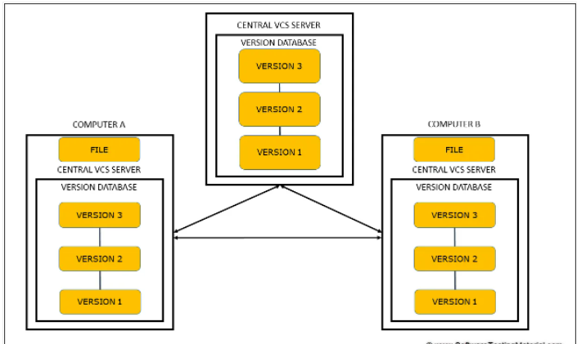
Distributed version control systems
In this system, multiple people working on their own computers on a single project communicate with the central database as well as they can also communicate with each other.
Using this model, all the changes done by everyone can be stored and no data will be lost.

Slide 5
What is Git?
Git was created by Linus Torvalds in 2005 for the development of the Linux Kernel, with other kernel developers contributing to its initial development.
Git is a command-line tool whereas GitHub comes with a web-based graphical interface.
Git is one of the most popular & distributed version control systems.
It is an open-source project which is compatible with many operating systems and IDEs.
It allows us to track changes in an application, or in a folder, or in a single file over time across different users, and different computers.
Git takes a snapshot of all files whenever we create a new commit.

Slide 6
What is GitHub and why use GitHub?
GitHub is a cloud-based Git repository hosting service.
It lets individuals and teams work together on projects.
GitHub is an application allowing you to store remote repositories on their servers.
It is a public platform that allows millions of users to share their projects with the world.
The main purpose is to allow people to collaborate to build projects. But it’s not just limited to collaboration.
One of the most useful features of GitHub is being able to access your repository from any location. Also, it’s an industry standard for hosting Git repositories.

Slide 7
What is a Repository in GitHub?
Repositories, usually called ‘repos’, store the full history and source control of a project.
They can either be hosted locally or on a shared server such as GitHub.
Most repositories are stored on GitHub, while core contributors make copies of the repository on their machine and update the repository using the push/pull system.
Any repository stored somewhere other than locally is called a ‘remote repository’.

Slide 8
Git commands
ssh-keygen -t rsa -b 4096 -C "your_email@example.com"
1. git –help: When this command is hit in our terminal, Git will give a list of its most common commands.
2. git config: With this command, we must first set username and email address.
git config --global user.name "Ganesh Jadhav"
git config --global user.email “ganesh20215@gmail.com"
3. git init : use the git init command to convert the directory into an empty Git repository.
4. Git clone
5. git status

Slide 9
6. Git diff
7. Git Commit :
The git commit command saves the state of your project by adding snapshots of staged files to the repository.
This command includes the -m flag with a message describing what we have changed.
The command is: git commit -m “message”
8. git push : git push origin main
9. git pull : git pull origin main

Slide 10
10. Branches
Branching allows you to make a copy of your working project and change it without affecting the main branch (master branch), giving an opportunity to work on the same project with different commits.
We create a new branch whenever we want to work on a new feature or fix a bug. After the work is done on that branch, it is then merged with the master branch.
git checkout -b new_branch
11. Stash
The git stash command temporarily caches any changes you have made to your working copy so you can switch to something else, and then come back and recover them later.
12. git stash pop
pop will remove stashed changes from the stashed state.

