Slide 1
EMPLOYEE DATA ANALYSIS USING EXCEL
☆STUNDENT NAME : SHEELA.M
☆ REGISTER NO : 312214280
☆DEPARTMENT : B.COM COMMERCE A/F
☆COLLEGE : ST.THOMAS COLLEGE ARTS AND SCIENCE

Slide 2

PROJECT TITTLE
EMPLOYEE SALARY ANALYSIS USING EXCEL

Slide 3
AGEnda
☆End user
☆Our solution and propoition
☆Dataset description
☆Modelling approaches
☆Result and discussion
☆Conclusions
☆Problem statement
☆Project overview

Slide 4
ProBlem STATEMENT
A salary refers to Legal document, which, works as proof of compensation you receive from your employer.

Slide 5
PROJECT OVERVIEW
☆It consists of the basic salary, bonus and other allowances. Net salary: This is also known as the take-home salary and is what an employee receives every month. The amount includes basic salary, allowances and does not include the deductions for the employee provident fund and various taxes.
☆A payment from an employer to an employee, which may be specified in an employment contract.

Slide 6
Who ARE THE END USERS ?
°End user is the one who performs transactions in SAP after it Goes out
▪︎There are:
▪︎Companies and company

Slide 7
OUR SOLUTION AND Its VALUE PROPOITION
♡Basic salary is a rate of pay agreed upon by an employer and employee and does not include overtime or any extra compensation.
♡Take-home Salary = Gross Salary – Income Tax – Employee’s PF contribution (PF) – Professional Ta

Slide 8
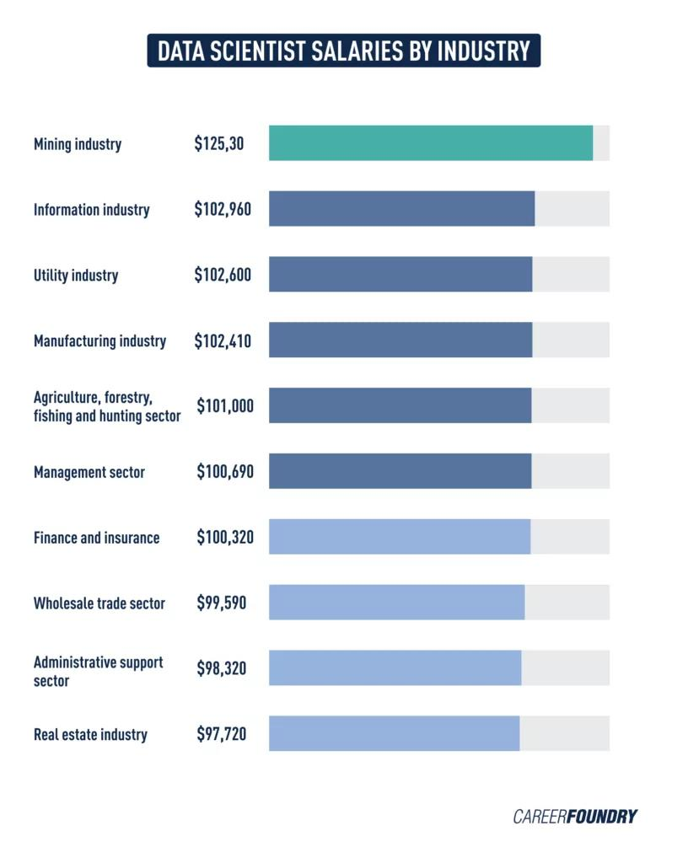
DATASET DESCRIPTION
●Salary data is a type of business-to-business (B2B) data that can include information about earnings, demographics, and contracts
Types of data base:
ordinal, discrete, and continuous

Slide 9
MODELLING
Average Salary of a Model in India ●Job Position Average Salary Package (Per Project) ●Fashion Models INR 60,000 to 1 lakhs per project ●Runway Models INR 50,000 to 75,000 per project ●Swimsuit Models INR 1 lakhs to 2 lakhs per project ●Commercials Models INR 40,000 to 80,000 per project

Slide 10
Employee salaries in India
♡The estimated total pay for a Employee is ₹20,833 per month, with an average salary of ₹20,000 per month. These numbers represent the median, which is the midpoint of the ranges from our proprietary Total Pay Estimate model and based on salaries collected from our users.

Slide 11
Calculation of salary format
☆The formula for calculating basic salary from gross salary would be: Basic Salary = Gross Salary – (All the allowances + benefits + bonuses, etc.)

Slide 12
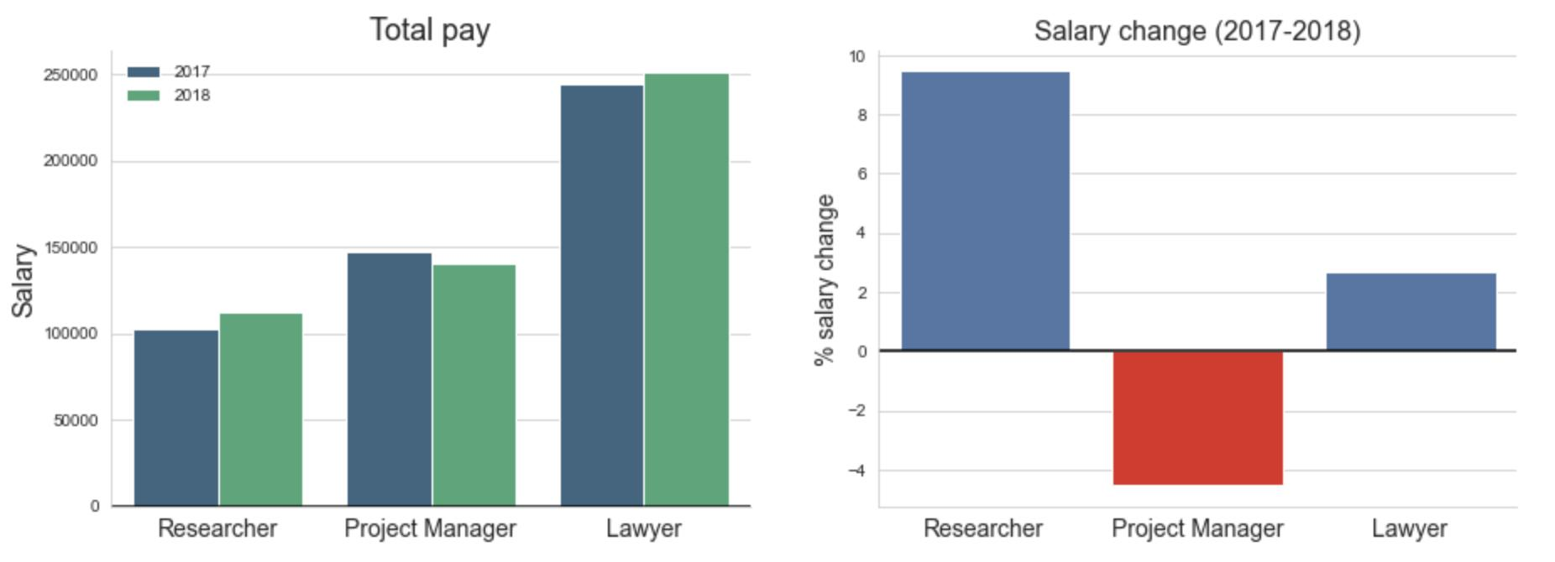
RESULT AND DESCussion

Slide 13
Conclusion
♡Salary is somewhat important for people to support their expenses but if they do not feel attached to their work, they will feel exhausted in their life

