Slide 1
Sakhi Bazaar
AI-Enabled Marketplace for Women Entrepreneurs
PROJECT REVIEW & STRATEGY PRESENTATION
Unique Features, Architecture, Security, Media Optimization & Pros

Slide 2

Project Overview & Mission
Lowering Digital Barriers
• Target Audience: Designed specifically to lower tech barriers for women-led micro-enterprises and independent female artisans.
• Zero-Code Onboarding: Simple store setups allow merchants to list inventory with simple parameters, bypassing complex web forms.
• Equitable Growth Platform: Combines creative AI assistance with practical, data-backed financial tools to grow local micro-stores.
• Unified Security & Trust: Features robust admin control panels to prevent listing fraud and verify merchant business credentials.

Slide 3
Unique Platform Value Propositions
Seller Challenges Solved
• Lack of Professional Copy: Sellers struggle to write compelling, structured product descriptions and WhatsApp tags.
• Competitive Pricing Blindspots: Artisans struggle to gauge localized bazaar rates, risking severe underpricing.
• Credential & Customer Trust: Micro-brands need immediate buyers' trust without expensive custom domain investments.
Unique Solution Features
• AI Generative Co-writer: Gemini drafts storytelling write-ups and hashtag-rich captions instantly with a single click.
• Dynamic Price Intelligence: Renders real-time category stats (Min, Max, Avg) directly inside the item listing panel.
• Vetted Storefront Badges: Features admin verification controls to review seller papers and display verified trust badges.

Slide 4
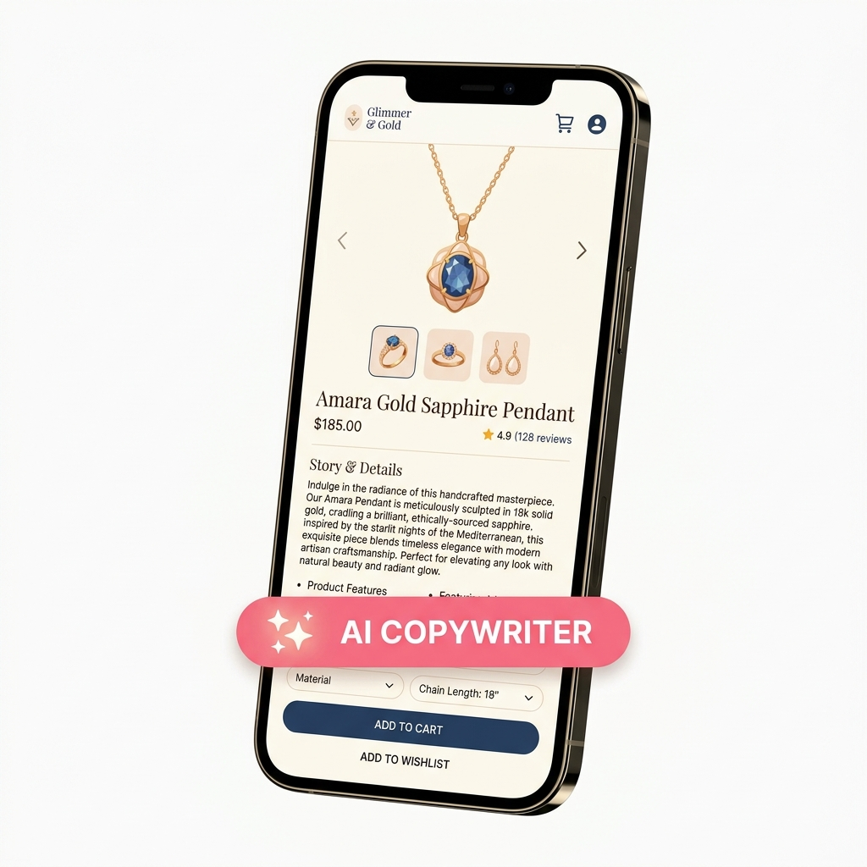
Empowerment: AI Writing & Price Guidance
AI-Driven Copy & Marketplace Analytics
• Dual-Mode Gemini Integration: Auto-writes a storytelling listing based on basic keywords, and generates emoji-rich social promos.
• Category Price Benchmarks: Fetches platform wide pricing data dynamically to calculate statistical medians on the fly.
• Price Comparison Widget: Enables buyers to view price spreads for similar listings, supporting transparent customer decisions.
• One-Click Clipboard Sync: Navigator Clipboard integration allows copy-to-clipboard for quick sharing to WhatsApp/Instagram.

Slide 5
Infrastructure: Security & Media Delivery
Security & Identity Trust
• Hybrid Authentication: Google Firebase SSO handles federated social logins, combined with custom email login endpoints.
• HTTPOnly Cookie Security: Session JSON Web Tokens (JWT) are saved in HTTPOnly secure cookies, blocking local script XSS attacks.
• Signature Verified Checkouts: Stripe/Razorpay webhooks verify payment tokens server-side before updating orders to 'Paid'.
CDN & Media Performance
• Auto-Optimized CDN Pipeline: Cloudinary middleware intercepts raw photo uploads, compressing and formatting them to modern WebP format.
• Mobile-First Delivery: Optimized media files ensure fast storefront loading speeds for rural buyers on low-bandwidth networks.
• Decoupled Database Storage: Media binary assets bypass the MongoDB database entirely, avoiding server performance bloat.

Slide 6
System Architecture & Data Flow
1. Frontend Presentation
• React Single Page Application: Serves as the interactive storefront. Built on the reactive React 19 engine.
• Tailwind CSS (v4): Modern, highly responsive utility styles that load quickly on mobile devices.
• Client-side SDKs: Connects directly to Firebase Auth widgets and manages token requests.
2. Backend API Logic
• Node.js / Express Server: Host for the central REST API. Handles route security and parses request headers.
• Auth Middleware: Custom verifyToken script intercepts requests, validating JWTs from HTTPOnly secure cookies.
• Image Middleware: Intercepts binary image data and pipelines it securely directly to Cloudinary.
3. Databases & Cloud APIs
• MongoDB (NoSQL): Stores catalog collections, user schemas, and bookmarks model metadata cleanly via Mongoose.
• Cloudinary Asset Storage: Stores optimized image files. Prevents database bloat and speeds up image delivery via Caching CDN.
• Gemini SDK Integrations: Facilitates server-to-server secure queries directly to Google models.

Slide 7
Pros & Platform Advantages
Seller & Business Benefits
• Digital Onboarding Ease: Zero-code listings enable micro-sellers with low computer literacy to run high-converting stores.
• Sales Boosting Copy: Friendly, high-quality AI-written descriptions increase customer trust and conversion metrics.
• Fair Revenue Shielding: Dynamic price indexes prevent rural artisans from underpricing their handcrafted items.
Technical & Architecture Pros
• Media Architecture: Uploading images to Cloudinary keeps the database lightweight and search indexing highly efficient.
• Reduced Server Footprint: Decoupling social logins to Firebase offloads security overhead and identity validation.
• Robust Session Security: Storing tokens inside HTTPOnly secure cookies protects user credentials against XSS exploits.

Slide 8
Platform User Roles
1. The Buyer (Customer)
• Browse Public Products: View recent items, apply text search, and filter by categories.
• Engage & Copy: View seller contacts, copy AI-generated promotional text.
• Secure Cart Checkout: Process credit card payments safely.
2. The Seller (Entrepreneur)
• Dashboard Console: Create, edit, and delete product cards.
• AI copywriter: Access instant Gemini descriptions and WhatsApp tags.
• Market insights: Compare listed prices against category statistics.
3. The Platform Admin
• Seller Verification: Vets business credentials of onboarding entrepreneurs.
• Content Moderation: Flag/remove inappropriate products.
• Sales Dashboard: Review global metrics and transaction details.

