Slide 1
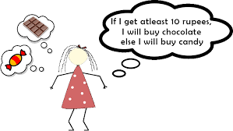

Slide 2
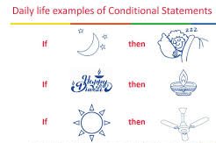

Slide 3
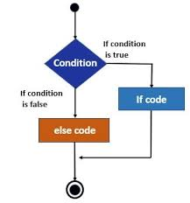

Slide 4
Python supports the usual logical conditions from mathematics:
Equals: a == b
Not Equals: a != b
Less than: a < b
Less than or equal to: a <= b
Greater than: a > b
Greater than or equal to: a >= b
These conditions can be used in several ways, most commonly in "if statements" and loops.
An "if statement" is written by using the if keyword.

Slide 5
a = 33
b = 200
if b > a:
print("b is greater than a")
In this example we use two variables, a and b, which are used as part of the if statement to test whether b is greater than a. As a is 33, and b is 200, we know that 200 is greater than 33, and so we print to screen that "b is greater than a".

Slide 6
Indentation
Python relies on indentation (whitespace at the beginning of a line) to define scope in the code. Other programming languages often use curly-brackets for this purpose.
a = 33
b = 200
if b > a:
print("b is greater than a") #error

Slide 7
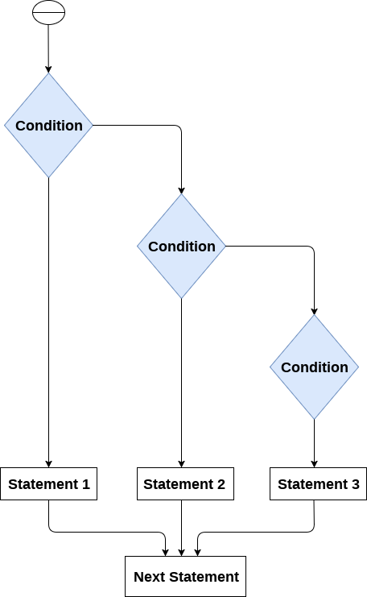

Slide 8
Elif
The elif keyword is Python's way of saying "if the previous conditions were not true, then try this condition".
a = 33
b = 33
if b > a:
print("b is greater than a")
elif a == b:
print("a and b are equal")

Slide 9
Else
The else keyword catches anything which isn't caught by the preceding conditions.
a = 200
b = 33
if b > a:
print("b is greater than a")
elif a == b:
print("a and b are equal")
else:
print("a is greater than b")

Slide 10
Short Hand If
If you have only one statement to execute, you can put it on the same line as the if statement.
One line if statement:
if a > b: print("a is greater than b")

Slide 11
Short Hand If ... Else
If you have only one statement to execute, one for if, and one for else, you can put it all on the same line:
One line if else statement:
a = 2
b = 330
print("A") if a > b else print("B")

Slide 12
You can also have multiple else statements on the same line:
One line if else statement, with 3 conditions:
a = 330
b = 330
print("A") if a > b else print("=") if a == b else print("B")

Slide 13
Nested If
You can have if statements inside if statements, this is called nested if statements.
Example
x = 41
if x > 10:
print("Above ten,")
if x > 20:
print("and also above 20!")
else:
print("but not above 20.")

Slide 14
The pass Statement
if statements cannot be empty, but if you for some reason have an if statement with no content, put in the pass statement to avoid getting an error.
Example
a = 33
b = 200
if b > a:
pass

