Slide 1
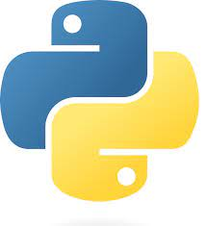
What is Python?
Python is a popular programming language. It was created by Guido van Rossum, and released in 1991.
It is used for:
web development (server-side),
software development,
mathematics,
system scripting.

Slide 2
Web Development: Python can be used to create web applications using frameworks like Django, Flask, and Pyramid.
Data Science and Machine Learning: Python has a rich ecosystem of libraries such as NumPy, Pandas, Matplotlib, and TensorFlow, making it a popular choice for data analysis, machine learning, and artificial intelligence tasks
What can Python do?
Game Development: Python, along with libraries like Pygame, can be used to create games and interactive experiences.
Backend Development: Python can be used to build the backend of web applications, handling tasks such as server-side logic, database interactions, and API development.

Slide 3
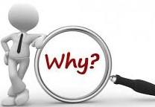
Why Python?
Python works on different platforms (Windows, Mac, Linux, Raspberry Pi, etc).
Python has a simple syntax similar to the English language.
Python has syntax that allows developers to write programs with fewer lines than some other programming languages.
Python runs on an interpreter system, meaning that code can be executed as soon as it is written. This means that prototyping can be very quick.
Python can be treated in a procedural way, an object-oriented way or a functional way.

Slide 4
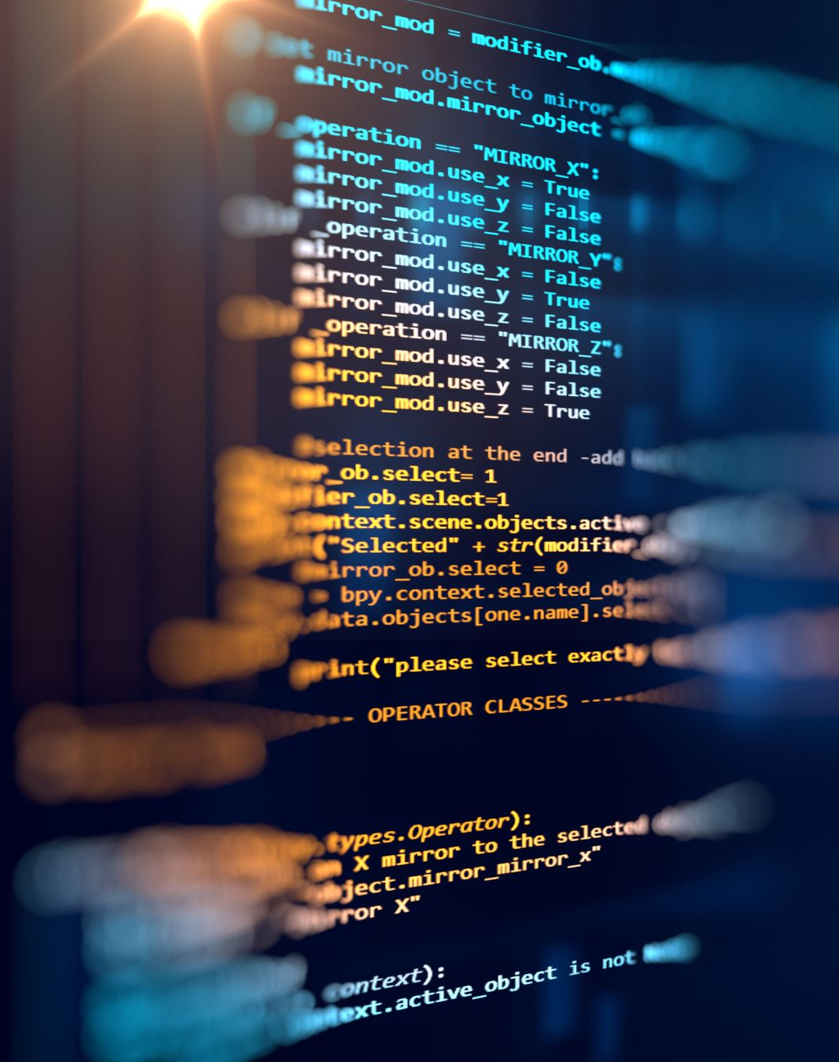
Python Syntax compared to other programming languages
Python was designed for readability, and has some similarities to the English language with influence from mathematics.
Python uses new lines to complete a command, as opposed to other programming languages which often use semicolons or parentheses.
Python relies on indentation, using whitespace, to define scope; such as the scope of loops, functions and classes. Other programming languages often use curly-brackets for this purpose.

Slide 5
Python Code:
print("Hello World“)
Java vs Python
Java Code:
public class HelloWorld {
public static void main(String[] args) {
System.out.println("Hello, World!");
}
}

Slide 6
Python Comments
Comments can be used to explain Python code.
Comments can be used to make the code more readable.
Comments can be used to prevent execution when testing code.
Creating a Comment
Comments starts with a #, and Python will ignore them:
Example
#This is a comment
print("Hello, World!")

Slide 7
Python does not really have a syntax for multiline comments.
To add a multiline comment you could insert a # for each line:
Multiline Comments
Example:
#This is a comment
#written in
#more than just one line
print("Hello, World!")
Or, not quite as intended, you can use a multiline string.
Since Python will ignore string literals that are not assigned to a variable, you can add a multiline string (triple quotes) in your code, and place your comment inside it:
Example:
"""
This is a comment
written in
more than just one line
"""
print("Hello, World!")

Slide 8
Python Install
Many PCs and Macs will have python already installed.
To check if you have python installed on a Windows PC, search in the start bar for Python or run the following on the Command Line (cmd.exe):
C:\Users\Ishfaque>python --version
If you find that you do not have Python installed on your computer, then you can download it for free from the following website: https://www.python.org/

Slide 9
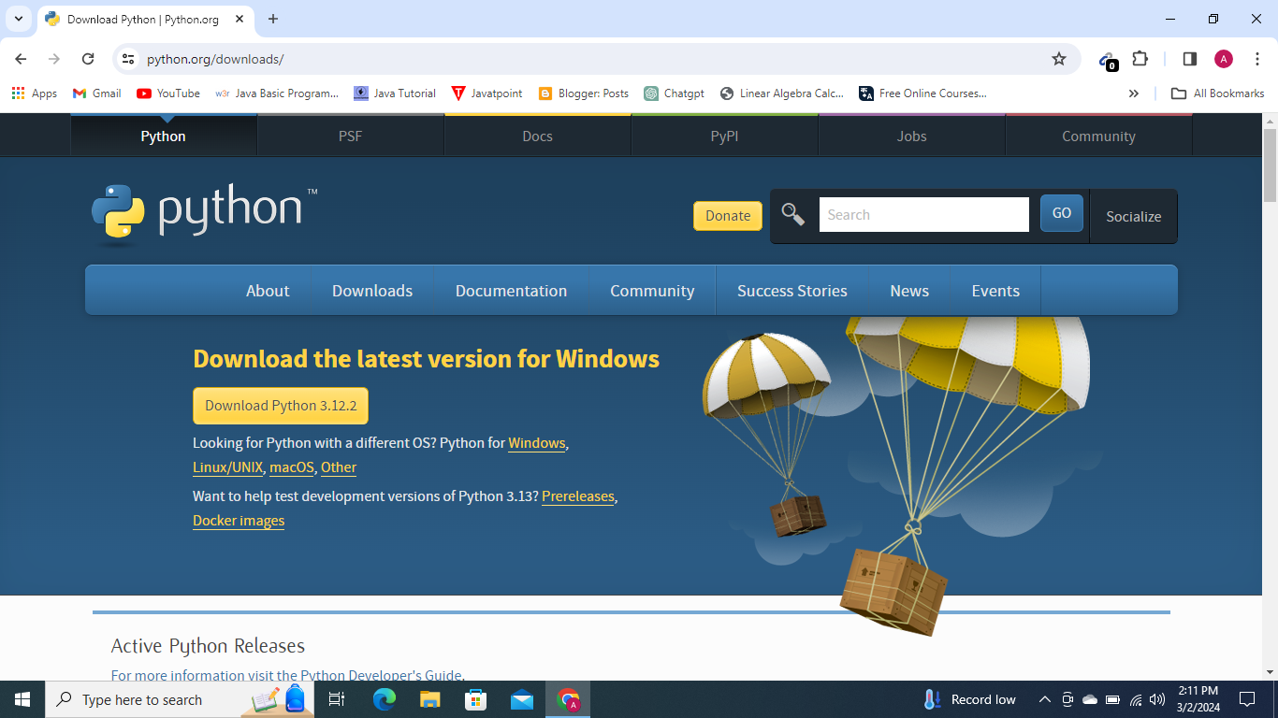

Slide 10
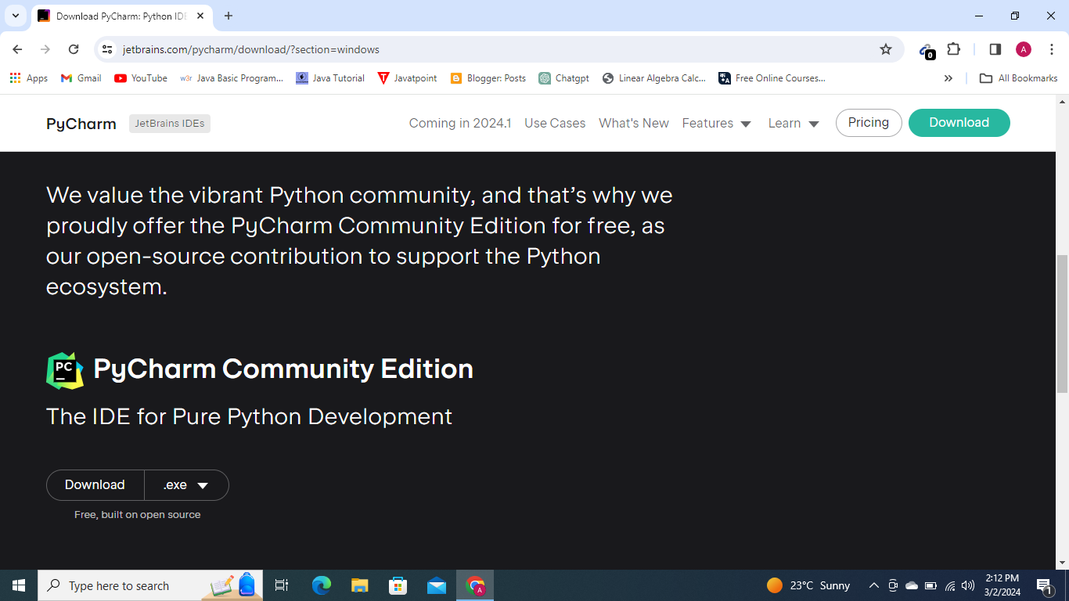

Slide 11
Python Data Types
Every value has a datatype, and variables can hold values. Python is a powerfully composed language; consequently, we don't have to characterize the sort of variable while announcing it. The interpreter binds the value implicitly to its type.
a = 5
We did not specify the type of the variable a, which has the value five from an integer. The Python interpreter will automatically interpret the variable as an integer.
a=10
b="Hi Python"
c = 10.5
print(type(a))
print(type(b))
print(type(c))
Output:
<type 'int’>
<type 'str’>
<type 'float'>

Slide 12
Standard data types
A variable can contain a variety of values. On the other hand, a person's id must be stored as an integer, while their name must be stored as a string.
The storage method for each of the standard data types that Python provides is specified by Python.
The following is a list of the Python-defined data types
Numbers
Sequence Type
Boolean
Set
Dictionary

Slide 13
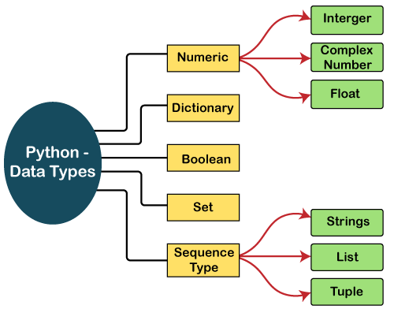

Slide 14
Numbers
There are three numeric types in Python:
int
float
complex
Int
Int, or integer, is a whole number, positive or negative, without decimals, of unlimited length.
x = 1
y = 35656222554887711
z = -3255522
print(type(x))
print(type(y))
print(type(z))

Slide 15
Float
Float, or "floating point number" is a number, positive or negative, containing one or more decimals
x = 1.10
y = 1.0
z = -35.59
print(type(x))
print(type(y))
print(type(z))
Float can also be scientific numbers with an "e" to indicate the power of 10.
x = 35e3

Slide 16
Complex
Complex numbers are written with a "j" as the imaginary part:
x = 3+5j
y = 5j
z = -5j
print(type(x))
print(type(y))
print(type(z))
Type Conversion
You can convert from one type to another with the int(), float(), and complex() methods:
x = 1 # int
y = 2.8 # float
z = 1j # complex
#convert from int to float:
a = float(x)
#convert from float to int:
b = int(y)
#convert from int to complex:
c = complex(x)
print(a)
print(b)
print(c)
print(type(a))
print(type(b))
print(type(c))

Slide 17
Sequence Type
String
The sequence of characters in the quotation marks can be used to describe the string. A string can be defined in Python using single, double, or triple quotes.
When dealing with strings, the operation "hello"+" python" returns "hello python," and the operator + is used to combine two strings.
Because the operation "Python" *2 returns "Python," the operator * is referred to as a repetition operator.
str = "string using double quotes"
print(str)
s = '''''A multiline
string'''
print(s)
Output:
string using double quotes
A multiline
string

Slide 18
str1 = 'hello students' #string str1
str2 = ' how are you' #string str2
print (str1[0:2]) #printing first two character using slice operator
print (str1[4]) #printing 4th character of the string
print (str1*2) #printing the string twice
print (str1 + str2) #printing the concatenation of str1 and str2
Output
he
o
hello studentshello students
hello students how are you

Slide 19
List
Lists in Python are like arrays in C, but lists can contain data of different types. The things put away in the rundown are isolated with a comma (,) and encased inside square sections [].
To gain access to the list's data, we can use slice [:] operators. Like how they worked with strings, the list is handled by the concatenation operator (+) and the repetition operator (*).
list1 = [1, "hi", "Python", 2]
#Checking type of given list
print(type(list1))
#Printing the list1
print (list1)
# List slicing
print (list1[3:])
# List slicing
print (list1[0:2])
# List Concatenation using + operator
print (list1 + list1)
# List repetation using * operator
print (list1 * 3)

Slide 20
Tuple
In many ways, a tuple is like a list. Tuples, like lists, also contain a collection of items from various data types. A parenthetical space () separates the tuple's components from one another.
Because we cannot alter the size or value of the items in a tuple, it is a read-only data structure
tup = ("hi", "Python", 2)
# Checking type of tup
print (type(tup))
#Printing the tuple
print (tup)
# Tuple slicing
print (tup[1:])
print (tup[0:1])
# Tuple concatenation using + operator
print (tup + tup)
# Tuple repatation using * operator
print (tup * 3)

Slide 21
Difference Between List and Tuple
In Python, both tuples and lists are data structures used to store collections of items. However, they have some key differences:
Mutability:
  Lists are mutable, meaning you can change, add, or remove elements after the list has been created.
  Tuples are immutable, meaning once they are created, you cannot change the elements within them. You can't add or remove elements from a tuple.
Syntax:
  Lists are created using square brackets [].
  Tuples are created using parentheses ().

Slide 22
Dictionary
A dictionary is a key-value pair set arranged in any order. It stores a specific value for each key, like an associative array or a hash table. Value is any Python object, while the key can hold any primitive data type.
The comma (,) and the curly braces are used to separate the items in the dictionary.
d = {1:’Ashfaq', 2:’farooq', 3:’Asif', 4:’mir'}
# Printing dictionary
print (d)
# Accesing value using keys
print("1st name is "+d[1])
print("2nd name is "+ d[4])
print (d.keys())
print (d.values())

Slide 23
Boolean
True and False are the two default values for the Boolean type. These qualities are utilized to decide the given assertion valid or misleading. The class book indicates this. False can be represented by the 0 or the letter "F," while true can be represented by any value that is not zero.
# Python program to check the boolean type
print(type(True))
print(type(False))
print(false) #This will show error

