Slide 1
The One DevOps Platform
GitOps:
GitLab Agent for K8s (GA4K)
GitLab Proprietary Information

Slide 2



About me
Cesar Saavedra
Sr. Technical Marketing Manager
@cesar_saavedr
gitlab.com/csaavedra1
linkedin.com/in/saavedracesar
GitLab Proprietary Information

Slide 3

About me
William Arias
Sr. Technical Marketing Manager
@pywarias
gitlab.com/warias
linkedin.com/in/william-galindez-arias-87566542
GitLab Proprietary Information

Slide 4
The One DevOps Platform
All together now
Benefits
Faster cycle times
Revenue acceleration
High collaboration
Improved security
Fewer errors
A single application
GitLab Proprietary Information

Slide 5
Why Bother with the GitLab Agent for Kubernetes
Improved Security Posture for Traditional Runner CD Push Mode
No exposed end point
Kubernetes agent initiates secure connection with GitLab (KAS Service)
Support for True GitOps CD Pull Mode (Kubernetes Operator Pattern)
Performs initial application deployments and upgrades
Policy based configuration management
Automated Configuration Drift remediation
GitLab Proprietary Information

Slide 6
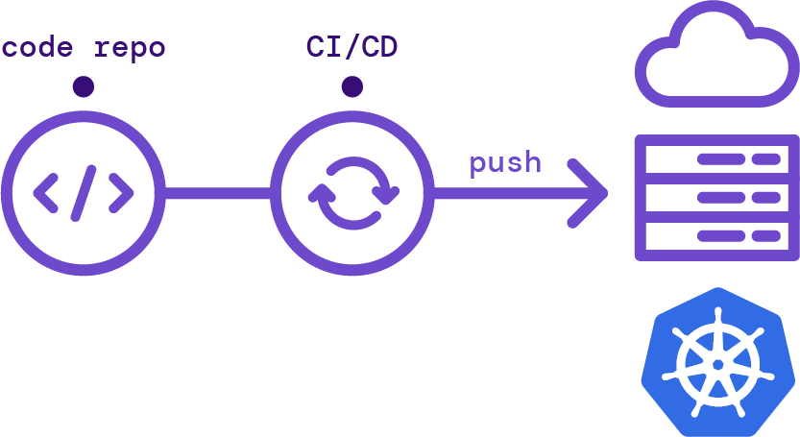
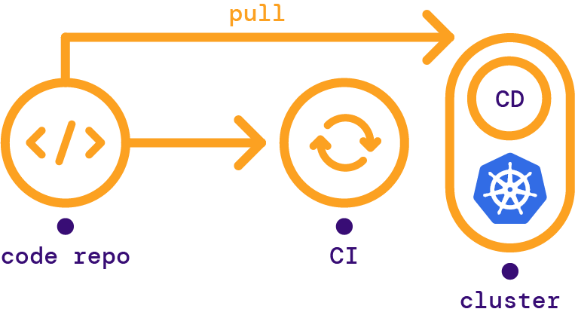

GA4K supports push and pull based approaches to GitOps
Push based GitOps
Pull based GitOps
Can be used for non-Kubernetes and Kubernetes environments
Primarily for Kubernetes environments
Approaches:
Terraform integration
Manually configured CI/CD targets
GitLab Agent for Kubernetes
Approaches:
GitLab Agent for Kubernetes
GitLab Proprietary Information
Notes:
Terraform MR tile - showing results of $terraform plan
Terraform state file stored and managed within GitLab (no need to use Terraform Cloud)
Terraform modules can also be stored within GitLab
With push-based approach, we can also support other IaC files, such as AWS CloudFormation, Azure Resource Manager files (ARM), Google Cloud Deployment Manager files.
You can securely modify your infrastructure from the CI/CD pipeline via the GA4K

Slide 7
Benefits for infrastructure teams
Better Collaboration
Lower Mean Time to Repair
Faster Time to Value
More Compliant
Everything as Code
Version Control
Automation
Security & Compliance
Self-documenting environments
Shared knowledge among your teams
Duplicate your environment
Mis-configured infra
Roll back / roll forward
App version depends on an infrastructure configuration
Lower MTTR
Deploy Faster More Often
Configuration drift
Productivity gains
Permissions to your environment
Auditing Compliance
Change process compliance
GitLab Proprietary Information

Slide 8

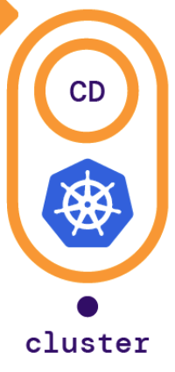
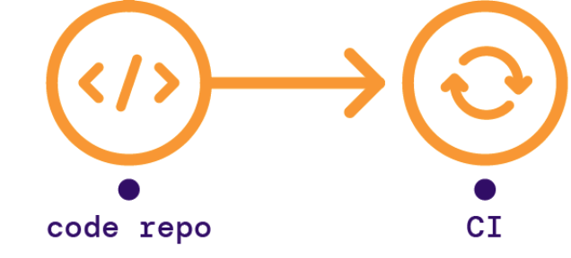

The GitLab CI/CD workflow for K8s (a.k.a. CI/CD Tunnel)
Securely connects to your K8s cluster from your CI/CD pipelines
Leverages the GitLab agent for K8s. No need to expose your K8s cluster to the internet
Inherits all permissions from the service account used to install the agent in the cluster
Besides impersonating the agent, it can also impersonate:
CI job that accesses the cluster.
A specific user or system account defined within the cluster.
Use fine-grained permissions + GitLab CI/CD workflow for K8s, to restrict & manage access to cluster resources
To restrict access to your cluster, use impersonation in your agent’s configuration file and use Kubernetes RBAC (role-based access control) rules to manage impersonated account permissions
GitLab Proprietary Information

Slide 9
Benefits for development and infrastructure teams
Better Collaboration
More Compliant
Separation of Duties
Security & Compliance
Fine-grained permissions at the project or group level in GitLab
Control permissions at the username or service account defined in your cluster
Leverages your K8s authorization capabilities to limit the permissions of what can be done on your cluster from CI/CD pipelines
Lowers the risk of providing unlimited access to your K8s cluster from CI/CD pipelines
GitLab Proprietary Information

Slide 10
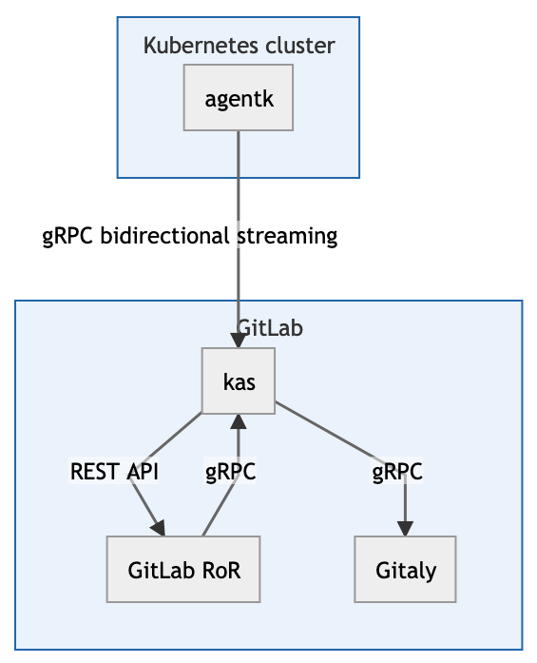
Cloud-native integrations with the GA4K
The GitLab Agent for Kubernetes is the foundational layer for cluster connections.
Current features:
Pull based deployments
Push based deployments
Container Vulnerability Scanning
GitLab Proprietary Information

Slide 11
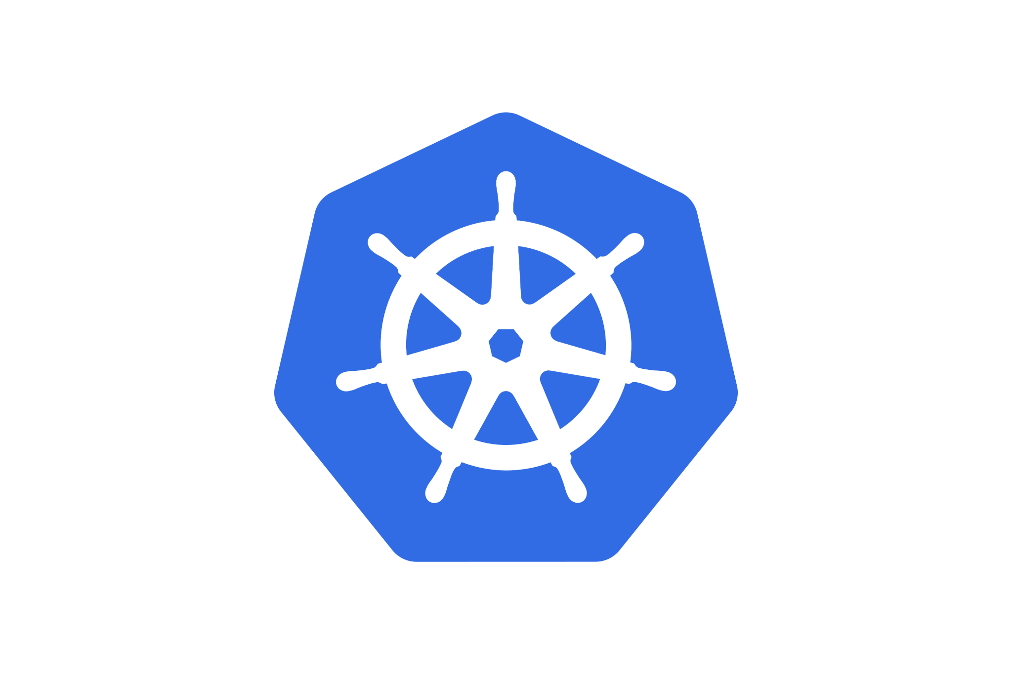
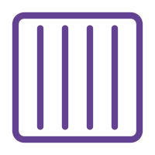
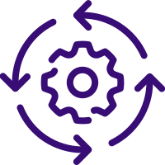
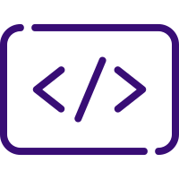


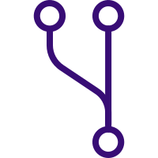
CONTAINER
SERVICE
CONTINUOUS CONFIGURATION MANAGEMENT
CI
APP CODE
MANIFEST CODE
GitLab Agent
Kubernetes
GIT CD OPTIONAL SCANNING AND APPROVALS
Notes:
GitOps is an emerging technology and the definition is still evolving. Currently - there are two main ways different vendors approach GitOps - a push based deployment and a pull based deployment.
In the push based deployment model, the application code and infrastructure code (e.g., Kubernetes yaml) is saved in the same repository. When the application / infrastructure code is updated, a build pipeline is triggered which updates the environment repository - which could be in the same git repository as the application code. This in turn triggers the deployment pipeline which applies all the infrastructure configuration to the environment. In this case, drift in the environment and desired state is not monitored - unless there is monitoring in place that runs on a frequent basis to test that. This approach can work across various deployment targets like physical, virtual servers, on premise or cloud deployments, containerized deployments including Kubernetes. This does require stringent security controls and separation of duties to ensure that everybody does not have full access to the deployment environment.
In the pull based deployment, the first few steps remain the same. The application code and infrastructure code (e.g., Kubernetes yaml) is saved in the same repository. When the code is updated, a build pipeline is triggered which updates the environment repository. This environment repository or manifest repository - which could be the same git repository that the application code is saved in - is continuously monitored by an operator that is setup in the cluster environment. As you can see on the screen, there is no deployment pipeline. This operator continuously compares the desired state in the environment repository with the actual state in the deployed infrastructure. Whenever differences are noticed, the operator updates the infrastructure to match the environment repository. This approach is primarily used only for Kubernetes environments.
GitLab supports both of these approaches. Infact - many customers have been doing GitOps in the push based manner for many years - it was just not referred to as GitOps.
With that, I’d like to hand it over to Cesar who will showcase a demo of how to achieve GitOps with GitLab.

Slide 12
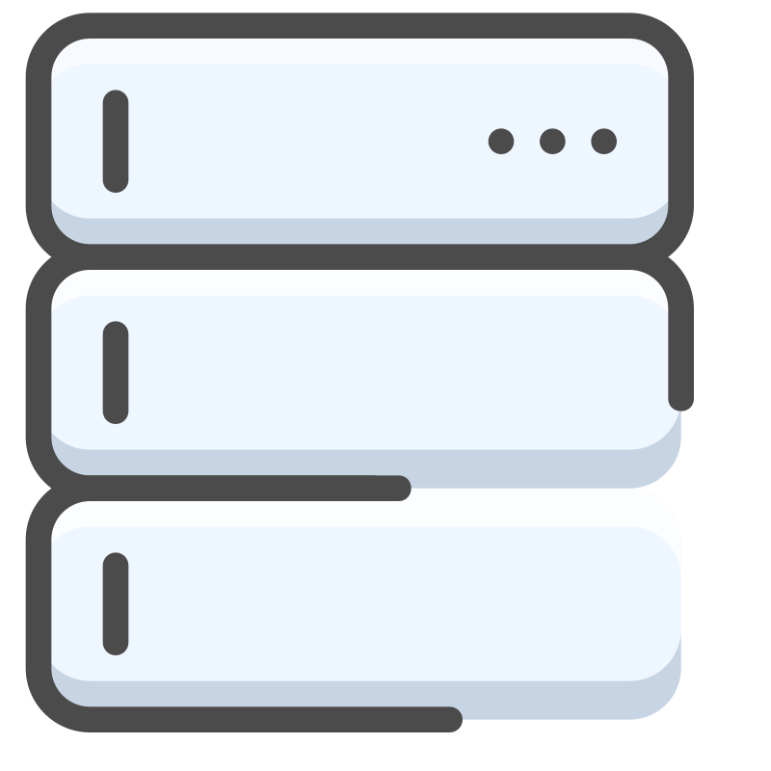
GIT CD APPROVAL
Secure
GitLab Agent
Kubernetes
PUSH CD
CI
CODE
Cloud
On-Prem
Notes:
GitOps is an emerging technology and the definition is still evolving. Currently - there are two main ways different vendors approach GitOps - a push based deployment and a pull based deployment.
In the push based deployment model, the application code and infrastructure code (e.g., Kubernetes yaml) is saved in the same repository. When the application / infrastructure code is updated, a build pipeline is triggered which updates the environment repository - which could be in the same git repository as the application code. This in turn triggers the deployment pipeline which applies all the infrastructure configuration to the environment. In this case, drift in the environment and desired state is not monitored - unless there is monitoring in place that runs on a frequent basis to test that. This approach can work across various deployment targets like physical, virtual servers, on premise or cloud deployments, containerized deployments including Kubernetes. This does require stringent security controls and separation of duties to ensure that everybody does not have full access to the deployment environment.
In the pull based deployment, the first few steps remain the same. The application code and infrastructure code (e.g., Kubernetes yaml) is saved in the same repository. When the code is updated, a build pipeline is triggered which updates the environment repository. This environment repository or manifest repository - which could be the same git repository that the application code is saved in - is continuously monitored by an operator that is setup in the cluster environment. As you can see on the screen, there is no deployment pipeline. This operator continuously compares the desired state in the environment repository with the actual state in the deployed infrastructure. Whenever differences are noticed, the operator updates the infrastructure to match the environment repository. This approach is primarily used only for Kubernetes environments.
GitLab supports both of these approaches. Infact - many customers have been doing GitOps in the push based manner for many years - it was just not referred to as GitOps.
With that, I’d like to hand it over to Cesar who will showcase a demo of how to achieve GitOps with GitLab.

Slide 13
Demo
GitLab Proprietary Information

