Slide 1
An active inference approach to second-person neuroscience

Slide 2

Importance of Social Interaction
irresistible drive (内在动力) to seek social contact and companionship
Be shaped by & learn how to get along with other
separation from our social environment
affects our wellbeing detrimentally
increases the risk of mental health issues
increases the risk of physical health issues
raises rates of mortality

Slide 3
From Third-person to Second-person neuroscience
third-person interatcion vs. reciprocal (ideally real-time) interaction
Linguistically
she/he/they→you
I→we
capture the dynamics and mechanisms at play in genuinely (真正互动) interactive human behavior in individuals and groups (个人或集体).
Experiments Paradigm
PARTICIPANT & SOCIAL/INTERACTIVE STIMULUS
classic approach (采用第三视角观察)
audience effect (观众效应)
mere observation, 只观察
actions of participants can be observed, 能看到参与者的行为
reciprocal social interaction (交互性|社会互动)
slowly paced sequential interactions, 顺序互动
reciprocal and dynamic, 动态交互

Slide 4

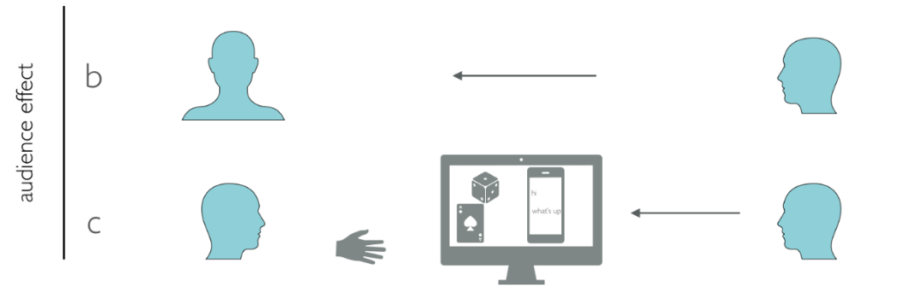
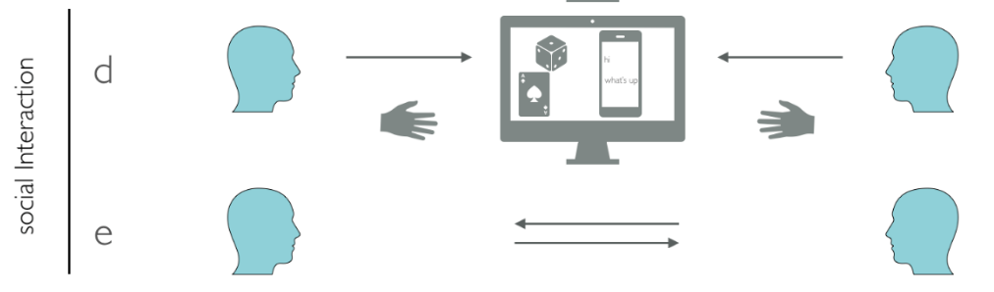

Slide 5
Differences under interactive/observational contexts
social attention (indexed by gaze behavior) significantly decreased
neural activation pattern showed a widespread increase
the default mode network (DMN)
the salience network (SN)
subcortical areas including the basal ganglia
Observed brain activity in the mentalizing network
「 synonymously for the default mode network」
task made no explicit mentalizing demands on the participants
address the critique mainly stemming from pragmatist(实用主义), embodied(具身认知), and enactive (主观能动) approaches to cognitive science (instead of passive consumption of external stimuli)
the mechanisms driving these differences are not well understood

Slide 6
Applying the Active Inference
brian: passive organ → enactive
actively generates predictions of its environment (Friston, 2013a)
dynamics of the brain(大脑的动力学) are said to instantiate(实例化) a generative model
The hierarchical process
At each level
generate **predictions
compare against sensory input
Reduce the 'prediction error'
lower levels operate at smaller spatial and shorter temporal scales
higher levels or deeper layers process increasingly abstract information at greater spatiotemporal scales
the brain must be devoted to modelling our world and entities that populate the world [@fristonFantasticOrgan2013]
forming models of other people’s motivations, desires and thoughts.
repetition suppression 重复抑制
The balancing act between sensory and prior prediction errors is assumed to be mediated by neuromodulatory mechanisms of synaptic gain that encode their reliability or precision

Slide 7
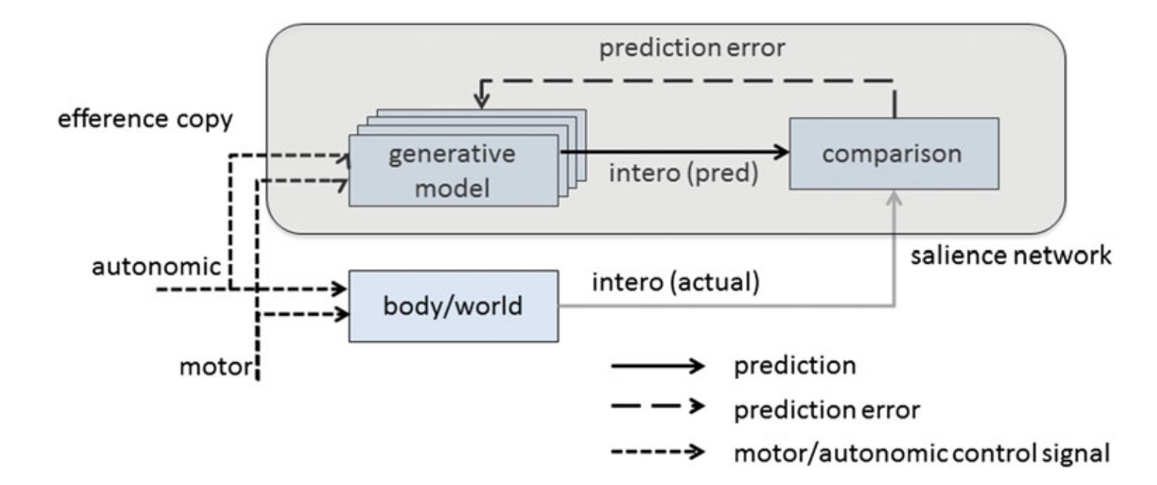

Slide 8
Hierarchical predictive processing (include action)
perception: prior belief & sensory data
action: prior planning & feedback from proprioceptive effector
when predictions and sensory data clash
updating one’s beliefs in a Bayes-optimal manner
through perception and learning, changing the internal model to make it more predictive of current sensory input (让内部模型可以更好地对外部世界进行模拟)
changing the world
through action, making future data (from the environment) consistent with one’s expectations (让外部环境符合自己的预期)
Free Energy 自由能的降低：reduce uncertainty
take place unconsciously at all levels of brain activity
engaged in a recurrent message passing between lower and higher levels of the cortical hierarchy

Slide 9
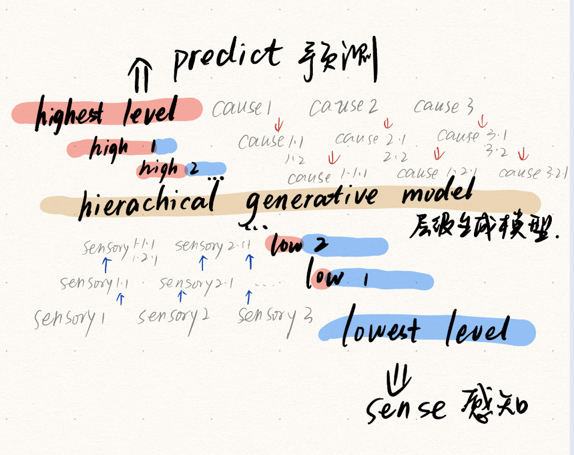

Slide 10
The exploration of opportunities for action
which action will reduce an agent’s uncertainty the most？
How to Select Actions? : explored possible action opportunities
not only based on beliefs of the sensory consequences
but also based on the consequences of an action for future beliefs
counterfactual processing 反事实加工
imagining what the next sensory input would be, if I were to execute a particular action.
如果...那么...
e.g., 社会心理学中，上行反事实思维（对于过去已经发生了的事件，想象如果满足某种条件，就有可能出现比真实结果更好的结果）是许多负性情绪产生的原因所在
having beliefs about beliefs (关于信念的信念)
心理理论(ToM)：主要是指对他人的愿望、信念、动机等心理状态以及心理状态与行为之间关系的认识
Expected Free Energy 期望自由能

Slide 11
A deep decision tree
用深度决策树理解行为决策：
Potential action trajectories are recursively (递归) explored, and their sensory consequences are counterfactually imagined ｜潜在动作轨迹被递归探索，其可能产生的“结果”被预期
span over timescales of various durations 跨尺度
underwrites multiple process 跨场景
episodic prospection 情景展望
rumination 反刍思维
catastrophizing 灾难化思维
mind wandering 心智游离
In monadic contexts 单一语境下，行动本身不会被另一个个体所影响
In dyadic context of social interaction (真实社交场景), the recursive structure of action selection additionally becomes recursively nested (递归嵌套, 更大的树)
happening in an automatic and implicit mode (自动化/隐形), make social action exploration seem effortless (更轻松)
Contextual or other prior information (先验信息的作用): narrow down hypothetical alternatives

Slide 12
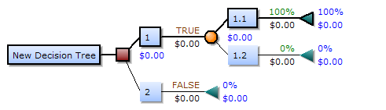
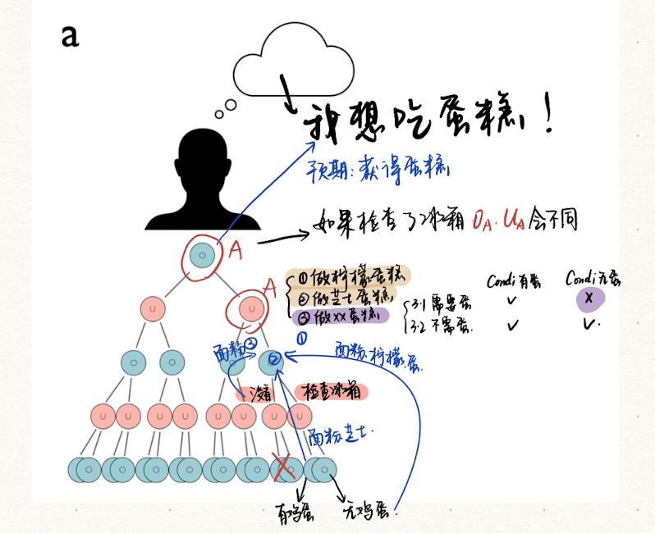

Slide 13
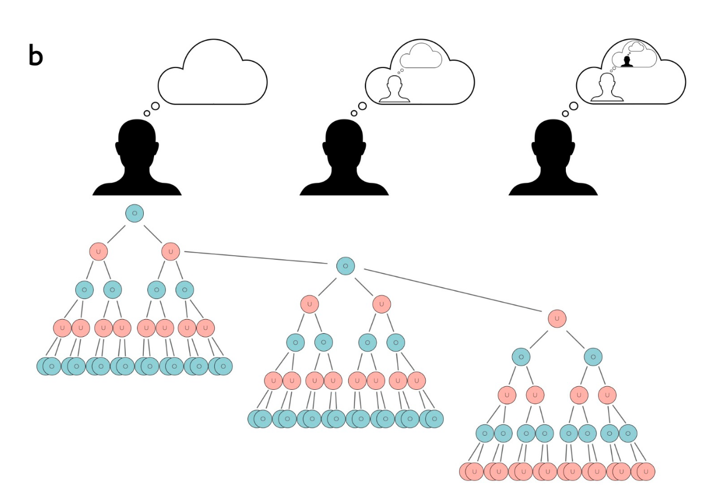

Slide 14
Neural mechanism: the Default Mode Network
dyadic games in a virtual interactive space
when accounting for how our own actions influence the subsequent actions of an opponent ｜在考虑我们自己的行为会如何影响他人的后续行为时，默认网络(the default mode network)被深度激活(pivotally involved)；
deficiencies in estimating how one’s own actions affected the opponent’s behavior ｜“评估自己的行为将如何影响他人的行为”的能力出现障碍，伴随着右侧颞顶联合区 (the right temporoparietal junction, as part of the default mode network )与默认网络的内部连接下降(diminished connectivity within the DMN)
opponent is perceived as “having a mind”, one ascribes an increased ability to infer mental states (should have more recursively nested thoughts) ｜对手越有“城府”，个体越需要进行更深的递归思考，默认网络的激活程度也就越大

Slide 15
Action Selection (from those probabilities)
which of those actions should I select?
Policy
a set of beliefs about which action one is undertaking (一组信念，关于需要采取怎样的行动)
a kind of self-fulfilling prophecy 自我实证预言
Social information processing is inherently uncertain and ambiguous 社交信息的不确定性（被深度树搜索解决）
point to an action that best resolves these problems——policy with high precision
precision
high confidence in one’s own beliefs about action outcomes
the precision of beliefs about policies determines how vigorously an action is conducted 决定了行动力

Slide 16
The role of the basal ganglia
basal ganglia
consistently activate in a second-person neuroscience studies
engage in higher order belief inferences about another person—both the basal ganglia and the default mode network showed heightened activity (recursive thinking in interpersonal strategic interactions)
The Dopamine
the precision signaling is carried out via dopaminergic transmission in the basal ganglia
Dopaminergic signaling may have originally served to arbitrate between local exploitation and long-range exploration 在探索&利用之间进行权衡
the process of action selection and precision signaling
not purely rational (i.e., context free)
tightly linked and informed by the affective states of an interacting agent that mediate a variety of contextual—and possibly hedonic—priors

Slide 17
Dynamic change of action selection
when to select?
both the demand on selecting an action and the corresponding counterfactual belief updates highly dynamic
微笑时间过长-刻版&勉强
更长时间的交流间隔-理解困难
长时间的表达厌恶-负面情绪更大
高度的背景依赖性
想要讲述故事(t1)，但谈话过程中话题转移，该故事不再合适(t2)
recall for dimension of time

Slide 18
Computation of transition uncertainties: the ACC
ACC (转移概率-扣带回)
beliefs for u & beliefs for o - has a change probability (B matrix)
行动后，s1转化为s2概率有多大？
行动是否可以改变状态
行动的变化如何影响状态的变化
某个时间的不确定性
不确定性随时间和背景 (hidden states)变化
via noradrenergic projections from the locus coeruleus 与蓝斑处的去甲肾上腺素投射有关 (调节注意力)
扣带回(ACC)在注意力和行为控制方面起着重要作用
increase in neuronal activity in the ACC
higher computational demands on the evaluation of transition probabilities between actions and states.
more action alternatives to evaluate
the nested recursive structure of deep tree exploration of action 递归的深度
the dynamic ever-evolving fluctuation in the action opportunities 环境的不确定性

Slide 19
Internal bodily cycles: interoceptive&proprioceptive
external world ↓ information processed about possible courses of action internal bodily cycles ↑
allostasis(稳态): alteration of set points to suit the demands of the situation
interoceptive systems 内感觉-脑岛
呼吸，心跳，肠胃，内脏（交感与副交感系统）
constantly fluctuating
e.g., 站立时调节血压
前脑岛(AI)颗粒细胞是一个稳态点(set points)的调节器
大量纺锤型神经元(VEN)
双向调节
关注外部时候降低内部噪音
调整呼吸调整情绪
生理信号的同步
proprioceptive domain 本体感觉-额顶网络
长投射神经元
镜像神经元系统（对他人动作的预测与规划）

Slide 20
Remarkable Conclusion & Further Discussion
几个网络的交互作用
DMN-规划
基底神经节&多巴胺-选择
身体与外界环境的互适应
扣带回-状态转化
内感觉-脑岛
本体感觉-额顶联合区
实验范式中需要保留 “嵌套递归”（的相关任务）
缺点：计算上变得复杂
需要降低参数复杂性
元贝叶斯框架 (meta-Bayesian framework)
配合 动力系统 (dynamic system)
脑活动数据
生理学数据（e.g., 呼吸，心跳）
将观测数据作为约束条件
个体 → 集体（尺度的扩展）

Slide 21
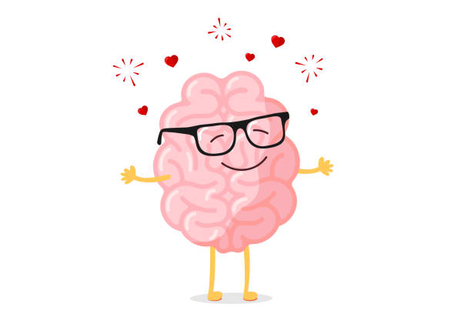
Thank you!
And feel free to ask any question.

