Slide 1
Action selection in early stages of psychosis: an active inference approach

Slide 2
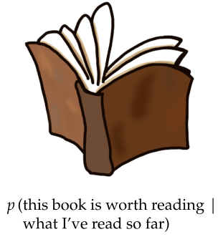
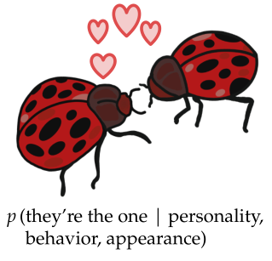
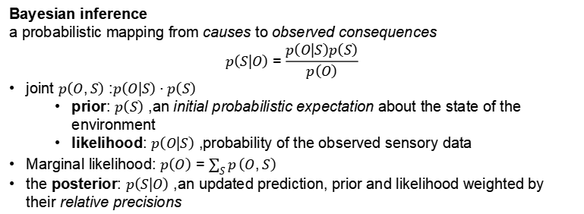
Bayesian Brain & Action Selection
Introduction
to make the most adaptive choices, the brain should
inferring the current state of the environment
considering possible action outcomes to choose the most probable policy
given the organism’s expectations
its goals
preferred state of the environment
Bayesian inference
a probabilistic mapping from causes to observed consequences $$p\left(S|O\right)=\frac{p\left(O|S\right)p\left(S\right)}{p\left(O\right)}$$
joint $p\left(O,S\right)$: $p\left(O|S\right)⋅p\left(S\right)$
prior: $p\left(S\right)$, an initial probabilistic expectation about the state of the environment
likelihood: $p\left(O|S\right)$, probability of the observed sensory data
Marginal likelihood: $p\left(O\right)=\sum_{S}^{​}{p}\left(O,S\right)$
the posterior: $p\left(S|O\right)$, an updated prediction, prior and likelihood weighted by their relative precisions

Slide 3
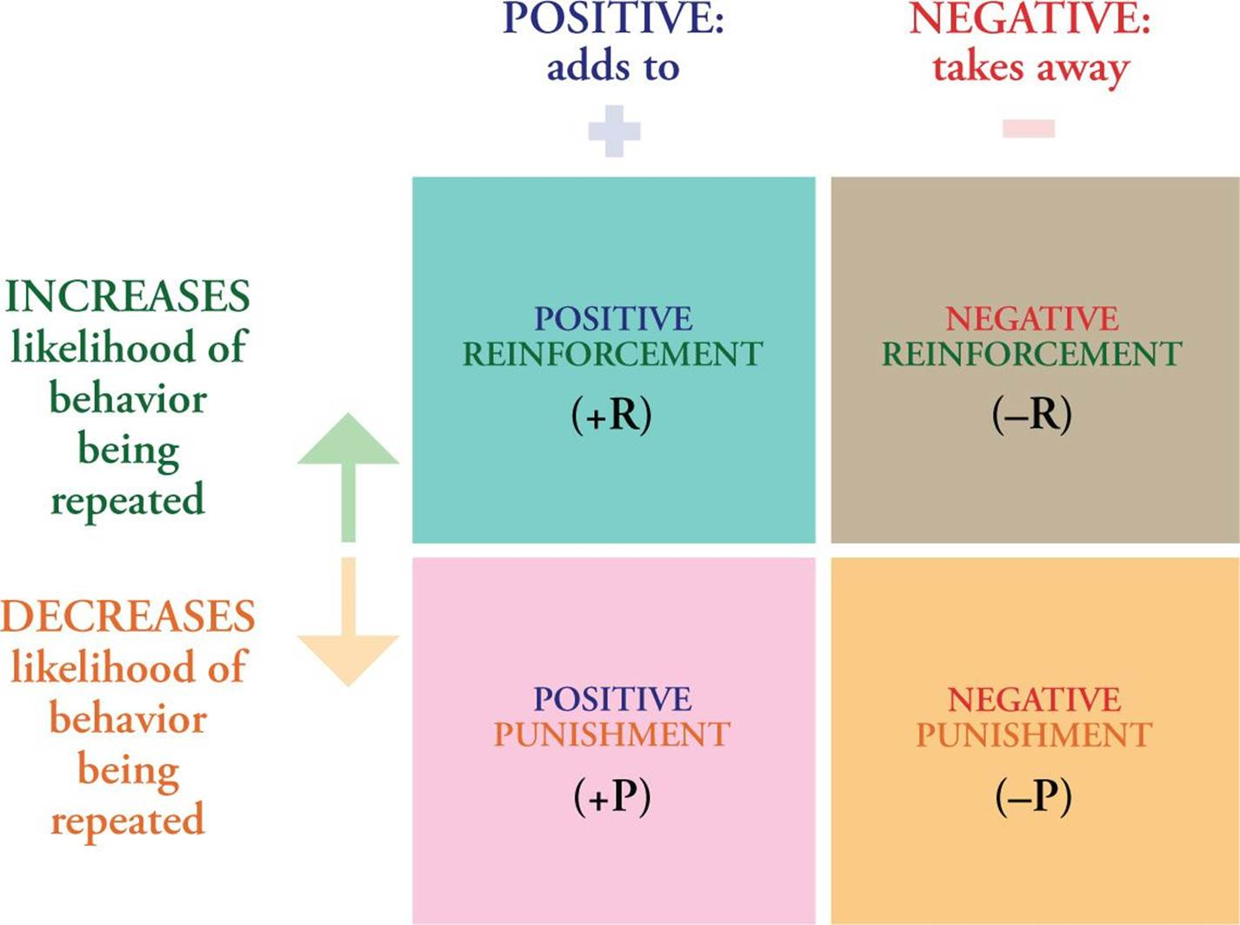
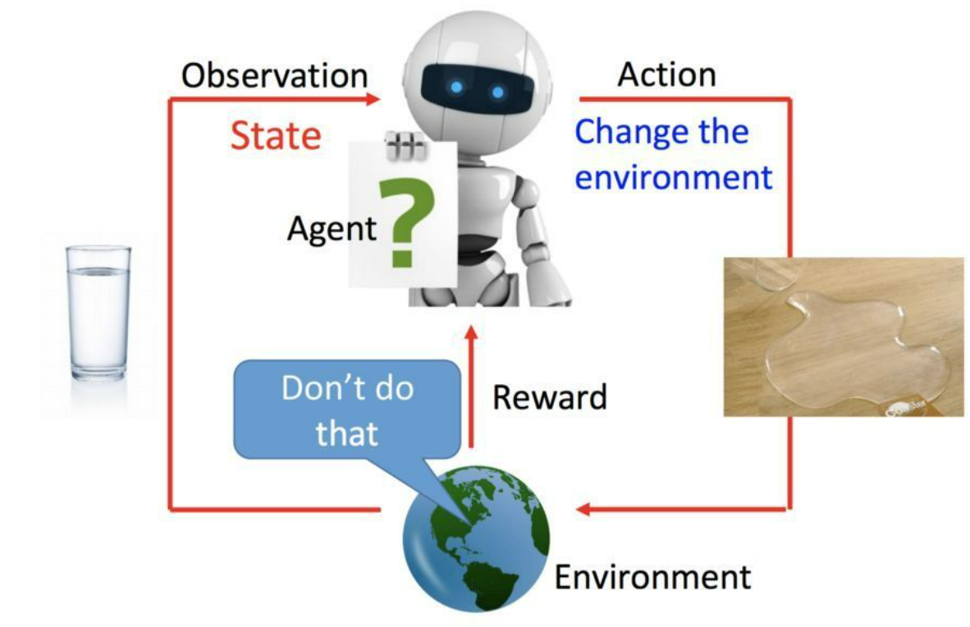
RL model
Introduction
Reinforcement Learning
algorithm to approximate how the brain optimizes action selection.
Model free RL learning using fairly simple associative updates
Effective action selection is characterized by (through forming accurate beliefs)
maximizing rewards
minimizing losses
Accommodate complex task structures & Allow powerful performance even when the associations are shaped by higher order contingencies - 即便是高维结构产生的低维影响

Slide 4
Impairment in Psychosis: Action Selection with RL Model
Introduction
In psychosis, behavioral and cognitive alterations appeared in optimal action selection - in value-based action selection (e.g., reinforcement learning) - in action-outcome (reward/punishment-conditional) learning can be observed change before the disease onset → a robust sign of the pathophysiology of the disorder
Patients with FEP → RL deficits (Limongi et al., 2022)
showed significant impairments in overriding Pavlovian conflict: "Go to loss&NoGo to win"
a lower learning rate
a lower sensitivity to both reward and punishment (both FEP & ARMS, At Risk Mental State for psychosis)
NOT predicted by molecular genetic risk for schizophrenia
Does NOT support the role of RL as an intermediate phenotype in psychosis.
a potential biomarker of risk that improves early identification and intervention - failed (?)

Slide 5
Impairment in Psychosis: Active Inference Model
Introduction
not just to infer hidden states of the world, but also to plan and select actions
the primary goal of the agent is to minimize ‘surprise’ (e.g., I want to go outside and I don’t want to be too hot): acting to bring about sensory inputs that it expects
e.g., if I wear shorts and a T-shirt, I will be nice and cool
Bayes term: maximizing evidence for its assumptions about the environment (i.e. model evidence; it is sunny and people walk around in short sleeves, ergo, I am expecting it to be warm, so shorts and t-shirt will keep me cool)
Psychotic symptoms
Causes
an individual is unable to use sensory information to correct prior beliefs - 先验太强
or when her prior beliefs are inaccurate and the precision of sensory information is inaccurate - (a result of an imbalance between the precision of prior beliefs in relation to sensory evidence)
especially hallucinations
other symptoms? decision-making?
Dysfunction in decision making → a core feature of psychosis and has been found to predict poor functional and clinical treatment outcomes.
In at-risk individuals levels of cognitive impairment have been reported to be intermediate compared to healthy controls and schizophrenia

Slide 6
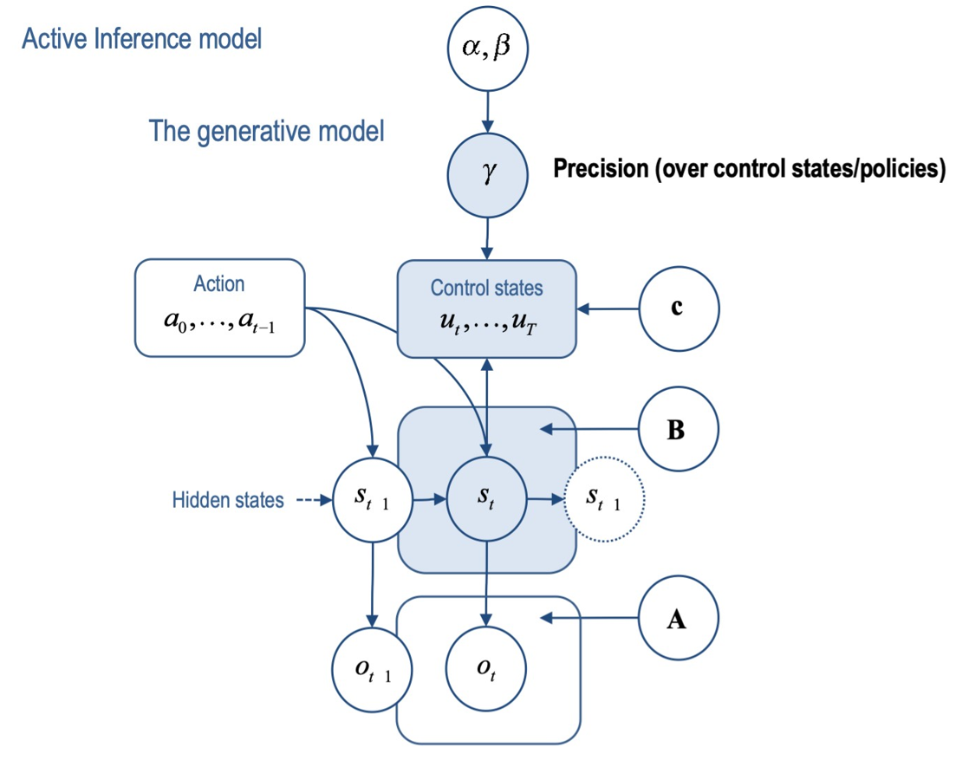
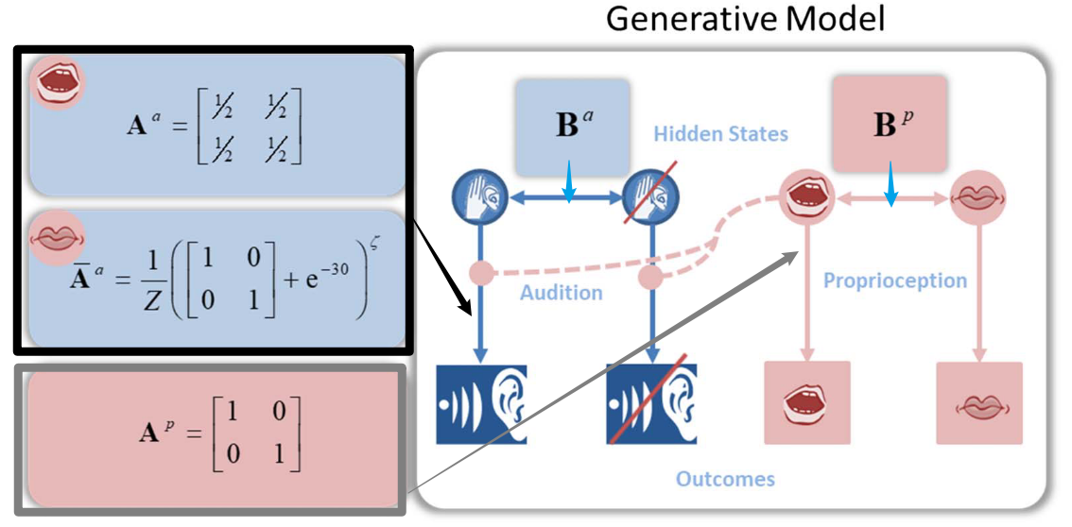

Active Inference Model
Background
Model structure - (Benrimoh et al., 2018)

Slide 7
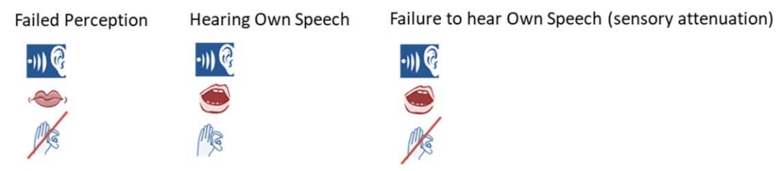
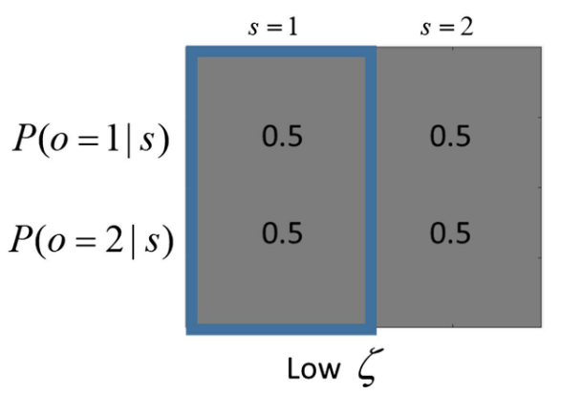
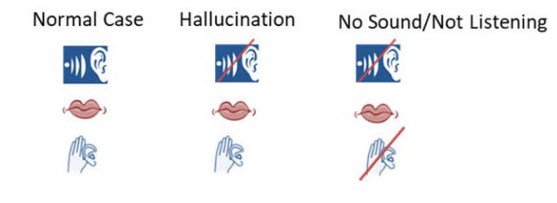
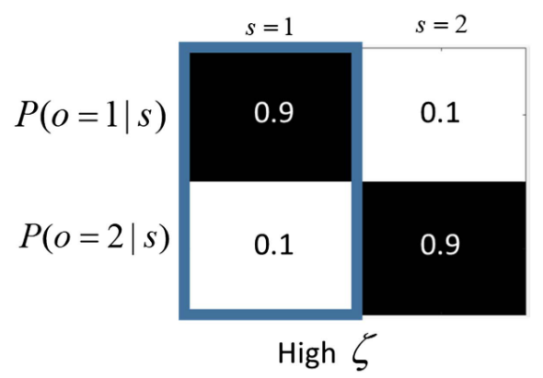
Active Inference Model - results
Background

Slide 8
Bullet Points in some Articles related
Background
Auditory Hallucinations
(Benrimoh et al., 2018)
Reducing Likelihood Precision Leads to False Positive Inferences
Increasing Prior Precision over Policies Can Elicit Hallucinations in the Presence of Reduced Likelihood Precision
Hallucinations Are Context Dependent
Language Behavior in First-episode Schizophrenia.
(Limongi et al., 2022)
The analytic thinking score causally depends on unobserved prior Co → 语言混乱
The effective connectivity between the ACC and the AI encodes the probability distribution of prior conceptual organization [salient network]

Slide 9
Active Inference: Action Selection in Early Stages of Psychosis
Experiments
Participants
three groups aged 17 to 35
Controls: 31 - recruited through advertisement in Cambridgeshire and through existing University of Cambridge research databases
At-Risk Mental State (ARMS): 23 - met CAARMS attenuated psychotic symptoms criteria
First-Episode Psychosis (FEP, 首发精神疾病): 26 - the Cambridge First Episode Psychosis service
Antipsychotic Medication (yes/no)
Clinical Assessments
get N, Mean, SD in each group
the matrix subscore of the Wechsler Abbreviated Scale of Intelligence (WASI, 韦氏简明智力测试)
to measure IQ
the Comprehensive Assessment of At-Risk Mental State Questionnaire (CAARMS, 高危精神病综合性评估)
providing operational criteria for identification of clinical risk for psychosis
the 21-items Peters Delusions Inventory (PDI, 妄想症状评估) & the Schizotypical Personality Questionnaire (SPQ, 分裂型人格问卷)
to measure schizotype
the Positive and Negative Symptoms Scale (PANSS, 精神分裂症阳性与阴性量表)
Positive score & Negative score
the Clinician-Administered PTSD Scale (CAPS, 创伤应激评估表)
the Mood and Feelings Questionnaire (MFQ, 心境情绪量表)
subset of the Young People Questionnaire (YPQ)
to measure depressive symptoms

Slide 10
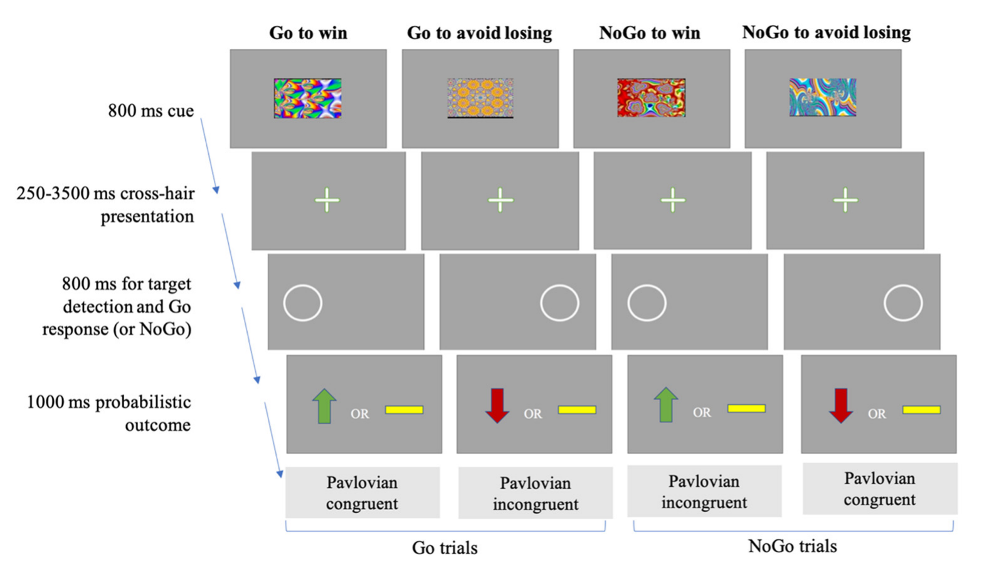
Go/NoGo Task
Experiments
(Adams et al., 2020)
choose the best action:
get the best feedback available 80% of the time
get the worst feedback 20% of the time
vice versa for the worst action
choice for every picture will not change
pictures presented in a random order
the reward/punishment outcomes of trials were dissociated from whether a Go or NoGo action

Slide 11
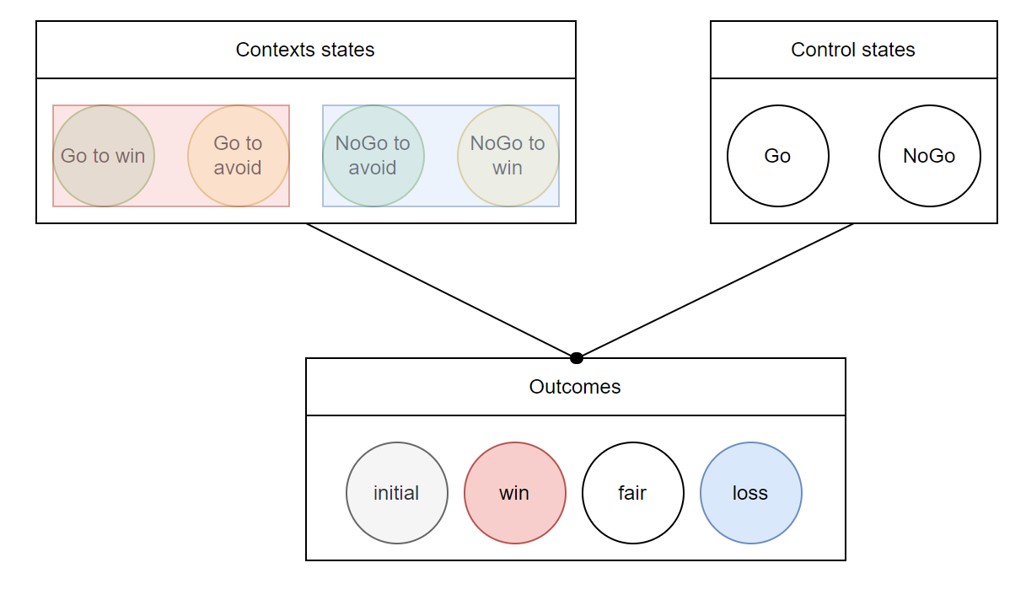
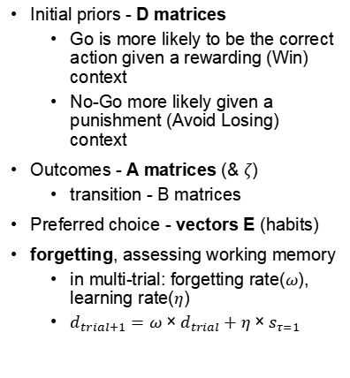
AI Model in Go/NoGo Task
Analysis
Initial priors - D matrices
Go is more likely to be the correct action given a rewarding (Win) context
No-Go more likely given a punishment (Avoid Losing) context
Outcomes - A matrices (& $ζ$)
transition - B matrices
Preferred choice - vectors E (habits)
forgetting, assessing working memory
in multi-trial: forgetting rate($ω$), learning rate($η$)
$d_{trial+1}=ω×d_{trial}+η×s_{τ=1}$

Slide 12
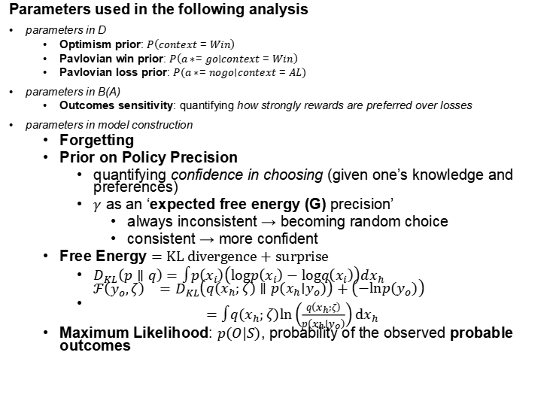
Model fitting: AI parameters
Analysis
Parameters used in the following analysis
parameters in D
Optimism prior: $P\left(context=Win\right)$
Pavlovian win prior: $P\left(a∗=go∣context=Win\right)$
Pavlovian loss prior: $P\left(a∗=nogo∣context=AL\right)$
parameters in B(A)
Outcomes sensitivity: quantifying how strongly rewards are preferred over losses
parameters in model construction
Forgetting
Prior on Policy Precision
quantifying confidence in choosing (given one’s knowledge and preferences)
$γ$ as an ‘expected free energy (G) precision’
always inconsistent → becoming random choice
consistent → more confident
Free Energy $=\text{KL} \text{divergence}+\text{surprise}$
$D_{KL}\left(p∥q\right)=∫p\left(x_{i}\right)\left(logp\left(x_{i}\right)−logq\left(x_{i}\right)\right)dx_{h}$
$\begin{matrix}ℱ\left(y_{o},ζ\right) & =D_{KL}\left(q\left(x_{h};ζ\right)∥p\left(x_{h}∣y_{o}\right)\right)+\left(−lnp\left(y_{o}\right)\right) \\ & =∫q\left(x_{h};ζ\right)ln\left(\frac{q\left(x_{h};ζ\right)}{p\left(x_{h}∣y_{o}\right)}\right)\text{d}x_{h}\end{matrix}$
Maximum Likelihood: $p(O|S)$, probability of the observed probable outcomes
using the Hierarchical Gaussian Filter toolbox
Empirical priors: estimating the parameter distributions from the empirical data using Empirical Bayes (经验贝叶斯), and iterating a small number of times until approximate convergence (近似收敛).
parameter recovery analyses: check that the model parameters could be reliably recovered from simulated datasets

Slide 13
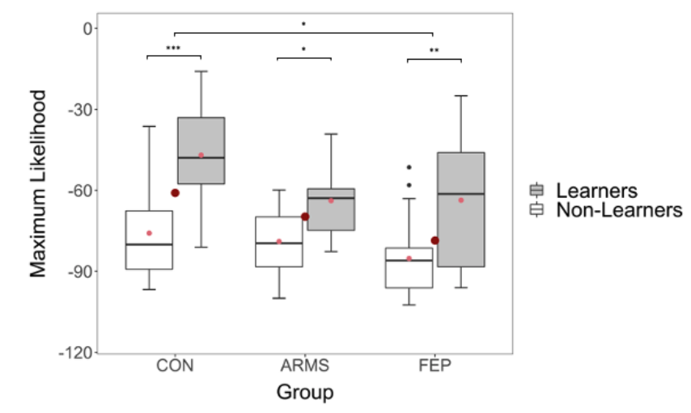
Model fitting: AI parameters
Analysis & Results
Comparison of Model Fit Parameters
Groups: "learner" vs. "non-learners"
for individuals who performed above chance in the last 20 trials *each condition- groups of ‘learners’ (above chance in all conditions)&‘non-learners’
used a two-way ANOVA and Tukey post hoc analyses to compare model fit as assessed by maximum likelihood measures between groups

Slide 14
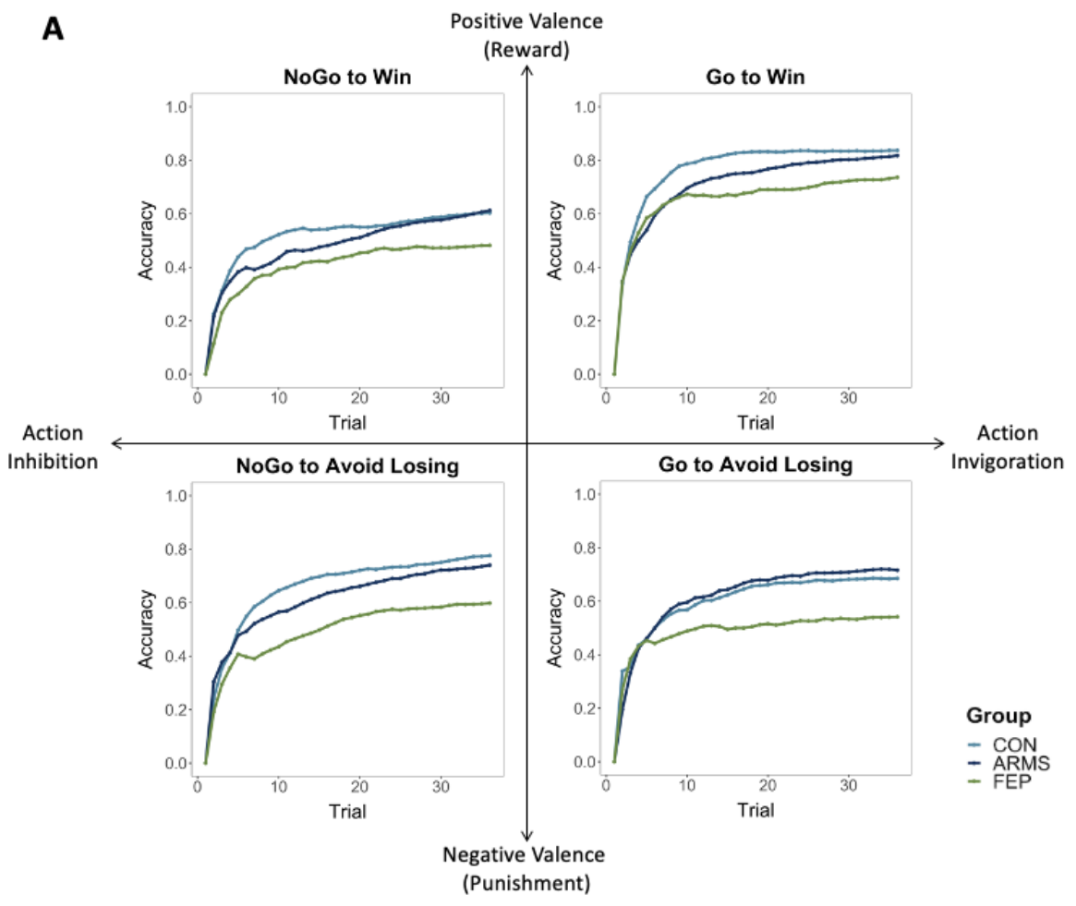
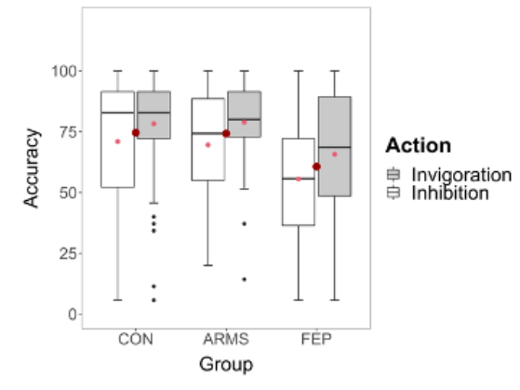
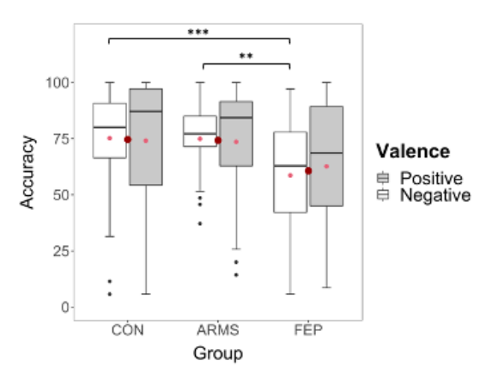
Performance-ANOVA
Analysis & Results
the within-variables valence (positive vs. negative) and action (invigoration vs. inhibition) in a mixed analysis of variance (ANOVA) design with subsequent Tukey post hoc tests.

Slide 15
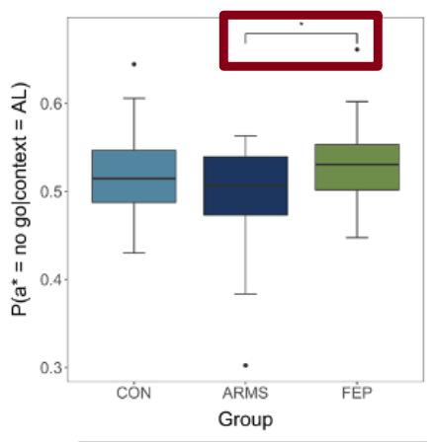
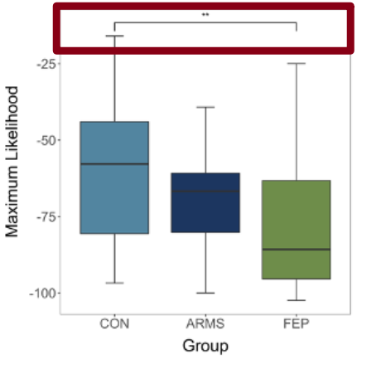
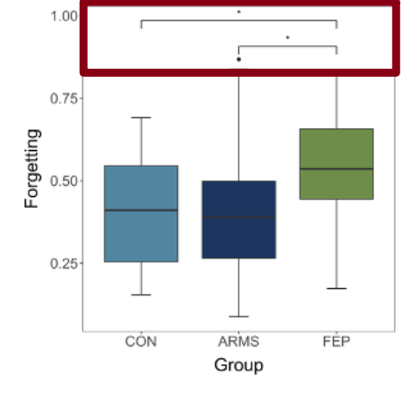
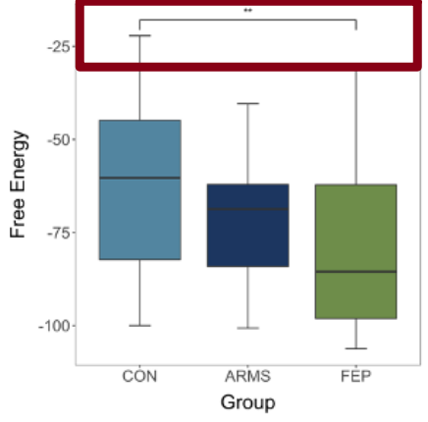
Active Inference Parameters-ANOVA
Analysis & Reults
One-way ANOVAs and Tukey post hoc tests were performed (between groups) We found
significant differences for (*p < 0.05, **p < 0.01, ***p< 0.001)
Pavlovian loss prior
forgetting
Free Energy
Maximum Likelihood

Slide 16
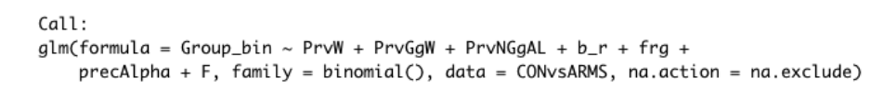
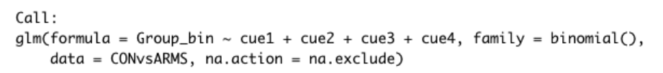
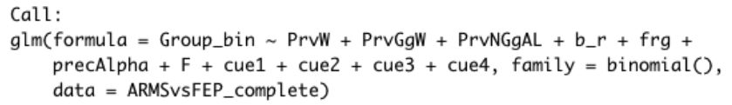
Classification Based on Different Parameters
Analysis
Logistic Regression, LR
虽然是回归，但实际上是分类模型
Receiver Operating Characteristic, ROC analysis
Performance of classification: assessed the area under the curve (AUC) to evaluate whether AI parameters contribute to the classification of individuals.
class distribution imbalance problem, 样本在不同类别上的不均衡分布
cost sensitive learning, 在一些分类问题中犯不同的错误代价是不同的
x-coordinate: false positive rate(FPR)
y-coordinate: true positive rate(TPR)
(0, 0)-(1, 1) → chance
AUC thresholds for classification were defined as follows:
excellent = 0.90–1
good = 0.80–0.89
fair = 0.70–0.79
poor = 0.60–0.69
fail = 0.50–0.59 (ROC) analyses

Slide 17
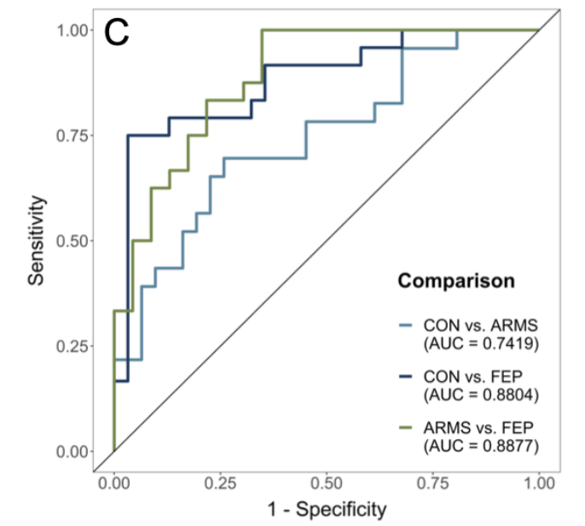
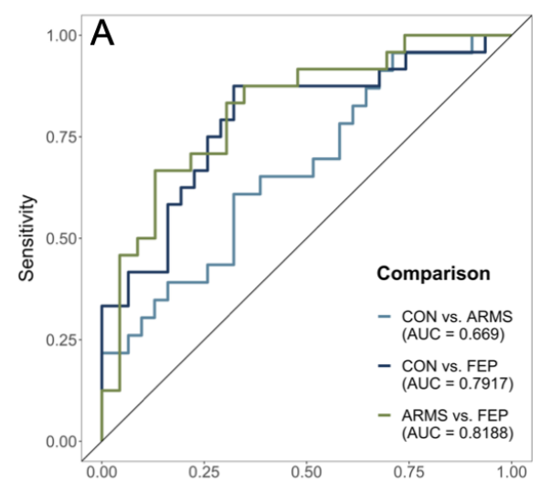
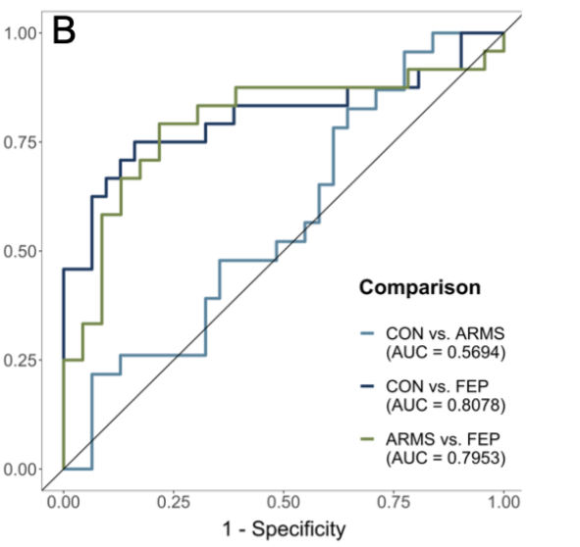
Classification Based on Different Parameters
Results

Slide 18
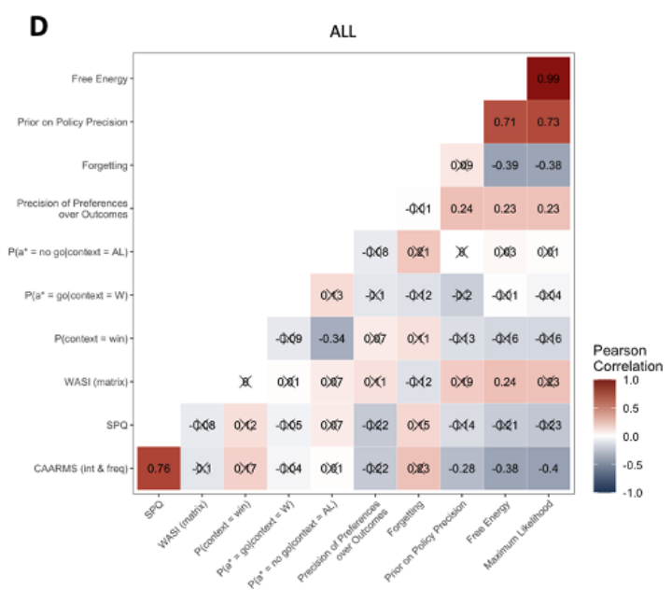
Exploration: AI Parameters & Clinical Measures
Analysis & Results
using exploratory heatmaps reporting Pearson’s correlation
a significant negative relationship between CAARMS and policy precision (r = -.28, p = .016)
Free Energy (r = -.38, p = .001)
maximum likelihood (r = -.40, p < .001) across all participants

