Slide 1
統計計算
賴俊延 林采宣

Slide 2
Outline
1
Introduction and Problem Setup
Monty Hall Problem、Simulation Framework
2
Statistical Inference
Bootstrap
Jackknife Method
Permutation Test
Markov Chain Monte Carlo (MCMC)-Metropolis Hastings Algorithm
Notes:
Monte Carlo Estimation Methods:
R Built-in Bernoulli Simulation
Inverse Transform Method
Antithetic Variates

Slide 3
1
Introduction and Problem Setup
三扇門
1參賽者第一次選到跑車
2參賽者第一次沒選到跑車:
a.主持人知道跑車在哪
b.主持人不知道跑車在哪

Slide 4
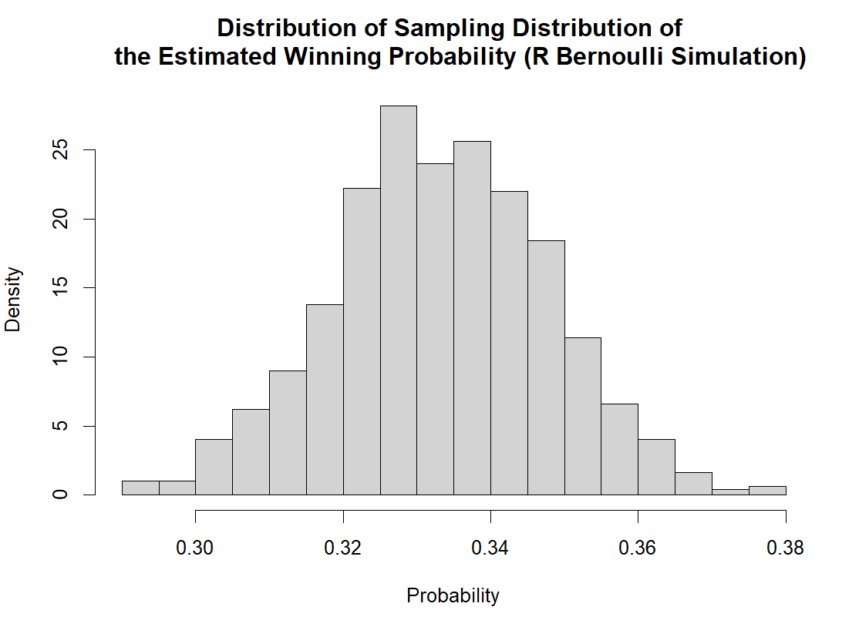
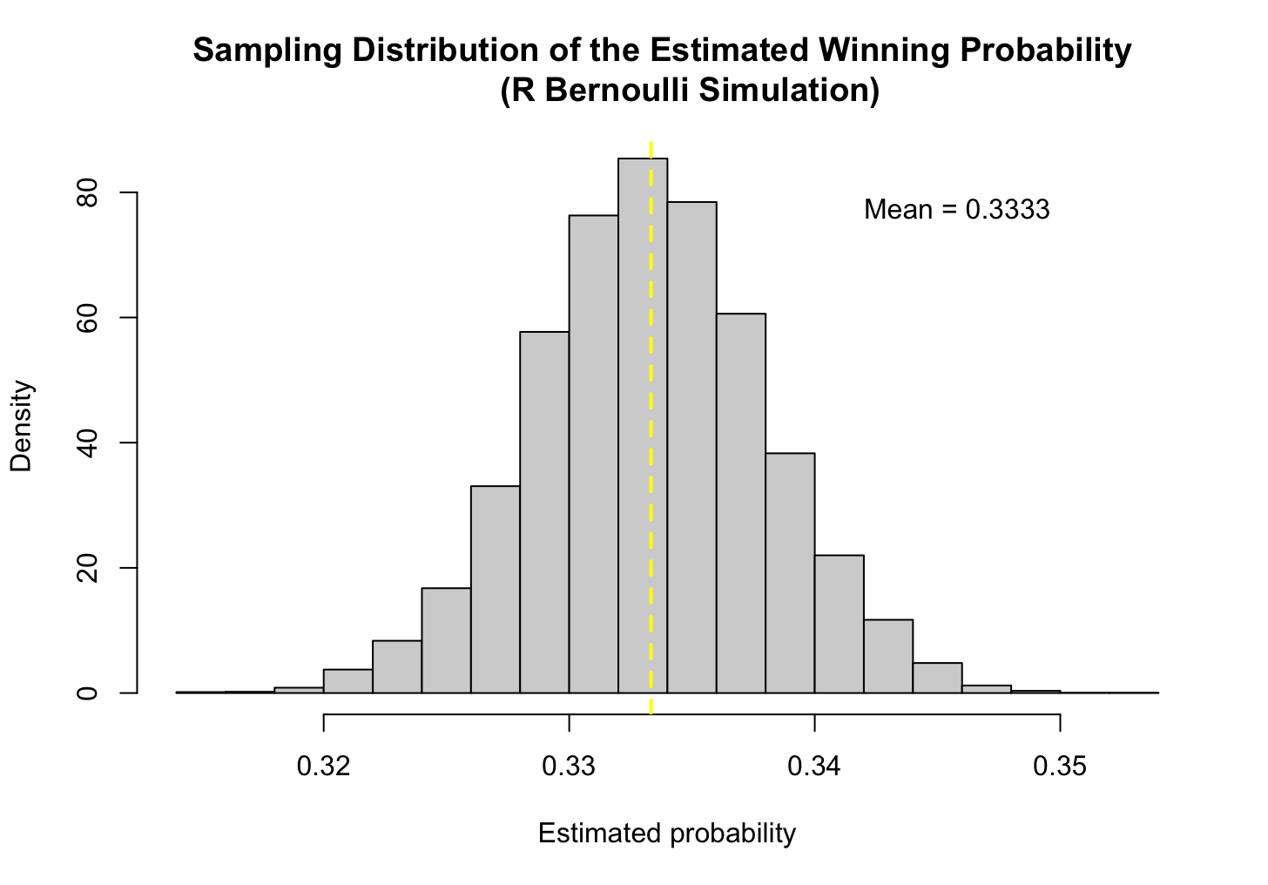
1
Situation 1: When contestant selected the sport car at the 1st time
Method: Built in R Bernoulli Simulation
Notes:
再看要如何呈現 我的是右邊的圖

Slide 5
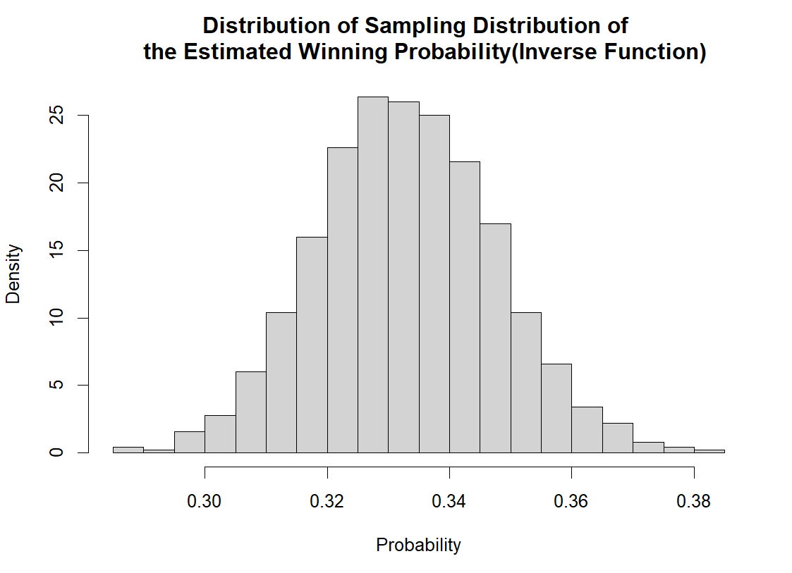
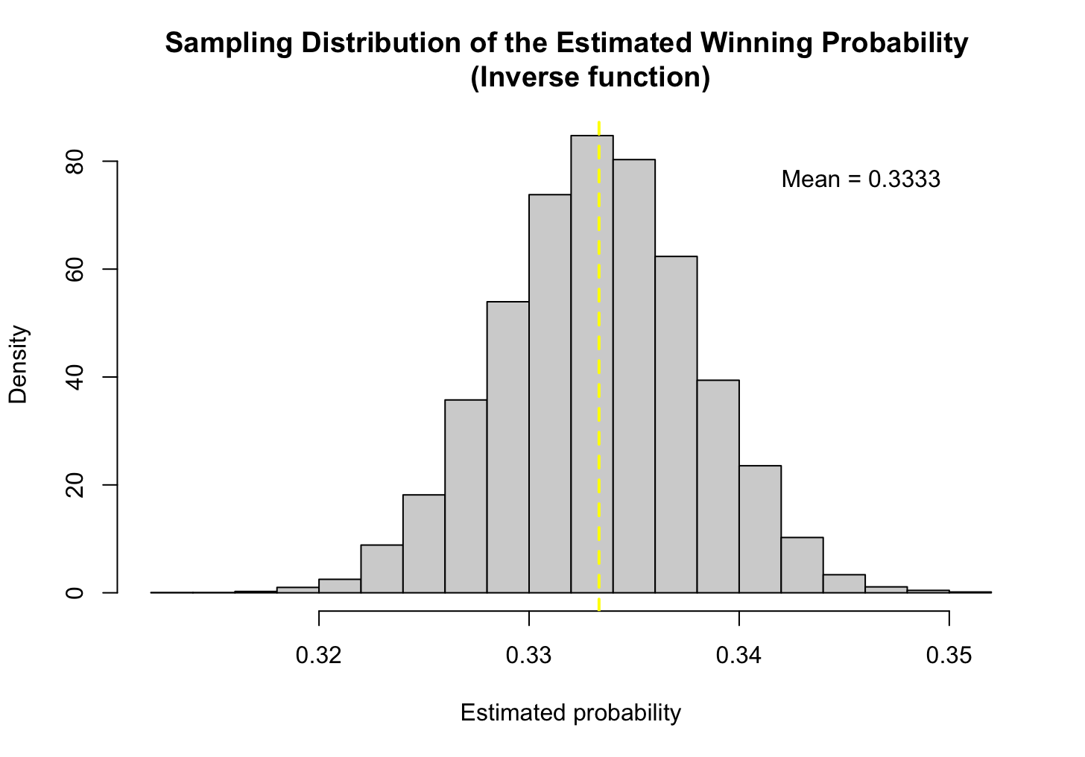
1
Situation 1: When contestant selected the sport car at the 1st time
Method: Inverse Function

Slide 6
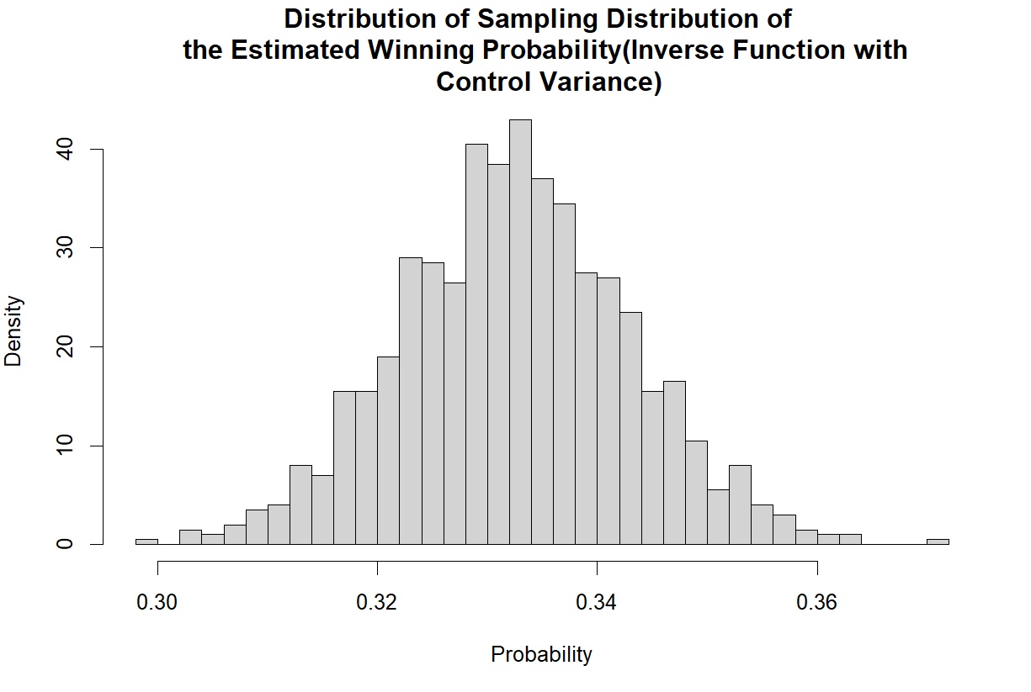
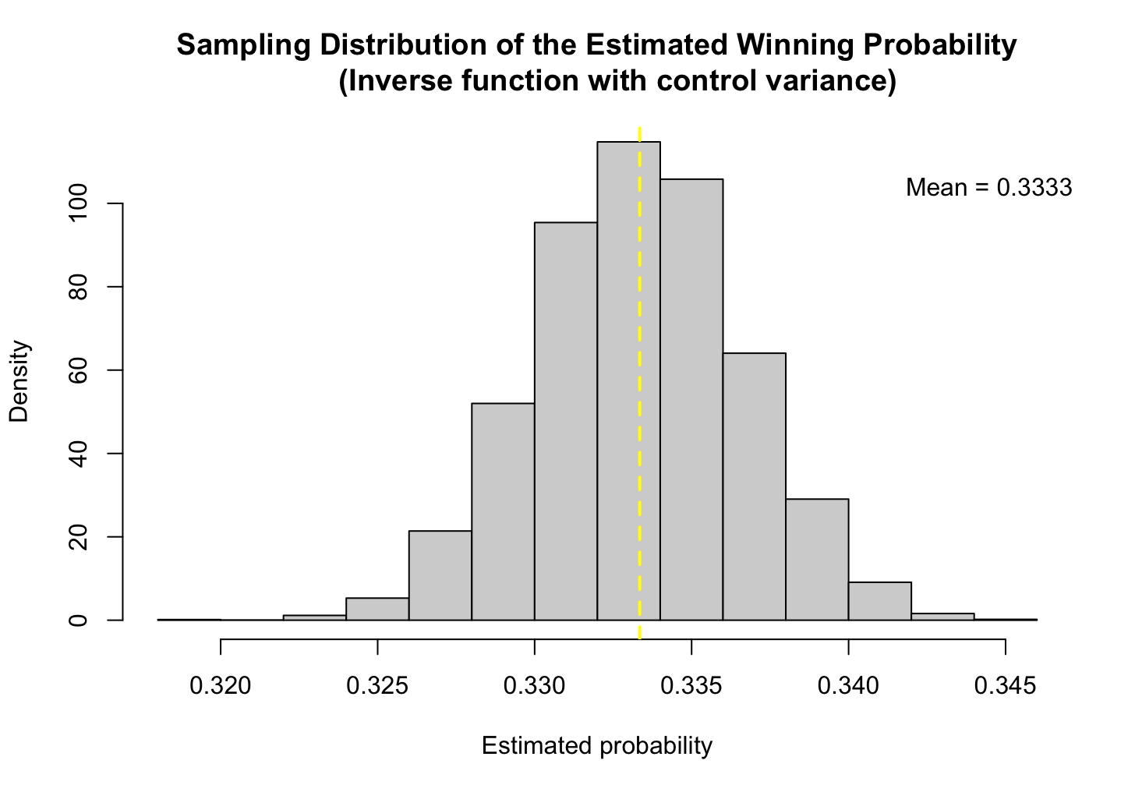
1
Situation 1: When contestant selected the sport car at the 1st time
Method: Inverse Function with Control Variance

Slide 7
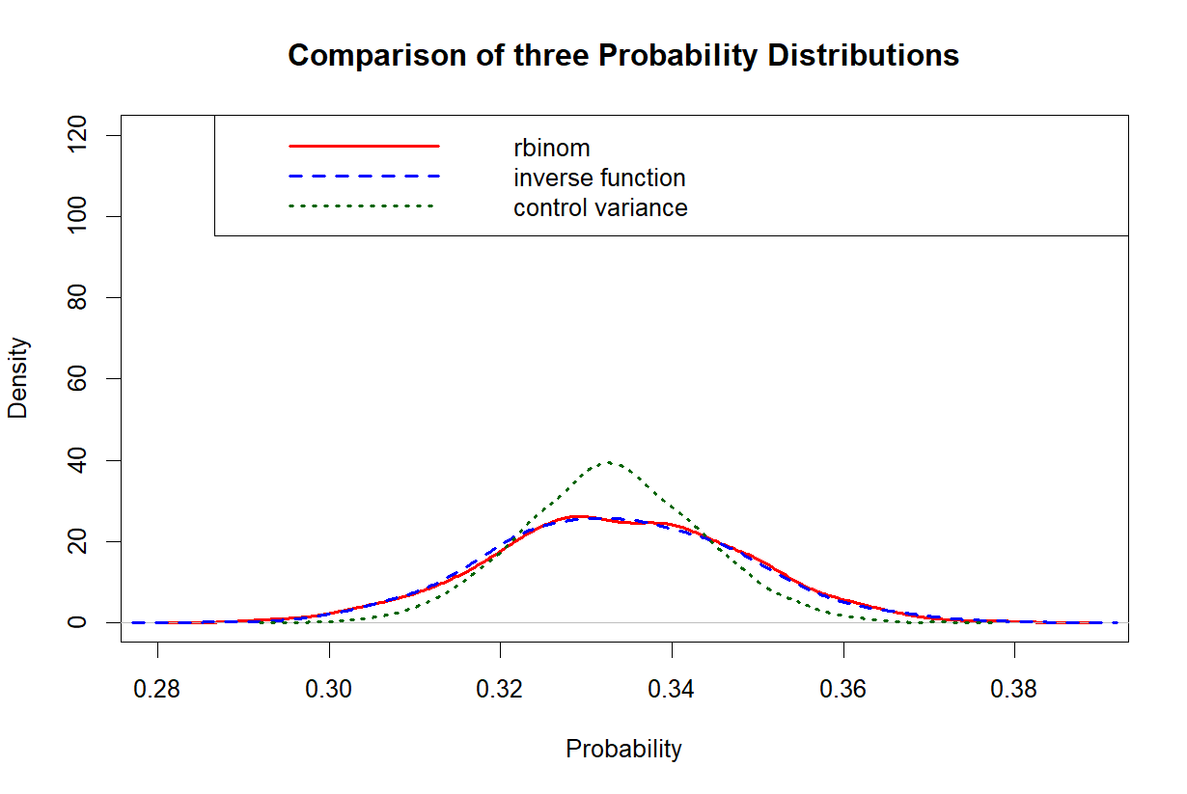
1
Situation 1: When contestant selected the sport car at the 1st time
Variance reduction = 47.68226 %
Method | Mean | Var
Built in R Bernoulli Simulation | 0.333476 | 0.0002325059
Inverse Function | 0.332992 | 0.0002223783
Inverse Function with Control Variance | 0.333429 | 0.0001163433
Notes:
antithetic variates 確實降低了估計值的變異

Slide 8
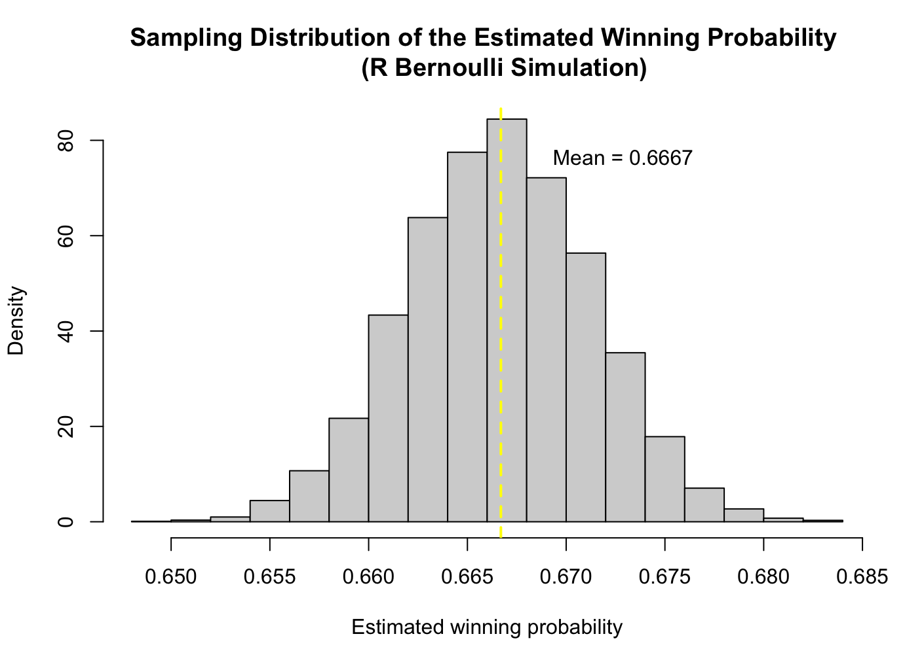
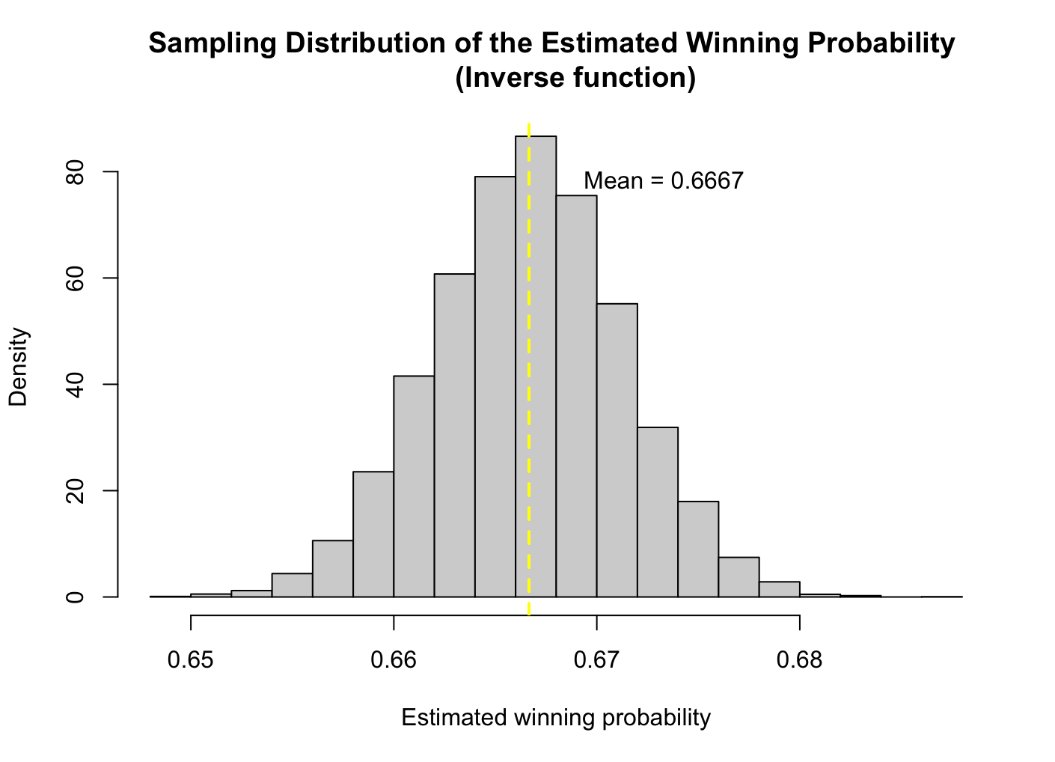
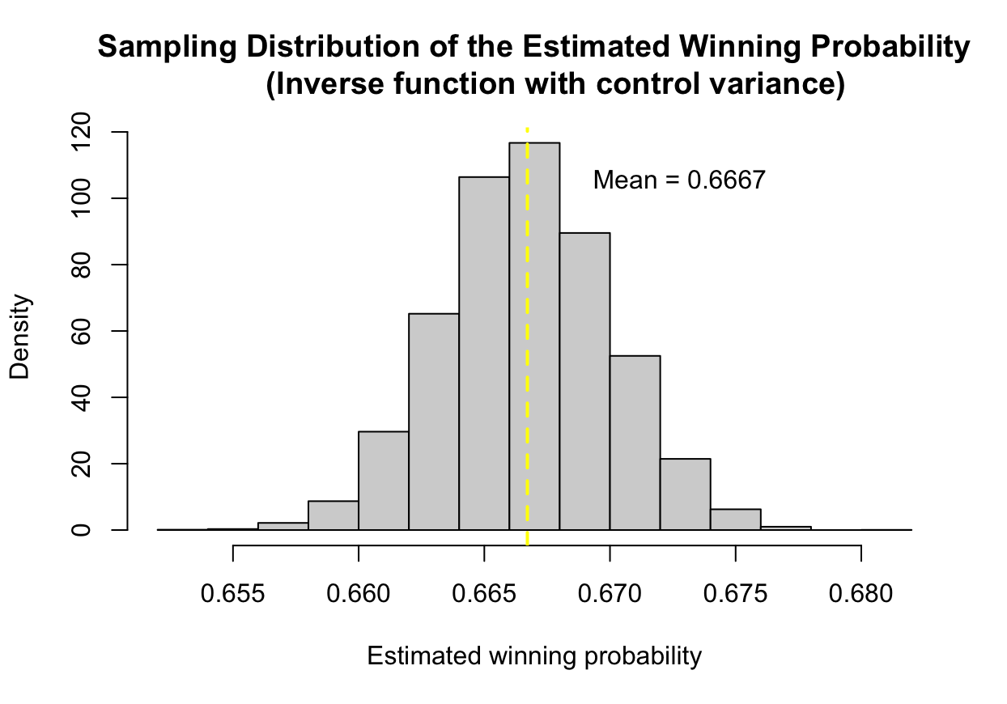
1
Situation 2: When contestant didn’t select the sport car at the 1st time
a. If host knows the correct answer:

Slide 9
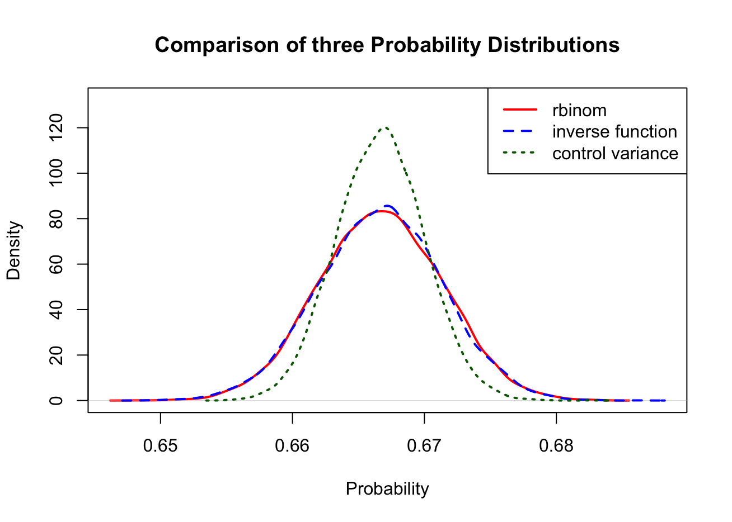
1
Situation 2: When contestant didn’t select the sport car at the 1st time
a. If host knows the correct answer:
Variance reduction = 49.30385 %
Method | Mean | Var
Built in R Bernoulli Simulation | 0.6666710 | 0.00002238811
Inverse Function | 0.6666709 | 0.00002207536
Inverse Function with Control Variance | 0.6666532 | 0.00001110665
Notes:
antithetic variates 降低了估計值的變異

Slide 10
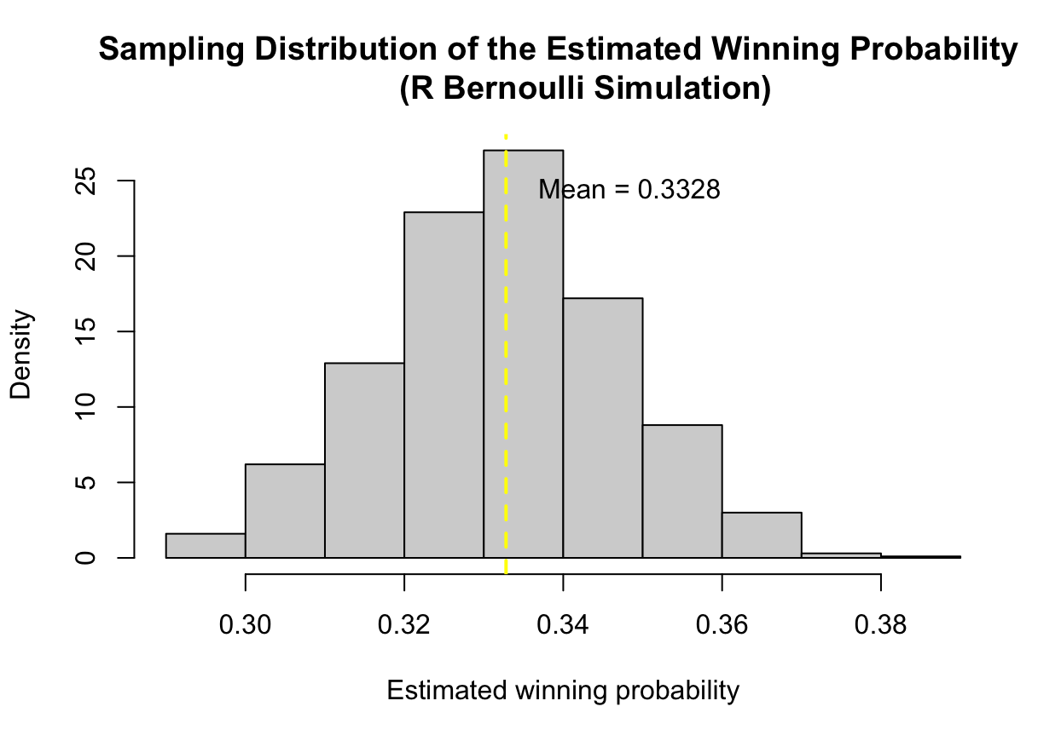
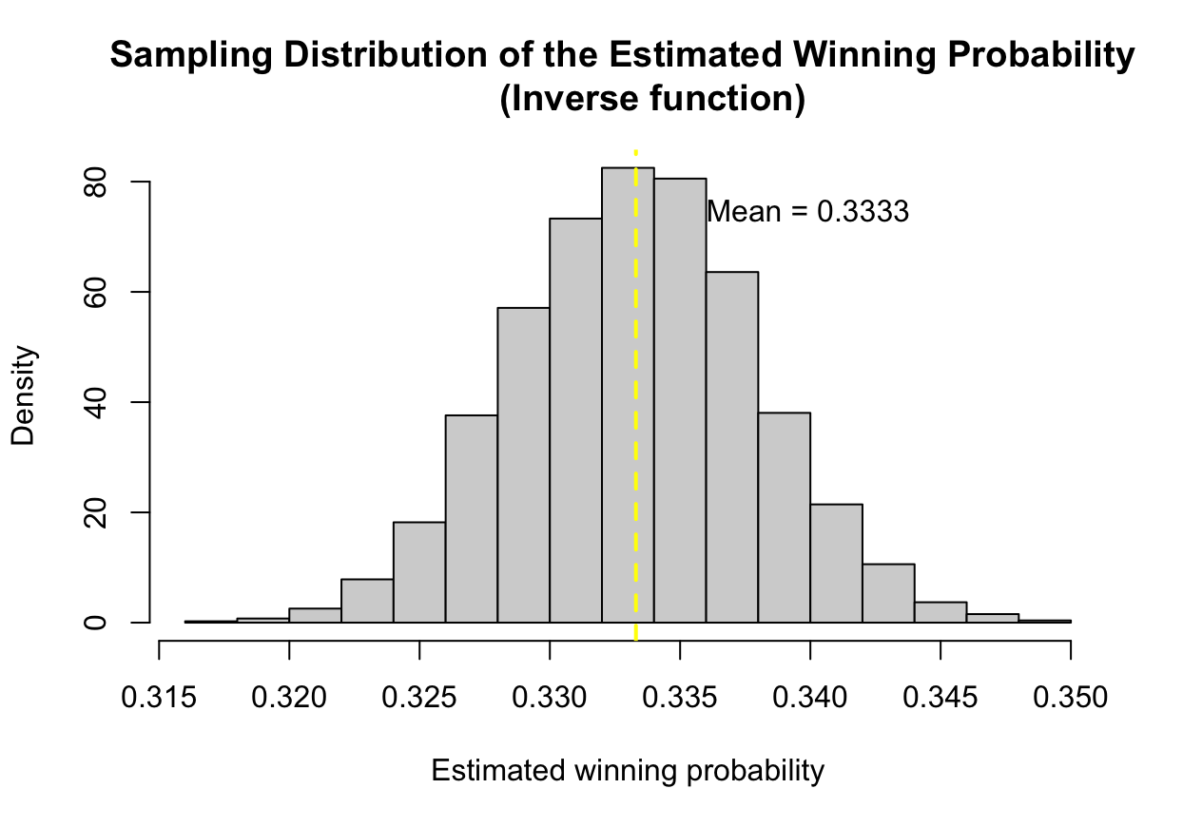
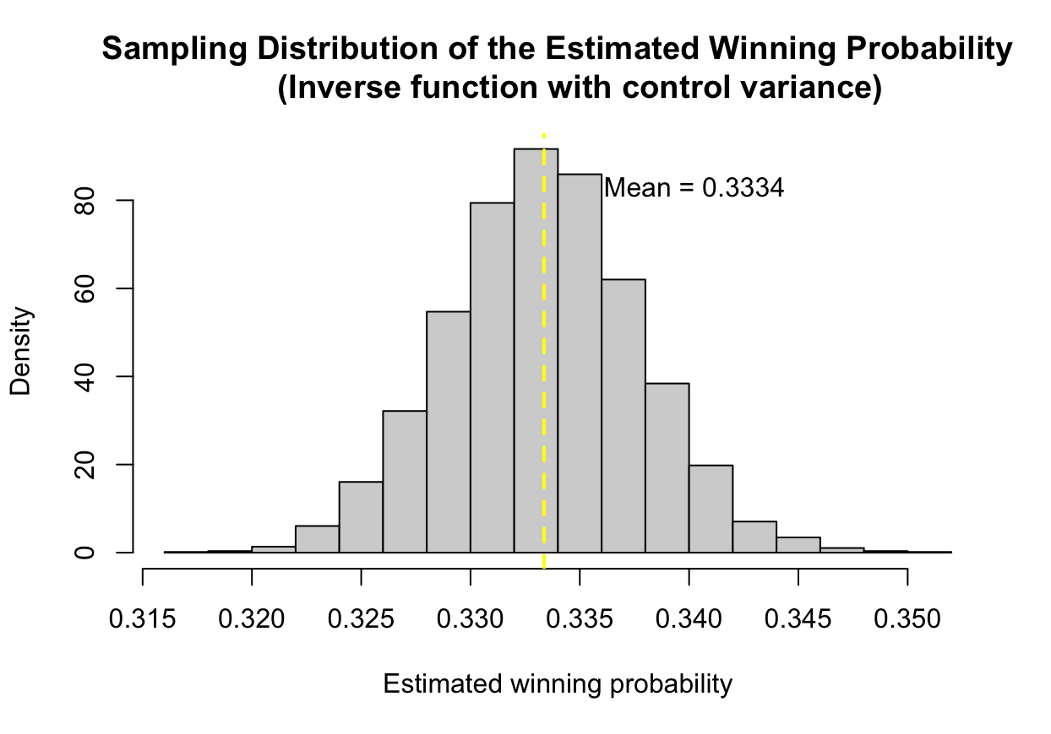
1
Situation 2: When contestant didn’t select the sport car at the 1st time
b. If host doesn’t know the correct answer:
Notes:
Bernoulli Var:0.0002245371

Slide 11
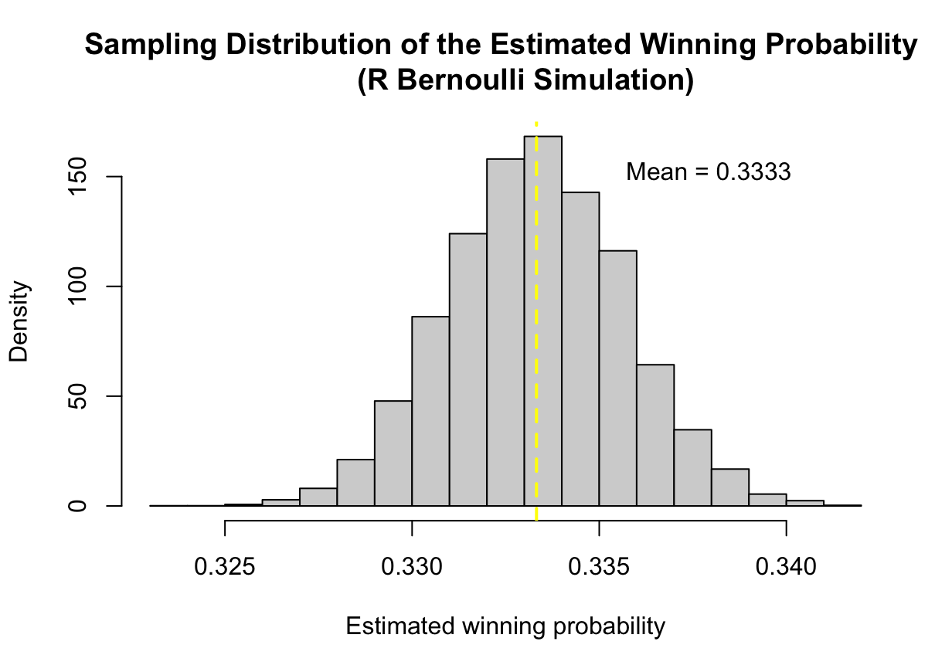
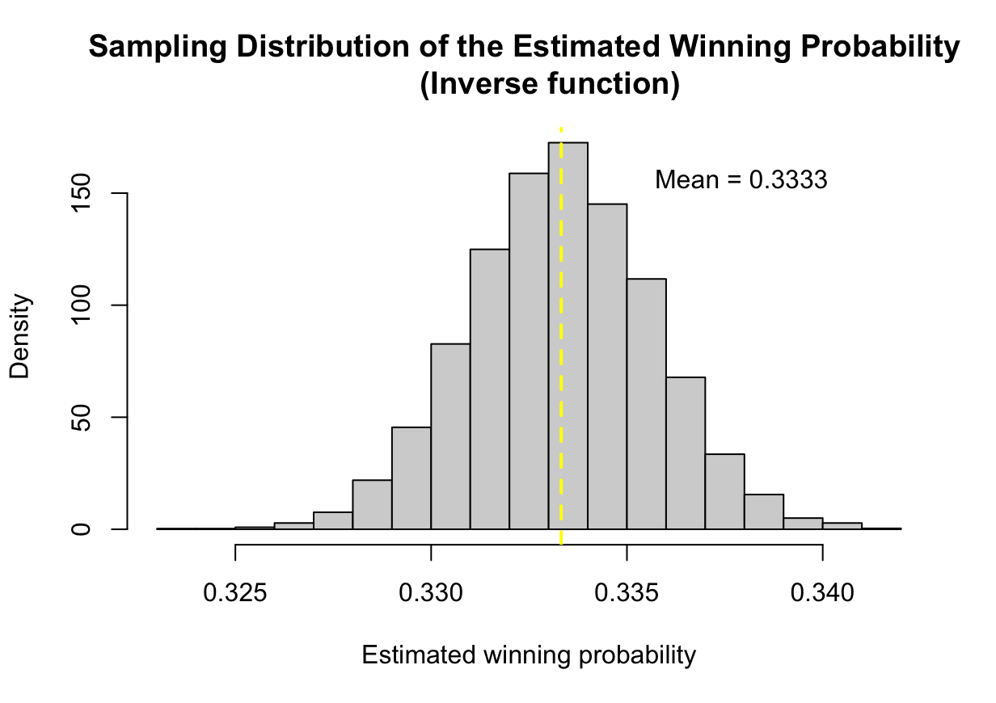
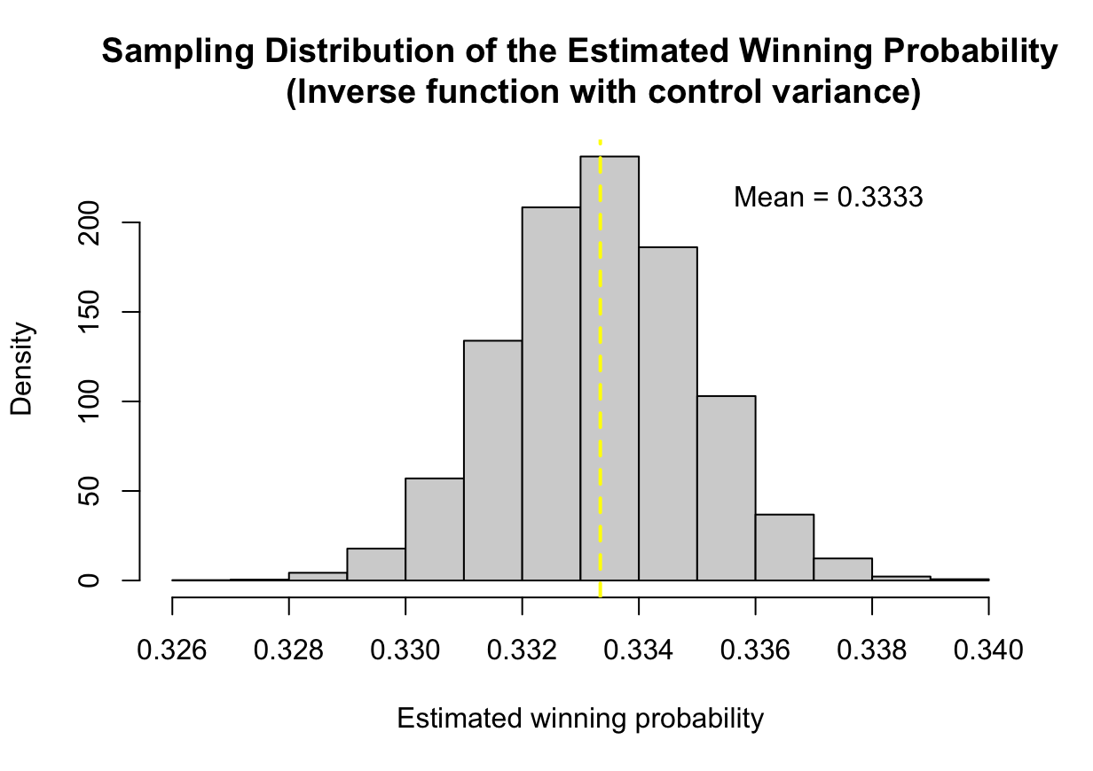
1
Situation 2: When contestant didn’t select the sport car at the 1st time
b. If host doesn’t know the correct answer: (control)
Notes:
Bernoulli Var:0.0002245371

Slide 12
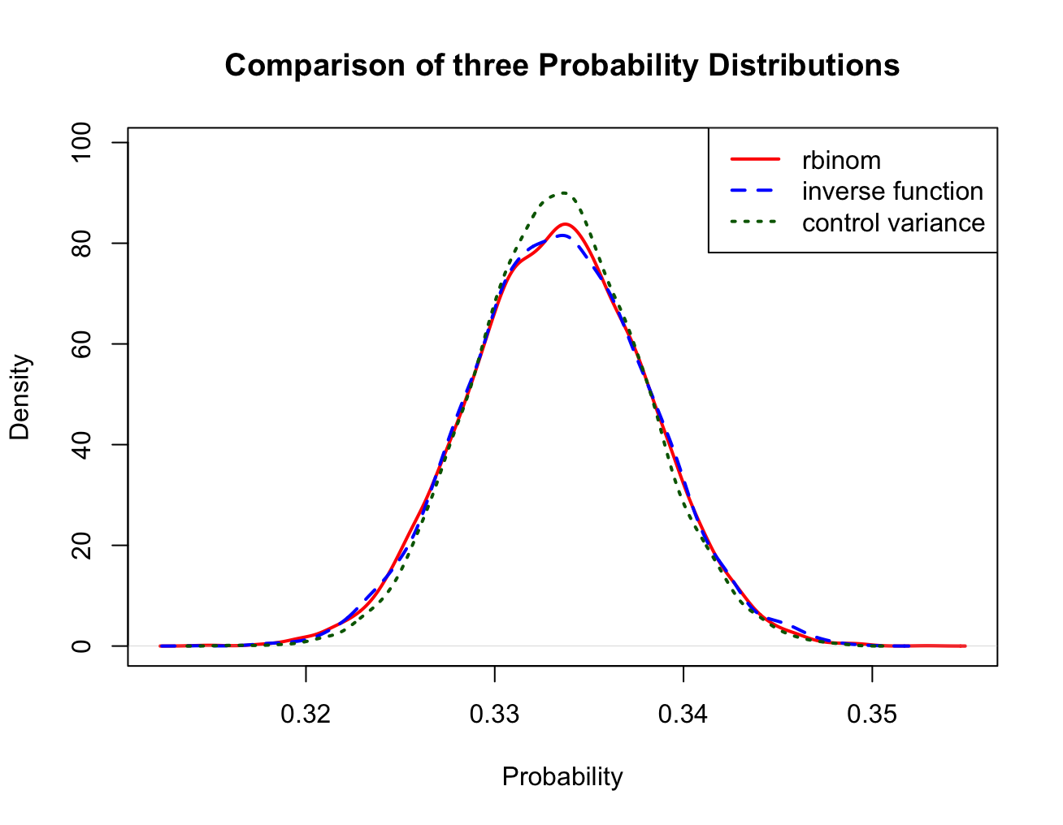
1
Situation 2: When contestant didn’t select the sport car at the 1st time
b. If host doesn’t know the correct answer:
Variance reduction = 12.98665 %
Method | Mean | Var
Built in R Bernoulli Simulation | 0.333376 | 0.000220071
Inverse Function | 0.333328 | 0.0000214475
Inverse Function with Control Variance | 0.333403 | 0.0000196868

Slide 13
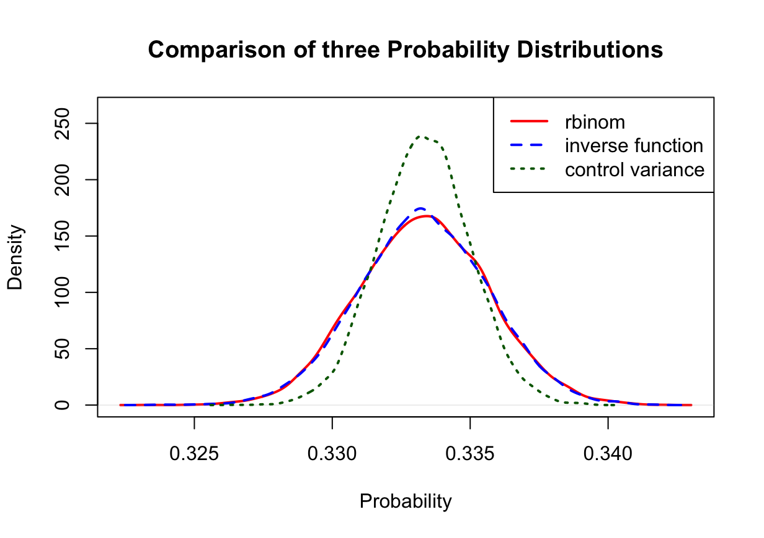
1
Situation 2: When contestant didn’t select the sport car at the 1st time
b. If host doesn’t know the correct answer: (control)
Variance reduction = 50.20768 %
Method | Mean | Var
Built in R Bernoulli Simulation | 0.3333115 | 0.000005541007
Inverse Function | 0.3333216 | 0.000005634683
Inverse Function with Control Variance | 0.3333022 | 0.000002810874

Slide 14
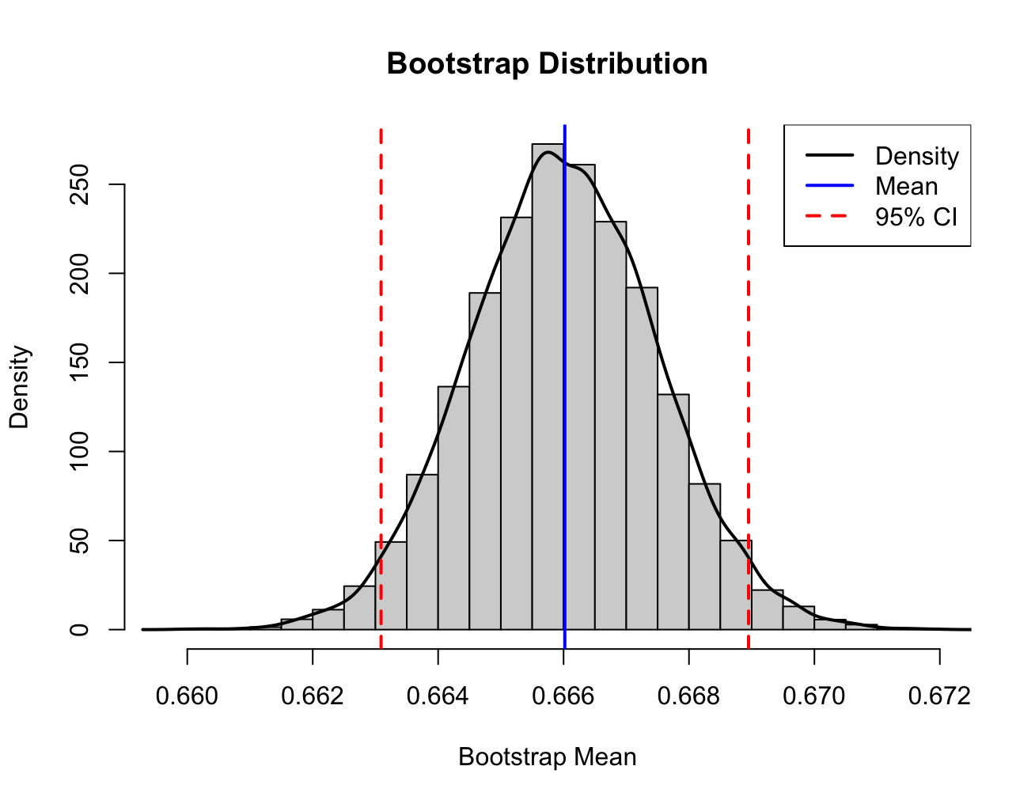
2
Statistical Inference - Bootstrap
Method | mean | bias | std. error
Bootstrap | 0.66602 | -0.00001.9895 | 0.001496019
Notes:
換門後選到車的機率
Ｑ:bootstrap（設定是inverse function）需要跟前面兩種情況（主持人是否知道答案）比較嗎

Slide 15
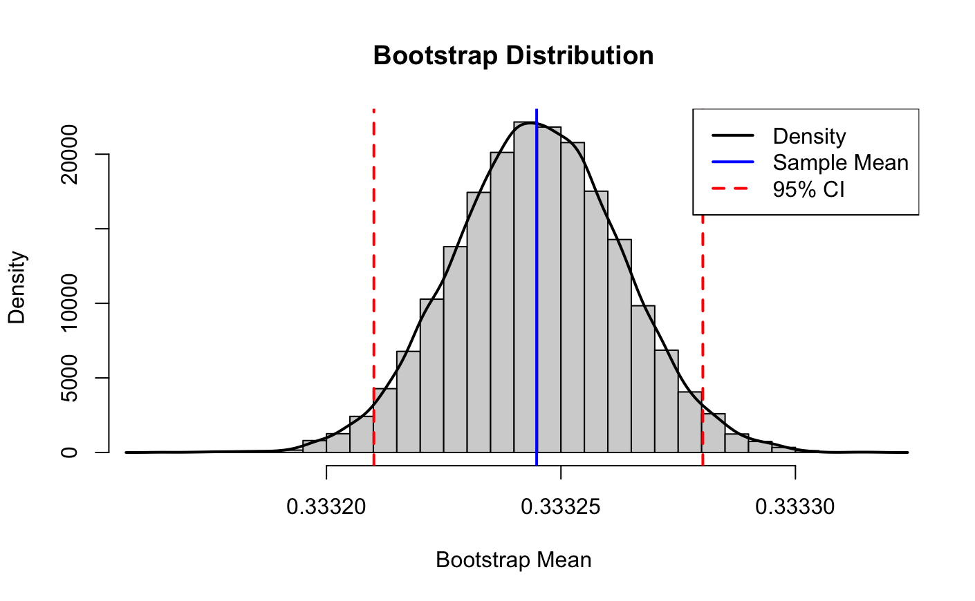
Statistical Inference - Bootstrap
new
2
Method | mean | bias | std. error
Bootstrap | 0.3332448 | 0.000000202 | 0.0000178

Slide 16
2
Statistical Inference - Bootstrap
Method | mean | bias | std. error
Bootstrap | 0.66602 | -0.00001.9895 | 0.001496019
Notes:
換門後選到車的機率
Ｑ:bootstrap（設定是inverse function）需要跟前面兩種情況（主持人是否知道答案）比較嗎

Slide 17
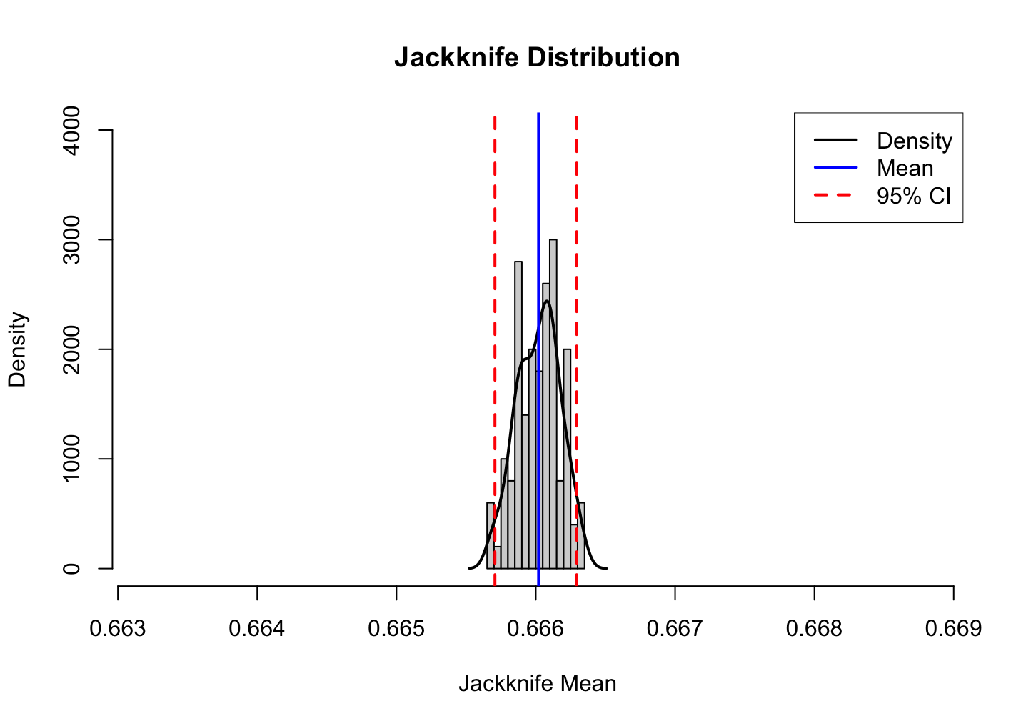
2
Statistical Inference - Jackknife
New 還美改完語法
Method | mean | bias | std. error
Jackknife | 0.66602 | 0 | 0.001502186

Slide 18
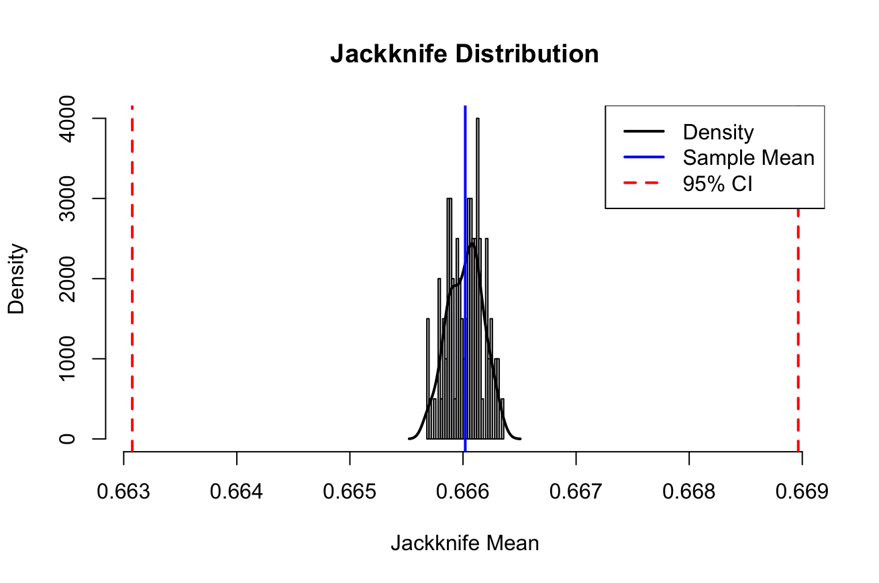
2
Statistical Inference - Jackknife
修正過1.96
Method | mean | bias | std. error
Jackknife | 0.66602 | 0 | 0.001502186

Slide 19
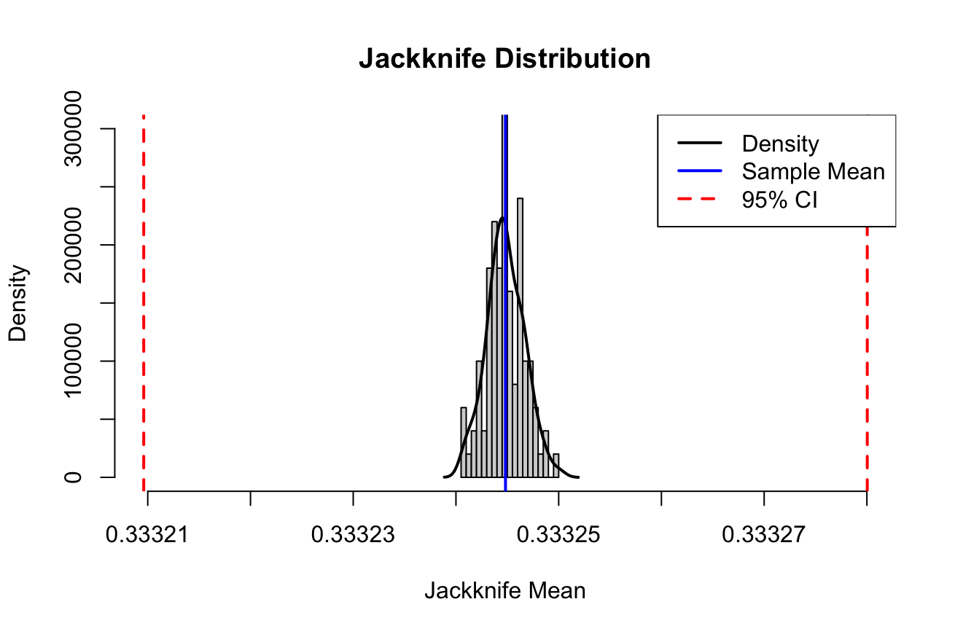
Statistical Inference - Jackknife
2
new
Method | mean | bias | std. error
Jackknife | 0.3332448 | 0 | 0.00001796697

Slide 20
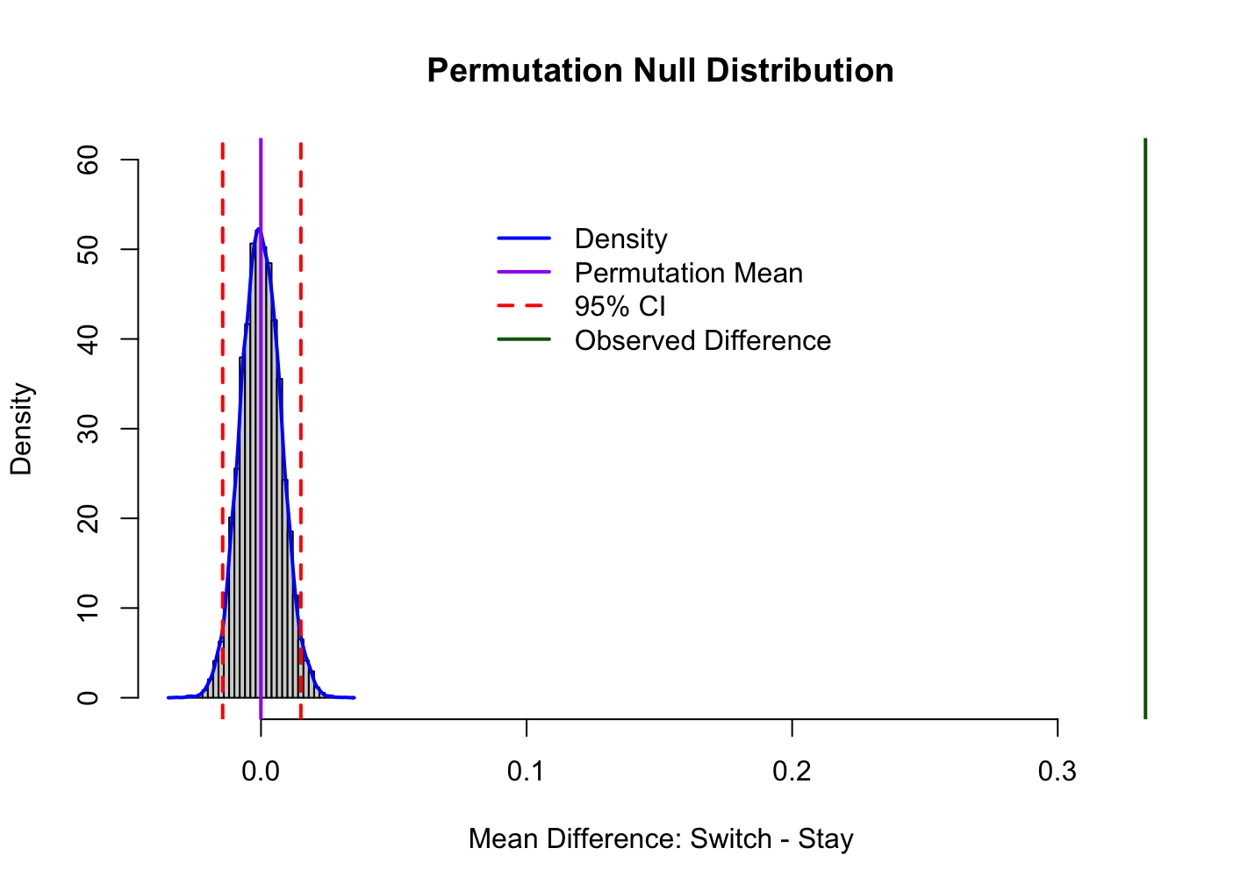
2
Statistical Inference - Permutation Test
$H_{0}:μ_{swtich}= μ_{stay}$
observation difference :
換門勝率 - 不換門勝率
= 0.666746- 0.333708
Method | mean | observation difference | p-value
Permutation | −0.0000369804 | 0.333038 | 0
Notes:
Permutation 結果：換門勝率66.7%、不換的勝率是33.4%
接近理論:換門勝率2/3. 不換的勝率1/3
H0:換門與不換門勝率沒有差別 （兩組平均數差異=0）
p=0:observed difference 幾乎不可能來自null distribution

Slide 21
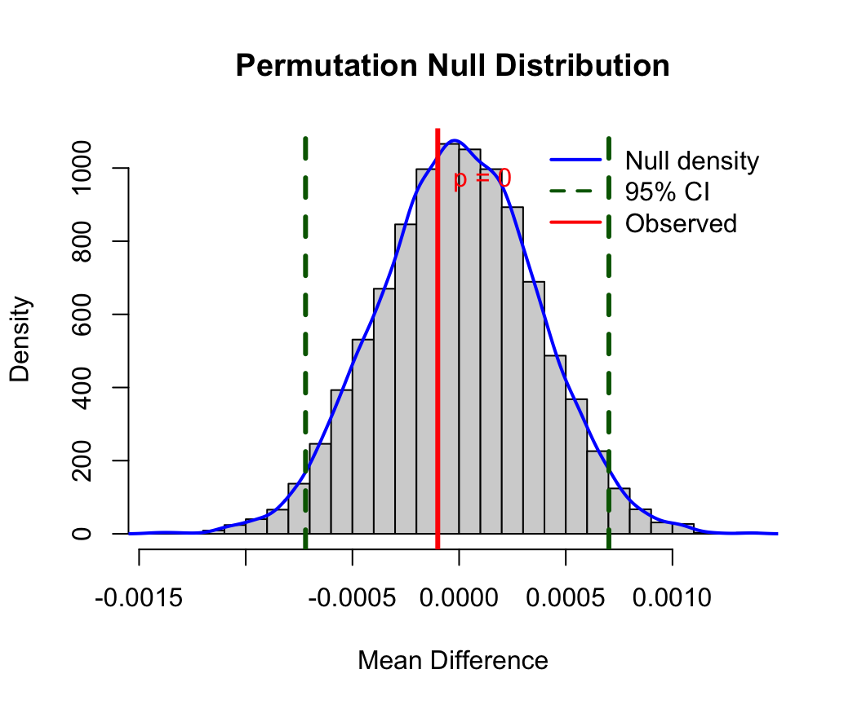
2
Statistical Inference - Permutation Test
new
$H_{0}:μ_{swtich}= μ_{stay}$
Notes:
> mean(permutation_dist)
[1] -5.675989e-06
> mean(x - y)
[1] -0.0001001191
> sd(permutation_dist)
[1] 0.0003675256

Slide 22
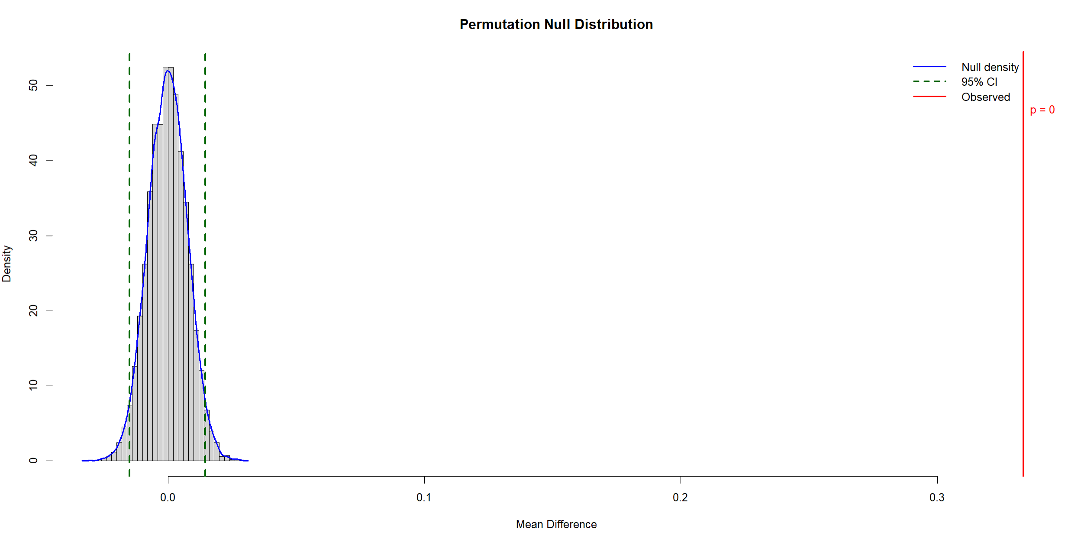
換門與不換門選到跑車的機率是否有差
 | Mean | Obs | std. error
Jacknife | 0.0001991734 | 0.333292 | 0.007416886

Slide 23
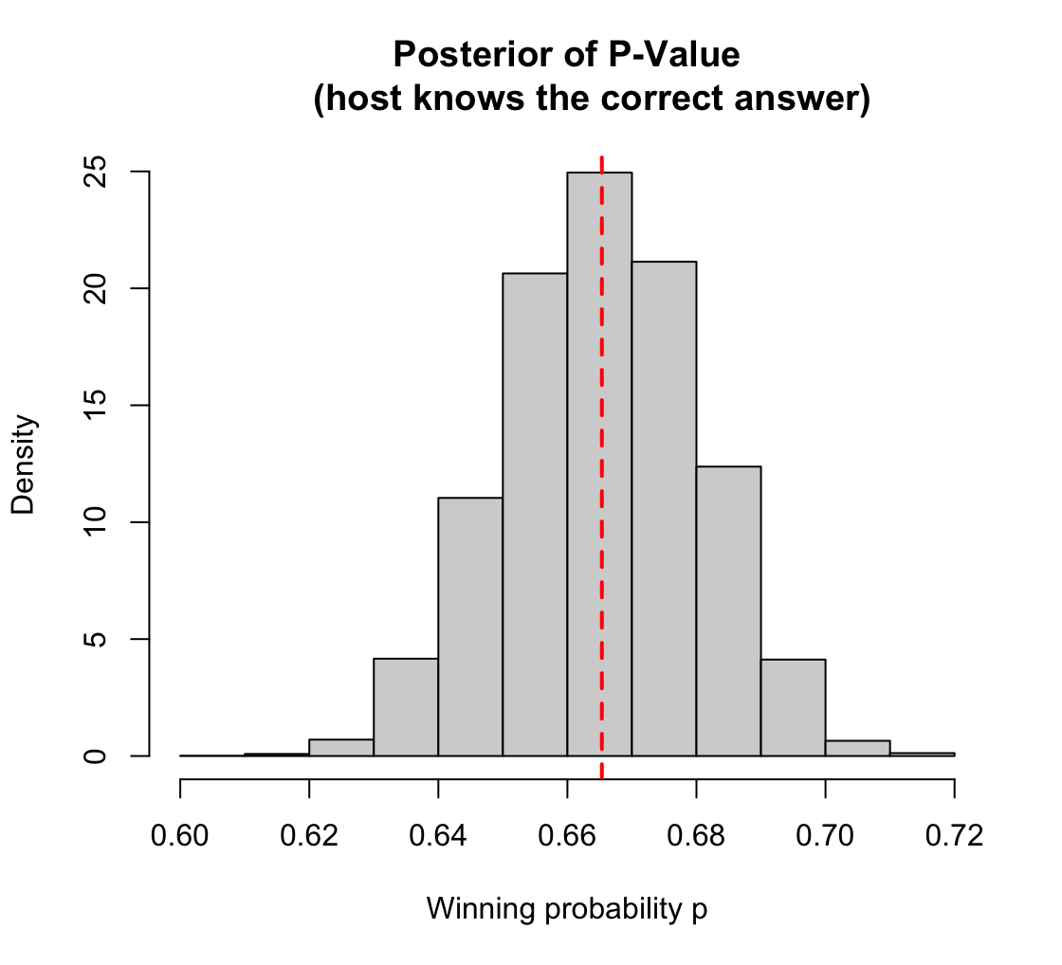
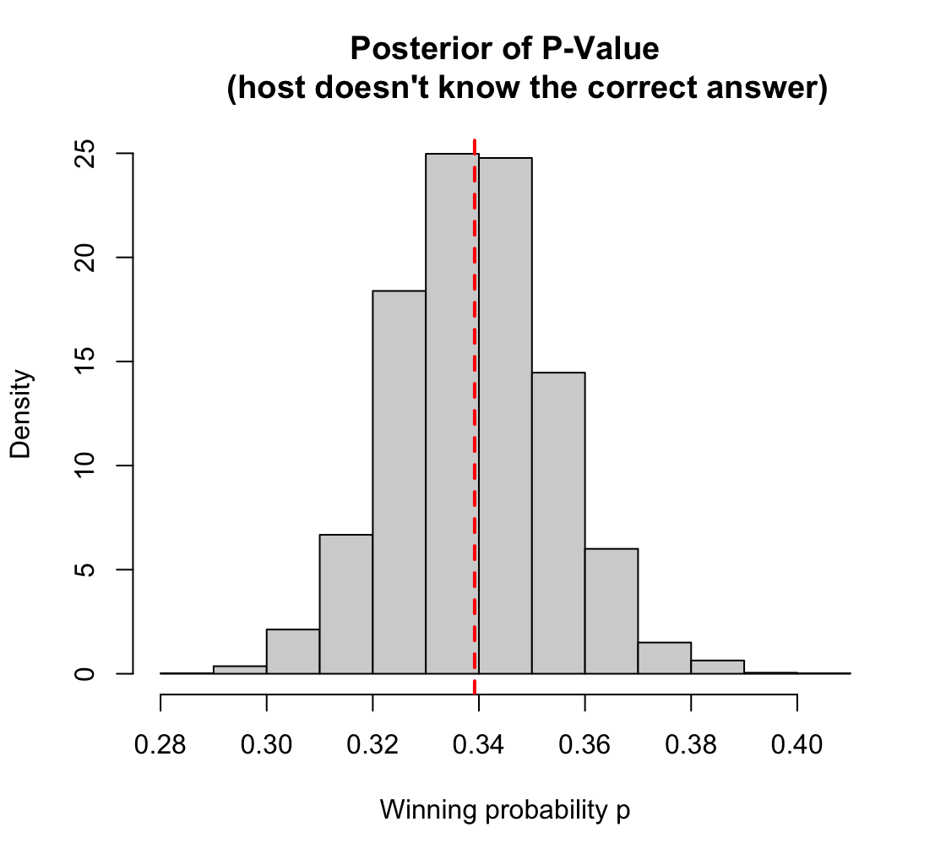
2
Statistical Inference: Markov Chain Monte Carlo (MCMC)-Metropolis Hastings Algorithm
N_iter: 10000
Probability:0.6653407
Probability: 0.3391910
Notes:
Monte Carlo Estimation Methods
Bootstrap
Jackknife Method
Permutation Test
Markov Chain Monte Carlo (MCMC)-Metropolis Hastings Algorithm

Slide 24
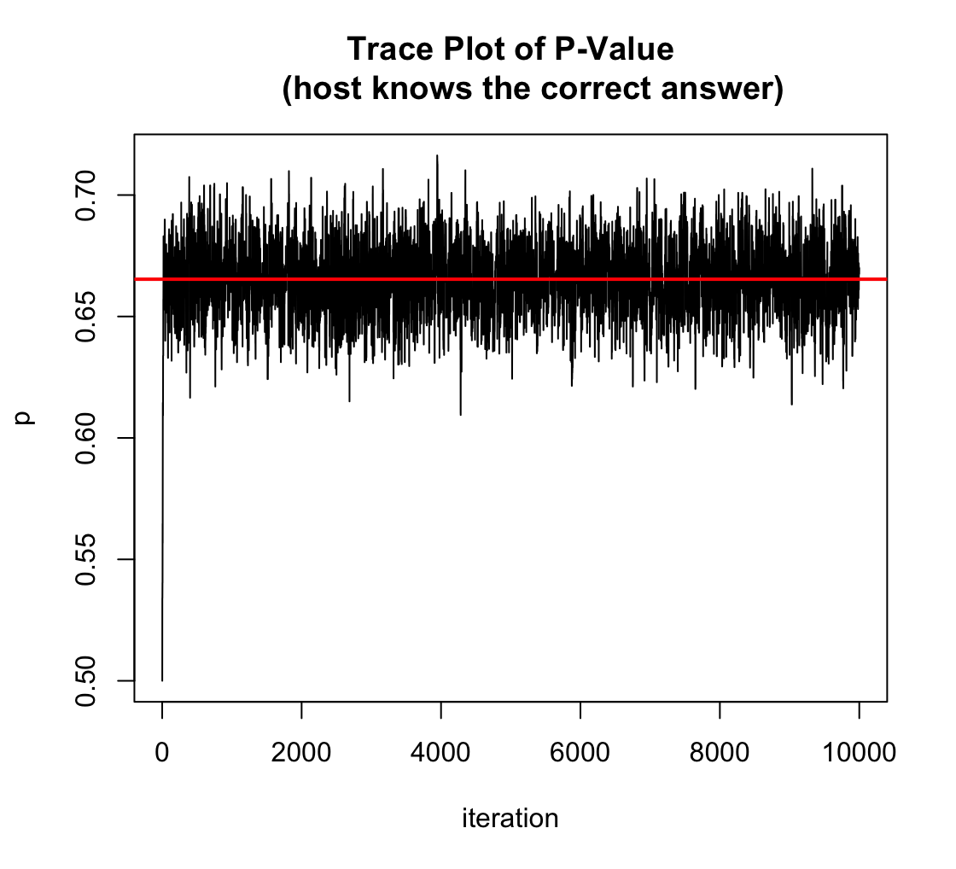
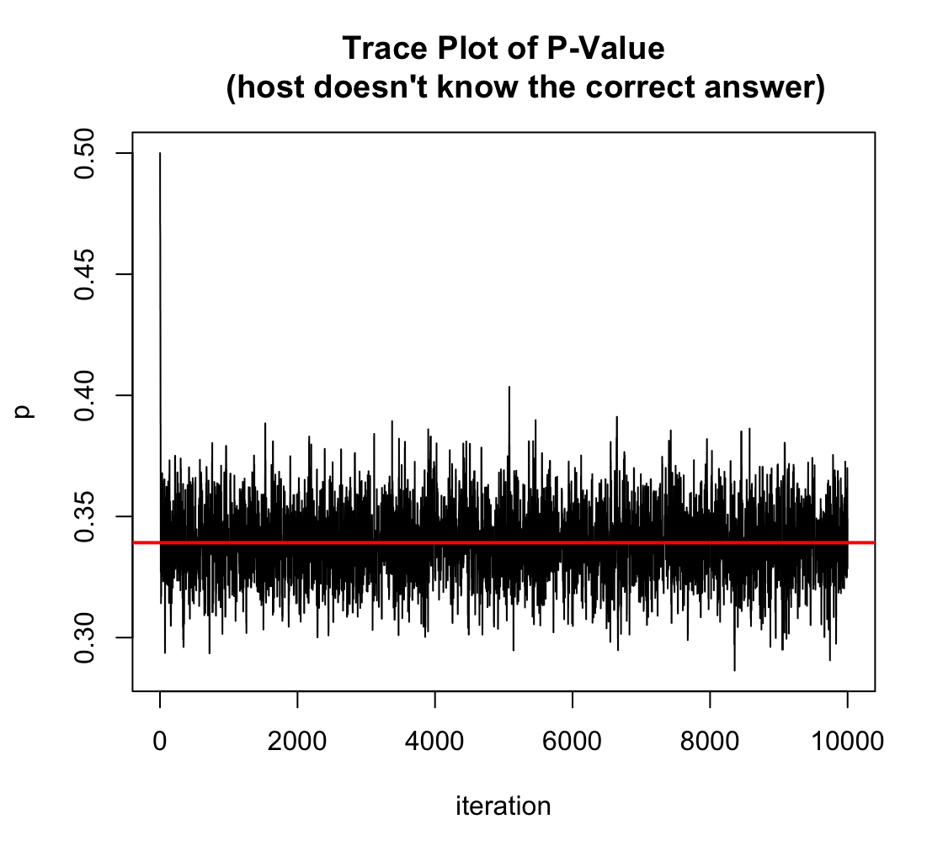
2
Statistical Inference: Markov Chain Monte Carlo (MCMC)-Metropolis Hastings Algorithm
burn-in period:chain前2000次的抽樣先不用 ->從trace plot可知前期波動大
兩個抽樣機率的分佈都是穩定落在相同區間
Notes:
Monte Carlo Estimation Methods
Bootstrap
Jackknife Method
Permutation Test
Markov Chain Monte Carlo (MCMC)-Metropolis Hastings Algorithm

Slide 25
樹狀圖
Car
2/3
Goat
Goat
Choice
1/3
Goat
Car
Car

Slide 26
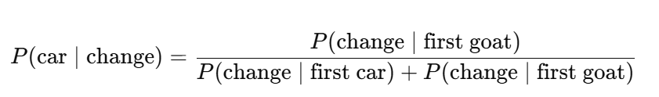
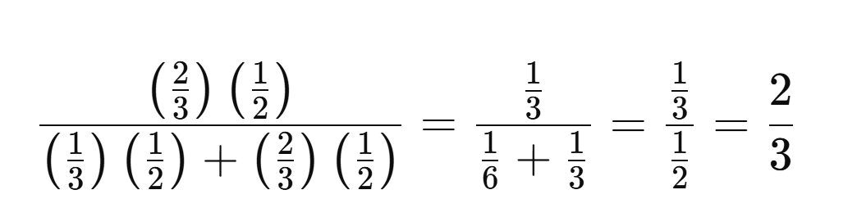
換門的勝率

