Slide 1
Biodiversity for the National Parks
An Analysis by Jason Zhu

Slide 2
Objectives
Analyse data on endangered species from several different parks.
Perform some data analysis on the conservation statuses of these species.
Investigate if there are any patterns or themes to the types of species that become endangered.

Slide 3
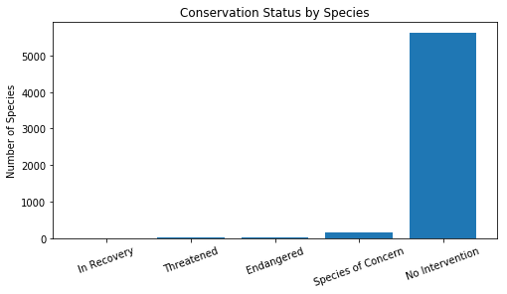
Species Overview
Total 5541 species live in the national parks.
The vast majority of species do not require conservation intervention!
5 conservation statuses:
Species of Concern
Endangered
Threatened
In Recovery
No Intervention
Conservation Status | Number of Species
In Recovery | 4
Threatened | 10
Endangered | 16
Species of Concern | 161
No Intervention | 5633

Slide 4
Species Overview The categories in these species
Category | Count
Amphibian | 79
Bird | 488
Fish | 125
Mammal | 176
Nonvascular Plant | 333
Reptile | 78
Vascular Plant | 4262
The category has most species is Vascular Plant which has 4262 species.

Slide 5
Most Likely Endangered species
category | Not Protected | Protected | Protected Rate
Amphibian | 72 | 7 | 0.088608
Bird | 413 | 75 | 0.153689
Fish | 115 | 11 | 0.087302
Mammal | 146 | 30 | 0.170455
Nonvascular Plant | 328 | 5 | 0.015015
Reptile | 73 | 5 | 0.064103
Vascular Plant | 4216 | 46 | 0.010793
The two species types most at risk of becoming endangered are mammals with17% and birds with 15%.
Use chi squared test to identify the difference of mammals and birds.
P-value is 0.6876.
The result shows this difference isn't significant.

Slide 6
Recommendation
Focus conservation efforts on those species which are the most likely to become endangered, such as mammals and birds.
Perform regular analysis of all populations to assess risk over time.

Slide 7
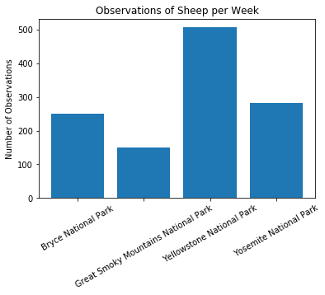
Foot and mouth disease of Sheep
Some scientists are studying the number of sheep sightings at different national parks.
Our scientists know that 15% of sheep at Bryce National Park have foot and mouth disease.
They want to be able to detect reductions of at least 5 percentage points.
Minimum Detectable Effect is 33.34

Slide 8
Observe sheep at Bryce National and Yellowstone National Park
The sample size we need at Bryce National Park is 870.
Bryce National Park need 3.48 weeks in order to observe enough sheep.
The sample size we need at Yellowstone National Park is 810.
Yellowstone National Park need 1.60 weeks to observe enough sheep.

