Slide 1

Smart Doorbell System
Ayesha Fatima 22-NTU-CS-1339
Muhammad Sheeraz 22-NTU-CS-1356
Sumaiya Shehzadi 22-NTU-CS-1376

Slide 2
Abstract / Executive Summary
ESP32-CAM captures visitor images and sends them via WiFi.
Flask server runs face recognition using OpenCV & SVM.
OLED & buzzer provide instant feedback.
Logs are stored in Firebase for remote monitoring.

Slide 3
Introduction
Traditional doorbells lack intelligence and monitoring.
Smart homes need secure, real-time visitor recognition.
This system enables remote logging and identity feedback.

Slide 4
Problem & Goals
Problems:
- No visitor identification or remote logging.
- Inefficient manual monitoring.
Goals:
- Real-time face recognition with feedback.
- Log events in the cloud.
- Modular, expandable design.

Slide 5

Hardware Components
• ESP32-CAM (AI Thinker): Image capture, WiFi.
• OLED Display (SSD1306): Shows name or 'Unknown'.
• Buzzer: Audio alert based on prediction.
• Power supply and GPIO wiring for peripherals.
•RASPI: Prediction and gateway.

Slide 6
Software Design
ESP32 Firmware (Arduino):
- WiFi connect, capture image, HTTP POST.
Flask Server (Python):
- Accepts image, processes face, logs to Firebase.
- Controls GPIO (OLED, Buzzer) using Adafruit libs.

Slide 7
Cloud & Network
• Firebase Realtime DB logs events with metadata.
• WiFi connection enables communication.
• Web UI provides image gallery and logs.

Slide 8
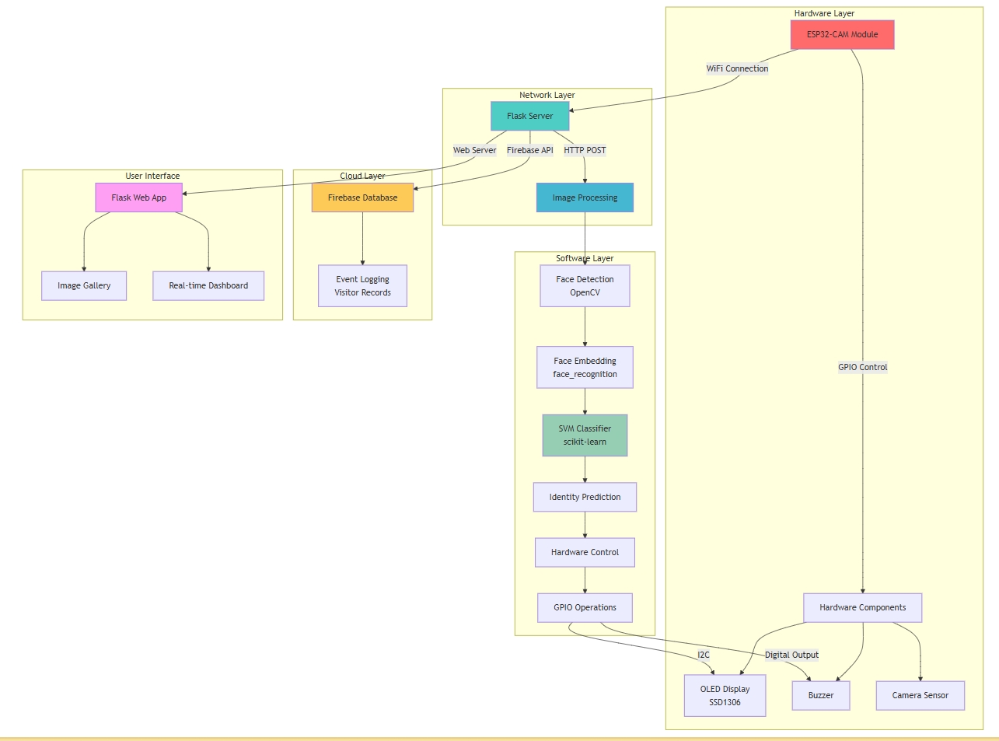

Slide 9
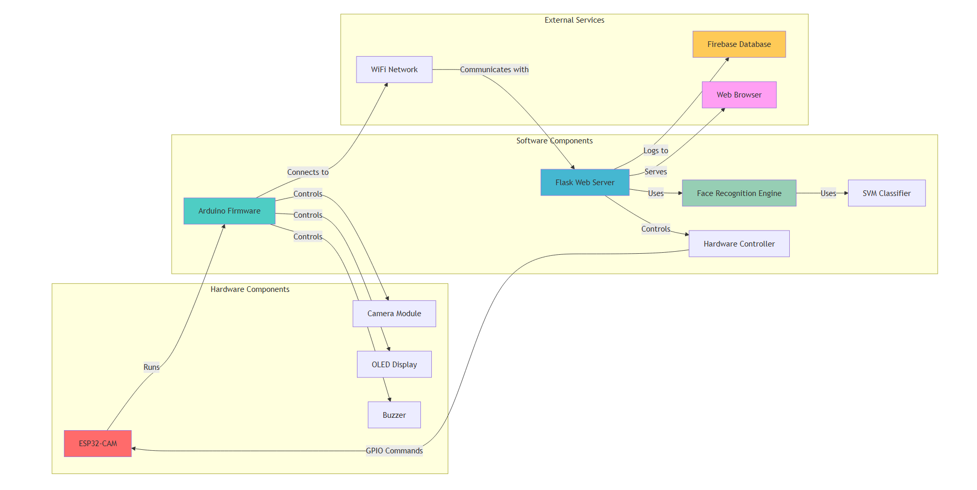
Flowchart Overview

Slide 10
Implementation Steps
1. Wire ESP32-CAM, OLED, Buzzer
2. Flash ESP32 firmware with WiFi credentials
3. Run Flask server & face recognition code
4. Connect Firebase for logging
5. Verify with real face samples

Slide 11
Code Highlights
ESP32: Sends image via HTTP POST to Flask.
Python:
- Embeds face using face_recognition
- Predicts identity using SVM model
- Triggers GPIO and logs to Firebase

Slide 12
Testing & Limitations
Test Cases: Known, Unknown, Network Failures.
Limitations:
- Requires trained dataset for recognition.
- Dependent on WiFi and server uptime.

Slide 13
Results & Discussion
• High accuracy on known faces.
• Feedback latency < 10 seconds.
• Logs and images are stored reliably in Firebase.

Slide 14
Future Scope
• Push mobile notifications.
• Door lock integration.
• Motion detection.
• Deep learning-based recognition.

Slide 15
Conclusion
Combines IoT, AI, and embedded systems.
Practical, secure, and responsive doorbell.
Cloud integration provides remote access.

