Slide 1
Conducting a Security Audit for a Network

Slide 2
Defining the Scope
Network Choice: The audit was conducted on our home network, where we have full authority to perform security checks.
Scope of Audit: We examined essential devices including the router, computers, smartphones, and smart home gadgets like smart bulbs.

Slide 3
Risk Assessment
Identify Assets:
Router: The device connecting our network to the internet.
Computers and Laptops: All devices connected to our network.
Smart Devices: IoT gadgets such as smart TVs, speakers, and sensors.
Network Storage: External hard drives and network-attached storage (NAS) units.
Identify Threats:
Unauthorized Access: Risk of outsiders gaining access to our network.
Malware: Potential for harmful software to infect our devices.
Data Theft: Risk of sensitive information being accessed or stolen.
Assess Risks:
Likelihood: The chance that our network could be compromised.
Impact: The potential consequences if a device were breached.

Slide 4
Vulnerability Scanning
Tools Used:
Nmap: To discover devices and check for open ports.
Nessus Essentials: For scanning up to 16 IP addresses for vulnerabilities.
OpenVAS: Open-source tool for finding security weaknesses.
Scanning Process:
Network Scan: Used nmap (Nmap) with the command nmap -sS -sU -T4 -A -v 192.168.117.9 to perform a detailed scan of devices, open ports, and operating systems.
Vulnerability Scan: Applied OpenVAS to detect vulnerabilities on my own network.

Slide 5
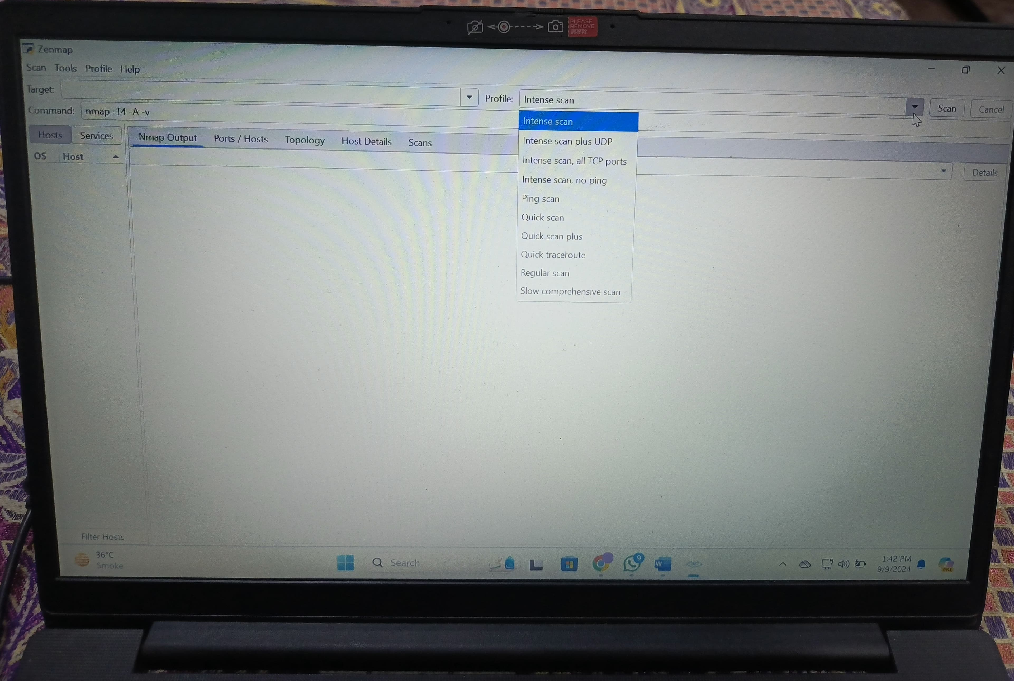

Slide 6
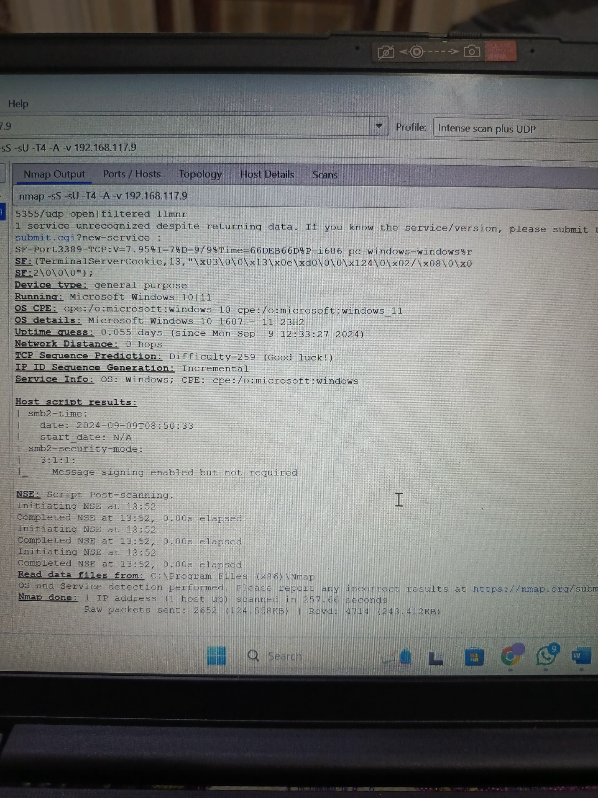

Slide 7
Review of Security Policies and Procedures
Documentation:
Router Configuration: Checked settings like WPA2 encryption, guest network settings, and firewall rules.
Device Security: Ensured all devices are running the latest operating systems and software updates.
Compliance:
Passwords: Confirmed the use of strong, unique passwords, avoiding password reuse.
Firmware Updates: Verified that the router and other devices have the latest firmware.
Access Controls: Limited network access and changed default settings.

Slide 8
Findings and Recommendations
Findings:
No Major Issues: Found no open ports, outdated software, or insecure settings.
Recommendations:
Update Firmware: Make sure all devices, including the router, have the latest firmware.
Change Passwords: Use strong, unique passwords for all devices.
Secure Network: Enable WPA3 encryption if available, or WPA2 if not.

Slide 9
Action Plan
Immediate Actions:
Update router and device firmware.
Change passwords to strong, unique ones.
Review and, if needed, enhance Wi-Fi encryption to WPA3 or WPA2.
Ongoing Actions:
Regularly monitor the network for new vulnerabilities.
Keep all devices and software up-to-date.

Slide 10
Stakeholder Communication
Family/Roommates: Share these findings and recommendations to ensure everyone follows good security practices.

