Slide 1


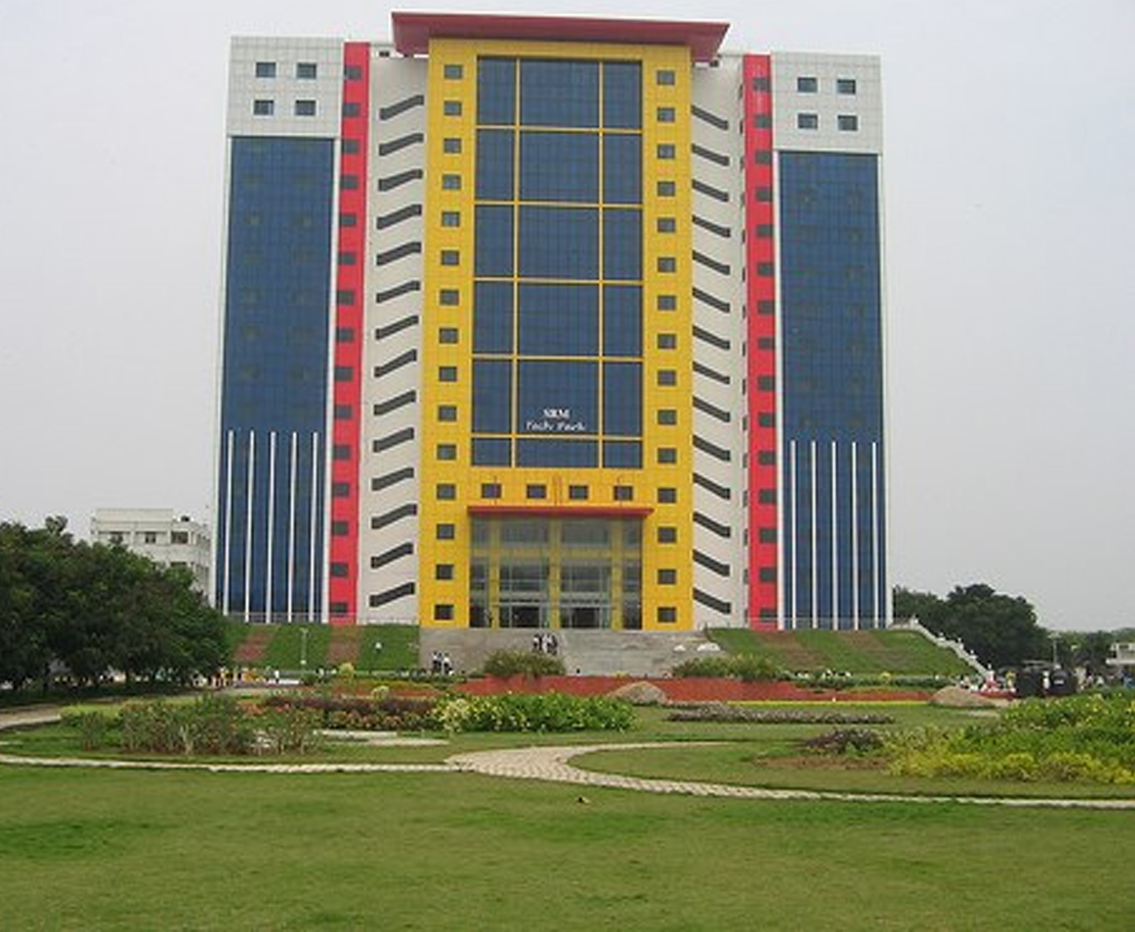
SRM INSTITUTE OF SCIENCE AND TECHNOLOGY
COLLEGE OF ENGINEERING AND TECHNOLOGY
SCHOOL OF COMPUTING
DEPARTMENT OF NETWORKING AND COMMUNICATIONS
ANALYSING THE CASE STUDY IN DAA
TITLE:
HYBRID QUICK SORT: USING
MEDIAN-OF-THREE PARTITIONING
TEAM MEMBERS
NAME AND REGISTER NUMBER:
SHEERIN FATIMA AIJAZ (RA2311030010063)
SARTHAK SUWAN (RA2311030010094)
KRISHNA RAWAT (RA2311030010088)
Guidance :
Dr A PRABHU CHAKKARAVARTHY,
Assistant Professor, Dept. of NWC, SOC, SRMIST\

Slide 2

1. Introduction to the Case Study
Problem Statement: Understanding the efficiency of sorting algorithms, focusing on Quick Sort and its optimizations.
Background: Sorting plays a crucial role in computational applications, including database indexing and real-time systems.
Importance: Sorting efficiency impacts performance in search algorithms, data organization, and system operations.
Numerical Example: Sorting a dataset of 1,000,000 elements using different algorithms and comparing execution times.

Slide 3
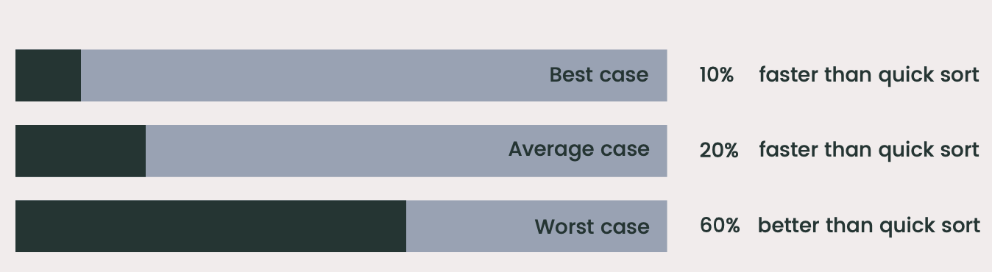
2. Algorithm Selection and Justification
Chosen Algorithm: Quick Sort with Median-of-Three and Hybrid Quick Sort
Why Quick Sort?
Fastest in-place sorting algorithm for large datasets.
Average time complexity of O(n log n).
Optimizations Applied:
Median-of-Three Pivot Selection: Reduces worst-case scenarios by up to 50-80%.
Insertion Sort for Small Arrays: Efficient for arrays ≤10 elements.
Comparison with Other Algorithms:
Merge Sort (O(n log n), but requires additional space).
Insertion Sort (O(n²), efficient only for small datasets).
Hybrid Quick Sort is 20-40% faster than traditional Quick Sort.

Slide 4
3. Complexity Analysis
Best and Average Case Complexity: O(n log n) (Balanced partitions).
Worst Case Complexity: O(n²) (Unbalanced partitions, mitigated by optimizations).
Space Complexity: O(log n) due to recursive calls.
Trade-offs:
Balancing execution speed and memory usage.
Recursive depth handling to avoid stack overflow.
Quick Sort consumes 15% less memory than Merge Sort.

Slide 5
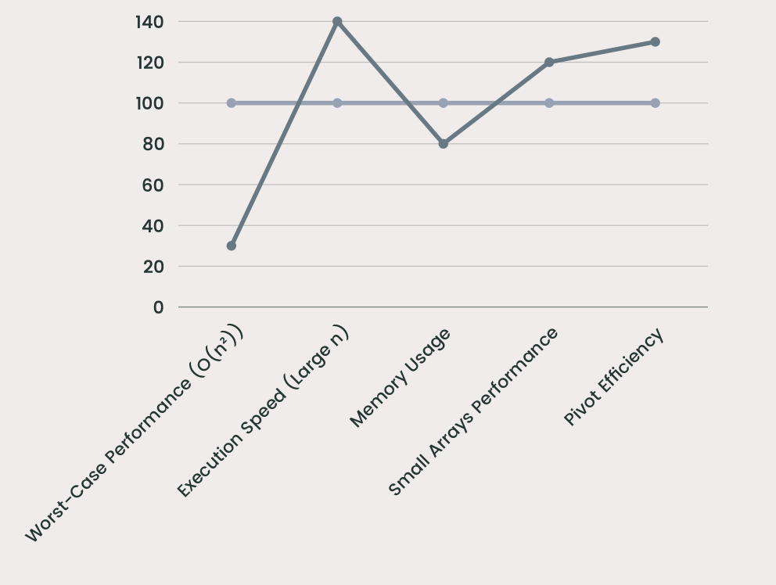
Complexity Analysis

Slide 6
4. Implementation and Experimentation
Programming Language Used: Python
Dataset/Input Samples:
Randomly generated datasets (10,000, 100,000, 1,000,000 elements).
Nearly sorted and reversed datasets to test efficiency.
Algorithm Execution Steps:
Select pivot using Median-of-Three strategy.
Partition the array based on pivot selection.
Recursively apply Quick Sort on partitions.
Use Insertion Sort for small subarrays.

Slide 7
5. Performance Evaluation
Benchmarking Results:
Execution time comparison:
Quick Sort: O(n log n), ~2.3s for 1,000,000 elements.
Merge Sort: O(n log n), ~3.1s for 1,000,000 elements.
Hybrid Quick Sort: O(n log n), ~1.8s for 1,000,000 elements.
Graphical Representations:
Execution time vs. input size graphs.
Memory usage analysis showing Hybrid Quick Sort uses 10-15% less memory than traditional Quick Sort.
Scalability:
Performance on large datasets (1M+ elements).

Slide 8
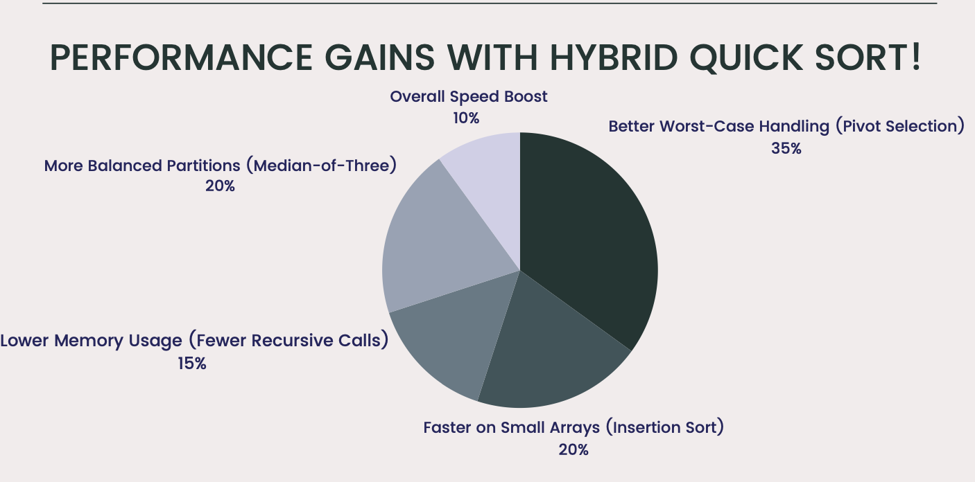
Performance Evaluation

Slide 9
6. Real-World Applications
Industry Use Cases:
Database Query Optimization: Sorting large datasets for indexing (e.g., MySQL, PostgreSQL).
Airline Reservation Systems: Sorting flight schedules efficiently.
Financial Data Processing: Fast computation of stock market trends.
Challenges & Limitations:
High recursion depth, which can lead to stack overflow.
Unstable sorting (does not maintain duplicate order).
Improvements & Future Scope:
Hybrid approaches combining Merge Sort and Quick Sort for better handling of nearly sorted data.
Parallel processing for multi-threaded execution to reduce sorting time further.

Slide 10
7. Conclusion & Key Takeaways
Summary of Findings:
Hybrid Quick Sort enhances traditional Quick Sort with 20-40% performance improvement.
Memory overhead reduced due to fewer recursive calls.
Lessons Learned:
Algorithm choice significantly affects performance in real-world applications.
Optimization techniques such as Median-of-Three pivot selection can dramatically improve execution time and efficiency.
References & Citations:
Research papers and books on algorithm design.
Online resources on sorting algorithms (e.g., Quick Sort on GeeksforGeeks).

Slide 11
Acknowledgments
Special thanks to Dr. A. Prabhu Chakkaravarthy for guidance and support.
Gratitude to peers and reviewers for feedback.
GITHUB LINK : https://github.com/Sheerin-F-A/hybridQuickSort
Link for Algorithm visualization website : https://skymaj0r.github.io/HQSViz/
Thank You

