Slide 1
Tomato Leaf Disease Classification
A from-scratch CNN for detecting Early Blight and Late Blight
Healthy · Early Blight · Late Blight
Presented by: Sheersh Gupta

Slide 2
Preface & Objective
1
Problem
2
Objective
3
Scope
Manual identification of tomato leaf diseases can be time-consuming and prone to misclassification.
To develop a CNN-based model for classifying tomato leaves into Healthy, Early Blight, and Late Blight categories, and compare baseline and augmented training approaches.
The project focuses on classifying tomato leaf images into three categories—Healthy, Early Blight, and Late Blight using CNN-based image classification.
It also evaluates the effect of data augmentation by comparing a baseline CNN with an augmented CNN.

Slide 3
Dataset: PlantVillage Tomato Subset
4,500
images across 3 classes
80 / 10 / 10
train / validation / test split (seed 42)
~22%
Early Blight share: the minority class

Slide 4
Model Architecture & Experiment Setup
Input Image
(128×128×3)
Conv Block 1:
32 filters +
ReLU + MaxPool
Conv Block 2:
64 filters +
ReLU + MaxPool
Flatten
Dense Layer:
128 Neurons
ReLU + Dropout 0.5
3-classes + Softmax Function
›
›
›
›
›
Baseline CNN
Trained on the original training images without
augmentation.
CNN + Augmentation
Same architecture and training setup, with random transformations applied to training images.
Setup: Adam · categorical cross-entropy · early stopping (patience 3, max 20 epochs) · 80/10/10 split, seed 42
Controlled experiment: Augmentation is the only variable changed between the two runs.

Slide 5
Results: Evaluation Metrics
Model | Accuracy | Precision | Recall | F1
Baseline CNN | 92.70% | 0.929 | 0.927 | 0.928
CNN + Augmentation | 92.04% | 0.922 | 0.920 | 0.920
3 of 452
The accuracy difference corresponds to approximately 3 test images.
Small Performance Gap
One run per model, so a gap this small is not conclusive evidence either way.

Slide 6
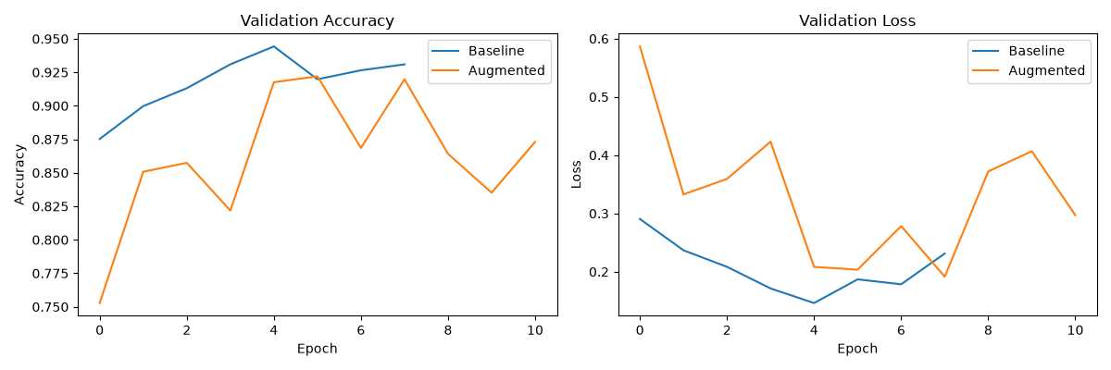
Training Dynamics
Baseline: smooth
Stopped at 8 epochs. Validation loss fell to 0.146 and val accuracy peaked at 94.4%.
Augmented: More Variable
Ran 11 epochs. Validation accuracy ranged from 75.2% and 92.2%.
Slower start
Validation accuracy after 1st epoch: 75% vs 88% showing a slower initial learning trend.

Slide 7
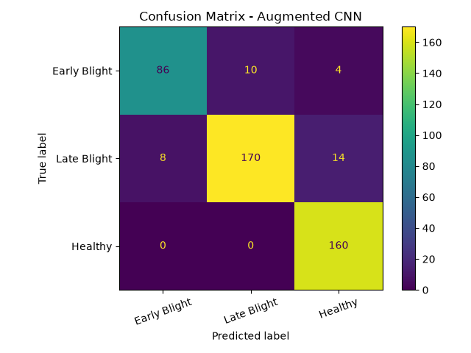
Where the Augmented Model Makes Errors
Healthy
160 / 160
100% recall
Late Blight
170 / 192
88.5% recall
Early Blight
86 / 100
86.0% recall
Most errors occur between the two disease classes, while Healthy leaves are classified correctly.

Slide 8
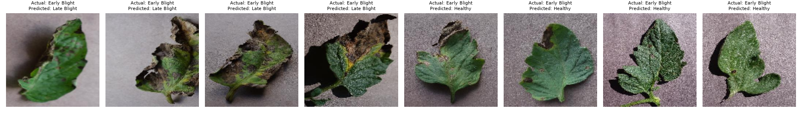
Error Analysis: Misclassified Leaves
Early Blight → Late Blight
Similar dark lesions cause confusion between the two disease classes.
Early Blight → Healthy
Small or less-distinctive lesions are difficult to detect.
Key Observation: Most shown errors occur when disease symptoms are visually similar or subtle.

Slide 9
Why Augmentation Did Not Improve Results
1
Limited Overfitting
Baseline validation accuracy already reached 93–94%, leaving limited room for improvement.
2
Similar Data Distribution
Random splits may contain visually similar images in both training and test sets.
3
More Variable Training
Augmentation produced a slower, more fluctuating validation-accuracy curve.
4
Subtle Disease Features
Transformations may alter small visual cues important for detecting early-stage symptoms.
These are hypotheses consistent with the observed results.

Slide 10
Conclusion
1
2
3
Comparable Performance: Baseline CNN: 92.70%
CNN + Augmentation: 92.04%
Augmentation did not improve the measured test performance.
Main Classification Challenge: Early Blight achieved the lowest recall (86.0%).
Most errors occurred between disease classes and subtle disease cases.
Key Takeaway: Augmentation helps when a model overfits or faces shift. Test it where it should matter.
Questions & Discussion
Thank you for your time.

