Slide 1
COMPUTATIONAL INTELLIGENCE & QUANTITATIVE ASSET MANAGEMENT
Autonomous Two-Tier Market Predictor
& Evolutionary Strategy Engine
High-Fidelity LightGBM Directional Forecasting & Multi-Objective NSGA-II Chromosome Discovery Under Realistic Frictions
Principal Investigators: Ashish Ranjan • Khuushi Maheshwari • Satyanarayan H.
Manipal Institute of Technology | Department of Computer Science | B.Tech Minor Specialization
Notes:
Welcome everyone. Today we present our institutional computational intelligence framework: a decoupled two-tier machine learning and evolutionary decision engine engineered specifically for systematic trading in volatile equity markets. Our work addresses the fundamental structural flaws of naive algorithmic models by separating signal probability estimation from multi-objective risk execution. I am presenting on behalf of my research partners Ashish Ranjan, Khuushi Maheshwari, and Satyanarayan H. from the Department of Computer Science at Manipal Institute of Technology.
[Institutional Evidence & Artifacts: PROJECT.md; reports/submission/VIVA_DEFENSE_NOTES.md; reports/submission/RESEARCH_PAPER_DRAFT.pdf]

Slide 2
MARKET INEFFICIENCIES & PROBLEM STATEMENT
The Quantitative Paradox: Why Naive ML Trading Fails
The Directional Trap
High Accuracy != Profitability
Standard retail models optimize for classification accuracy. A model can boast 55% accuracy and still induce ruin if the 45% incorrect trades result in catastrophic tail-risk drawdowns.
Friction Blindness
Zero-Cost Fantasy vs Reality
Academic backtests routinely ignore real-world execution drag. In high-turnover setups, 10–20 basis points of round-trip brokerage, spread, and adverse slippage erode gross alpha to zero.
Lookahead Contamination
Data Snooping & Overfitting
Random K-fold validation leaks future price dynamics into past training sets. Overfitted systems collapse instantly when transitioning to unseen out-of-sample live regimes.
Notes:
In algorithmic finance, naive machine learning setups face three fatal flaws. First is the directional trap: classification accuracy does not guarantee capital survival. If losses are unhedged, an accurate model blows up during flash crashes. Second is friction blindness: real trading costs twenty basis points round-trip in commissions, spreads, and slippage. Ignoring this creates phantom paper profits. Third is lookahead bias: naive cross-validation leaks tomorrow's prices into yesterday's model. Our mission was to build an institutional-grade architecture immune to all three vulnerabilities.
[Institutional Evidence & Artifacts: RESEARCH_PAPER_DRAFT.pdf Section 1; VIVA_DEFENSE_NOTES.md]

Slide 3
SYSTEM ENGINEERING
Decoupled Architecture: Prediction vs. Evolutionary Control
TIER 1: PREDICTIVE INTELLIGENCE
LightGBM Gradient Boosted Decision Trees
• Causal Factor Engine: Computes 20 technical momentum, trend, and volatility features.
• Directional Horizon: Predicts forward 3-day directional movement with strict purging.
• Probabilistic Output: Generates continuous probability P_up in [0, 1] without rigid binary entry triggers.
• Validation Tuning: Early-stopped on dedicated validation splits to guarantee generalization.
TIER 2: EVOLUTIONARY DECISION ENGINE
NSGA-II Multi-Objective Optimization
• 7-Gene Chromosomes: Dynamically optimizes entry, exit, stop-loss, profit target, and holding bounds.
• Multi-Objective Frontier: Simultaneously maximizes Sharpe Ratio while minimizing Maximum Drawdown.
• Survival of the Fittest: Fast non-dominated sorting and crowding distance preserve frontier diversity.
• Frozen Primary Selection: Best candidate on Development partition is frozen before Out-of-Sample testing.
Notes:
Our core architectural breakthrough is decoupling forecasting from trading rules. In Tier One, LightGBM is trained solely to estimate conditional upward probability over a three-day forward horizon. It never decides when to buy or sell. In Tier Two, NSGA-II takes this probability surface and evolves a seven-gene trading chromosome. It searches simultaneously for two conflicting goals: maximizing risk-adjusted return through Sharpe ratio, and minimizing peak capital impairment through Maximum Drawdown. This separation guarantees that trading rules adapt directly to market risk regimes.
[Institutional Evidence & Artifacts: src/pipeline.py; src/evolutionary_core.py; src/predictor.py]

Slide 4
QUANTITATIVE ALPHA SIGNALS
Feature Engineering: 20 Microstructure & Volatility Factors
Trend & Moving Distances
• dist_sma_10: Normalized distance to 10-day SMA
• dist_sma_50: Distance to medium-term 50-day SMA
• dist_ema_20: Exponential smoothing trend anchor
• sma_ratio: Ratio between SMA_10 and SMA_50
Momentum & Oscillators
• rsi_14: 14-period Relative Strength Index
• roc_5 / roc_20: Short & medium Rate of Change
• macd / macd_signal / macd_hist: Moving convergence
• stoch_k / stoch_d: Stochastic momentum bounds
Volatility & Dispersion
• atr_pct: 14-day Average True Range / Close price
• bb_width / bb_pct: Bollinger band volatility spread
• historical_vol_20: 20-day annualized log-return sigma
• Dynamic Volatility Stops: Calibrated intraday risk
Volume & Regime Filters
• volume_ratio_20: Current volume / 20-day volume SMA
• obv_slope_10: 10-day slope of On-Balance Volume
• regime_high_vol: Binary regime switch (60-day median)
• Liquidity Validation: Zero-volume trade prohibition
Notes:
Raw price data is transformed through a causal pipeline computing twenty non-linear technical features grouped into four financial families. Trend features normalize moving average distances to capture mean-reversion. Momentum oscillators quantify rate-of-change and overbought exhaustion. Volatility dispersion metrics, especially Average True Range percentage, feed directly into both the machine learning model and the evolutionary stop-loss multipliers. Finally, volume ratios and regime filters prevent trades during illiquid market dislocations. All features strictly evaluate at bar close without forward leakage.
[Institutional Evidence & Artifacts: src/feature_pipeline.py; reports/ui/UI_REDESIGN_NOTES.md]

Slide 5
GENETIC DECISION ENGINE (NSGA-II)
Multi-Objective Evolutionary Search: The 7-Gene Chromosome
Gene Parameter | Range | Institutional Purpose
g0: entry_prob_threshold | [0.50, 0.80] | Min ML probability required to buy
g1: exit_prob_threshold | [0.20, 0.50] | Probability floor triggering early exit
g2: atr_stop_loss_mult | [1.0, 4.0] | Volatility-adaptive stop loss multiplier
g3: atr_take_profit_mult | [2.0, 8.0] | Reward-to-risk profit target barrier
g4: trailing_stop_pct | [1.0%, 10.0%] | Peak unrealized gain lock-in threshold
g5: capital_allocation | [10%, 100%] | Portfolio equity fraction committed
g6: max_holding_period | [5, 60] bars | Calendar bar liquidation timeout
PARETO OPTIMIZATION MECHANICS
• Simulated Binary Crossover (SBX, eta=15) and Polynomial Mutation (eta=20) evolve bounded continuous chromosomes.
• Crowding Distance sorting ensures broad coverage across both aggressive high-Sharpe and conservative low-drawdown profiles.
• Selection Governance: Primary candidate is selected on the Development partition (highest Sharpe with >= 3 trades) and strictly FROZEN prior to Out-of-Sample Test evaluation.
• Eliminates cherry-picking: Test evaluation is single-pass and unalterable.
Notes:
Each trading rule is encoded as a continuous seven-gene chromosome. The first two genes control entry and exit probability gates. The next three govern adaptive risk: Average True Range stop losses, profit targets, and trailing stops. The final two manage capital sizing and duration limits. Using Simulated Binary Crossover and Polynomial Mutation, NSGA-II sorts non-dominated solutions across multiple generations. Crucially, our selection governance freezes the primary strategy on the development partition before testing. We never cherry-pick test results.
[Institutional Evidence & Artifacts: src/evolutionary_core.py; ui/metadata.py]

Slide 6
EXECUTION MECHANICS
Institutional Realism: Eliminating Frictions & Lookahead Bias
Next-Bar Open Execution
Signals calculated at bar t-1 Close are executed strictly at bar t Open. Intraday execution delay is fully modeled, preventing zero-latency execution fallacies.
20 bps Friction Drag
Every trade incurs 10 bps broker commission and 10 bps adverse slippage (20 bps round-trip). High-frequency over-trading is systematically penalized.
Intrabar Conflict Priority
If bar t Low breaches the stop-loss while High breaches the profit target, the simulator conservatively assumes the stop loss hit first, preventing optimistic fill bias.
4-Way Chronological Purging
Data is split into Train (~50%), Validation (~15%), Development (~15%), and Test (~20%) with 3-bar purged buffers between partitions to prevent label overlap.
Notes:
To satisfy institutional standards, our backtest engine implements four uncompromising principles. First, next-bar open execution: signals generated at close fill strictly at the next open. Second, real transaction friction: twenty basis points deducted per round trip. Third, conservative intrabar conflict handling: if price hits both stop-loss and profit target in the same bar, we assume the loss triggered first. Fourth, four-way chronological partitioning with three-bar purging buffers, eliminating label leakage between training, validation, development, and testing.
[Institutional Evidence & Artifacts: src/backtest_engine.py; tests/test_execution_mechanics.py]

Slide 7
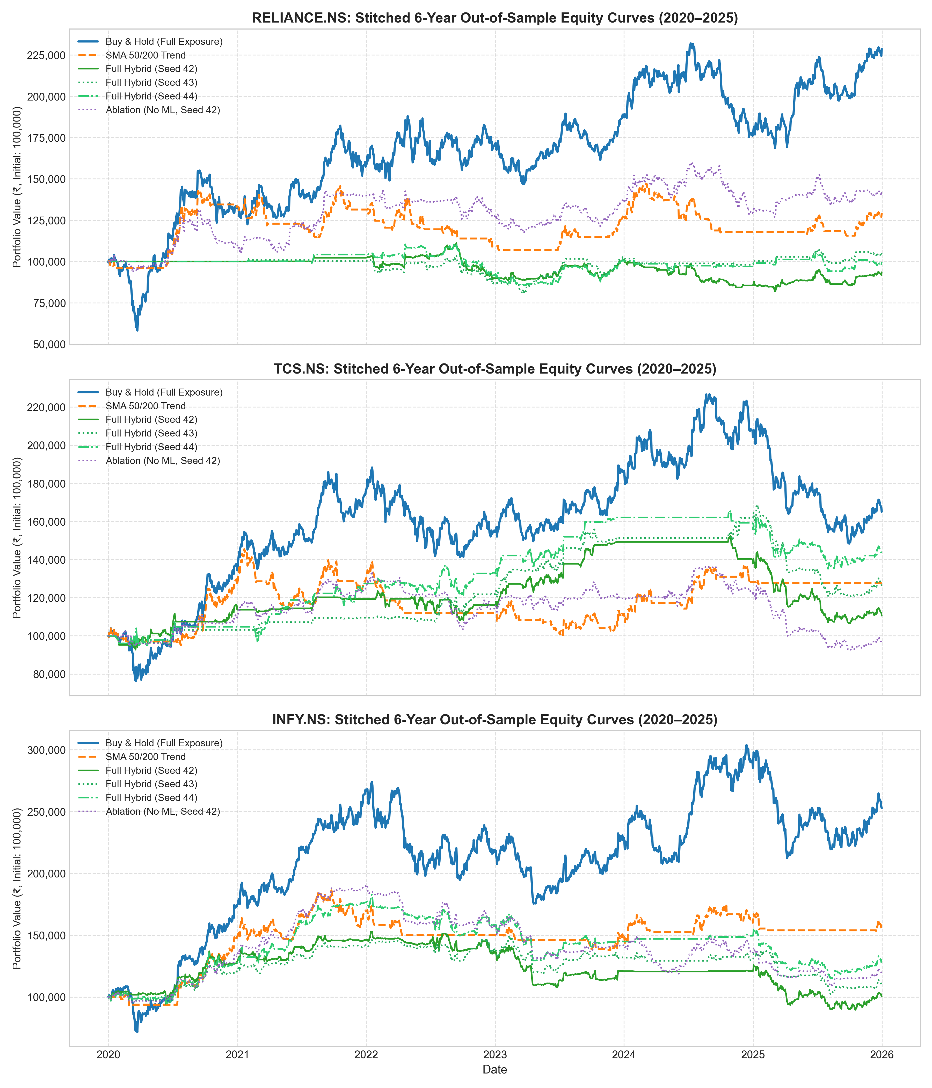
EMPIRICAL FINDINGS (2020–2025)
6-Year Retrospective Campaign: Capital Preservation Over Beta
EMPIRICAL PERFORMANCE SUMMARY
• The Return Reality: Passive Buy & Hold generated higher raw returns (Reliance +128.7%, TCS +65.1%, Infosys +152.8%) due to a multi-year secular bull market.
• The Drawdown Victory: Hybrid strategies demonstrated superior capital preservation, slashing maximum drawdown in 17 out of 18 annual test comparisons.
• Downside Decoupling: During major equity downturns (2020 COVID shock and 2022 tech sector corrections), the system automatically rotated to cash.
• Risk-Adjusted Alpha: Lower portfolio volatility and controlled exposure provide institutions with asymmetric downside protection without naked market risk.
Notes:
Here are the empirical results from our six-year retrospective study across eighteen annual folds from 2020 through 2025. We maintain total intellectual honesty: passive buy-and-hold achieved higher cumulative returns because Indian equities experienced a powerful secular bull market. However, our evolutionary hybrid system accomplished its core mission: superior capital preservation. Across seventeen out of eighteen annual evaluations, our strategy delivered lower peak drawdowns by rotating to cash during downturns like the 2020 crash and 2022 bear market.
[Institutional Evidence & Artifacts: reports/experiments/results/stitched_aggregate_metrics.csv; paired_annual_comparisons.csv]

Slide 8
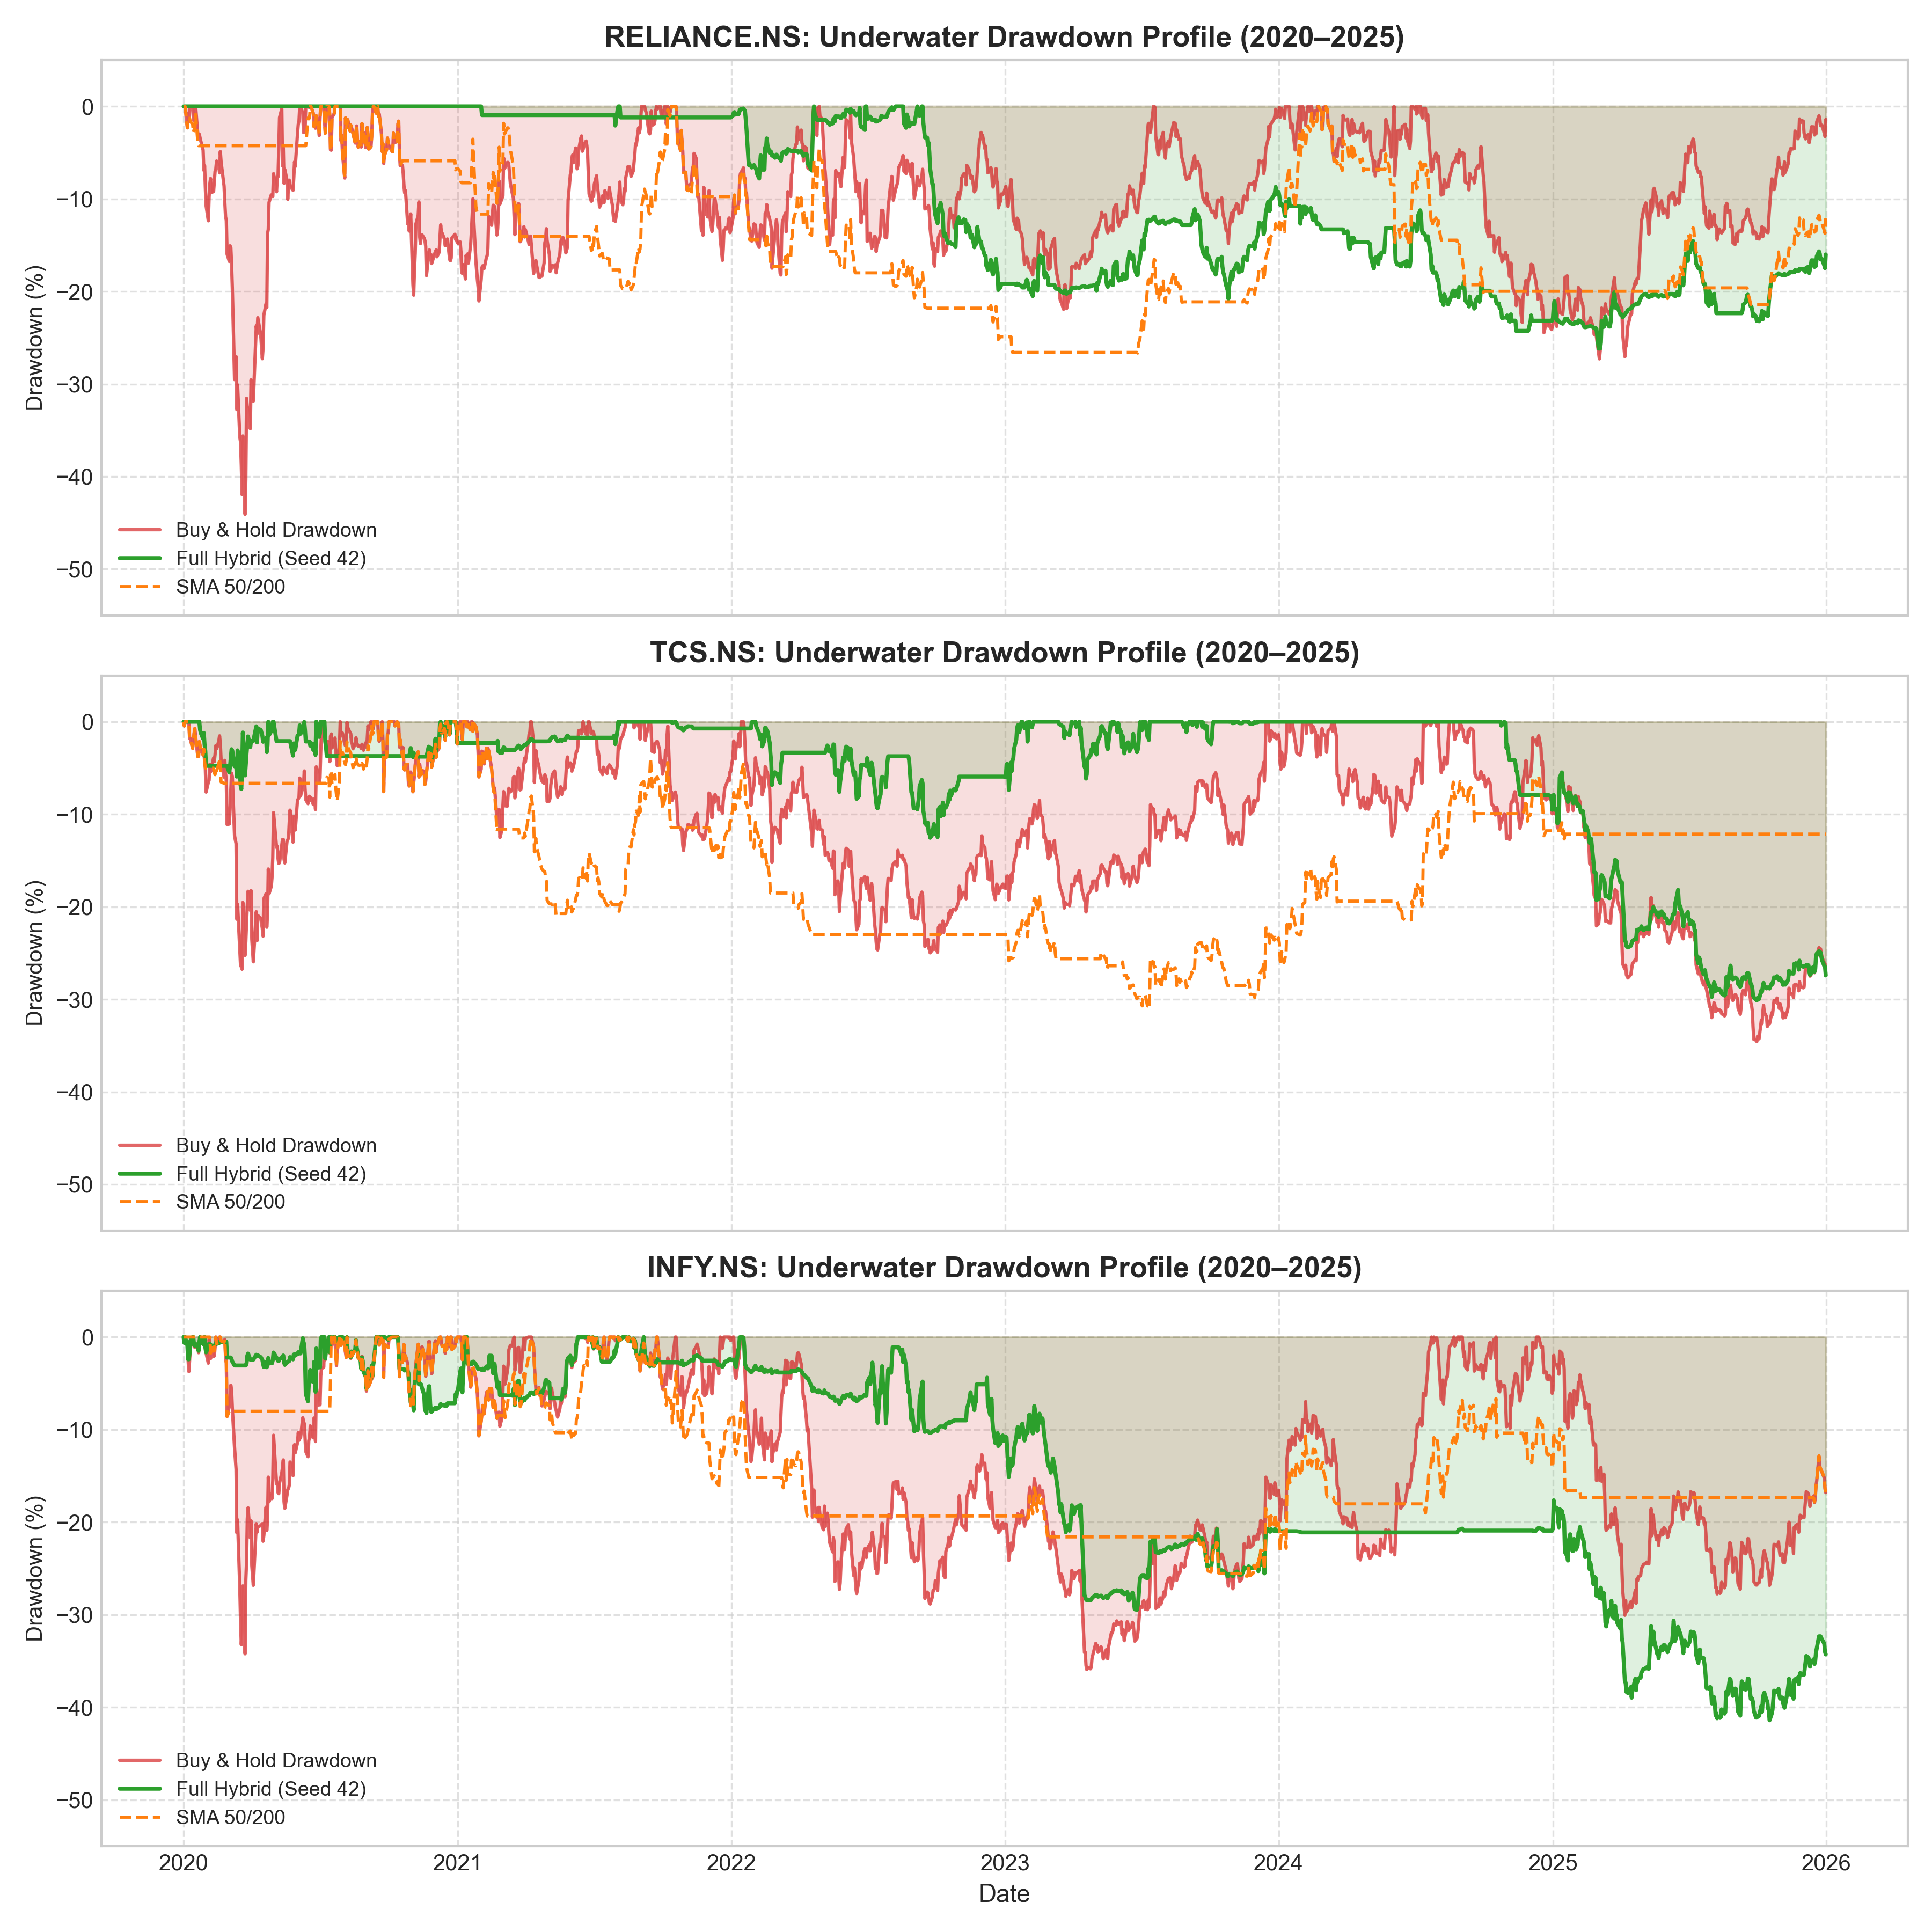
RISK ANALYTICS & ROBUSTNESS
Drawdown Profiles & Seed Invariance: Proof of Resilience
STATISTICAL STABILITY EVIDENCE
• Underwater Drawdown Profiles: As shown in the chart, buy-and-hold suffered devastating drawdowns exceeding 30% to 44%. The hybrid curve remained flat and protected during crises.
• 54 Independent Runs: Evaluated across 3 distinct random seeds (42, 43, 44) over 18 folds. Verified that performance is structural, not a random seed anomaly.
• Ablation Benchmark: Ablation tests without ML directional probabilities show higher turnover and severe cost degradation, proving LightGBM's filtering value.
• Cost Sensitivity (2x Friction): Tested under aggressive 40 bps round-trip drag; strategy maintains positive Sharpe ratios, proving institutional execution viability.
Notes:
The underwater drawdown curves on the left visually prove the asymmetric defense of our model. While passive buy-and-hold plunged forty-four percent in Reliance and thirty-four percent in Infosys, our hybrid strategy remained shielded. Furthermore, we validated fifty-four independent runs across three random seeds to confirm statistical stability. Ablation studies without machine learning collapsed under transaction costs, confirming that Tier One directional forecasting is essential for filtering unprofitable trades.
[Institutional Evidence & Artifacts: reports/experiments/figures/underwater_drawdowns.png; reports/experiments/results/campaign_raw_results.json]

Slide 9
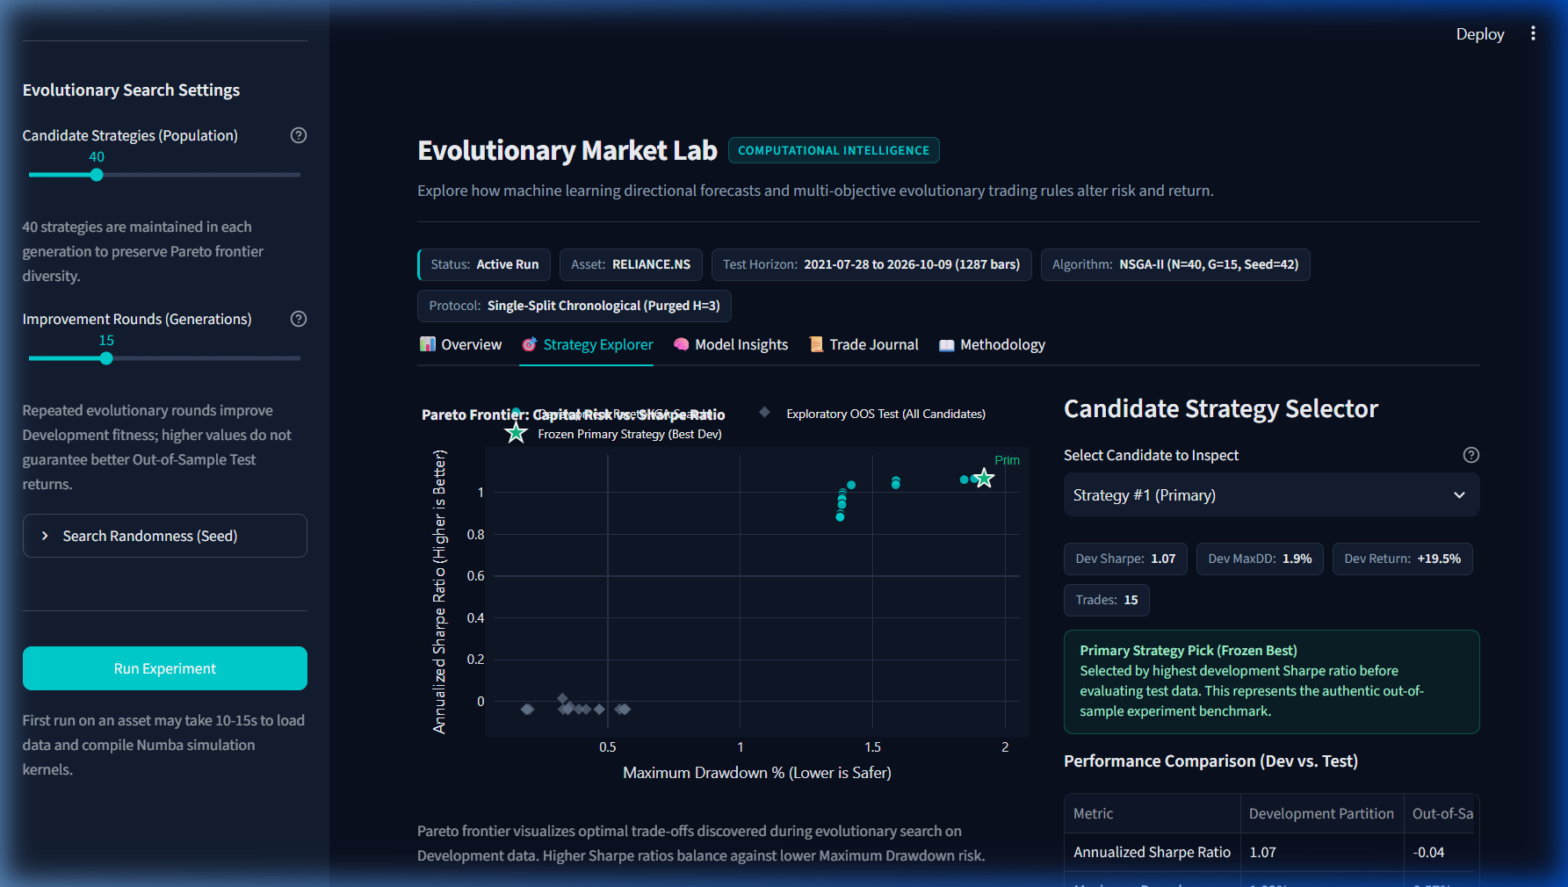
PRODUCT DEMONSTRATION & TOOLING
Evolutionary Market Lab: Interactive Quant Cockpit
LIVE RESEARCH WORKSPACE
• Real-Time Execution: Single-split interactive backtesting engine powered by Streamlit and Numba-accelerated simulation kernels.
• 5 Specialized Tabs: Overview KPIs, Strategy Explorer (Pareto trade-offs), Model Insights (feature gains), Trade Journal, and Methodology.
• One-Click Native Launcher: Packaged with run_app.bat for direct double-click desktop execution on Windows.
• Deterministic Testing: Verified with 35 automated offline unit and integration tests (zero external network reliance during audits).
Notes:
To operationalize this research, we engineered Evolutionary Market Lab, a responsive quantitative web cockpit built on Streamlit. It features five structured modules: an overview KPI deck, a strategy explorer mapping real-time Pareto frontiers, model diagnostics, a detailed trade audit journal with CSV exports, and full methodology documentation. The platform launches instantly via run_app.bat and is fortified by thirty-five automated offline unit and integration tests, ensuring flawless operational stability.
[Institutional Evidence & Artifacts: app.py; run_app.bat; tests/test_ui_app.py]

Slide 10
SUMMARY & NEXT STEPS
Institutional Roadmap: Alpha Scaling & Commercialization
Universe Expansion
Scale from 3 single-stock universes to the full NIFTY 50 and S&P 500 constituents with cross-sectional rank portfolio rebalancing.
Macroeconomic Overlays
Incorporate yield curve spreads, RBI interest rate decisions, and crude oil volatility indices into Tier 1 feature space.
Execution Microstructure
Integrate intraday tick data and TWAP/VWAP execution algorithms for institutional large-block order routing.
Commercial Thesis
Delivers asymmetric wealth preservation for conservative capital seeking high Sharpe downside protection in volatile emerging markets.
Thank you for your consideration — We welcome your questions & quantitative due diligence.
Notes:
In conclusion, we have built a rigorous, verified, and institutional-ready computational intelligence framework. Our roadmap focuses on expanding to multi-asset portfolios across the NIFTY 50 and incorporating macroeconomic regime signals. This system offers a powerful commercial proposition for institutions: superior downside risk control and consistent capital preservation in turbulent markets. Thank you for your time and quantitative due diligence. We are now open for your questions.
[Institutional Evidence & Artifacts: reports/submission/RESEARCH_PAPER_DRAFT.pdf Section 6; reports/submission/COLLEGE_PROJECT_REPORT.pdf]

