Slide 1

REST APIs
Design | Build | Run

Slide 2
Module 5
FastAPI
Hands-On
Implementation
With Python

Slide 3
Recap | REST API Design
Resource-Centric Thinking
Start naming resources (nouns)
Map actions to HTTP Verbs
GET – Retrieve a resource
POST – Create a resource
PUT – Replace a whole resource
PATCH – Partially update a resource
DELETE – Remove a resource
Less common
HEAD – Retrieves headers only
OPTIONS – Discovery methods/metadata
Map HTTP Codes to API Operation Responses
RFC 9110 | Part 15 – Specification definition for Status Codes
1xx | Informational
The request was received, continuing processing
2xx | Successful
The request was successfully received, understood, and accepted
3xx | Redirection
Further action needs to be taken in order to complete the request
4xx | Client Error
The request contains bad syntax or cannot be fulfilled
5xx | Server Error
The server failed to fulfill an apparently valid request

Slide 4
Pre-Flight Check
You have setup up a work environment
Clone the api-workshop mono-repo
You can run the REST API under the directory library-api-basic
Look at the README.md document for instructions
Disclaimer: Most of my experience is building REST APIs using c# and the dotnet core platform for RESTful APIs. If you are experienced in Python and could improve upon the code presented here, feel free to submit PRs to the repo so others can benefit too
We continue the story from here…

Slide 5
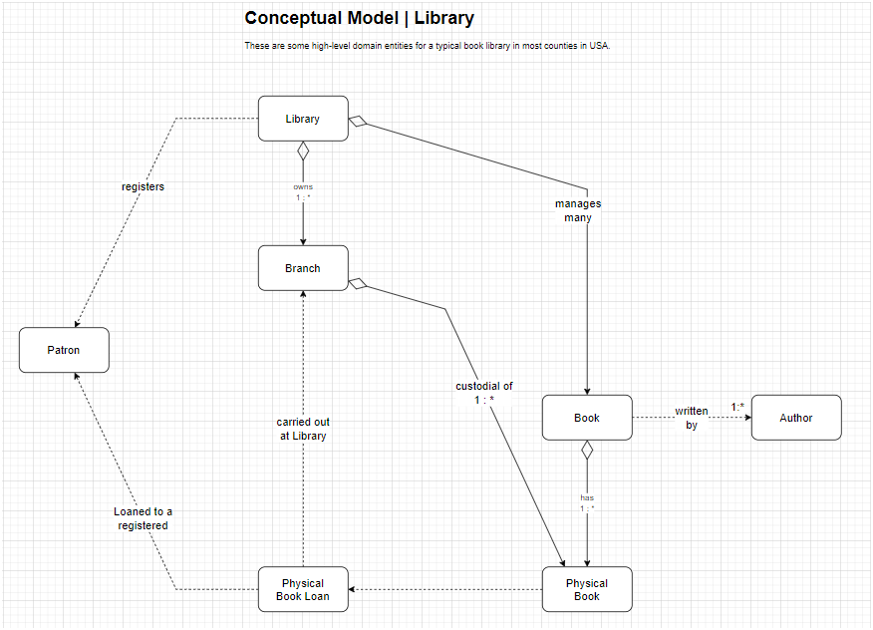
Recall | Conceptual Model

Slide 6
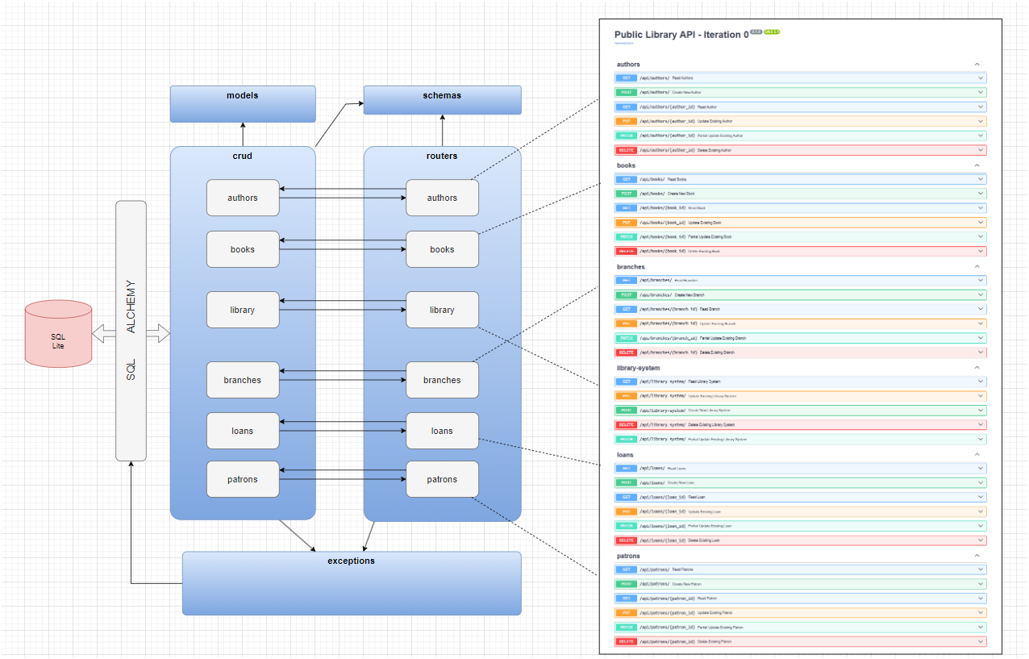
Inspect the Code | App Structure

Slide 7
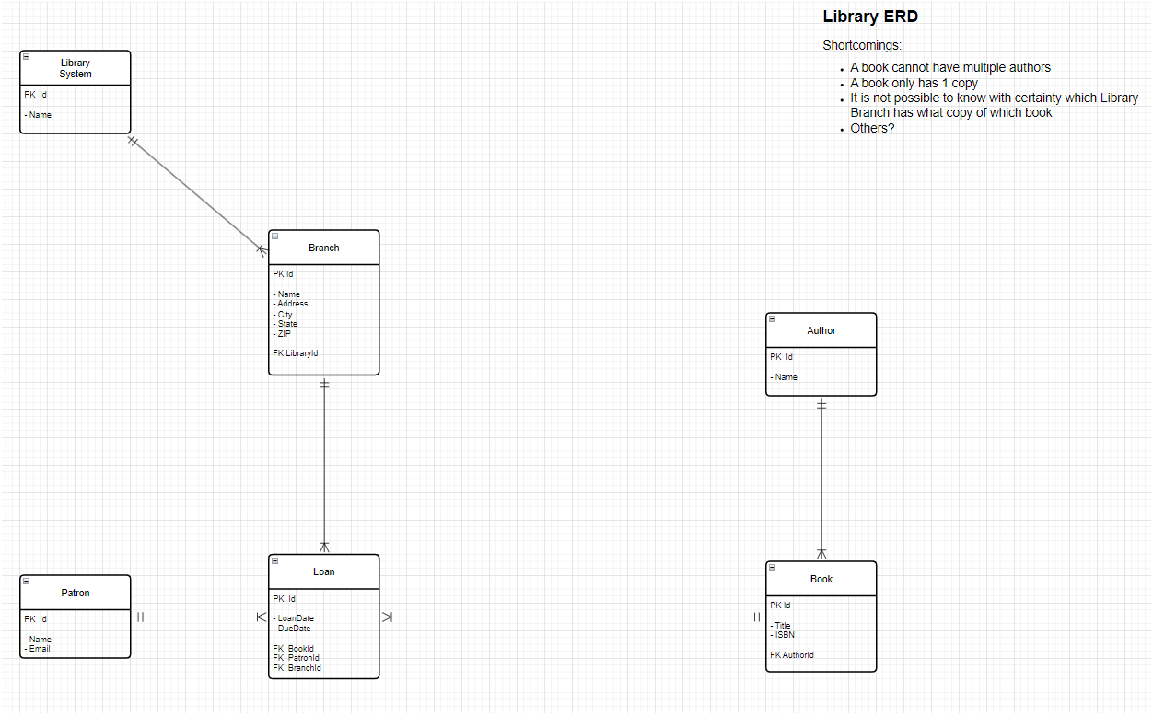
Inspect the Code | ERD v0.1

Slide 8
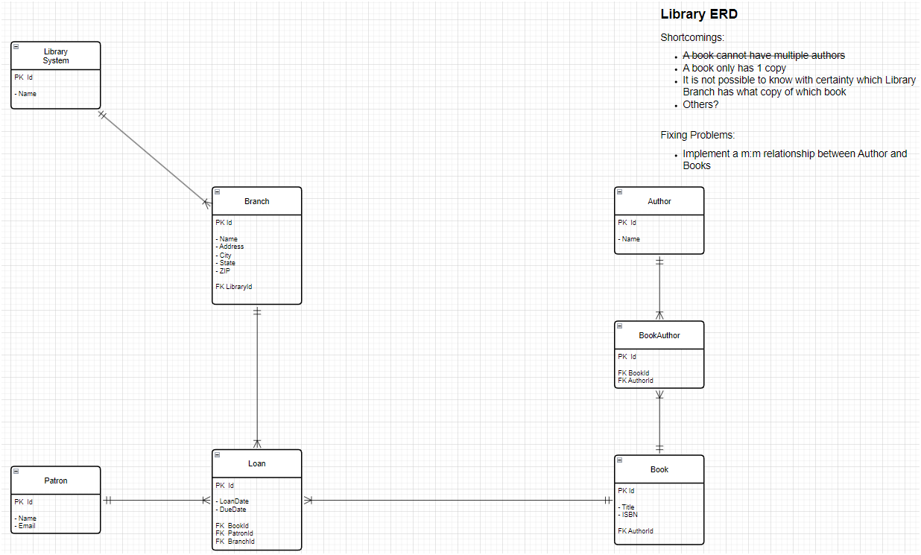
Inspect the Code | ERD v0.2

Slide 9
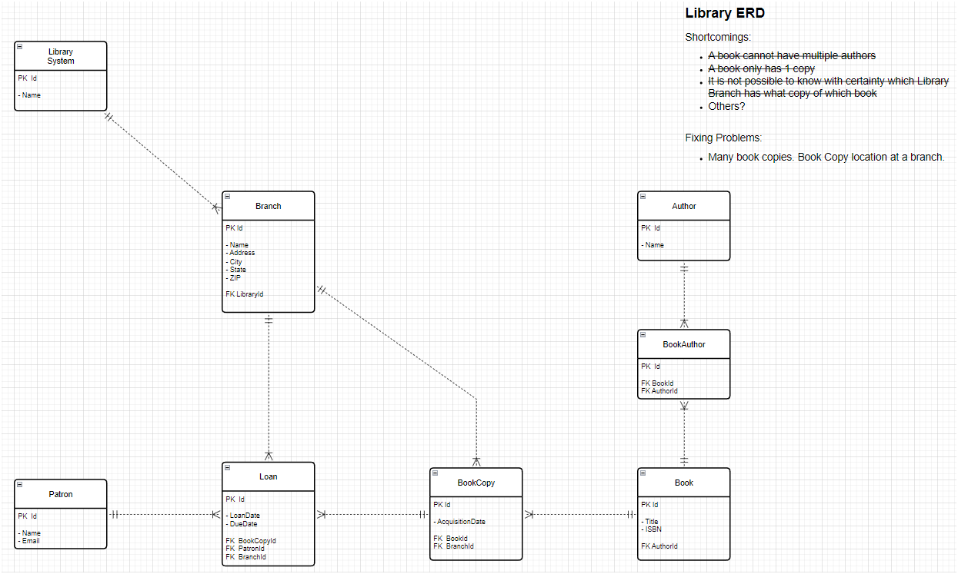
Inspect the Code | ERD v0.3

Slide 10
Inspect the Code | C.R.U.D. Ops
Run the app to
Create a book resource
Update a book resource
Using PUT
Using PATCH
Delete a book resource
Highlight the referential integrity problems
Show how this app deals with that issue
There are many approaches to this, you must be aware and deal with these in the best REST-ful way. Just having your REST API return 500 – Internal Server Error is not the only way!

Slide 11


Inspect the Code | Demo Time
Let’s give it a spin!

Slide 12
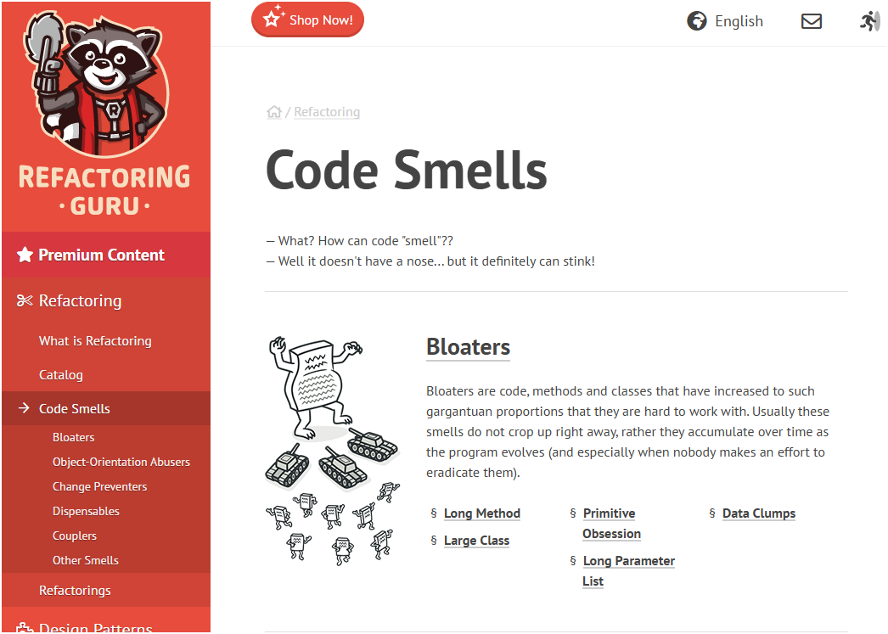
Inspect the Code | Error Handling
Try-Catch is your friend
But be careful
Create Custom Error Types
Only catch custom exceptions
Use a generic error handling for any other exceptions
If you must catch generic exceptions, have a good code commentary as to why
Catching generic exceptions is an anti-pattern / code smell
For more on code smells and how to best handle them visit
https://refactoring.guru/refactoring/smells

Slide 13
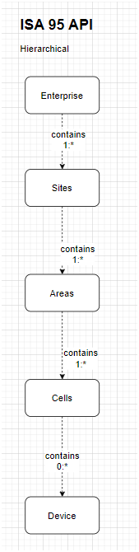
Manufacturing Context
Modeling based on ISA 95
Enterprise
Sites
Areas
Cells
Devices

Slide 14
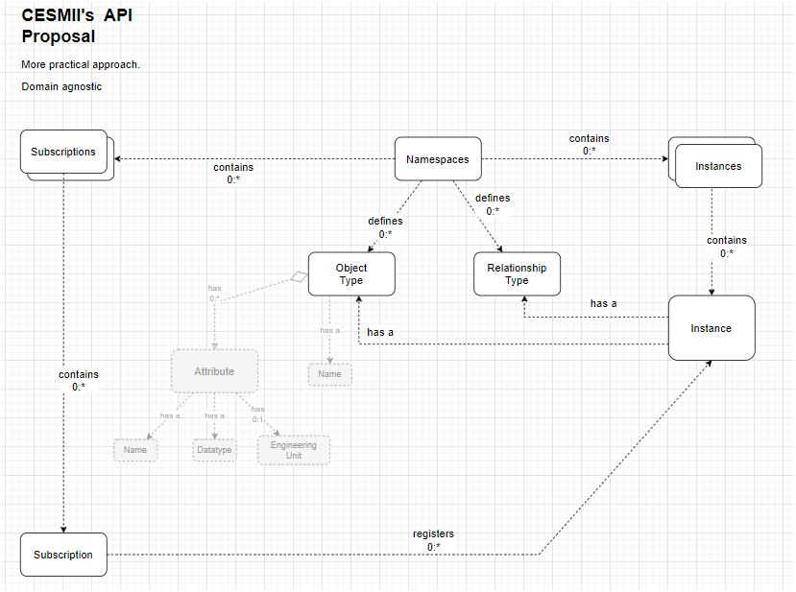
Manufacturing Context
Modeling based on CESMII’s API Proposal
Namespaces
Subscriptions
Instances
Object Types
Relationship Types

Slide 15
Module 6
Security &
Authentication

Slide 16
Sec-Basics | Thread Modeling
Identify Assets
User data
Service Endpoints
Tokens / keys
Threats
Token theft
Replay
Injection
Broken AuthN/AuthR
DDoS / DoS attacks
Security Objectives
Confidentiality
Integrity
Availability
Authentication (AuthN)
Authorization (AuthR)
Non-Repudiation
Principles at play
Least Privilege (only provide what’s needed and no more)
Defense in Depth (security layers)

Slide 17
Sec-Basics | AuthN v AuthR
Authentication (AuthN)
Verify who the client is
API Keys
JWT
OAuth2 Flows
Authorization (AuthR)
Verify what the client can do
Roles
Scopes
Access Control Lists (ACLs)
Example
Client “X” is authenticated, if it has the role “Billing” then it is allowed to call endpoint
POST api/billing

Slide 18
Sec-Basics | TLS
Transport Layer Security (TLS)
HTTPS in PROD – especially if exposed to the public Internet
It is better to use in all ENV (if your budge allows it or it is a practice already enforced by IT team)
The problem with HTTP is network packets travel in plain-text
Enforce redirects (HTTP → HTTPS)
Use Certificates when possible
letsencrypt is free and opensource
Automate the renewal
https://letsencrypt.org
TLS Checklist
TLS 1.2 minimum
TLS 1.3 is preferred
Strong cypher suties
HSTS – browser policy to enforce connecting to HTTPS only
Disable obsolete protocols
Forward secrecy (no long-lived session tokens)
Never put cert/private-key info in code repository

Slide 19
Sec-Basics | Tokens & Secrets Lifecycle
Use short-lived access-tokens
Use refresh-tokens for long-lived sessions
Adopt tooling that allows you to revoke and/or rotate tokens (blacklists, token version, etc.)
Store secrets safely and effectively
Use ENV vars
Secret stores (e.g., Thycotic, AWS Secret Manager)
Key management
Rotate signing keys
Asymmetric signing (public/private keys)

Slide 20
Sec-Basics | Input Validation
Validate everything for an incoming request
Or as much as you can
Url Path
Query String
Headers
Body
Use typed-models to de-risk injection and serialization errors
Sanitize user input
Refer to OWASP Top 10: Input Validation
Log suspicious inputs
Rate-limit abusive patterns

Slide 21
Sec-Basics | Preventing Overuse
Prevent abuse, protect backend resources (RAM, CPU, Storage), enforce SLAs
Strategies
Token Bucket
Leaky Bucket
Fixed Window
Sliding Window
Per-{x}, where “x” is
User
IP Address
API Key
Implementation
API Gateway (Kong, NGINX, Express Gateway, etc.)
Reverse Proxy
Cloud Gateway / API LB
Redis
When implementing, respond with appropriate HEADER in the response
x-RateLimit-Limit
x-RateLimit-Remaining
Use HTTP 429 Too Many Requests Status Code

Slide 22
Sec-Basics | Other Best-Practices
Use secure headers
Content-Security-Policy
X-Frame-Options
X-Content-Type-Options
Cross-Origin Resource Sharing (CORS) – allow only required origins and methods
Cross-Site Request Forgery (CSRF) – relevant when using cookies
Audit logging
authN/authR failures, token issues, suspicious IPs
Auto Sec Checks
Dependency scanning
Static analysis
Secrets scanning

Slide 23
Sec-Basics | API Keys v. JWT Tokens
Consideration | API Keys | JWT Tokens / OAuth2
Features | Simple, often stateless, good for service-to-service or first-party clients. Typically, bearer key in header or query string (avoid query if possible). | Self-contained claims (sub, exp, aud, iss, scopes). Short-lived access tokens and optionally refresh tokens. Can be validated stateless with signature (HS256 or RS256).
Issues | Hard to revoke individual sessions unless tracked server-side. | Revocation harder with fully stateless tokens — need jti + blacklist or token versioning.
Best Use Case | Best for simple service credentials internal (inside your WAN/LAN) microservices | user authentication delegated auth public clients, mobile/web
Security Nuances |  | Store access tokens in memory or secure httpOnly cookies, avoid localStorage for web apps. Choose asymmetric signing (RS256) if multiple services verify tokens without sharing secret. Always verify exp, nbf, aud, iss, and signature.

Slide 24
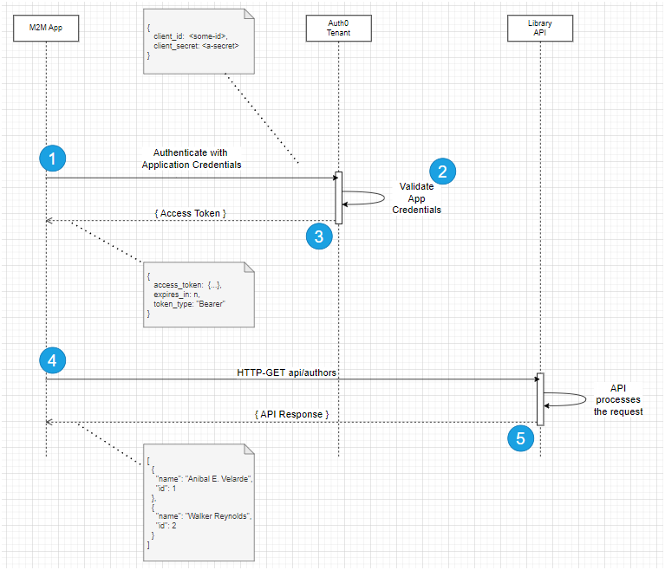
Sec-Basics | OAuth 2.0 m2m Flow

Slide 25
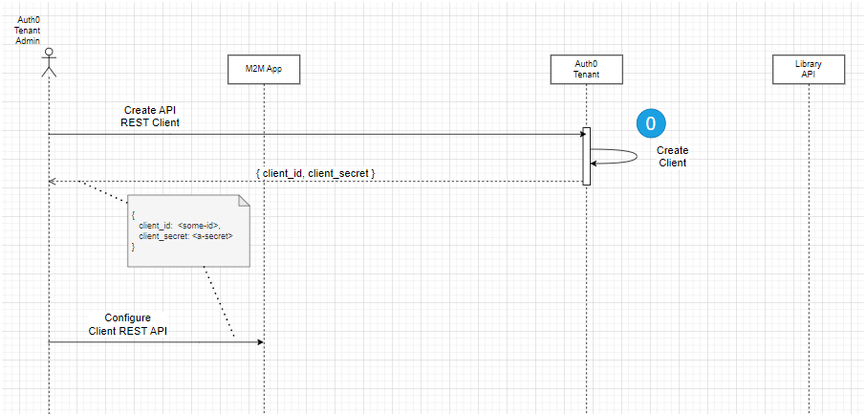
Sec-Basics | OAuth 2.0 Prequel
Do this first!

Slide 26
FastAPI Security
Let’s discuss:
While looking at code
Leverage built-in security features
Use dependency injection for security
Spot shortcomings of the original design
Address how to correct structural data issues
Implement (and test) machine-2-machine OAuth 2.0 flow

Slide 27
FastAPI Security | Built-In Features
Fast API contains small helper dependencies available in the fastapi.security module
These are some utilities available
OAuth2 PasswordBearer
OAuth2
HTTP Basic
HTTP Bearer
HTTP Digest
APIKey Header
APIKey Query

Slide 28
FastAPI Security | Rate-Limiting
API Rate-Limiting
Helps control the frequency of requests to the entirety or selected routes of a REST API with a fixed limit
Callers can be uniquely identified by IP Address, API Key, user ID, etc.
Can be applied uniformly to the whole API or routes of the API
When limit is hit, subsequent requests are blocked (HTTP 429 Too Many Requests)
Focus is towards prevent API abuse (DDoS)
API Throttling
It is another API access control which aims to control frequency of requests with a dynamic value that changes based on sever criteria such as Server Load, User Priority, Request Type, Time of Day, etc.
Focus is towards system performance and availability

Slide 29
Module 7
Building
Evolvable
APIs

Slide 30
Evolvable APIs| Versioning
REST API versioning allows an API to evolve overtime and introduce braking changes without interrupting service to clients using a previous API version
Consider implementing if you are exposing your API to public Internet
Define a policy of how your API contract may change and make clients aware of it
Leverage concepts from Semantic Versioning v2.0.0 (major.minor.patch)
Purpose/Scope – communication stability between provider-consumer of the API
Format – Use v1 or v1.1, no need to introduce “patch” number
Meaning of Increments – You are in control. Example:
Major – breaking changes to existing endpoints, removed fields from request/response pairs
Minor – new endpoints or optional fields in existing endpoints, no fields removed in existing request/response pairs
Backwards compatibility – You must guarantee and commit to it. Document it!
Version Lifecycle – Deprecate old versions (e.g., anything older than 3 versions ago)
Standards? You’ll need to define one and make your clients aware

Slide 31
Evolvable APIs| Versioning Strategies
URI Versioning (very common)
The API version is defined on the route itself. Explicit. Easy to read. Cacheable.
Can lead to “URL Clutter”.
Example v1 | GET api/v1/books?skip=0&limit=100
Example v2 | GET api/v1/books?skip=0&limit=100
Query
The API version is defined one of the query-string parameters. Explicit. Could be difficult see a version if the query-string is long.
Example v1 | GET api/books?version=1&skip=0&limit=100
Example v2 | GET api/books?version=2&skip=0&limit=100
HTTP Header
Requires a client to explicitly send a HEADER for each call
Keeps URI clean (REST-purist)
Example: X-API-Version: 1 or X-API-Version: 2
Media-Type Versioning
More complex to implement and manage. Clients are required to specify media-types
Aligns well with REST principles
Example: Accept: application/vnd.mycompany.v1+json or Accept: application/vnd/myco.v2+json

Slide 32


Evolvable APIs| Best Practices
Start with versioning early
If possible, implement it from the beginning of your API development
Choose a consistent strategy
Select one approach and apply it uniformly across your API
Document thoroughly
Provide clear documentation for all API versions, including breaking changes and migration paths
Communicate effectively
Inform API consumers about changes, deprecations, and new features well in advance. If possible, provide a time-line of events and the drop-dead date for deprecated endpoints
Monitor usage
Track which API versions are actively being used to inform your deprecation planning

Slide 33
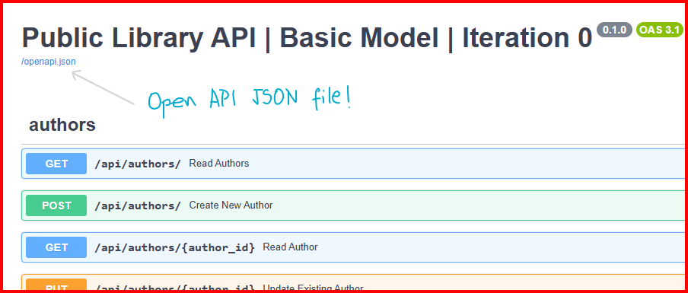
Evolvable APIs | Dox & OpenAPI
Fast API helps with documentation
Automatically produces a valid OpenAPI Spec JSON document
Automatically produces a Swagger Style User Interface
Endpoint http(s)://{host}:port/docs
Automatically produces a ReDoc Style User Interface
Endpoint http(s)://{host}:port/redoc
Familiarize yourself with OpenAPI Specifications
https://spec.openapis.org/oas/v3.0.3.html
Documentation of your API will
facilitate integrations with other services
facilitate MCP implementation

Slide 34
Module 8
Manufacturing
Applications
And MCP
Integrations

Slide 35
Industrial Use Cases
An API oriented towards ISA-95 style contract
api/v1/enterprise
api/v1/sites
api/v1/areas/
api/v1/cells
api/v1/devices
Where to get work orders?
api/v1/areas/{id}/work-orders
api/v1/cells/{id}/work-orders
api/v1/devices/{id}/work-orders
Where to get individual resources?
api/v1/areas/{id}
api/v1/cells/{id}
api/v1/devices/{id}
What about relationships?
???
???
???

Slide 36
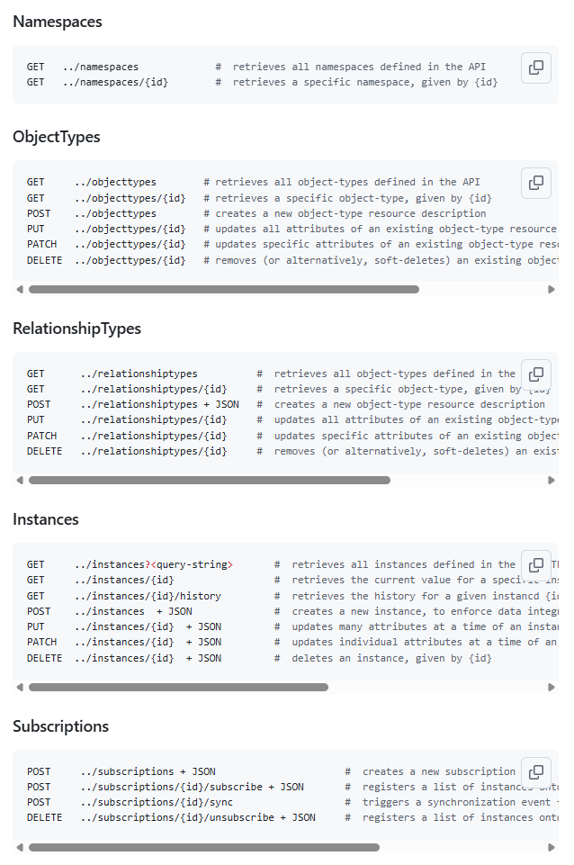
Industrial Use Cases
An API oriented towards CESMII/API standardization | github.com/cesmii/api/issues/94
Is it easier to generalize?

Slide 37

REST for MCP…
Decoupled nature of a REST API allows agents to access relevant tools
Helps reduce custom integrations ( NxM problem)
Statelessness of REST enables MCP scalability (think NFRs)
Helps with context window limits issues
Cache-ability of REST improves MCP Efficiency
Reduces latency. Improves model response
A stable API “contract” promotes MCP Interoperability
Helps reduce hallucinations
Layered System enables MCP Extensibility
Security. Control abuse. Logging.
Richardson Maturity Model adoption improves MCP interpretation of tool capabilities
Adequate HTTP Verbs, HTTP response codes, and OpenAPI Spec definitions educate an Agent about MCP capabilities
Others?

Slide 38
The Recap _
Day
Dos

Slide 39
Day Two | Recap
Created REST API application with Python’s FastAPI library
Implemented a basic REST API for a library
Discussed Error Handling
Discussed API Security basics
Iterated on the basic API and added a security layer with OAuth 2.0 (with Auth0)
Iterated on the API and added rate-limiting capabilities
Iterated on the API and added sustainable evolution (versioning) approach
Discussed manufacturing implications
ISA-95 Hierarchy
CESMII / API Initiative
Industrial Use Cases
Machine data APIs
Production Monitoring
MCP Workshop in November!

