Slide 1

REST APIs
Design | Build | Run

Slide 2
Module 5
FastAPI
Hands-On
Implementation
With Python

Slide 3
Recap | REST API Design
Resource-Centric Thinking
Start naming resources (nouns)
Map actions to HTTP Verbs
GET – Retrieve a resource
POST – Create a resource
PUT – Replace a whole resource
PATCH – Partially update a resource
DELETE – Remove a resource
Less common
HEAD – Retrieves headers only
OPTIONS – Discovery methods/metadata
Map HTTP Codes to API Operation Responses
RFC 9110 | Part 15 – Specification definition for Status Codes
1xx | Informational
The request was received, continuing processing
2xx | Successful
The request was successfully received, understood, and accepted
3xx | Redirection
Further action needs to be taken in order to complete the request
4xx | Client Error
The request contains bad syntax or cannot be fulfilled
5xx | Server Error
The server failed to fulfill an apparently valid request

Slide 4
Pre-Flight Check
You have setup up a work environment
Clone the api-workshop mono-repo
You can run the REST API under the directory library-api-basic
Look at the README.md document for instructions
Disclaimer: Most of my experience is building REST APIs using c# and the dotnet core platform for RESTful APIs. If you are experienced in Python and could improve upon the code presented here, feel free to submit PRs to the repo so others can benefit too
We continue the story from here…

Slide 5
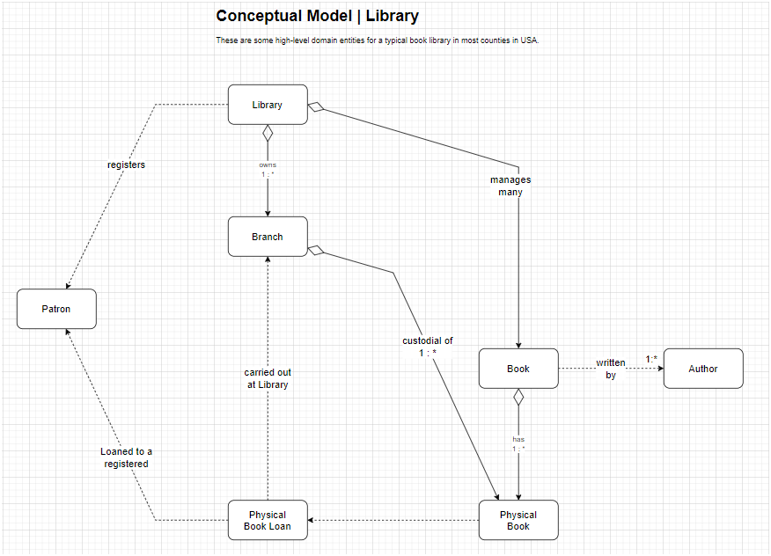
Recall | Conceptual Model

Slide 6
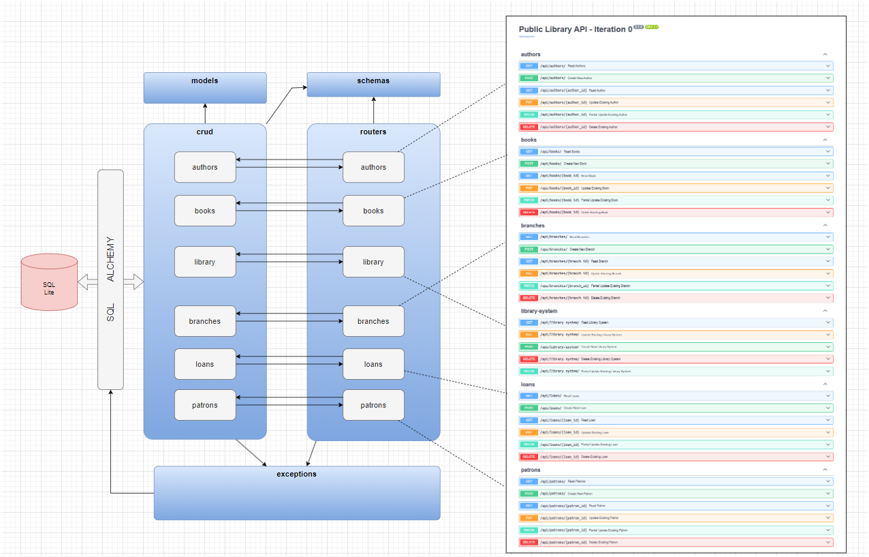
Inspect the Code | App Structure

Slide 7
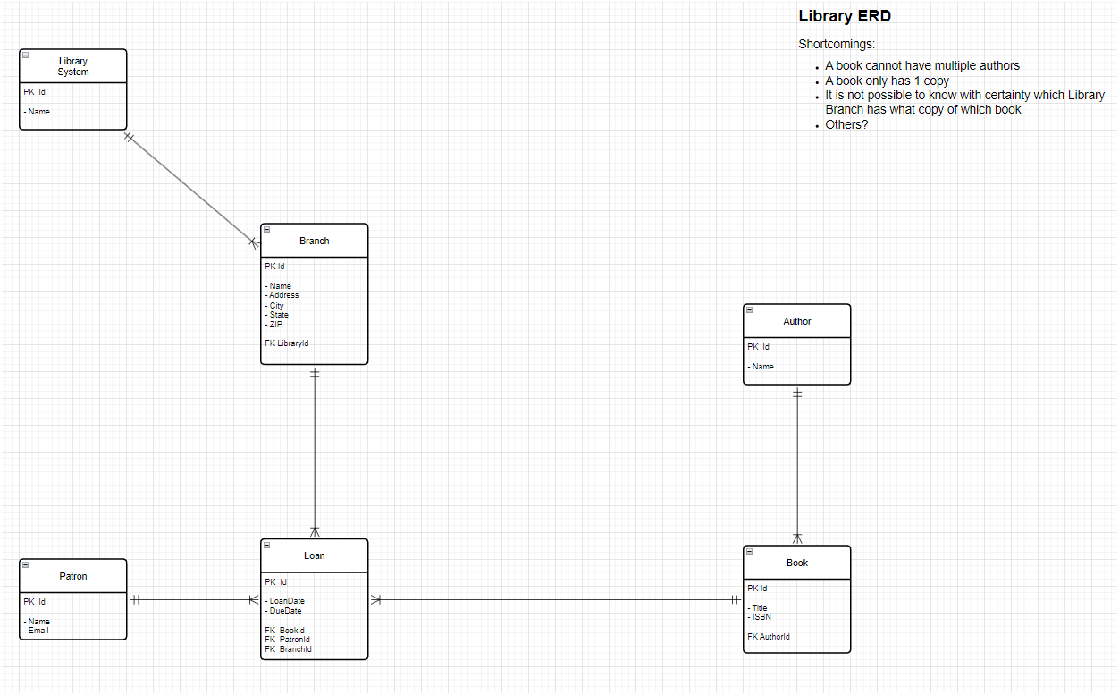
Inspect the Code | ERD v0.1

Slide 8
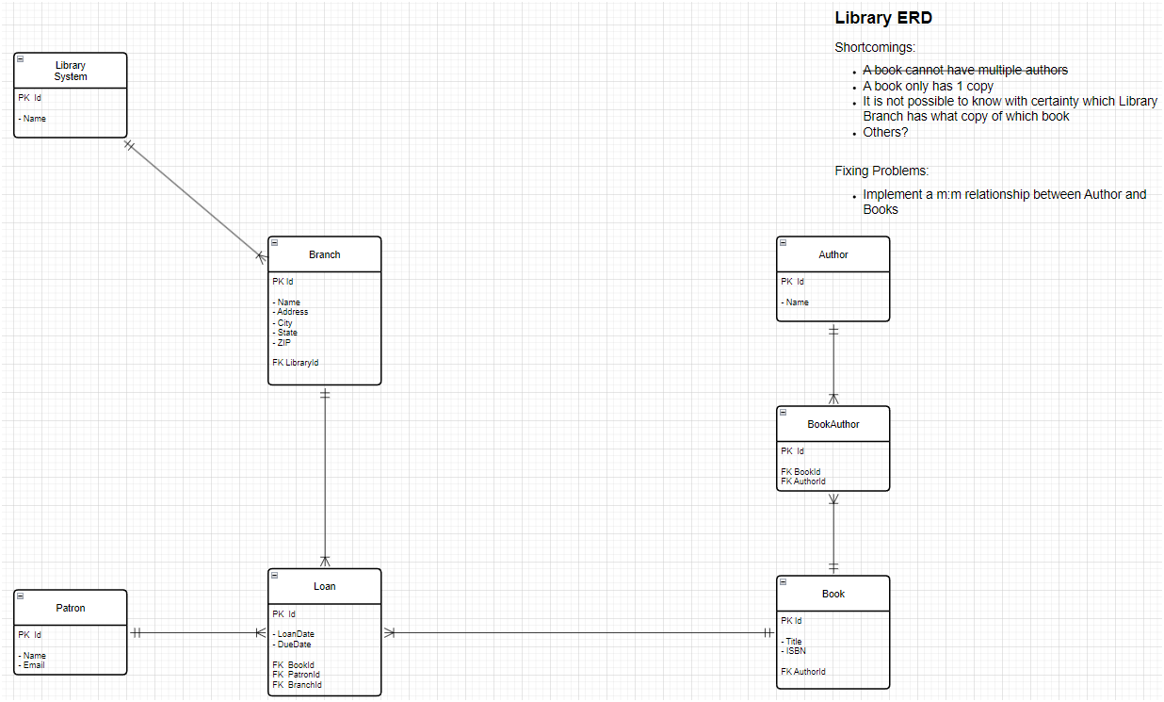
Inspect the Code | ERD v0.2

Slide 9
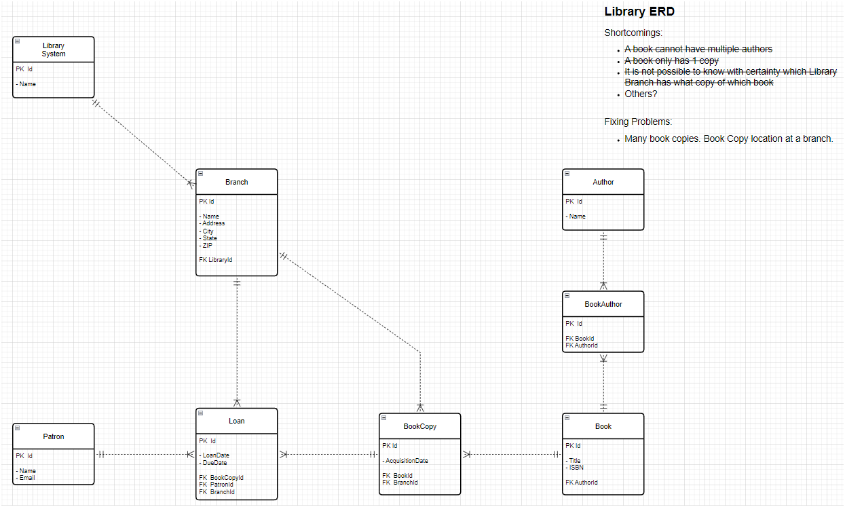
Inspect the Code | ERD v0.3

Slide 10
Inspect the Code | C.R.U.D. Ops
Run the app to
Create a book resource
Update a book resource
Using PUT
Using PATCH
Delete a book resource
Highlight the referential integrity problems
Show how this app deals with that issue
There are many approaches to this, you must be aware and deal with these in the best REST-ful way. Just having your REST API return 500 – Internal Server Error is not the only way!

Slide 11


Inspect the Code | Demo Time
Let’s give it a spin!

Slide 12
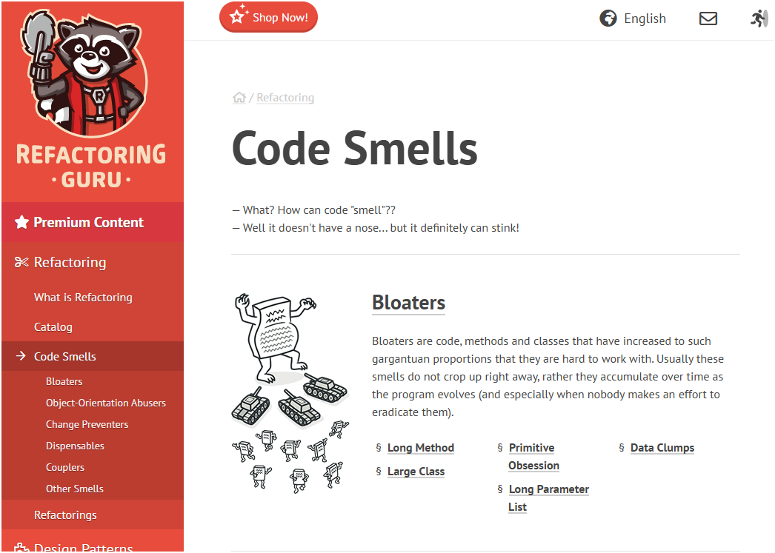
Inspect the Code | Error Handling
Try-Catch is your friend
But be careful
Create Custom Error Types
Only catch custom exceptions
Use a generic error handling for any other exceptions
If you must catch generic exceptions, have a good code commentary as to why
Catching generic exceptions is an anti-pattern / code smell
For more on code smells and how to best handle them visit
https://refactoring.guru/refactoring/smells

Slide 13
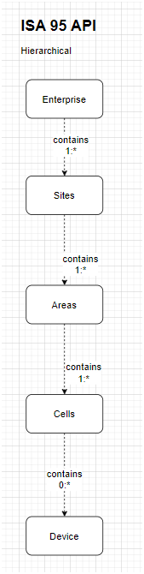
Manufacturing Context
Modeling based on ISA 95
Enterprise
Sites
Areas
Cells
Devices

Slide 14
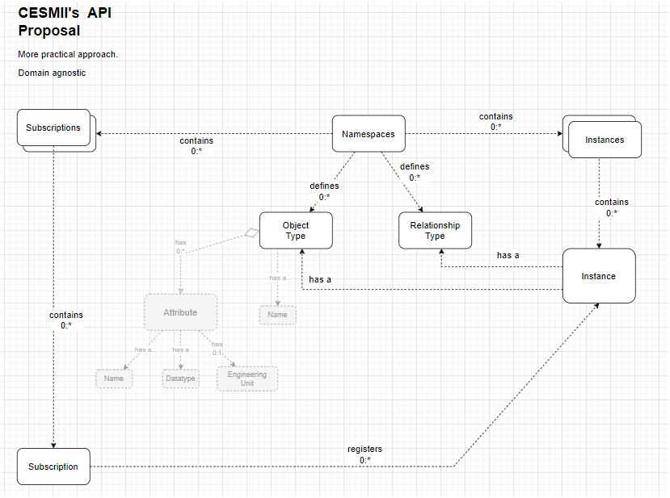
Manufacturing Context
Modeling based on CESMII’s API Proposal
Namespaces
Subscriptions
Instances
Object Types
Relationship Types

Slide 15
Module 6
Security &
Authentication

Slide 16
Sec-Basics | Thread Modeling
Identify Assets
User data
Service Endpoints
Tokens / keys
Threats
Token theft
Replay
Injection
Broken AuthN/AuthR
DDoS / DoS attacks
Security Objectives
Confidentiality
Integrity
Availability
Authentication (AuthN)
Authorization (AuthR)
Non-Repudiation
Principles at play
Least Privilege (only provide what’s needed and no more)
Defense in Depth (security layers)

Slide 17
Sec-Basics | AuthN v AuthR
Authentication (AuthN)
Verify who the client is
API Keys
JWT
OAuth2 Flows
Authorization (AuthR)
Verify what the client can do
Roles
Scopes
Access Control Lists (ACLs)
Example
Client “X” is authenticated, if it has the role “Billing” then it is allowed to call endpoint
POST api/billing

Slide 18
Sec-Basics | TLS
Transport Layer Security (TLS)
HTTPS in PROD – especially if exposed to the public Internet
It is better to use in all ENV (if your budge allows it or it is a practice already enforced by IT team)
The problem with HTTP is network packets travel in plain-text
Enforce redirects (HTTP → HTTPS)
Use Certificates when possible
letsencrypt is free and opensource
Automate the renewal
https://letsencrypt.org
TLS Checklist
TLS 1.2 minimum
TLS 1.3 is preferred
Strong cypher suties
HSTS – browser policy to enforce connecting to HTTPS only
Disable obsolete protocols
Forward secrecy (no long-lived session tokens)
Never put cert/private-key info in code repository

Slide 19
Sec-Basics | Tokens & Secrets Lifecycle
Use short-lived access-tokens
Use refresh-tokens for long-lived sessions
Adopt tooling that allows you to revoke and/or rotate tokens (blacklists, token version, etc.)
Store secrets safely and effectively
Use ENV vars
Secret stores (e.g., Thycotic, AWS Secret Manager)
Key management
Rotate signing keys
Asymmetric signing (public/private keys)

Slide 20
Sec-Basics | Input Validation
Validate everything for an incoming request
Or as much as you can
Url Path
Query String
Headers
Body
Use typed-models to de-risk injection and serialization errors
Sanitize user input
Refer to OWASP Top 10: Input Validation
Log suspicious inputs
Rate-limit abusive patterns

Slide 21
Sec-Basics | Preventing Overuse
Prevent abuse, protect backend resources (RAM, CPU, Storage), enforce SLAs
Strategies
Token Bucket
Leaky Bucket
Fixed Window
Sliding Window
Per-{x}, where “x” is
User
IP Address
API Key
Implementation
API Gateway (Kong, NGINX, Express Gateway, etc.)
Reverse Proxy
Cloud Gateway / API LB
Redis
When implementing, respond with appropriate HEADER in the response
x-RateLimit-Limit
x-RateLimit-Remaining
Use HTTP 429 Too Many Requests Status Code

Slide 22
Sec-Basics | Other Best-Practices
Use secure headers
Content-Security-Policy
X-Frame-Options
X-Content-Type-Options
Cross-Origin Resource Sharing (CORS) – allow only required origins and methods
Cross-Site Request Forgery (CSRF) – relevant when using cookies
Audit logging
authN/authR failures, token issues, suspicious IPs
Auto Sec Checks
Dependency scanning
Static analysis
Secrets scanning

Slide 23
Sec-Basics | API Keys v. JWT Tokens
Consideration | API Keys | JWT Tokens / OAuth2
Features | Simple, often stateless, good for service-to-service or first-party clients. Typically, bearer key in header or query string (avoid query if possible). | Self-contained claims (sub, exp, aud, iss, scopes). Short-lived access tokens and optionally refresh tokens. Can be validated stateless with signature (HS256 or RS256).
Issues | Hard to revoke individual sessions unless tracked server-side. | Revocation harder with fully stateless tokens — need jti + blacklist or token versioning.
Best Use Case | Best for simple service credentials internal (inside your WAN/LAN) microservices | user authentication delegated auth public clients, mobile/web
Security Nuances |  | Store access tokens in memory or secure httpOnly cookies, avoid localStorage for web apps. Choose asymmetric signing (RS256) if multiple services verify tokens without sharing secret. Always verify exp, nbf, aud, iss, and signature.

Slide 24
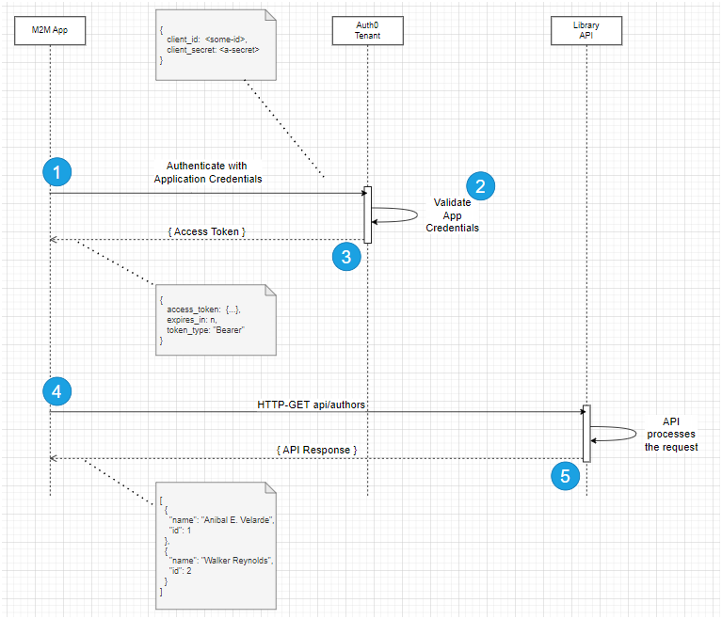
Sec-Basics | OAuth 2.0 m2m Flow

Slide 25
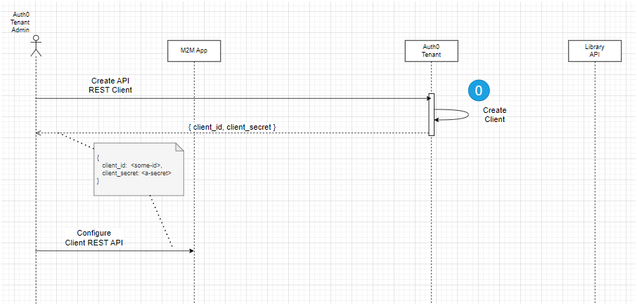
Sec-Basics | OAuth 2.0 Prequel
Do this first!

Slide 26
FastAPI Security
Let’s discuss:
While looking at code
Leverage built-in security features
Use dependency injection for security
Spot shortcomings of the original design
Address how to correct structural data issues
Implement (and test) machine-2-machine OAuth 2.0 flow

Slide 27
FastAPI Security | Built-In Features
Fast API contains small helper dependencies available in the fastapi.security module
These are some utilities available
OAuth2 PasswordBearer
OAuth2
HTTP Basic
HTTP Bearer
HTTP Digest
APIKey Header
APIKey Query

Slide 28
FastAPI Security | Rate-Limiting
API Rate-Limiting
Helps control the frequency of requests to the entirety or selected routes of a REST API with a fixed limit
Callers can be uniquely identified by IP Address, API Key, user ID, etc.
Can be applied uniformly to the whole API or routes of the API
When limit is hit, subsequent requests are blocked (HTTP 429 Too Many Requests)
Focus is towards prevent API abuse (DDoS)
API Throttling
It is another API access control which aims to control frequency of requests with a dynamic value that changes based on sever criteria such as Server Load, User Priority, Request Type, Time of Day, etc.
Focus is towards system performance and availability

Slide 29
Module 7
Building
Evolvable
APIs

Slide 30
Evolvable APIs| Versioning
REST API versioning allows an API to evolve overtime and introduce braking changes without interrupting service to clients using a previous API version
Consider implementing if you are exposing your API to public Internet
Define a policy of how your API contract may change and make clients aware of it
Leverage concepts from Semantic Versioning v2.0.0 (major.minor.patch)
Purpose/Scope – communication stability between provider-consumer of the API
Format – Use v1 or v1.1, no need to introduce “patch” number
Meaning of Increments – You are in control. Example:
Major – breaking changes to existing endpoints, removed fields from request/response pairs
Minor – new endpoints or optional fields in existing endpoints, no fields removed in existing request/response pairs
Backwards compatibility – You must guarantee and commit to it. Document it!
Version Lifecycle – Deprecate old versions (e.g., anything older than 3 versions ago)
Standards? You’ll need to define one and make your clients aware

Slide 31
Evolvable APIs| Versioning Strategies
URI Versioning (very common)

Slide 32
Module 8
Manufacturing
Applications
And MCP
Integrations

Slide 33
Discard Slides below and including this one

Slide 34
HTTP Protocol
HTTP – Hyper-Text Transfer Protocol
Invented circa 1980 by Tim Berners-Lee while working at CERN
Foundational technology for the World Wide Web
Facilitates data transfer over the internet
Enables communication between clients (web-browsers) and servers
Versions
HTTP / 0.9 – 1991
HTTP / 1.0 – 1996
HTTP / 1.1 – 1997
HTTP / 2.0 – 2015
HTTP / 3.0 - 2021

Slide 35
HTTP Protocol
Request / Response
REQUEST
Method | Verbs representing actions GET, POST, PUT, DELETE
URL | Address of a resource on a server
Headers | Metadata about the request
Body | Data sent along-side a request, typically used with POST or PUT verbs
RESPONSE
Status Code | Numeric codes that indicate the result of the request (e.g., 200, 404, 500, etc.)
Headers | Metadata about the response
Body | The content of the response (e.g., API data, error message, etc.)
Key Characteristics
Stateless | Each request is independent. There is no requirement of the server to “remember” prior requests.
Text-Based | Both req/resp are composed of plain text, making them human readable

Slide 36
Module 2
REST
Philosophy &
Principles

Slide 37
What is ReST?
Representational State Transfer
Initial idea proposed by Roy Fielding in his PhD dissertation in 2000
Architectural Style
A set of architectural principles or constraints that guide the design of networked systems
Characteristics
Uniform Interface (contract)
Stateless
Client-Server Architecture
Cache-ability
Leverages the capabilities of the Hyper-Text Transfer Protocol

Slide 38
Alternatives To ReST
GraphQL
Open-source query language for APIs developed by Facebook
Relies mostly on POST HTTP method. With that structure it handles
Queries are used to request data from the server
Mutations are used to modify the data on the server
Subscriptions are used to get live updates when data changes
Steeper learning curve
Great for aggregating multiple backends and letting clients fetch exactly what they need
Client-driven
The client defines exactly the data it wants to retrieve
Data is retrieved in a single request-response fashion

Slide 39
Alternatives To ReST
gRPC
RPC stands for Remote Procedure Call
High performance, open source, bi-directional streaming, auth, load balancing
Created by Google (initially, the “g” in gRPC was for Google, now it means “general”)
Architectural Style
Based on client-server model of remote procedure calls, typeically, over HTTP/2
Client can invoke operations on the server as if it was a local object
Contract-based, strict, approach. Both client and server must know the contract
Request/Response contract is defined in a DSL (protocol buffer language)
The protobuf compiler generates client and server code artifacts

Slide 40
Comparisons
Feature | ReST | GraphQL | gRPC
Data Format | JSON, XML, Plain Text | JSON | Compact binary string
Data Fetch | Pre-defined data shapes. All or nothing | Retrieves data in the shape the client wants it | Available with extensions
Browser Support | Default in all modern browsers | Default in all modern browsers
Code Generation | No dependencies | GraphQL Schema | Protobuf compiler
Response Time |  |  | Extremely performance
Usage | Easiest to implement most domains | Most useful when clients should decide what data they want | Best-fit for frequent internal interactions between microservices
Protocol | HTTP 1.0 / 1.1 / 2.0 | HTTP 1.0 / 1.1 / 2.0 | HTTP/2

Slide 41
Designing REST APIs
Resource-Centric Thinking
Start naming resources (nouns)
Map actions to HTTP Verbs
GET – Retrieve a resource
POST – Create a resource
PUT – Replace a whole resource
PATCH – Partially update a resource
DELETE – Remove a resource
HEAD – Retrieves headers only
OPTIONS – Discovery methods/metadata
HTTP Status Code Ranges
1xx | Informational
2xx | Successful Outcomes
3xx | Redirection
4xx | Client-side Errors
5xx | Server-side Errors
Examples
Library REST API
GET ../api/v1/books?search-filters={}
Show me a list of books
GET ../api/v1/books/{id}
Show me book with ID = {id}
POST ../api/v1/books + { JSON payload }
Create a new book resource
More on this later

Slide 42
Recap | REST Constraints
The “Rules”
Client-Server
Separation of concerns between UI/Clients and data/storage/server/business logic
Stateless
Each request is stand-alone. No required state between requests
Cacheable
Responses should identify if client should cache them or not as indicated in response Headers
Uniform Interface
Document with Open API Spec
Layered System
Intermediaries (proxies, gateways, middleware) can be inserted as pre or post processing. Mileage may vary depending on framework used.

Slide 43
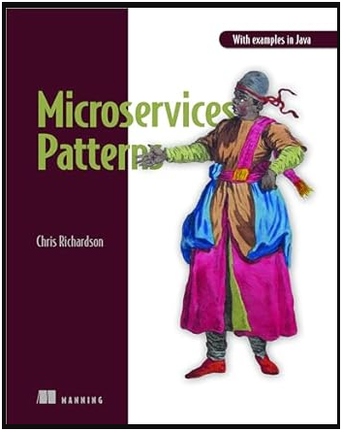


Recap | REST Benefits
The “Benes”
Scalability
Performance & Efficiency
Simplicity
Evolvability
Modifiability
Visibility
Reliability
Security

Slide 44

Recap | REST Trade-offs
The “Trade-offs”
Statelessness increases overhead per-request. The client must convey the full context for the interaction.
Layering improves scalability but can add latency (speed of light is the limit)
REST reduces coupling to the published API surface/specification, but callers are often penalized for extra-round trips

Slide 45
Module 3
Hands-On
Resource
Modeling & URL
Design

Slide 46


REST API | The Library
Domain facts
You run a public library.
Users (patrons) borrow physical copies of books.
A book can have multiple authors
Patrons of the library place holds on specific books
Loans track check-outs and returns
There are 3 branches for the library in the county
Tasks:
Identify key REST API resources
Propose 6-8 routes for operations on resources you identified

Slide 47
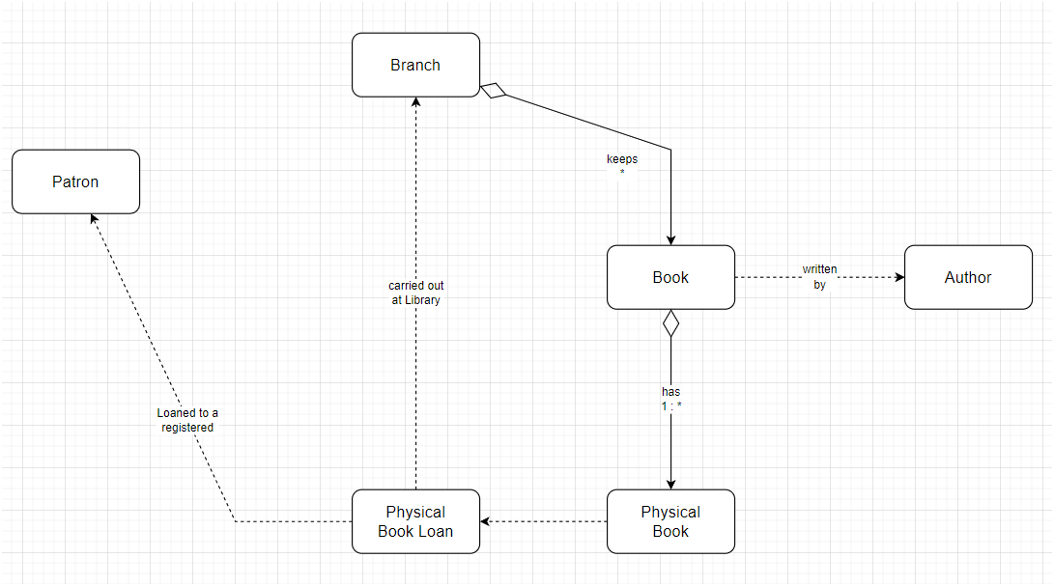
The Library Model | Partial

Slide 48
The Library Model | What’s missing?
?

Slide 49
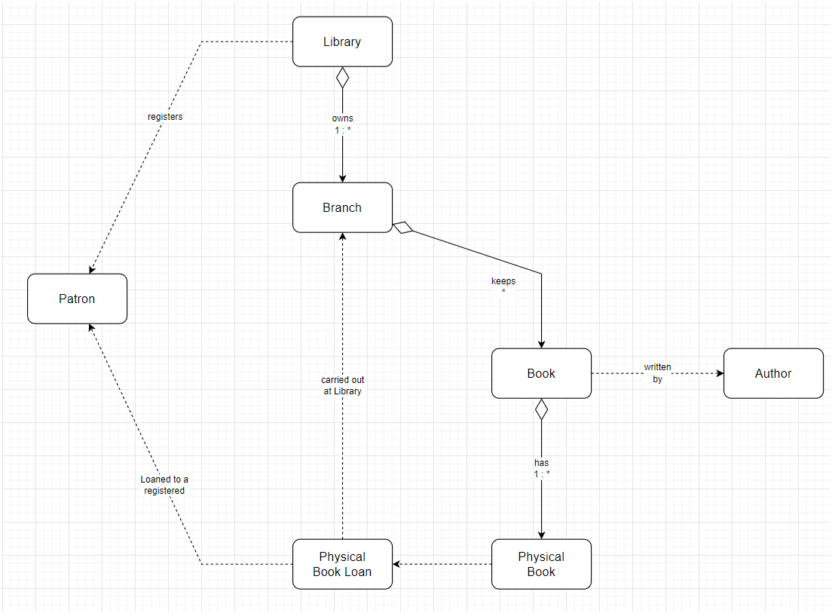
The Library Model | Complete
Something to represent the domain.

Slide 50
REST API | The Library
What resources did you think of?

Slide 51
The Library API | Resources?
…/api/branches
…/api/patrons
…/api/loans
…/api/books
…/api/authors
…/api/library

Slide 52
REST API | The Library
What resource routes (operations) did you think of?

Slide 53
The Library API | What’s the problem here?
POST /checkoutBook
What is the intent?
Where does it fall short?
Is this better?
POST /loans
Why?

Slide 54
The Library API | What’s the problem here?
POST /books/{isbn}/hold?user=99
What is the intent?
Where does it fall short?
Is this better?
POST /holds + {JSON}
Why?
What should the JSON document look like?

Slide 55
The Library API | What’s the problem here?
POST /books/{isbn}/hold?user=99
What is the intent?
Where does it fall short?
What is better?
POST /holds + {JSON}
What should the JSON document look like?

Slide 56
The Library API | What’s the problem here?
POST /books/delete?id=42
What is the intent?
Where does it fall short?
Is this better?
DELETE /books/{id}
Why?

Slide 57
Module 4
HTTP
Verbs & Status
Codes

Slide 58
REST API Design
Resource-Centric Thinking
Start naming resources (nouns)
Map actions to HTTP Verbs
GET – Retrieve a resource
POST – Create a resource
PUT – Replace a whole resource
PATCH – Partially update a resource
DELETE – Remove a resource
Less common
HEAD – Retrieves headers only
OPTIONS – Discovery methods/metadata
Map HTTP Codes to API Operation Responses
RFC 9110 | Part 15 – Specification definition for Status Codes
1xx | Informational
The request was received, continuing processing
2xx | Successful
The request was successfully received, understood, and accepted
3xx | Redirection
Further action needs to be taken in order to complete the request
4xx | Client Error
The request contains bad syntax or cannot be fulfilled
5xx | Server Error
The server failed to fulfill an apparently valid request

Slide 59
HTTP Verbs | GET Method
It requests transfer (to the client) of an existing selected representation for the target resource
See RFC 9110 | Part 9.3.1 for more information
It can be used to return multiple resources or a single resource
For single resource retrieval, it is an idempotent request (same request {id} returns the same data)
Response for request may be cached. Can override with Cache-Control header field
Examples
GET ../api/v1/books?search-filters={}
Show me a list of books
Responds with {JSON} with a list of book resources, data about each book is high-level
May do pagination based on filters
GET ../api/v1/books/{id}
Show me book with ID = {id}
Responds with {JSON} with data about that specific book-id
Payload may contain data about a book resource and immediate, related, resources (e.g., Author)

Slide 60
HTTP Verbs | POST Request
It requests that the target resource interprets the payload in the request to create a new instance of the resource
Make user to validate the client input (trust but verify)
See RFC 9110 | Part 9.3.3 for more information
It may be used create resources in-bulk.
Not idempotent
Bulk updates is not “pure” REST but the pragmatic benefits usually outweigh the theoretical REST ~ use the pattern guided by experience
Examples
POST ../api/v1/books + {JSON}
Add a new book resource
Server responds with
HTTP 200 – OK
HTTP 201 – Created
POST ../api/v1/bulk/books
Body: [{JSON book1}, {JSON book2}, etc.]
Server responds with
HTTP 200 – OK (if it can finish it in reasonable amount of time)
HTTP 202 – Accepted (if client needs to call back to get the results async)

Slide 61
HTTP Verbs | PUT Request
It requests that the target resource be “created” or “replaced” with the state defined in the representation {JSON}
See RFC 9110 | Part 9.3.4 for more information
Some frameworks interpret this literally ~ watch out~ Test! Test! Test!
Example
PUT ../api/v1/books/{id} + {JSON}
Update an existing book resource based on JSON body
Server responds with
HTTP 200 – OK
HTTP 204 – No Content

Slide 62
HTTP Verbs | PATCH Request
It requests that the target resource be “created” or “replaced” with the state defined in the representation {JSON}
See RFC 9110 | Part 9.3.4 for more information
It is idempotent assuming you are not tracking LastUpdated timestamp
Some frameworks interpret this literally ~ watch out ~ Test! Test! Test!
Example
PATCH
../api/v1/books/{id} + {isChkeckedOut = true}
Update specific attribute(s) of an existing book resource based on JSON body
Server responds with
HTTP 200 – OK
HTTP 204 – No Content

Slide 63
HTTP Verbs | DELETE Request
It requests that the target resource be “created” or “replaced” with the state defined in the representation {JSON}
See RFC 9110 | Part 9.3.4 for more information
It is idempotent assuming you are not tracking LastUpdated timestamp
Some frameworks interpret this literally ~ watch out ~ Test! Test! Test!
Example
DELETE
../api/v1/books/{id}
Server responds with
HTTP 200 – OK
HTTP 204 – No Content
DELETE ../api/v1/bulk/books
Body: [{JSON book1}, {JSON book2}, etc.]
Server responds with
HTTP 200 – OK (if it can finish it in reasonable amount of time)
HTTP 202 – Accepted (if client needs to call back to get the results async)
[{book-id-1}, {book-id-2}, …]

Slide 64
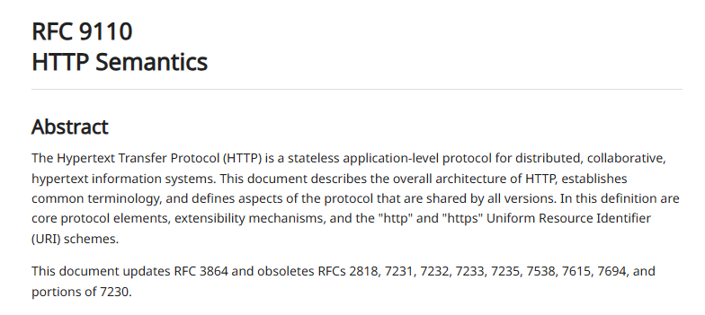
REST API Design | HTTP Codes
Map requests/responses from HTTP Verbs to HTTP Status Codes
GET – Retrieve a resource
200 Ok; 304 Not Modified; 404 Not Found
POST – Create a resource
201 Created; 200 OK + JSON; 202 Accepted (callback is needed to ensure creation was OK); 204 No Content is acceptable for “action” style POST operations (e.g., command type of endpoint)
PUT – Replace a whole resource
204 No Content; 200 OK + JSON
PATCH – Partially update a resource
200 OK; 204 No Content; 404 Not Found; 409 Conflict / 412 Precondition Failed common when using e-Tags
DELETE – Remove a resource
204 No Content; 200 OK + JSON; 404 Not Found; 202 Accepted (for asynchronous deletes)
HEAD – Retrieves headers only
200 OK;
OPTIONS – Discovery methods/metadata
204 No Content or 200 OK with “Allow” and “CORS” headers; 404 Not Found if “target” option is required
Cross-cutting HTTP Status Codes for any HTTP Verb
400 Bad Request
401 Unauthorized
403 Forbidden
405 Method not Allowed
415 Unsupported Media Type
429 Too many requests (specially for quotas)
500 Internal Server Error
503 Service Unavailable
More Info – Check out RFC 9110

Slide 65
The Recap _
Day
Uno

Slide 66
Day One | Recap
REST is everywhere
There are options (gRPC, GraphQL) and trade-offs
Domain Analysis helps a lot – goes a long way
Keep in mind the REST Maturity Model as you design your API surface
When in doubt, consult RFC 9110
It is about `nouns` in your domain
Be consistent on how you apply HTTP Verbs
Be consistent on how API responses indicate HTTP Status Codes
Try to at least meet RMM – Level 2
Document with a standard pattern
Open API Spec (Swagger)
Redoc

Slide 67
Homework
For “brown” field apps
Select an API in your environment and score it for
How well does it use `resource` based structure (nouns)
How well does it map to HTTP Verbs
How well does it make use of HTTP Status code
For “green” field apps
Select an API idea you’d like to build for a specific domain
Design the resources for the domain
Design routes for operations for each resource, include HTTP Verbs in your design
Make sure you are designing-in the HTTP Response Codes

