Slide 1



Flowery The Dream Shop
BY
SHEETAL ILAMKAR

Slide 2

INTRODUCTION
Flowery the dream shop
In this application u can see more kind of variety's of flowers which easily available to u in just one click
In this application I added some services
Insert service 3.Delete service
Update service 4. view service

Slide 3



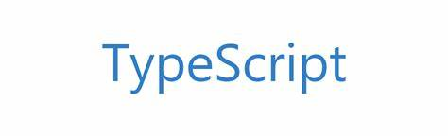
Things which is use in Frontend framework

Slide 4

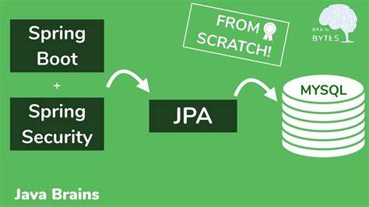


Framework use in backend

Slide 5

Database which Is use
STRUCTURE QUERY LANGUAGE

Slide 6

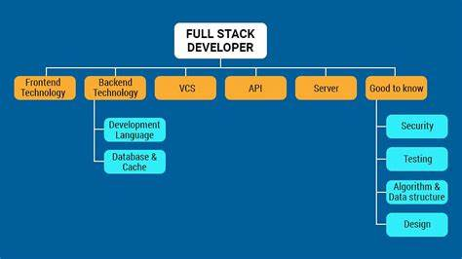
The complete view of this application

Slide 7
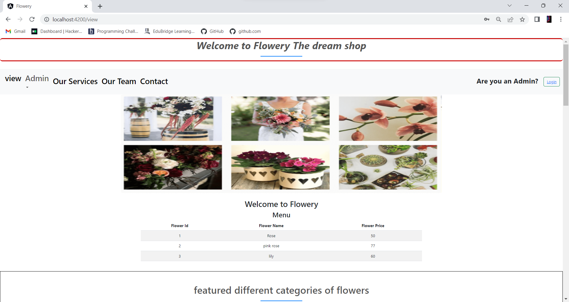
Flowery the dream shop- Home page

Slide 8
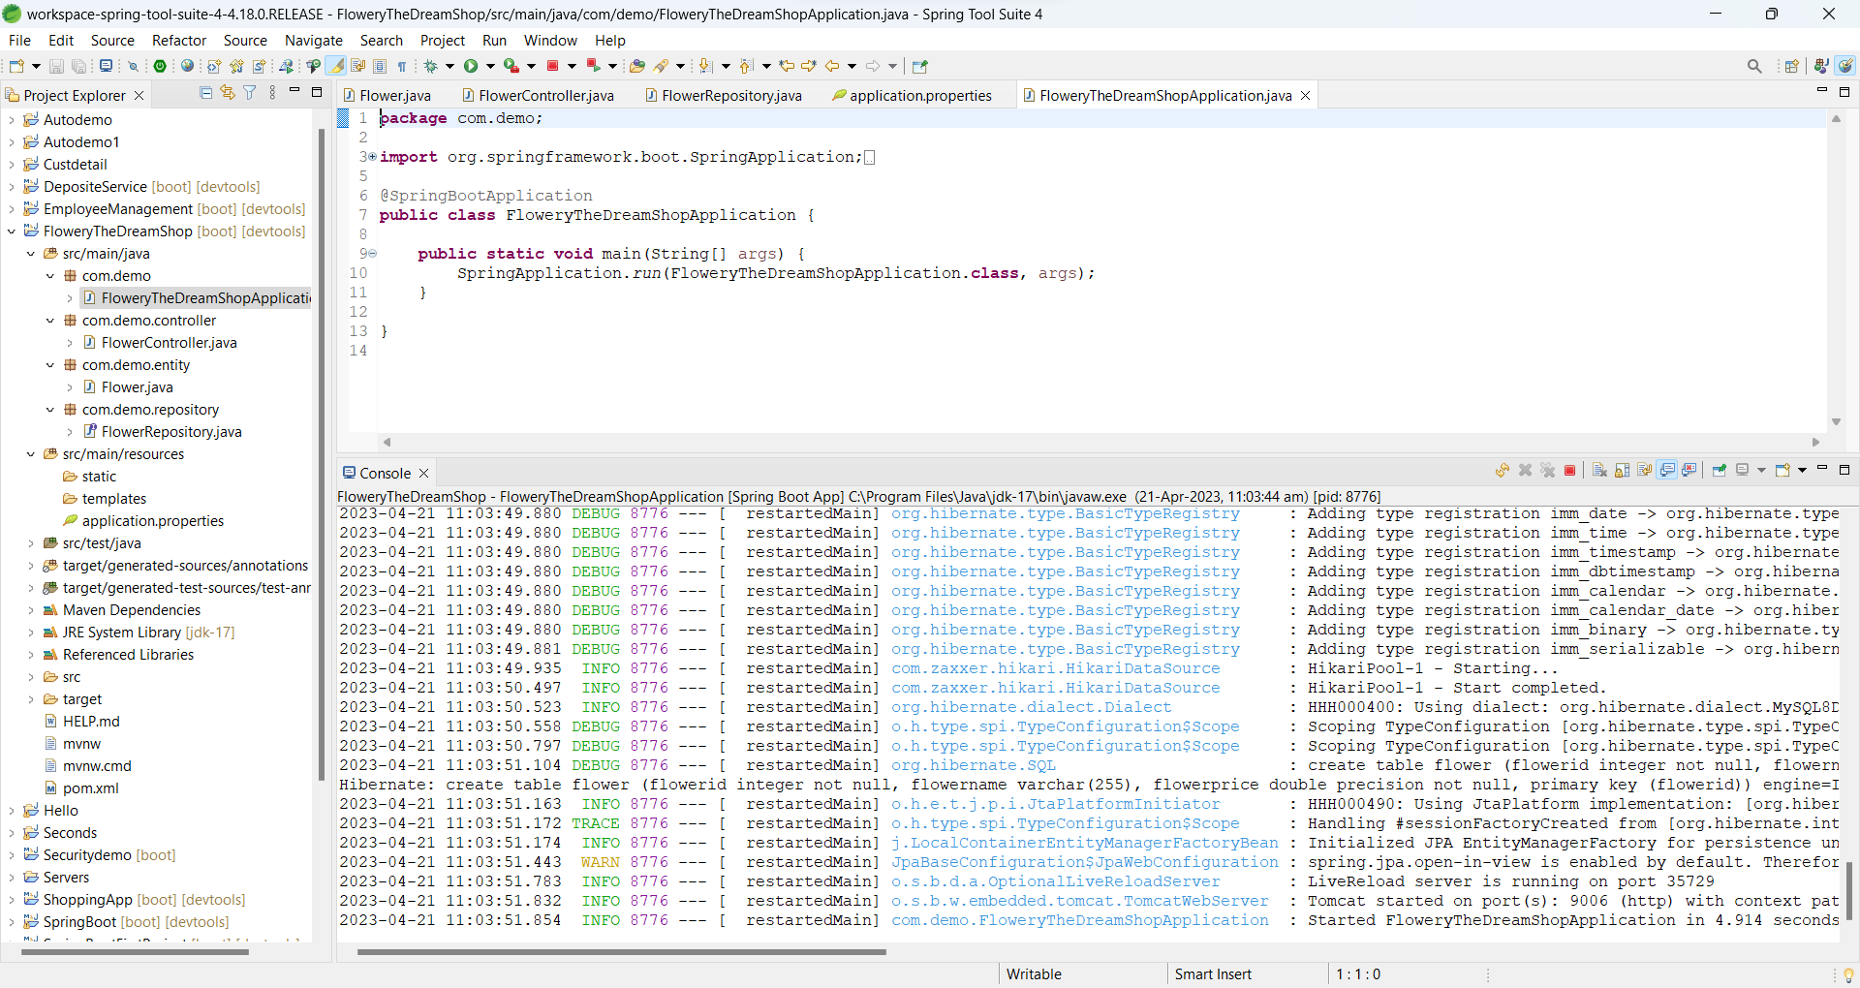
Flowery The dream Shop – Spring app

Slide 9
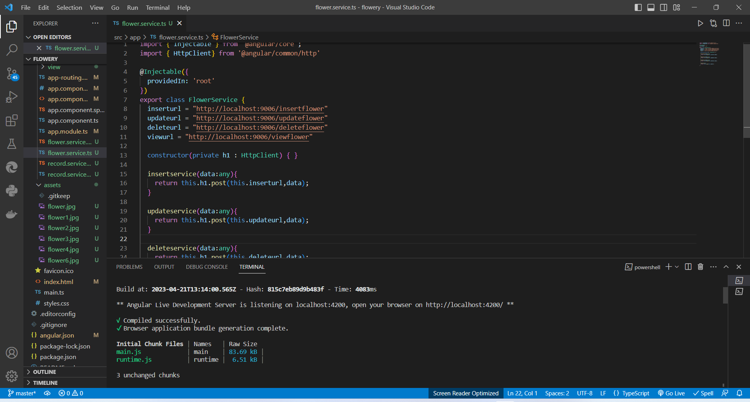
Flowery The dream Shop- angular view

Slide 10
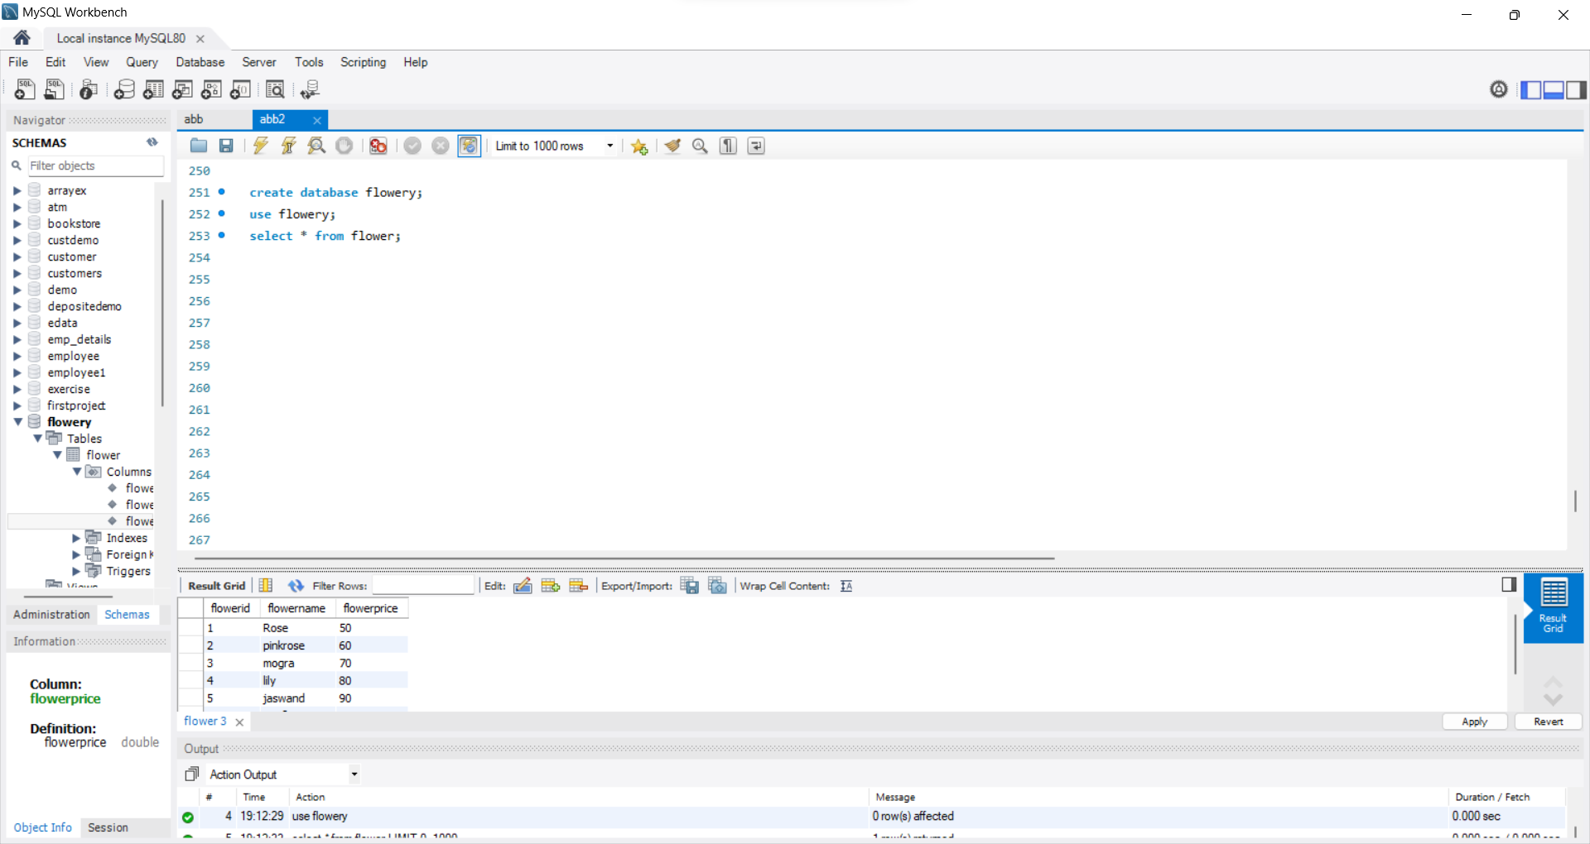
Flowery the dream shop- Database

Slide 11

Future scope of the project
As of now only few services are added in to the application but in future I will add more services which is useful for user and admins also
The main purpose of this application to provide fresh flowers to the people and it is easiest way to connect with supplier and while using this application it will reduce time and extra spending amount on brokers.
If we launch this application most of the farmers can easily supply their product directly

Slide 12

GitHub link
https://github.com/Sheetal14i/Flowery.git

Slide 13


