Slide 1
A Project presentation on WEB APPLICATION DEVELOPMENT IN ASSOCIATED WITH VATSALYA TRUST SUBmitted by Shabista idrisi – 17202a0017 Sheetal Gupta – 17202a0028 Under the guidance of Ms. Archana gopnarayan

Slide 2
INDEX
Introduction
Literature Survey
Hardware and Software Requirements
Module description
Planning & Testing
Advantages
Applications
Bibliography

Slide 3
INTRODUCTION
Our Project is about Web Application for an Orphanage. Our aim is to make a simple and interactive web application which helps the users as well as admin to interact with it. Our project has user as well as admin panel.
User panel has various modules such as home page, about us page, projects page, gallery page, contact page, feedback page and online donation.
Admin panel will fetch all records for database and display it on admin panel. It has only one access so only one admin access that page.

Slide 4
LITERATURE SURVEY
Why we are selecting this Project ?
As our Project is about Web Application of an Orphange, we are selecting this project so that we can help people by Technology.
By making their Web Application people can know about that Orphanage.
By doing this project we can help them as well as we are trying to make their work simpler.
Is this type of System was implemented earlier or not?
This type of system was implemented by them earlier in 90s So, their web application is much older and doesn’t contain new Technology and Database system.
By making their Web Application it will help them by New Design, Technology and Storing data.

Slide 5
HARDWARE & SOFTWARE REQUIREMENTS
HARDWARE REQUIREMENTS
SOFTWARE REQUIREMENTS
System : 64 bit Operating System, x 64-based processor
Processor : Intel® Core™ i5 – 6200U CPU@ 2.30GHz 2.40 GHz
Hard Disk : 40 GB
RAM : 8GB
Operating system : Windows 10
Database : PhpMyAdmin: MYSQL
Coding Language : PHP, Html, Css, Javascript

Slide 6
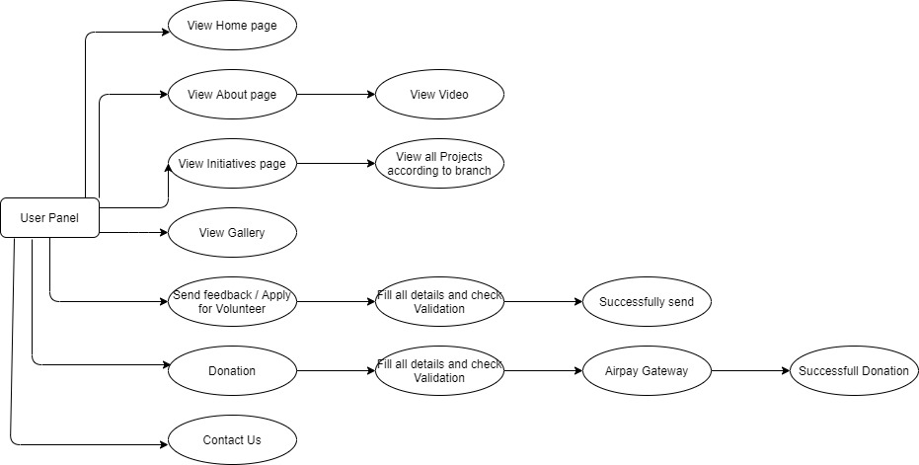
MODULE DESCRIPTION : USER PANEL
User modules has this all sections where user can view pages, images, send any feedback or they can send an message for volunteer as well as they can pay money through online donation procedure using Airpay.

Slide 7
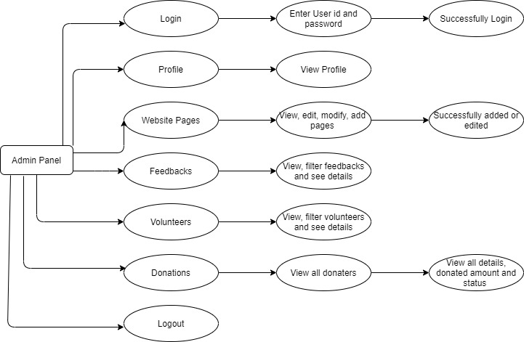
MODULE DESCRIPTION : ADMIN PANEL
Admin module has various sections such as Login, profile, feedbacks, volunteers, list of donaters and website pages. Admin can view and sort feedback and volunteers according to their departments.

Slide 8
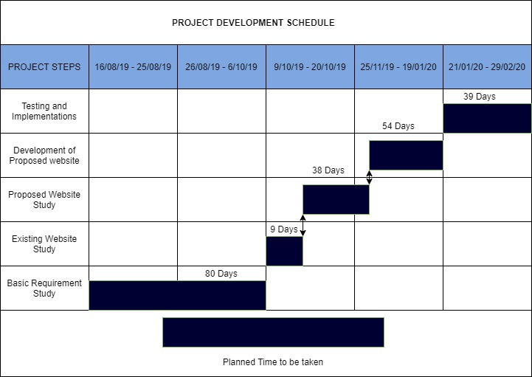
PLANNING Planned time to be taken

Slide 9
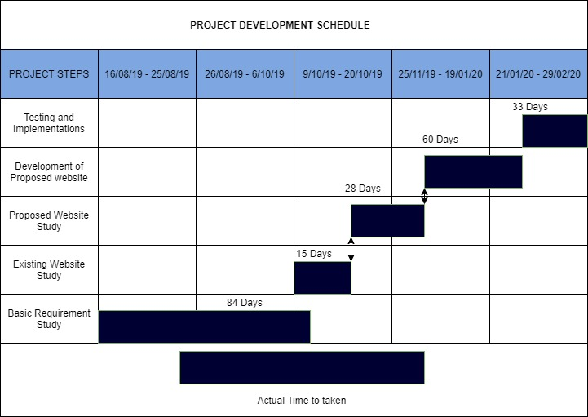
PLANNING Actual time to be taken

Slide 10
TESTING User Module
SR.NO | ACTION | INPUT | EXPECTED OUTPUT | RESULT
1. | Give Feedback | Fill feedback(if correct details) | Success | Pass
2. | Give Feedback | Fill feedback(if incorrect details or empty columns) | Please fill all columns correctly. | Pass
3. | Fill for Volunteer | Fill details (if correct) | Success | Pass
4. | Fill for Volunteer | Fill details (if incorrect or empty columns) | Please fill all columns correctly. | Pass
5. | Donation | Fill the form (if correct) | Donation is successful | Pass
6. | Donation | Fill the form (if incorrect) | Fill details (Fail donation) | Pass

Slide 11
TESTING Admin Module
SR.NO | ACTION | INPUT | EXPECTED OUTPUT | RESULT
1. | Login | Enter username and password (if correct) | Successfully login | Pass
2. | Login | Enter username and password (if incorrect) | Incorrect username and password | Pass

Slide 12
ADVANTAGES
Users can get Overall information of that Trust through our Web Application.
Donation will be made easy for Users through online.
Through this Events, Projects and Gallery will be up to dated regularly.
Through this we can provide them Online Tech.

Slide 13
APPLICATIONS
Orphanage Management System will be used by Vatsalya Trust or any Orphanage Management System.
Online donations will be easy for end user as well as for the management.

Slide 14
BIBLIOGRAPHY
https://unsplash.com/
http://www.vatsalyatrustmumbai.org/
https://www.techjockey.com/detail/airpay-payment-gateway
https://www.kashipara.com/project/html5/3479/orphanage-management-system
https://www.lambdatest.com/blog/27-tips-for-finding-bugs-in-your-website/

Slide 15
THANK YOU!!!

