Slide 1
Customer Behaviour Prediction Using Machine Learning
Guided by
Prof. S. K. Gaikwad
Project by
Sheetal Gautam Jade
121742009
1

Slide 2
Contents
Introduction
Motivation
Research Gap
CBP model
Problem Statement
Objective
Literature Survey
System Requirement
Proposed System Design
Experimentation and results
Conclusion
Future Scope
References

Slide 3
Introduction
What is customer behaviour prediction?
It is a process of identifying common behaviour among the group of customers.
Why it is needed?
It is used to retain valued customers and retaining current customer of organization is cheaper as compared to attracting new customers.
Customer Relationship Management.
Finding how customer spends their time on online shopping websites, how much time it spends on searching for items, most frequent items bought, quantity of items bought.

Slide 4
Motivation
Nowadays people are very busy. They don't have time to go to shop for shopping. Customers are approaching towards online shopping.
Online shopping has become the third most popular Internet activity, following e-mail using/instant messaging and web browsing.
Consumer-retailer relationship structure is dependent on understanding consumer behaviour in online environments.
So, Customer behaviour prediction has gained attention to improve sell of products. It is influenced by many external and internal factors, but the company can also influence the final process of buyer decision-making significantly by its activities.

Slide 5
Research Gap
From literature survey, it has been found that different approaches have been used in the field of Customer Behaviour Prediction. But still need to improve prediction accuracy.
Challenges presented in literature survey gave a scope to work in the domain of customer behaviour prediction based on What type of data user is visiting? Time spent on web pages Which type of page is visited by user?
Results of existing approaches can be optimized further for accurate customer behaviour prediction.

Slide 6
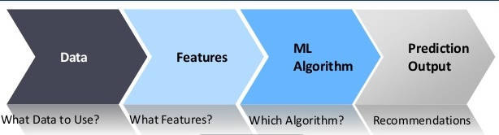
Customer Behavior Prediction Model

Slide 7
Problem Statement
To propose efficient model for customer behavior mining in the domain of online shopping.
Study and understand the current research work being done in this area.
Improving feature engineering to improve accuracy of model.
Selecting best suitable algorithm for classification.
Notes:
Verification also consists of comparing two computations. Note that the difficulty of computing discrete logs is why it is infeasible for an opponent to recover k from r.
Note that nearly all the calculations are mod q, and hence are much faster save for the last step.

Slide 8
Objective
To make the literature survey in the field of customer behavior prediction.
Selecting best suitable classification algorithm by comparing various algorithms.
Feature selection to improve accuracy and reduce unnecessary processing overhead.

Slide 9
Literature Survey
Author [1] classified customers using SVM into 6 classes. These classes are customer on regular, occasion, festival, offer, window shopping customer, recent customer. Future work for this was to compare results of SVM with other classification methods.
Author [2] proposed CBMF which is divided into 2 phases first phase is customer segmentation based on socio-demographic features. Second phase is prediction behavior of customer. Author used K means clustering for first part and Decision Tree and Neural Network for Behavior prediction.
Research [3] used MLPNN(88.63) and NB(87.97) algorithms for customer behavior prediction in banking. With the help of WEKA tool, he proved that accuracy of MLPNN is better than NB.

Slide 10
Literature Survey
According to [9], customer behavior prediction can be used to increase sales profit. Author used R and implemented RFA algorithm. He did data analysis according to gender and concluded that online shopping needs to be promoted among females.
In [15], author mentioned 10 techniques for customer retention of telephonic industry. He got best Maximum accuracy(approximately 96%) for RFA and adaboost.
Similarly[16,7,9], did survey in field of online shoppers behavior prediction and stated that good feature engineering is necessary to improve accuracy of models.

Slide 11
Literature Survey
From literature survey, we observed that many classification algorithms can be used for customer behaviour prediction in various fields like telephonic industry, banking industry and online shopping but need to improve accuracy of classification for online shopping data.
Feature selection can be done to improve accuracy and reduce unnecessary overhead of processing features.

Slide 12
System Requirement
Hardware Requirements
Processor: Intel(R) Core(TM) i3-2350M CPU @ 2.30GHz 2.30 GHz
RAM: 4 GB RAM
Disk: 500 GB
Software Requirements
Operating System: Windows 8.1 Pro
OS type: 64-bit Operating System, x64-based processor
Python 3.7
Jupyter notebook

Slide 13
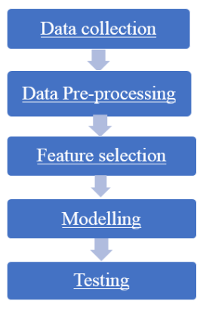
Proposed System Design

Slide 14
Data Collection and Description
Online Shoppers Purchasing Intention dataset from UCI Machine learning repository.
Dataset contains 12330 sessions and18 attributes. Revenue is our target variable.
Attribute values of this dataset are integer, real.
This dataset is donated on 2018-08-31.

Slide 15
Data Pre-processing
Data Cleaning - missing values removed
Data Transformation – Label Encoding
It is a process of converting data from one format to another format.
Alphabetical order

Slide 16
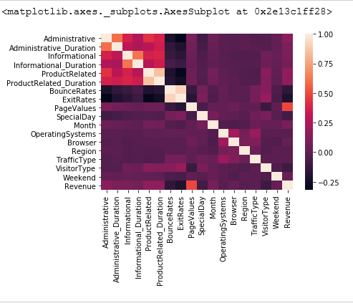
Correlation Matrix

Slide 17
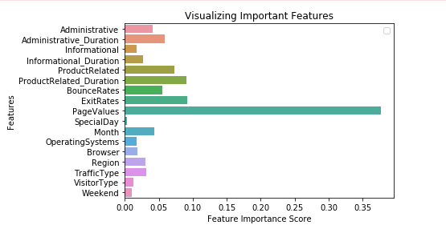
Feature Selection

Slide 18
Modelling
Adaboost classifier
Decision Tree classifier
GBM(Gradient Boosting Machine)
KNN (K-Nearest Neighbor)
Logistic Regression
Multi-Layered Perceptron Neural Network (MLPNN)
Nave Bayes (NB)
Random Forest Algorithm (RFA)
Support Vector Classification algorithm (SVC)
XGB (XGBoost)

Slide 19
Training and Testing
80% training 20% testing
70% training 30% testing
60% training 40% testing

Slide 20
Experimentation and Results
Accuracy of models during 10 folds with 80-20 split of data
Accuracy of models during 10 folds with 70-30 split of data
Accuracy of models during 10 folds with 60-40 split of data
Minimum, Maximum and Mean Accuracy of models
Confusion Matrix for RFA
Classification Report for RFA

Slide 21
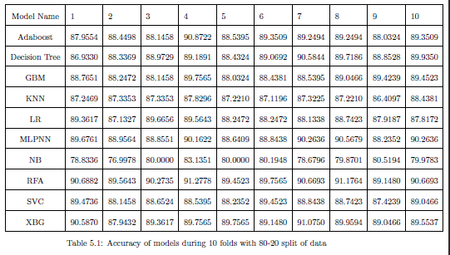

Slide 22
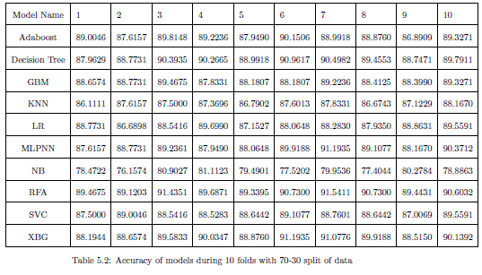

Slide 23
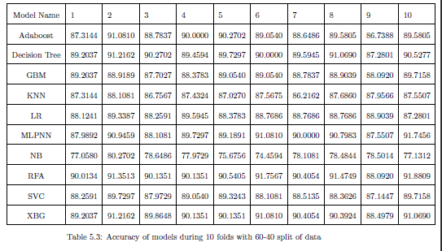

Slide 24
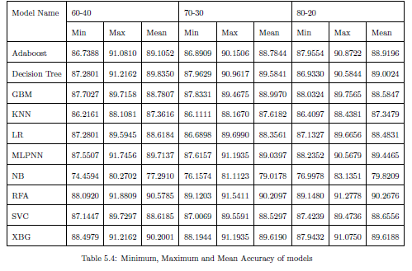

Slide 25
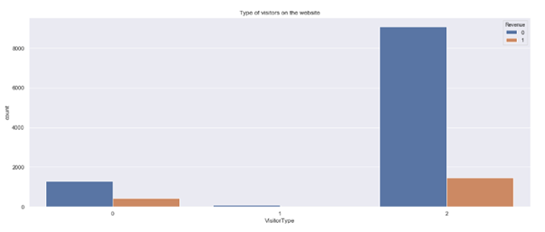
Visitors Type vs Revenue
New
Other
Returning

Slide 26
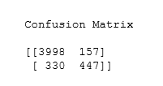
Customer did Not Purchase & Model predicted it as Not Purchase.
Customer did not Purchase but model predicted it as Purchase
Not Purchase
Purchase
Customer end with Purchase & Model predicted it as Purchase.
Customer purchased product, but model predicted it
as Not Purchase

Slide 27
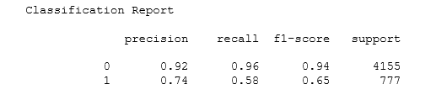
Accuracy of Proposed Model : 90.42986861119473
Not Purchase
Purchase

Slide 28
Precision
It is a ability of classifier to label Positive sample as positive and negative as negative.
Precision= TP/(TP+FP)
Recall
It is a ability of finding all positive samples of the class.
Recall = TP/(TP+FP)
F1-Score
Mean of Precision and Recall
Support
It is the number of samples of true responses present in that class. (i.e. sum of both Positive and Negative samples of class)

Slide 29
Conclusion
To conclude with the analysis, we have understood that customers purchase chances are more if Bounce Rate is below 0.050 and exit Rate below 0.075.
The Chances of product purchase is high if ProductRelated Duration is between 0-30000 seconds and ProductRelated pages are between 0-300.

Slide 30
Conclusion
During data analysis, we observed that customers have preferred Operating System 1,2,3,4 is most frequently used in all region.
Browser 2 is used by many customers.
Finally, we understood that online purchasing must be emphasized and improved more among New customers (Type 0) and other (Type 1) customers whereas the use of promo codes must be emphasized with both Visitor Types.

Slide 31
Future Scope
Suggesting promotional tools for improving the sales profit.
Predicting which products the customer buy most and providing marketing strategies for improving the sales.

Slide 32
References
Dr.K. Maheswari and P.Packia Amutha Priya, “Predicting Customer Behavior in Online Shopping Using SVM Classier", 2017 IEEE INTERNATIONAL CONFERENCE ON INTELLIGENT TECHNIQUES IN CONTROL, OPTIMIZATION AND SIGNAL PROCESSING.
Farshid Abdi and Shaghayegh Abolmakarem, “Customer Behavior Mining Framework (CBMF) using clustering and classification techniques", Journal of Industrial Engineering International. Received: 4 June 2017 / Accepted: 2 August 2018.
Femina Bahari T and Sudheep Elayidom M., “An Eficient CRM-Data Mining Framework for the Prediction of Customer Behaviour", International Conference on Information and Communication Technologies (ICICT 2014).
https://www.geeksforgeeks.org/ml-label-encoding-of-datasets-in-python/
https://archive.ics.uci.edu/ml/datasets/Online+Shoppers+Purchasing+Intention+Dataset

Slide 33
References
Mahendra Pratap Yadav, Mhd Feeroz and Vinod Kumar Yadav, “Mining the customer behaviour using web usage mining in e-commerce", ICCCNT'12 26th 2Sdl July 2012, Coimbatore, India.
Pooja Sharma, Vidyalakshmi Nair, Amalendu Jyotishi, “Patterns of Online Grocery Shopping in India: An Empirical Study", CONIAAC '14, October 10 - 11 2014, Amritapuri, India.
Ge Yunshengi, Zhang Qianqian and Kong Jie, “Research on the prediction of user behavior based on neural network", ICIIP '18, May 1920, 2018, Guilin, China.24
M.N.Saroja, S.Kannan,K.R. Baskaran, “Analysing the Purchase Behavior of a Customer for Improving the Sales of a Product", International Journal of Recent Technology and Engineering (IJRTE) ISSN: 2277-3878, Volume-7 Issue-4S, November 2018.
https://www.geeksforgeeks.org/confusion-matrix-machine-learning/

Slide 34
References
RanaAlaa El-DeenAhmeda, M. ElemamShehaba, ShereenMorsya and Nermeen-Mekawiea, ”Performance Study of Classification Algorithms for Consumer Online Shopping Attitudes and Behavior Using Data Mining", (CSNT), 2015 Fifth International IEEE Conference on 4-6 April 2015, Electronic ISBN: 978-1-4799-1797-6, Printon Demand (PoD) ISBN: 978-1-4799-1798-3.
https://scikit-learn.org/stable/modules/generated/sklearn.metrics.precision recall fscore support.html
https://www.geeksforgeeks.org/ml-label-encoding-of-datasets-in-python/
https://archive.ics.uci.edu/ml/datasets/Online+Shoppers+Purchasing+Intention+Dataset
Sahar F. Sabbeh, “Machine-Learning Techniques for Customer Retention: A Comparative Study", International Journal of Advanced Computer Science and Applications, Vol. 9, No. 2, 2018.

Slide 35
References
Mr. Shrey Harsh Baderiya, Prof. Pramila M. Chawan, “Customer buying Prediction Using Machine-Learning Techniques: A Survey", International Research Journal of Engineering and Technology (IRJET) e-ISSN: 2395-0056 Volume: 05 Issue: 10 | Oct 2018.
Harsh Valecha, Aparna Varma and Ishita Khare, “Prediction of Consumer Behaviour using Random Forest Algorithm", 2018 5th IEEE Uttar Pradesh Section International Conference on Electrical, Electronics and Computer Engineering (UPCON).

Slide 36
Thank you

