Slide 1

ENGINEERING ANALYTICS –II 2015 FLIGHT DELAYS & CANCELLATIONS ” eda & FLIGHT DELAY PREDICITIONS university of south florida , Tampa
Ram Sheetal Ramamoorthy (u90506343) , SPRING 2019 04/28/2019

Slide 2
Project idea
To perform the Exploratory Data Analysis and to predict if the given set of flights’ arrival will be delayed or not using the response variable “Arrival Delay” is the idea of the project.
Question to be answered : Which airline should you fly on?
Using “Tableau” visualization tool performed exploratory analysis on the dataset
https://public.tableau.com/profile/ram.sheetal#!/
(My Tableau Public Profile )

Slide 3
Motivation
Flight delays have always been one of the important problems in association with the management of airport and changes in flights schedules which affects the passengers the most.
We know for a fact that if we are late out of the driveway in the morning we will be late to work, and at times it costs us the whole day. Think about the people who travel on air and what the delay in flight’s arrival would cost them.
By predicting if the flights will be delayed or not with the help of the information we know in advance, like the departure information, flight information etc. will give the passengers a heads up on which airline they should fly to avoid significant delays.

Slide 4

DATA SET DISCOVERY
Data source: https://www.kaggle.com/usdot/flight-delays
Original Source: https://www.transtats.bts.gov/DL_SelectFields.asp?Table_ID=236
31 columns
139657 rows (randomly selected from the 5 million rows in the original dataset)
The response variable is Arrival_Delay

Slide 5
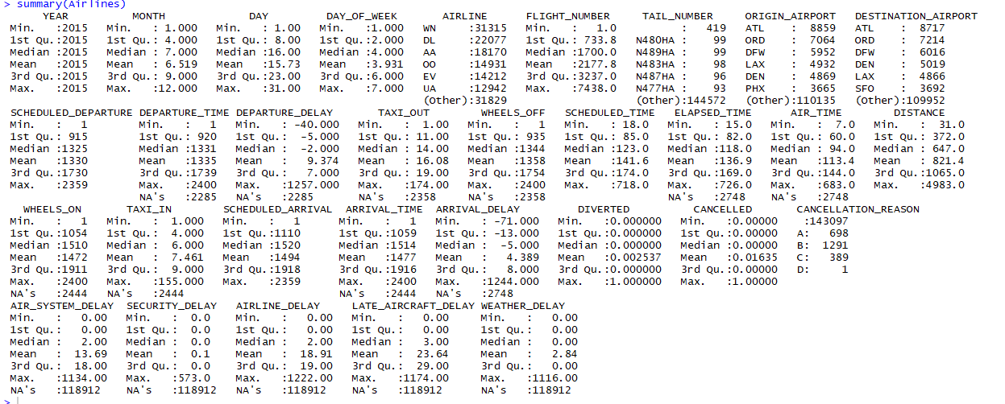
Dataset Discovery

Slide 6
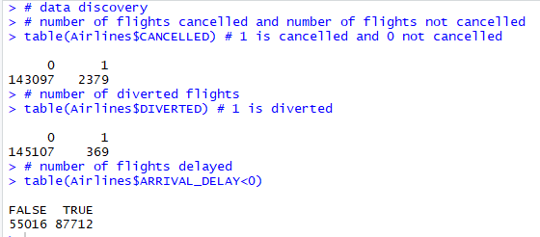
Dataset Discovery
Rcode :
Summary of the dataset shows us there are many NA’s
Below are the data information we discover from the dataset
No of flights delayed :55,016
No of flights diverted : 369
No of flights cancelled and not cancelled : 2379 and 143079

Slide 7
DESCRIPTIVE
ANALYTICS

Slide 8
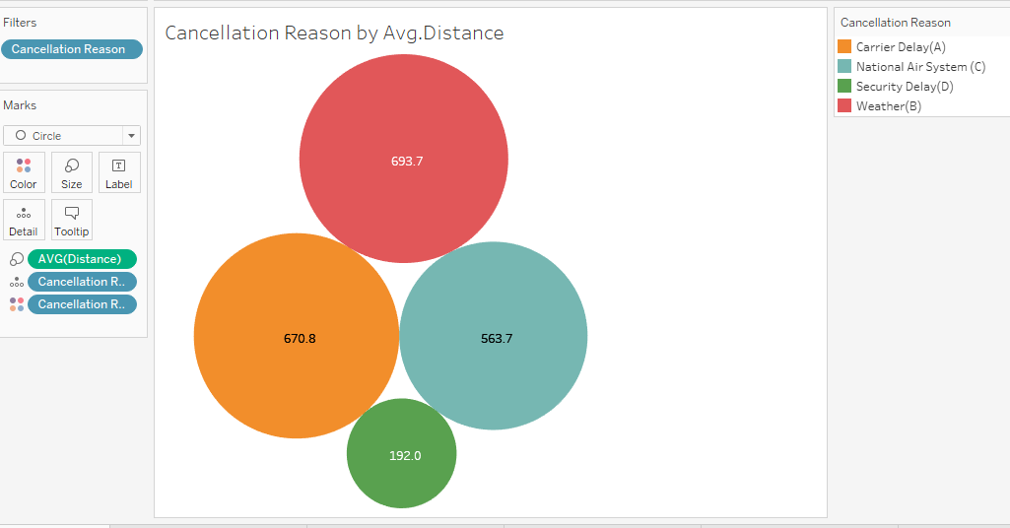
1.Cancellation Reason by Distance

Slide 9
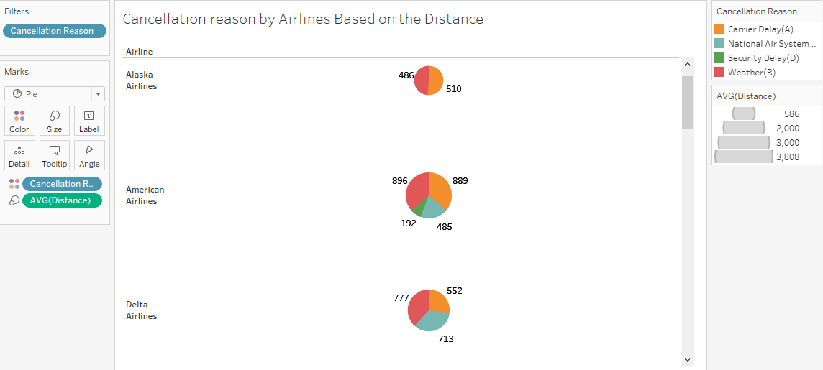
2.Cancellation Reason By Airlines based on Average Distance

Slide 10
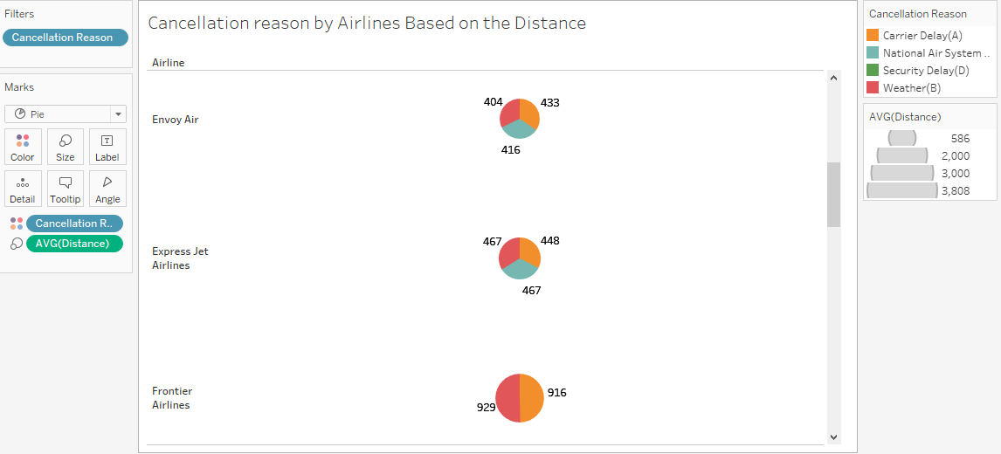

Slide 11
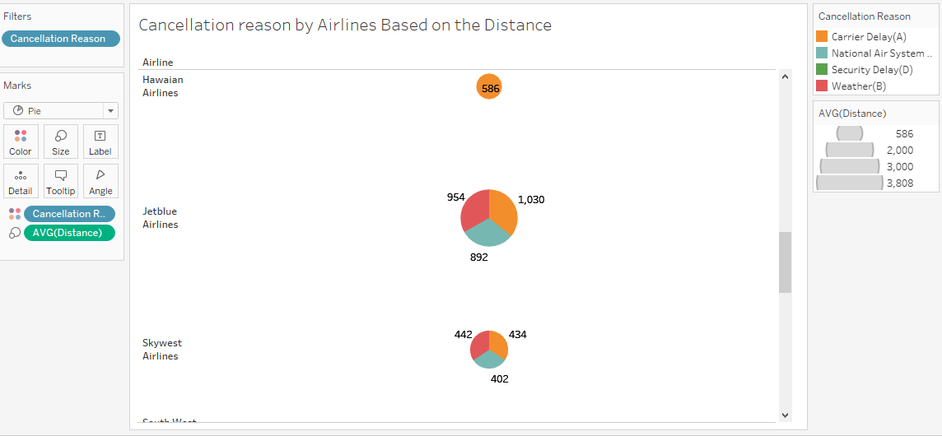

Slide 12
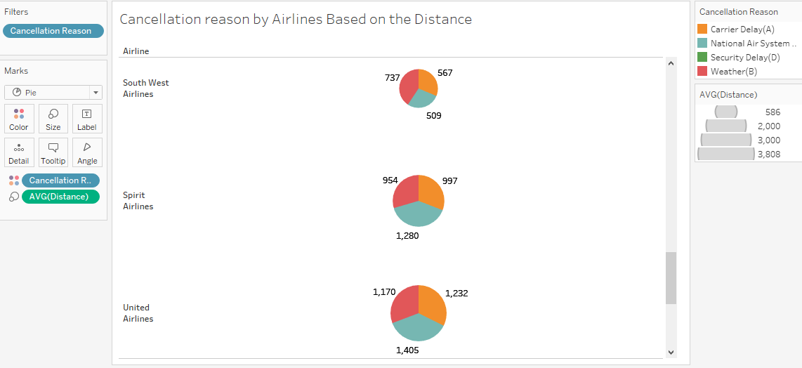

Slide 13
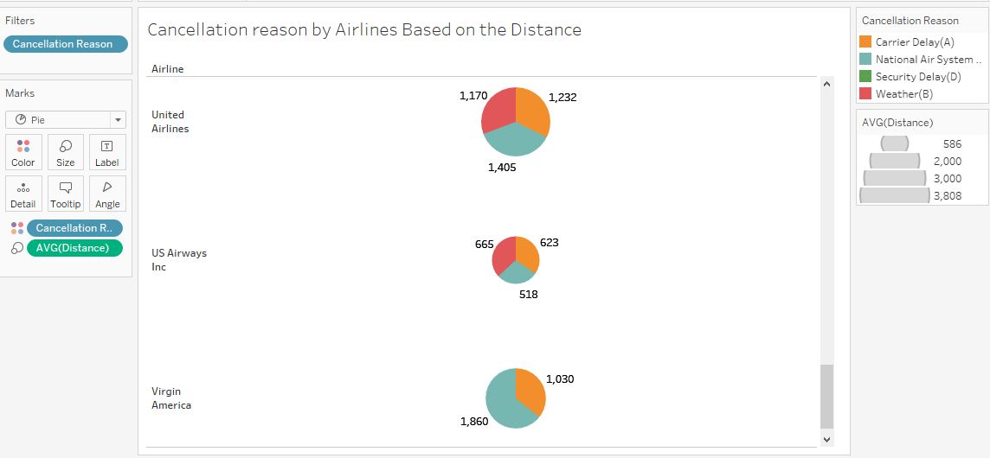

Slide 14
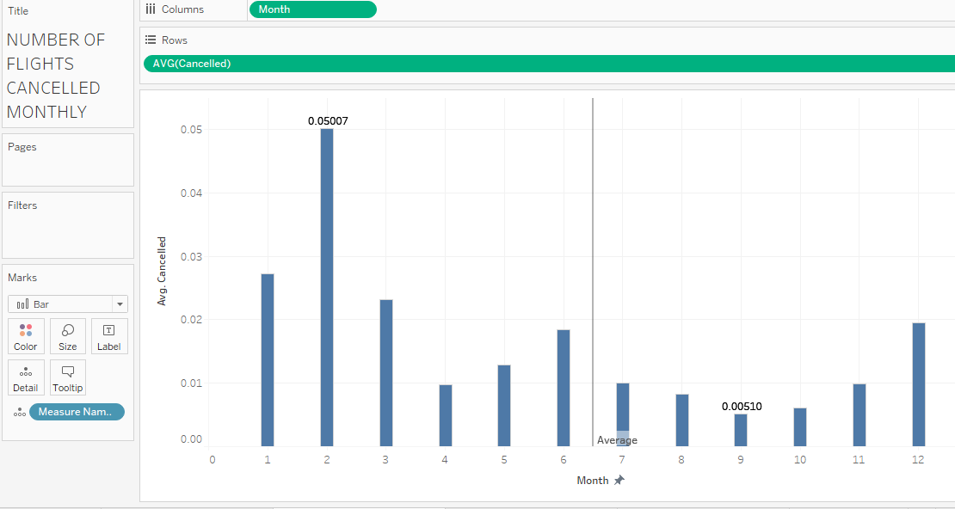

Slide 15
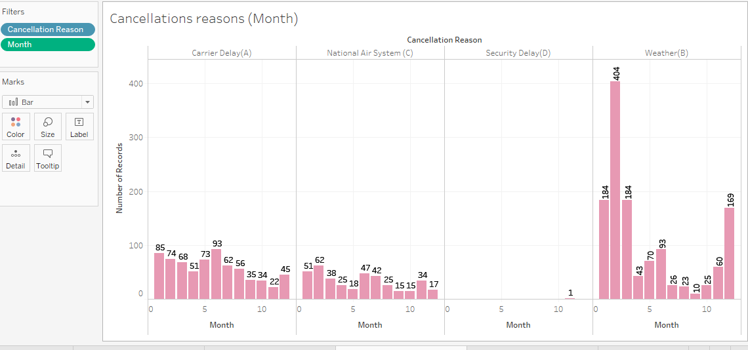

Slide 16
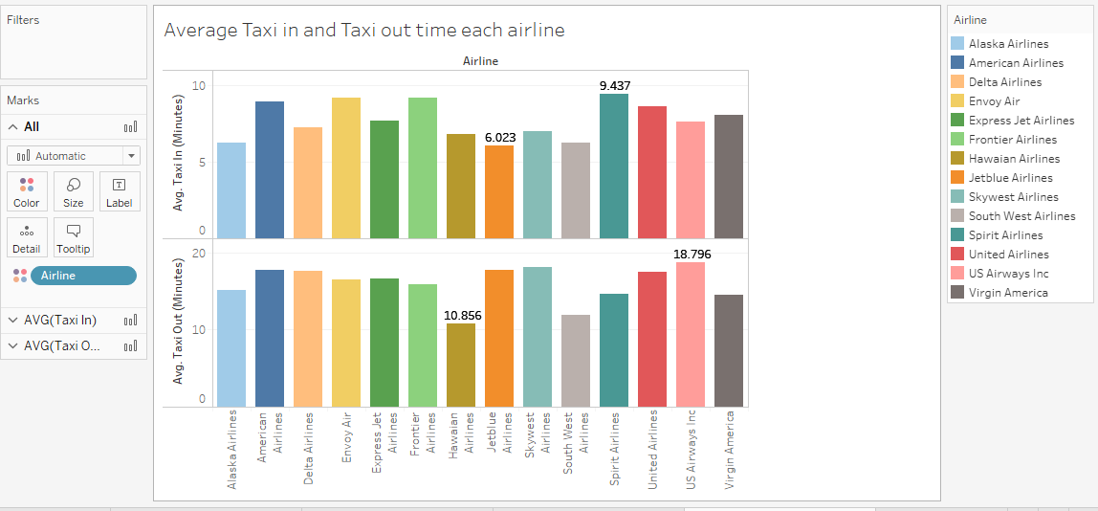

Slide 17
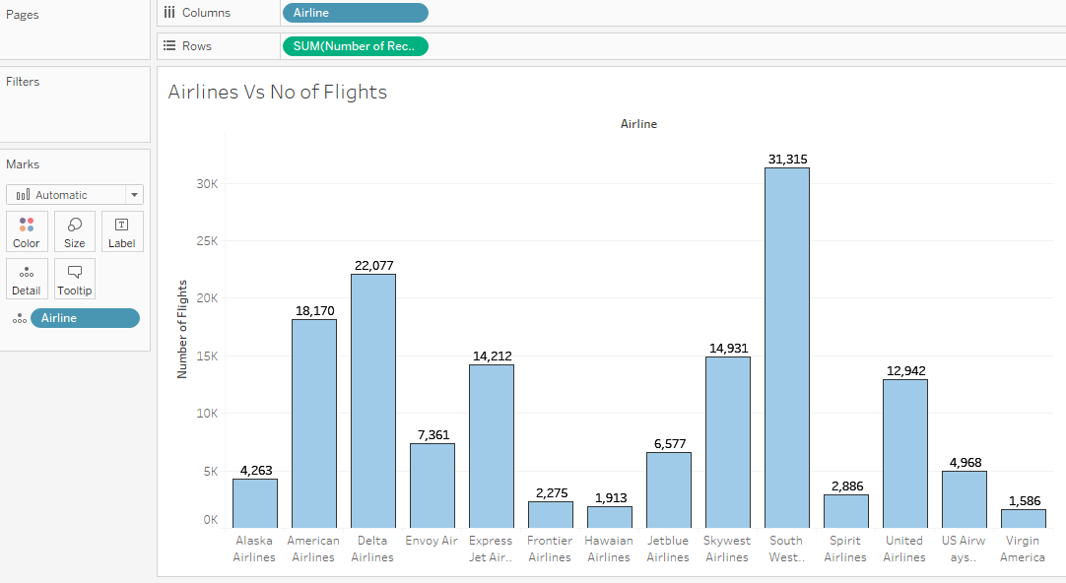

Slide 18
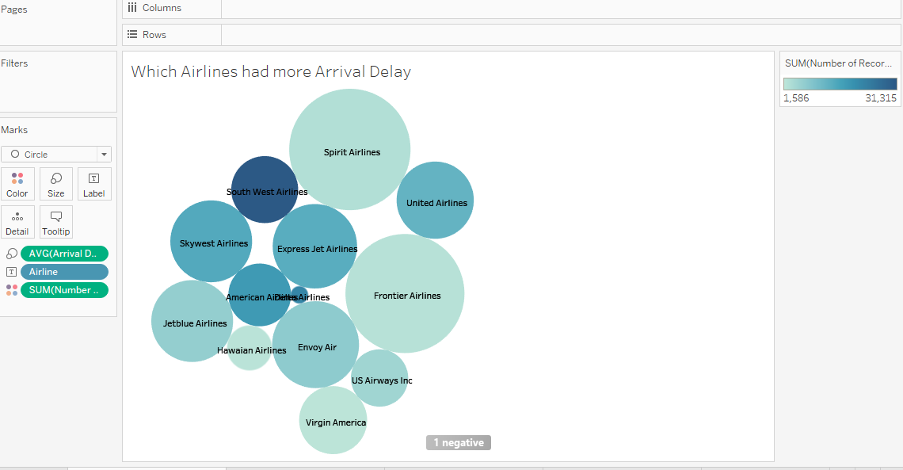

Slide 19
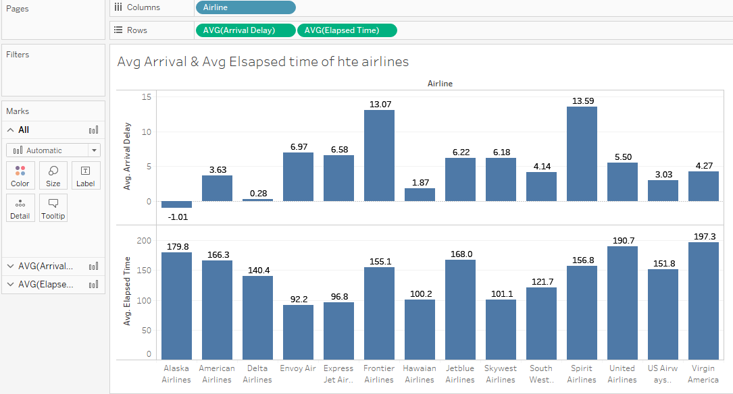

Slide 20
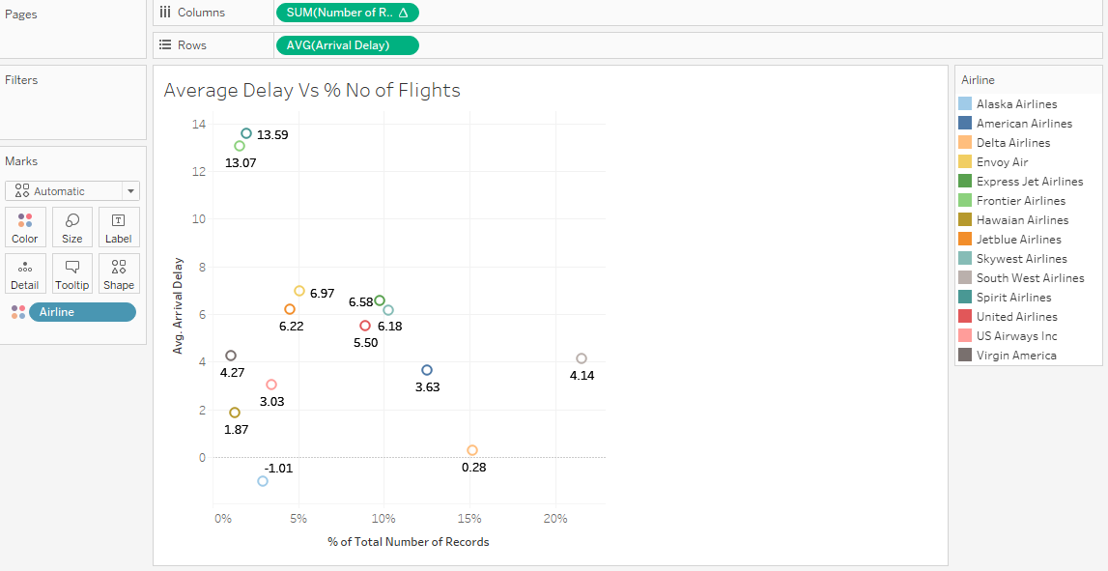

Slide 21
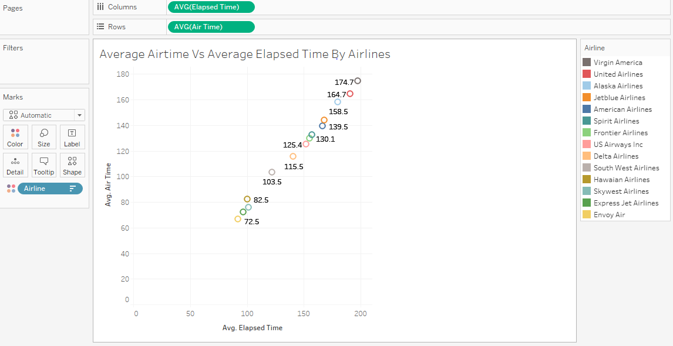

Slide 22
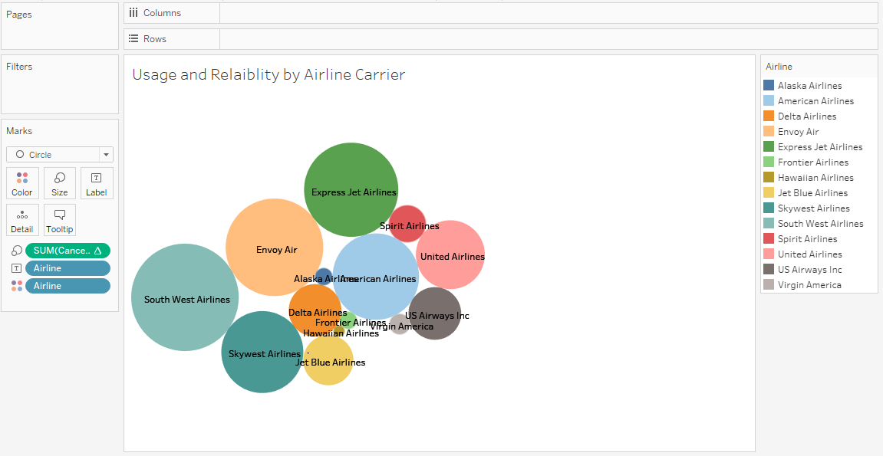

Slide 23
EXPLORATORY DATA ANALYSIS

Slide 24
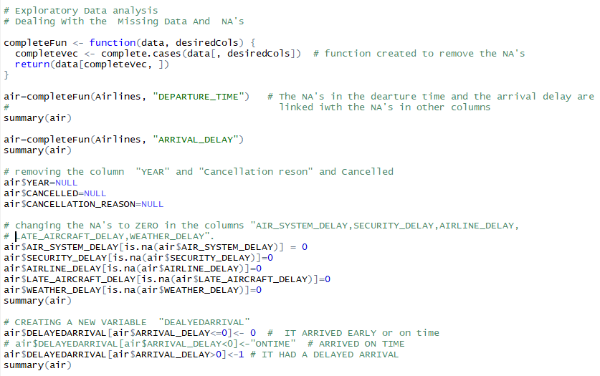
The NA’s have been removed from the dataset
The columns year, cancelled and cancellation reason have been removed since we are predicting arrival delay , the variables related cancellation are not useful
A new binary variable called “DELAYEDARRIVAL” is created based on the arrival delay
Na’s in the reasons for delays have been marked as zero

Slide 25
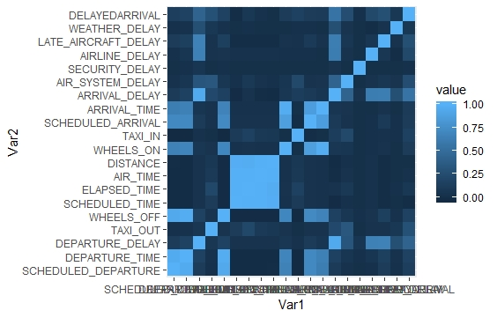
HEAT MAP FOR THE CORRELATIONS AMONG THE VARIABLES

Slide 26
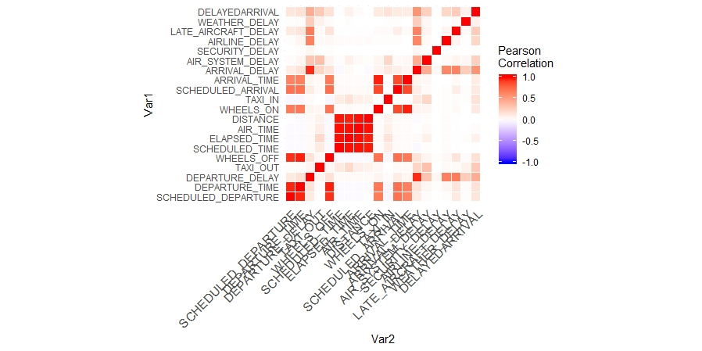
HEAT MAP CORRELATION MATRIX BASED ON PEARSON COEFFICIENT

Slide 27
FLIGHT DELAY PREDICTION

Slide 28
PREDICTIVE MODEL 1
DECISION TREE

Slide 29
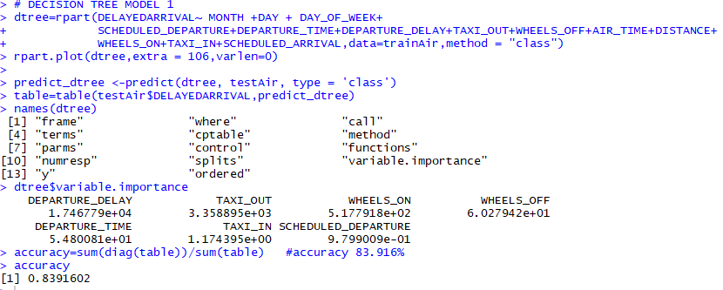
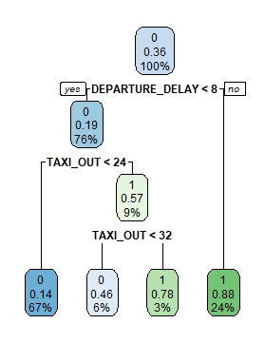
Decision Tree Model 1

Slide 30
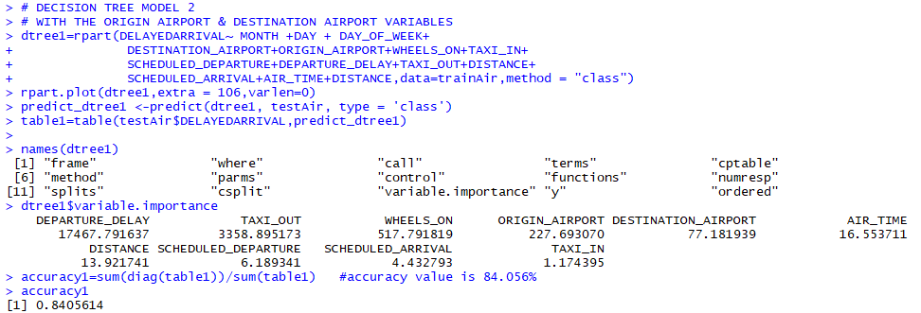
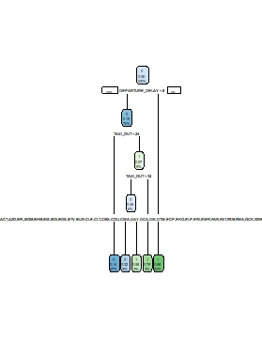
Decision Tree Model 2

Slide 31
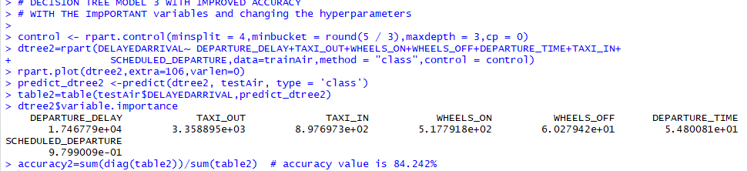
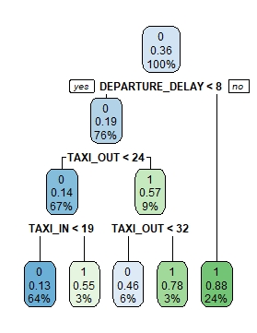
Decision Tree Model 3

Slide 32
PREDICTIVE MODEL II
RANDOM FOREST

Slide 33
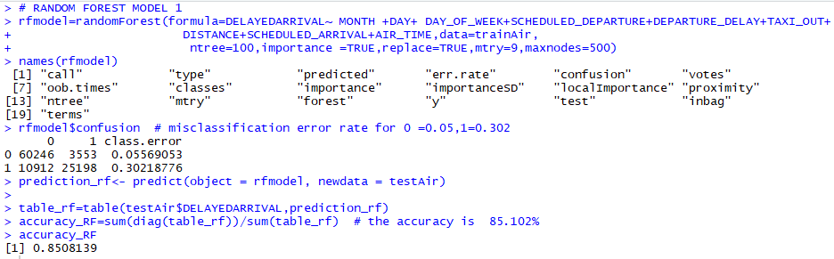
Random Forest Model1

Slide 34
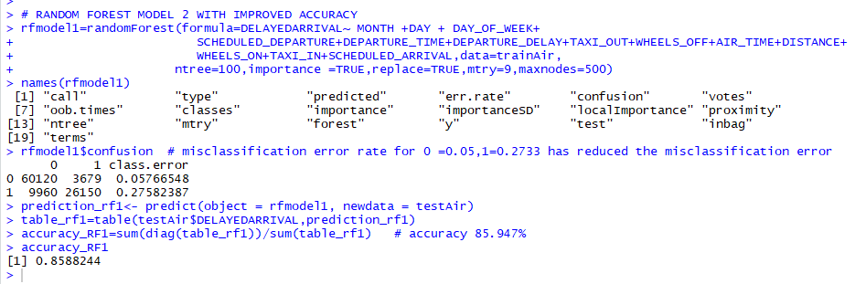
Random Forest Model 2

Slide 35
PREDICTIVE MODEL III
GRADIENT BOOSTING USING XGBOOST

Slide 36
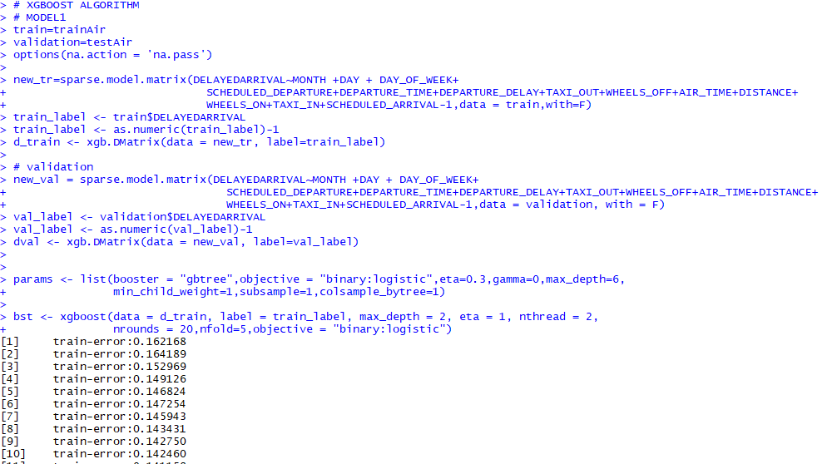
XGBOOST MODEL

Slide 37
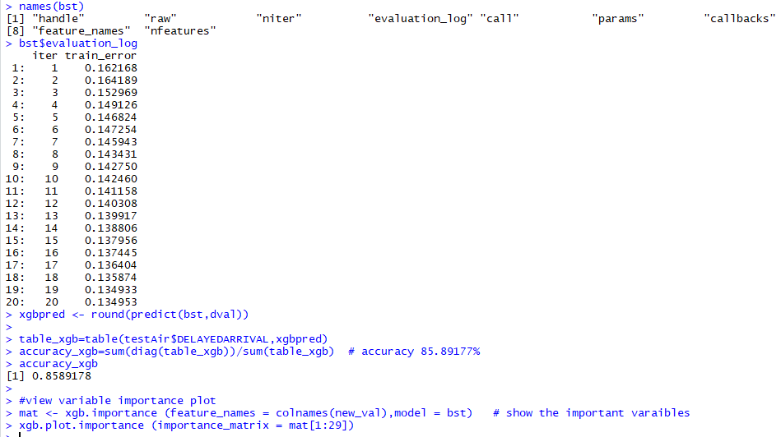
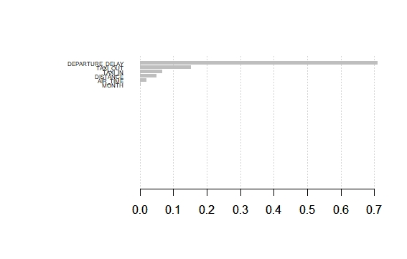
XGBOOST MODEL

Slide 38
PREDICTIVE MODEL IV
LOGISTIC ALGORITHM

Slide 39
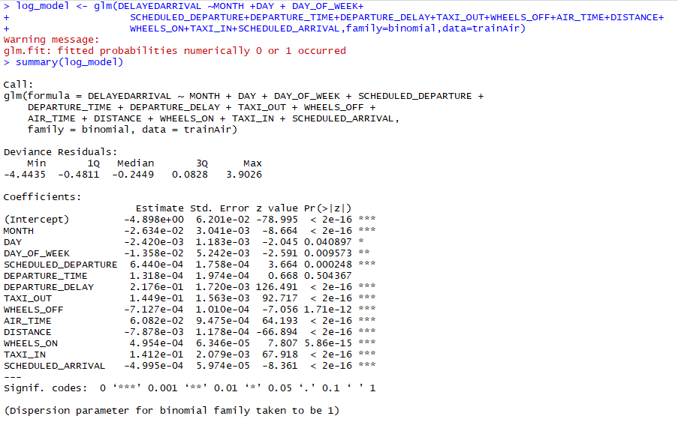

Slide 40
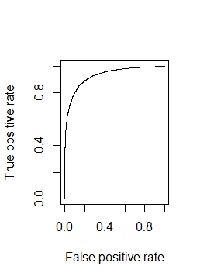
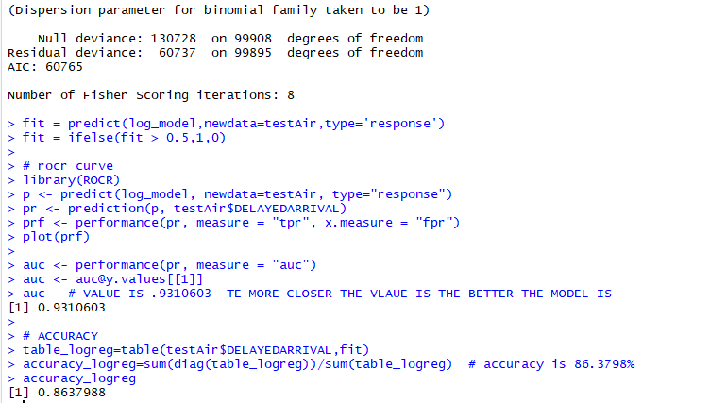

Slide 41
FINDINGS AND CONCLUSION
FINDING FROM THE DESCRIPTIVE ANALYTICS
When the distance between the origin and destination airport increases the reason for cancellation
is mostly “carrier delay”.
United Airlines has the most cancelled flights.
Carrier delay is the only reason for the cancellation of Hawaiian airlines.
American Airlines is the only flight cancelled because of the security delay.
Cancellation reason Dramatically increases in Jan ,Feb it is because of weather delay.
A minimum of 6 minutes is spent on the Average Taxi in time
The Southwest Airlines is the one with the maximum number of flights and a lower average delay.
Virgin America has the highest average elapsed time and Airtime .

Slide 42
FINDINGS AND CONCLUSION
FINDING FROM THE DESCRIPTIVE ANALYTICS
Alaska Airline is the only flight with a average on time arrival delay of 1.01 minutes
Roughly 2 % of the dataset have been removed because of the missing variables
The American Airlines is 80% reliable for not being cancelled and 81% for United Airlines and 90% for the Delta Airlines carrier
Based on cancellation rate Delta Airlines is a reliable one
Based on the arrival delay the South west Airlines is more reliable one .

Slide 43
FINDINGS AND CONCLUSION
PREDICTIVE MODEL | ACCURACY
DECISION TREE | 84.24%
RANDOM FOREST | 85.88%
XGBOOST ALGORITHM | 85.89%
LOGISTIC REGRESSION | 86.37%
From the Predictive Modelling Results , the Logistic Regression Model and Xgboost model predicts with a better accuracy.

Slide 44
THANK YOU !!

