Slide 1
NORTHWIND BUSINESS PROJECT
BY SHEETAL RAWAT

Slide 2
PROBLEM STATEMENT
Objective To transform Northwind Traders' business data into strategic, easy-to-understand insights using Power BI. The dashboard helps identify trends, inefficiencies, and growth opportunities across key operational areas.
Dashboard Scope The report covers five core business domains:
Sales Insights: Analyze revenue, order trends, and top-selling products/categories
Customer Segmentation: Understand customer distribution across countries, titles, and ordering patterns
Inventory Analysis: Track stock levels, reorder needs, and supplier dynamics
Employee Performance: Assess sales contributions, tenure, and reporting hierarchy
Shipping Insights: Evaluate delivery efficiency, duration, and company performance

Slide 3
KEY BUSINESS INSIGHTS
Sales Highlights
Total Sales grew from 81K to 106K, showing strong performance over time
Top-selling products include Tarte au sucre, Carnarvon Tigers, and Uncle Bob's Organic Pears
Beverages dominate sales volume, followed by Seafood and Confections
Seasonal spikes observed in Q4 1995 and Q1 1996
Customer Insights
Customers are spread across 22 countries, with USA, France, and Germany being the top contributors
Order trends peak during early 1996, indicating a surge in engagement

Slide 4
Inventory Overview
Products like Steeleye Stout and Côte de Blaye show low stock alerts
Categories like Beverages and Produce need proactive reorder strategies
Employee Performance
Most employees have a tenure of around 32–33 years, implying stability
Clear reporting structure aids in smooth workflow and accountability
Shipping Efficiency
Speedy Express offers the shortest average delivery time
Majority of shipments are delivered on time, but United Package shows higher delays

Slide 5

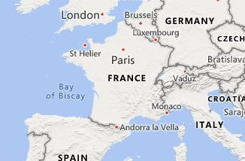

NORTHWIND BUSINESS DASHBOARD
Power BI Desktop
Total Sales
81.36K
Country
Total Orders
77
Total Customers
11
Argentina | Austria |  |  |  | Belgium | Brazil |  |  |  | Canada |  |  |  | Denmark | Finland |  |  |  | France |  | Germany | Ireland | Italy
Mexico | Norway |  |  |  | Poland | Portugal |  |  |  | Spain |  |  |  | Sweden | Switzerland |  |  |  | UK |  | USA | Venezuela
Sales Insights |  |  |  | Customer Segmentation |  |  |  |  | Inventory Analysis |  |  |  | Employee Performance |  |  |  | Sh | ipping Insights
Sales and Orders Trends
Total Sales Total Orders 40K
40
Total Orders
Total Sales
20K
20
1994
1995
1996
©© 22002255 TToommTToomm,, ©© 22002255 MMiiccrroossoofftt CCoorrppoorraattiioonn,, ©© OOppeennSSttrreeeettMMaapp
Top Selling Products
Top Selling Category
Average Shipping Duration of Shippers
Beverages Confections
Seafood Dairy Products Grains/Cereals
ProductName
Tarte au sucre
CategoryName
CompanyName
Speedy Express
Carnarvon Tigers
United Package
Uncle Bob's Organ…
Federal Shipp…
0
50
100
Sum of Quantity
150
200
0
500
Sum of Quantity
0
5
Average of Shipping_duration
10

Slide 6
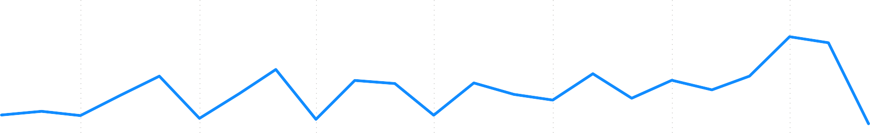
SALES INSIGHTS
Power BI Desktop
Total Sales
106.05K
CategoryName
Average Orders Value
127.77
Total Sales by Year, Quarter and Month
Total Orders
830
Beverages
Condiments
Confections
Dairy Products
Total Sales
10K
Grains/Cereals
Meat/Poultry
Produce
Seafood
0K
Oct 1994
Jan 1995
Apr 1995
Jul 1995
Year
Oct 1995
Jan 1996
Apr 1996
Count of OrderID by OrderValue (bins)
Count of ProductID by UnitPrice (bins)
Total Selling Products
Vegie-spread Sirop d'érable Louisiana Fiery Hot Pe… Northwoods Cranberr…
Gula Malacca Original Frankfurter gr… Chef Anton's Cajun Se… Grandma's Boysenber… Chef Anton's Gumbo …
10
200
Count of OrderID
Count of ProductID
ProductName
100
5
0K | 5K | 10K | 15K | 20K | 0 0K | 10K |  | 0 20K | 0.00
 |  | Total Sales |  |  |  | OrderValue (bins) |  |  | UnitPrice (bins)

Slide 7
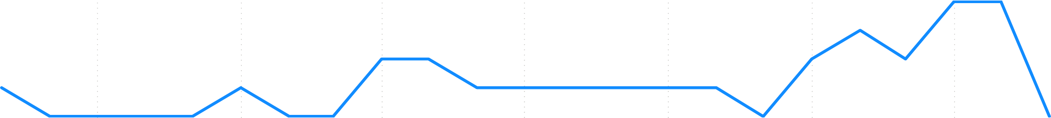

CUSTOMERS SEGMENTATION
Power BI Desktop
Country
Total Customers
4
Argentina
Austria
Belgium
Brazil
Canada
Denmark
Finland
France
Germany
Ireland
Italy
Mexico
Norway
Poland
Portugal
Spain
Sweden
Switzerl…
UK
USA
Venezuela
Customer orders over time
OrderDate
V
04-08-1994 
Count of CustomerID
4
05-06-1996 
2
Oct 1994
Jan 1995
Apr 1995
Jul 1995
Oct 1995
Jan 1996
Apr 1996
Customer distribution by City
Customer distribution by title
1.0
2
Count of CustomerID
Count of CustomerID
0.5
1
0.0
Barquisimeto
Caracas
I. de Margarita
San Cristóbal
0
Owner
Accounting Manager
ContactTitle
Sales Representative
City

Slide 8
INVENTORY ANALYSIS
Power BI Desktop
Stock Status
Sum of UnitsInStock and Sum of ReorderLevel by ProductName
Sum of UnitsInStock Sum of ReorderLevel
20
Sum of UnitsInStock and Sum of ReorderLevel by CategoryName
Sum of UnitsInStock Sum of ReorderLevel
40
In Stock
Sum of UnitsInStock and Sum o…
Sum of UnitsInStock and Sum of R…
15
30
10
20
Low Stock
5
10
0
Steeleye Stout
Côte de Blaye
Uncle Bob's Organic Dried Pears
0
Beverages Produce
CategoryName
ProductName
Out of Stock
Sum of UnitsInStock by CompanyName
20
Sum of UnitsInStock
15
Overstock
10
5
0
Bigfoot Breweries
Aux joyeux ecclésiastiques
CompanyName
Grandma Kelly's Homestead

Slide 9
EMPLOYEE PERFORMANCE
Power BI Desktop
Country
Employee Name ×
Manager Name ×
USA
UK
Janet Leverling
Sales Contribution by Employees
0.6M
Andrew Fuller 1
Total Sales
0.4M
0.2M
Janet Leverling
1
Andrew Fuller 1
0.0M
Count of EmployeeID
5
Laura Callahan 1
Sales Representative
Vice President, Sales
Title
Inside Sales Coordinator
Count of EmployeeID by EmpTenureYears (bins)
3
Margaret Peacock 1
Count of EmployeeID
Nancy Davolio 1
2
1
0
31
32
EmpTenureYears (bins)
33

Slide 10
SHIPPING
Power BI Desktop
ShipCountry
Argentina
Austria
Belgium
Brazil
Canada
Denmark
Finland
France
Germany
Ireland
Italy
Mexico |  | Norway |  | Poland |  | Portugal |  | Spain |  | Sweden |  | Switzerland |  | UK | USA | Venezuela
Average Shipping duration of Company
Delivery Status of Company
Delivery Status Delayed On Time
United Package
United Package
CompanyName
CompanyName
Speedy Express
Federal Shipping
Federal Shipping
Speedy Express
0
2
4 6
Average of Shipping_duration
8
10
0
20
40
60
Count of OrderID

