Slide 1

B.Tech 8th Semester project Presentation
“Stock Price Prediction”
Presented by:
Sheetal Jadav
200305105059
Supervisors:
PARUL INSTITUTE OF TECHNOLOGY, PARUL UNIVERSITY
NAME OF THE INSTITUTE, PARUL UNIVERSITY

Slide 2

Content of Presentation
Abstract
Introduction (front end technology/back end technology
/Aim and Objectives project/application etc.)
Problem Statement
Literature Review (if any)
Proposed Methodology
Project Module
Use case diagram/ER diagram/Flow diagram
Hardware and software Requirement
Excepted Outcome of the Project
Limitation
Conclusion and Future Work
References
PARUL INSTITUTE OF TECHNOLOGY, PARUL UNIVERSITY
NAME OF THE INSTITUTE, PARUL UNIVERSITY

Slide 3
Abstract
This project employs machine learning, specifically linear regression, to predict stock prices based on historical data. The implementation in Python uses Scikit-Learn, focusing on features like open, high and low. The model is evaluated using Mean Absolute Error (MAE) and Mean Squared Error (MSE). The code, provided as a starting point, encourages users to explore and enhance predictive accuracy by experimenting with various models and features. Visualizations comparing actual and predicted prices are included for analysis.
PARUL INSTITUTE OF TECHNOLOGY, PARUL UNIVERSITY
NAME OF THE INSTITUTE, PARUL UNIVERSITY

Slide 4
Introduction
This project utilizes machine learning, specifically linear regression, to predict stock prices. The front-end employs Python libraries like Matplotlib for visualizations, while the back-end relies on Scikit-Learn for model development. The aim is to create a user-friendly application for investors and traders to make informed decisions based on accurate stock price predictions.
Technology Used:
Front-end: Python with Matplotlib visualizations.
Back-end: Python with Scikit-Learn, Pandas, and NumPy for machine learning tasks.
PARUL INSTITUTE OF TECHNOLOGY, PARUL UNIVERSITY
NAME OF THE INSTITUTE, PARUL UNIVERSITY

Slide 5
Introduction
Aim and Objectives:
Aim: Develop a reliable stock price prediction model using linear regression.
Objectives: Collect and preprocess data, implement the model, evaluate performance, provide a user-friendly interface, and encourage experimentation for enhanced accuracy.
Application: This project benefits investors and traders by offering a tool that aids in making informed investment decisions through accurate stock price predictions.
PARUL INSTITUTE OF TECHNOLOGY, PARUL UNIVERSITY
NAME OF THE INSTITUTE, PARUL UNIVERSITY

Slide 6
Problem Statement
In financial markets, predicting stock prices accurately remains a challenging task. Investors and traders face uncertainty due to the dynamic nature of the stock market. Traditional methods often fall short in providing reliable predictions. This project aims to address this challenge by leveraging machine learning, specifically linear regression, to develop a robust model for predicting stock prices. The need is to enhance accuracy and offer a practical tool for stakeholders to make more informed investment decisions in a volatile market environment.
PARUL INSTITUTE OF TECHNOLOGY, PARUL UNIVERSITY
NAME OF THE INSTITUTE, PARUL UNIVERSITY

Slide 7
Proposed Methodology
The methodology involves collecting historical stock price data, preprocessing for outliers and missing values, and selecting relevant features. Utilizing Python and Scikit-Learn, a linear regression model is implemented and trained on the dataset. The model's performance is evaluated using metrics like Mean Absolute Error (MAE) and Mean Squared Error (MSE). The user interface incorporates data visualizations, and the project encourages experimentation for model improvement by adjusting features and parameters. Continuous adaptation to market changes is emphasized for sustained predictive accuracy.
PARUL INSTITUTE OF TECHNOLOGY, PARUL UNIVERSITY
NAME OF THE INSTITUTE, PARUL UNIVERSITY

Slide 8
Project Module
Data Collection: Gather historical stock data.
Preprocessing: Handle missing values, outliers, and normalize data.
Feature Selection: Identify relevant features.
Model Implementation: Use Scikit-Learn for linear regression.
Training and Evaluation: Split data, train, and assess using MAE, MSE.
Visualization:Develop a user-friendly interface with visualizations.
Experimentation: Encourage users to tweak features and parameters.
Continuous Adaptation: Emphasize ongoing model adjustments for market changes.
PARUL INSTITUTE OF TECHNOLOGY, PARUL UNIVERSITY
, PARUL UNIVERSITY
NAME OF THE INSTITUTE, PARUL UNIVERSITY

Slide 9
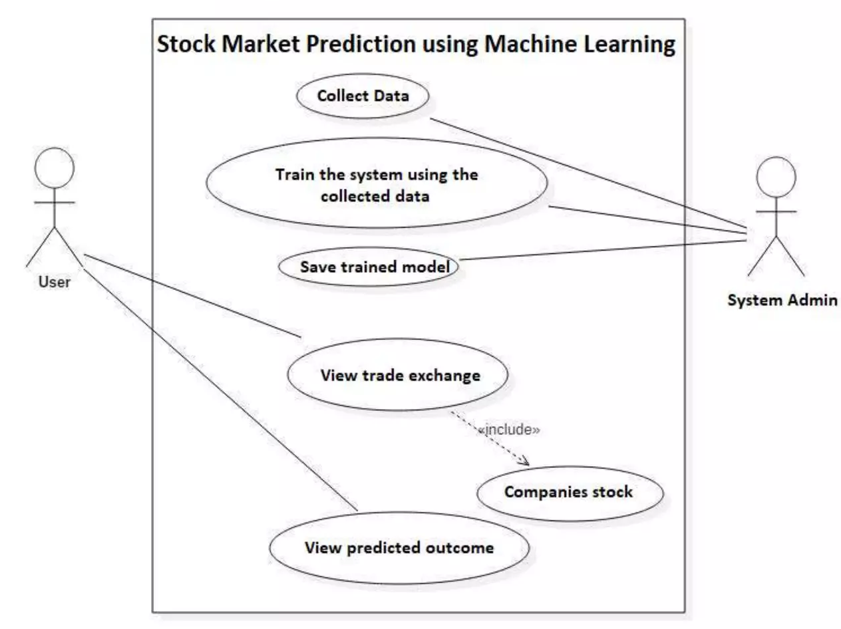
Use case Diagram
PARUL INSTITUTE OF TECHNOLOGY, PARUL UNIVERSITY
NAME OF THE INSTITUTE, PARUL UNIVERSITY

Slide 10
Hardware/Software Requirement
Hardware Requirements:
Processor: Multicore processor.
Memory (RAM): 8 GB or more.
Storage: Adequate space for data and models.
GPU: Optional but beneficial for faster computations.
Software Requirements:
Operating System: Windows, Linux, or macOS.
Python: Latest version.
IDE: Jupyter, PyCharm, or VSCode.
Libraries: Pandas, NumPy, Scikit-Learn, Matplotlib or Plotly.
Version Control: Git.
DBMS (Optional): MySQL or PostgreSQL.
Web Framework (Optional): Flask or Django.
PARUL INSTITUTE OF TECHNOLOGY, PARUL UNIVERSITY
NAME OF THE INSTITUTE, PARUL UNIVERSITY

Slide 11
Expected outcomes of the Project
Accurate Predictions
User-Friendly Interface
Model Evaluation Metrics
Investment Insights
Continuous Adaptation
Scalability
Contribution to Research
PARUL INSTITUTE OF TECHNOLOGY, PARUL UNIVERSITY
NAME OF THE INSTITUTE, PARUL UNIVERSITY

Slide 12
Limitations
Market Uncertainty: Inherent unpredictability in financial markets.
Data Sensitivity: Vulnerability to data anomalies or outliers.
Model Complexity: Limited by the simplicity of linear regression.
External Factors: Influence of global events not considered.
Past Performance: Assumes historical trends predict future behavior.
Overfitting Risk: Model may perform poorly on new data.
Limited Feature Set: Relevant market factors might not be captured.
Data Quality Dependency: Predictions highly dependent on data quality
PARUL INSTITUTE OF TECHNOLOGY, PARUL UNIVERSITY
NAME OF THE INSTITUTE, PARUL UNIVERSITY

Slide 13
Conclusion & Future Work
Conclusion:
Successfully implemented a stock price prediction model using linear regression.
Demonstrated valuable insights for investors through accurate predictions.
Highlighted limitations, emphasizing the need for caution in financial decision-making.
Future Work:
Explore advanced machine learning models for improved accuracy.
Integrate sentiment analysis for considering market sentiment.
Enhance the user interface for a more interactive experience.
Implement real-time data processing for up-to-the-minute predictions.
Collaborate with financial experts for model refinement and validation.
PARUL INSTITUTE OF TECHNOLOGY, PARUL UNIVERSITY
NAME OF THE INSTITUTE, PARUL UNIVERSITY

