Slide 1
Eliminating vRA Blueprint Sprawl
Discovering the bolt-ons that make vRA work for you

Slide 2
Who are these guys?
Brett Rath
@pa_sre
15 years with Sheetz Inc
Computer Tech turned Network & Security, turned automation junkie
Work on NSX, Load Balancers, SSO, WAF, Firewalls, Coding
Jason ‘Willie’ Williamson
@AdminWillie
14 years with Sheetz Inc
Computer Tech turned Windows Admin, turned VMware Admin, turning DevOps/Automation/Cloud/Buzzword Admin
vExpert ‘19

Slide 3
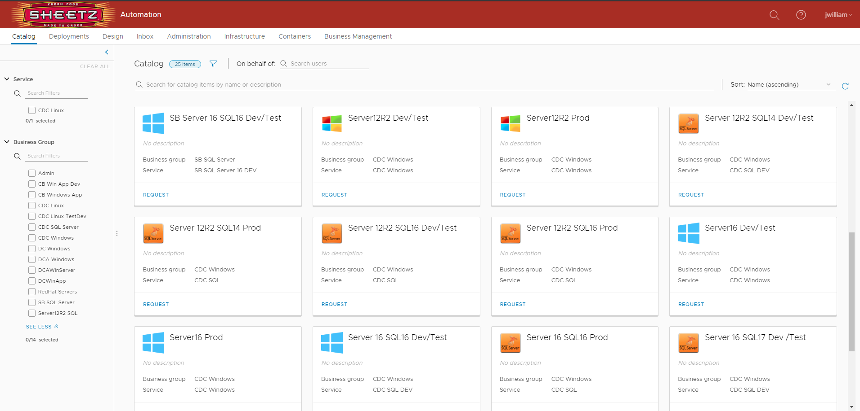
In the beginning…
Notes:
-Willie
Our first attempt at building servers through vRA was...messy. We had 25 catalog items for on prem server builds that our customers had to rifle through and hopefully pick the right one to give them the server they wanted, in the configuration they wanted, in the location they wanted. Any little change about the server (Redhat vs Windows, app vs database, prod vs staging vs test vs dev, this datacenter vs that one) all changed the blueprint you had to choose at the start. It usually worked, the customer usually got what they wanted; but we could see this starting us down the wrong path. Just like VM sprawl was a thing when virtualization was new, we were seeing blueprint sprawl emerging just as automation was picking up speed.

Slide 4
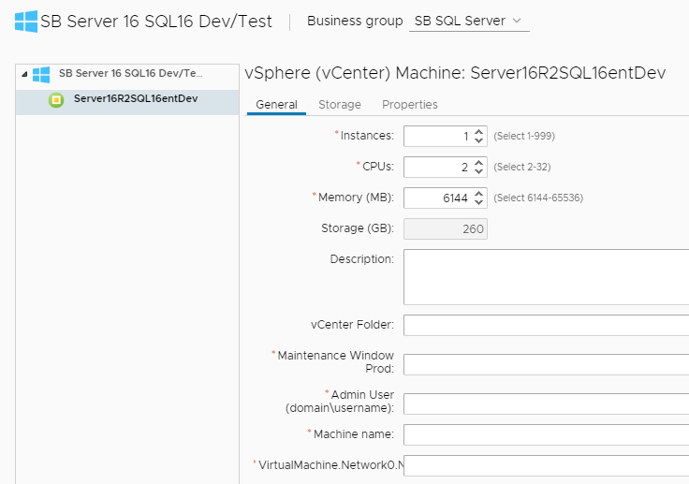
In the beginning…
Notes:
-Brett
This was originally built without custom forms and then a basic customization was added, but it just wasn't where we wanted it. Too many opportunities for human error.

Slide 5
In the beginning…
Notes:
-Willie
For 'Server Build 2.0' we set a lofty goal:

Slide 6
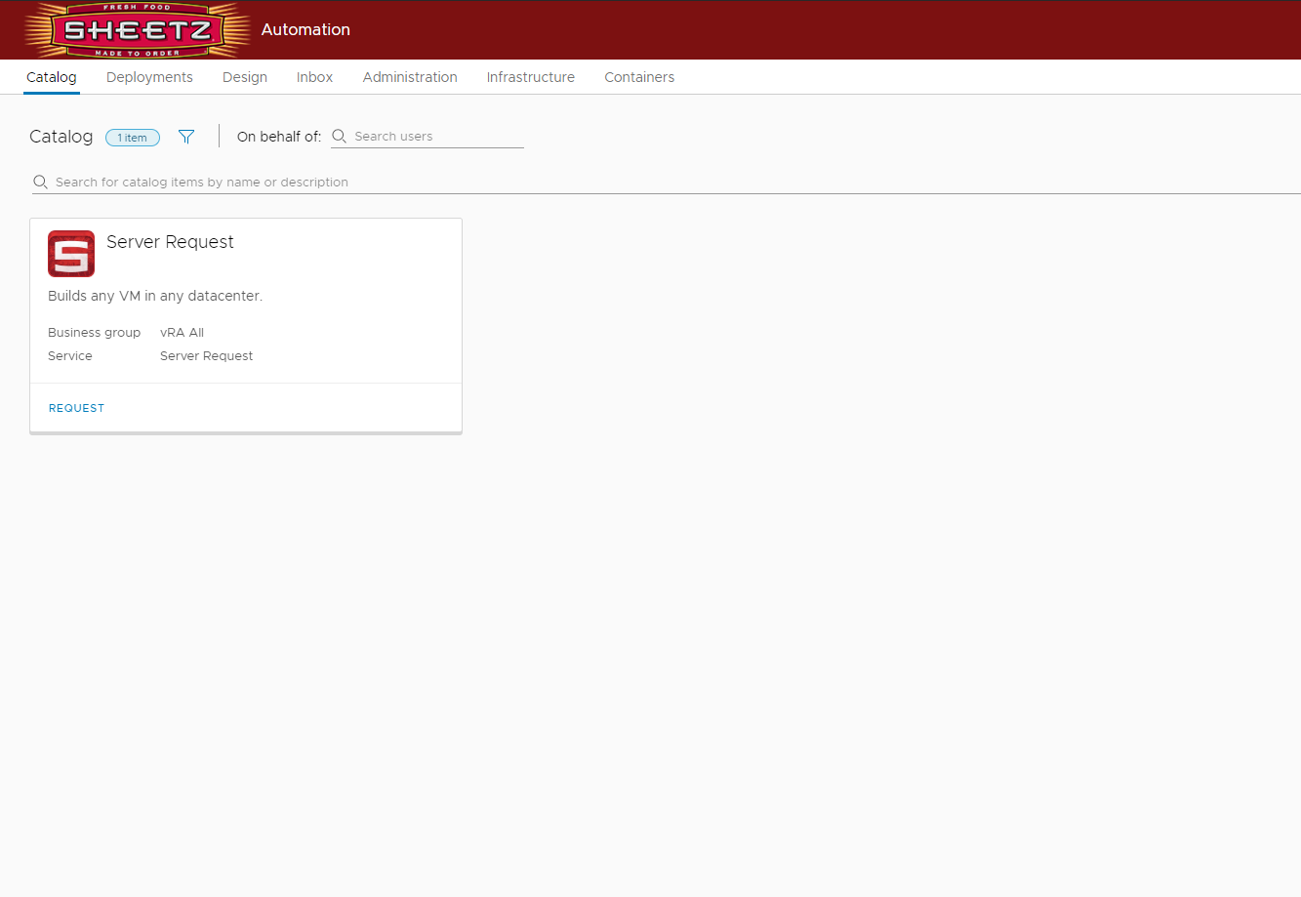
The vision
Notes:
-Willie
One blueprint to build any server, for any purpose, in any environment. Whether you wanted a production Red Hat server running Oracle in one of our Pennsylvania datacenters, or a test Windows web server in North Carolina, everyone's request started with the same "I need a server" blueprint.

Slide 7

The vision
Notes:
-Willie
Makes more sense, doesn’t it?

Slide 8
In the beginning…
Notes:
-Brett
Additionally, we want to require as little input from the customer as possible. We want hostnames, networks and IPs, firewall configurations, cluster placement, and virtual machine resource configuration all generated and executed behind the scenes.

Slide 9
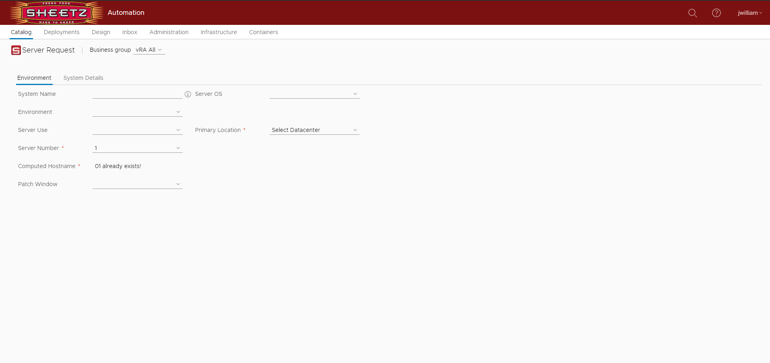
The vision
Notes:
-Willie
We wanted it to be clean. It had to be intuitive, minimalistic, consistent, and robust. VMware has a great thing going with the Clarity UI, and we wanted to do it justice.

Slide 10
The vision
Notes:
-Brett
Finally, this new process also had to conform to all of our current standards and procedures. The generated hostname had to fit in with our current standard. The SQL Server disk partitions had to match up with our DBAs best practices. We would not be bending our rules for this new tool to fit in.

Slide 11
Notes:
-Willie
We knew it would be tough. We knew it was going to take a lot time, effort, and learning. *ANIMATION* We were right.

Slide 12
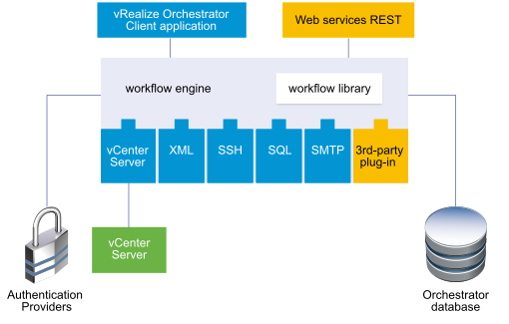
vRealize Orchestrator to the rescue!
Notes:
-Brett
The key thing we found was that Orchestrator was our foundation. For us, Orchestrator = flexibility. It's what allows us to load plugins for our storage arrays, IPAM, etc. that provide them; but also gives us access to use SOAP and REST APIs for those that don't. It's got a nice wealth of prewritten packages available, but also lets us write code to be able to pull off exactly what we want. It's allowed us to choose the right language for the task at hand whether it be in the native JavaScript, Powershell, BASH, Python, or Batch if it’s that simple.

Slide 13
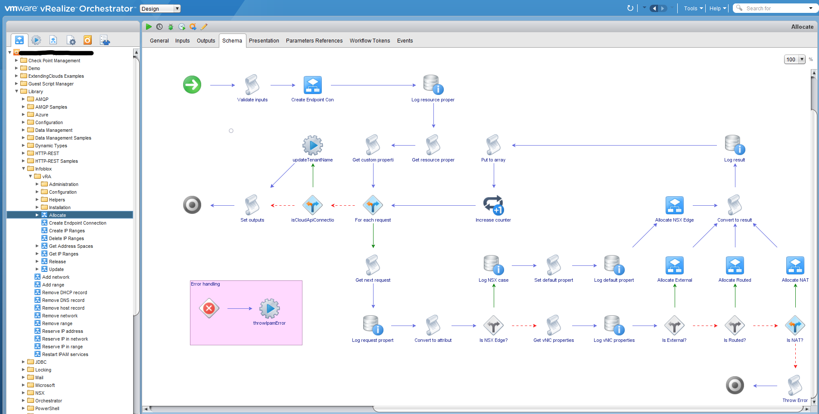
I get by with a little help from my vendors
Notes:
-Willie
The biggest bang for your buck in Orchestrator is if you can import workflows that do exactly what you want. We were able to use the ones from our IP manager to obtain IPs and register DNS entries. Our firewall vendor provided one with enough capability to create firewall objects and configure rules. We even found one from a third party that lets us create hard drives on the fly; fully customizable and configured to our liking.

Slide 14
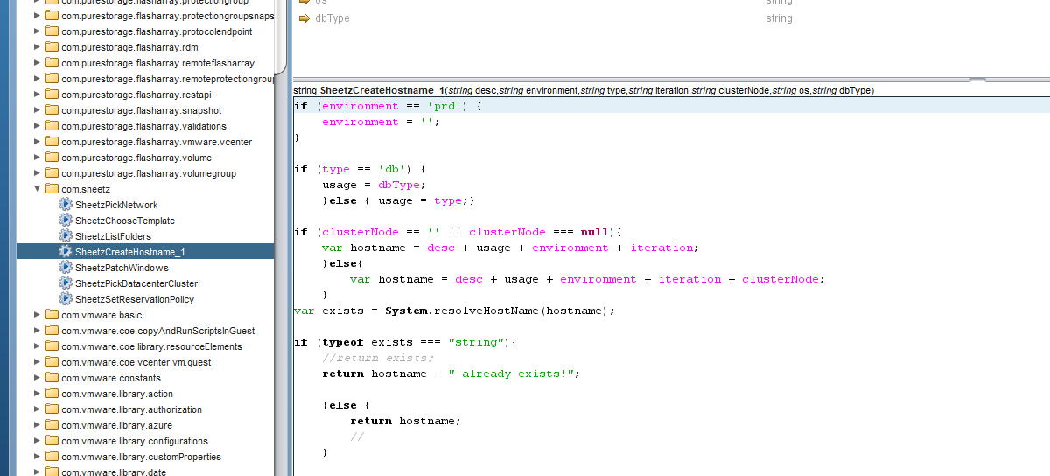
Aaaaaaaaaaannnd…Action!
Notes:
-Willie
Actions are like tiny workflows that do one job over and over again. We heavily use Actions to build our new VM's. They build the hostname and verify it doesn't already exist on the network before the user submits the form. They also report back to vRA to let it know what template, reservation, network, and VM folder to use. These are all put in place to think for the user. I no longer need my customer to know what network a test web server in North Carolina belongs on, the Action knows and it never makes a mistake.

Slide 15
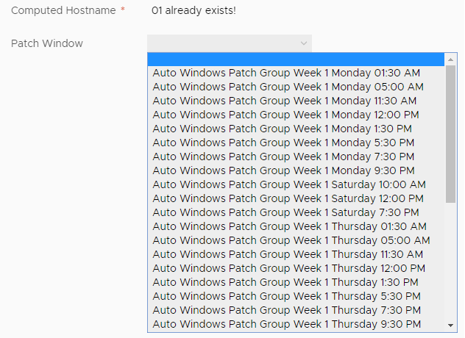
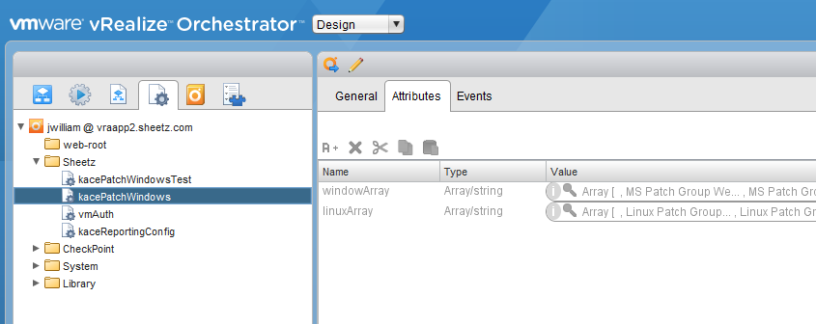
Maintenance windows for days
Notes:
-Brett
How do we keep from hard coding items into the workflows and actions? It took some head smashing but Configuration Elements came to light as the way to hold reusable data sources. How did we leverage this? For instance, when a user of ours provisions a server, we require them to pick a maint window. We can't let them just randomly pick their own time, so we provide predetermined windows around the clock that fits the application. We could just keep all these in the custom form, but that would be a pain to maintain. Instead we store all of those values in a Configuration Element in vRO, and just tell the custom form to populate the dropdown with the values in the Element. And to populate that Configuration Element, do we want to type those all in by hand? Check them periodically to make sure they are still complete and accurate? Of course not. That's why we wrote a Workflow to read the complete list of maintenance windows from our patching system and populate the element for us. Now we can schedule that workflow to run as often as we want and we know that dropdown is always correct, no human intervention required. It also means that we don’t need to query the external system on-demand. Even if it’s offline for some reason we can still build your server.

Slide 16
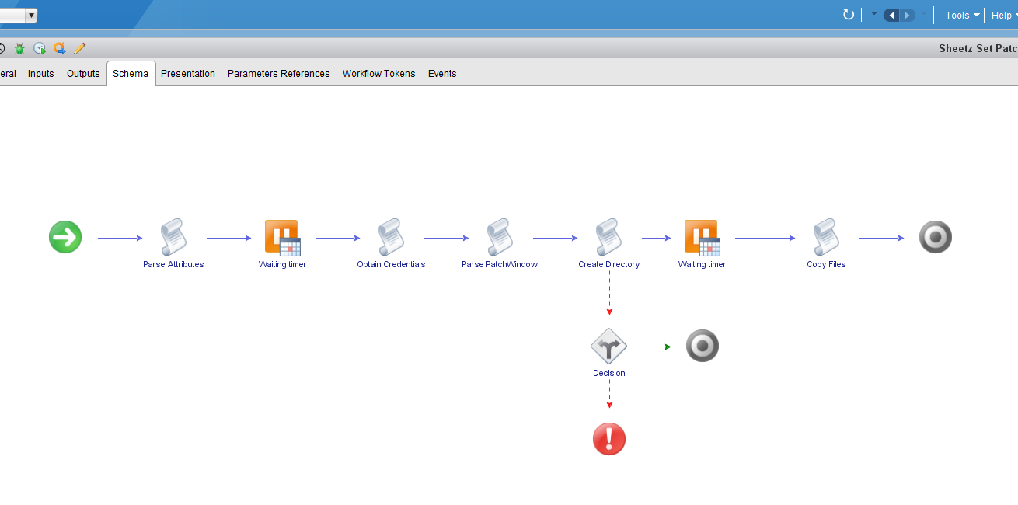
Maint File Creation
Notes:
-Brett
But how do we indicate to the asset management system when a new build is to be patched? Sadly there is no API available to update that attribute yet. Our team decided to place a file on the newly built box that is read by the management agent and in the system the patch window is dynamically assigned. And once it's there, the system keeps it there even if someone deletes it.

Slide 17
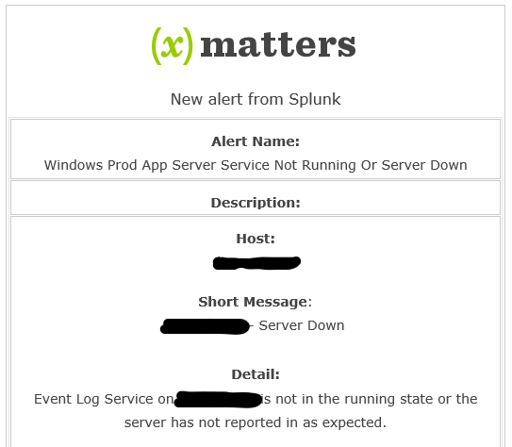
IT’S ALL DOWN…or is it?
Notes:
-Brett
Another benefit from this file is that the Splunk agent on the system reads this to disable alerting during these windows so the admins aren't spammed.

Slide 18
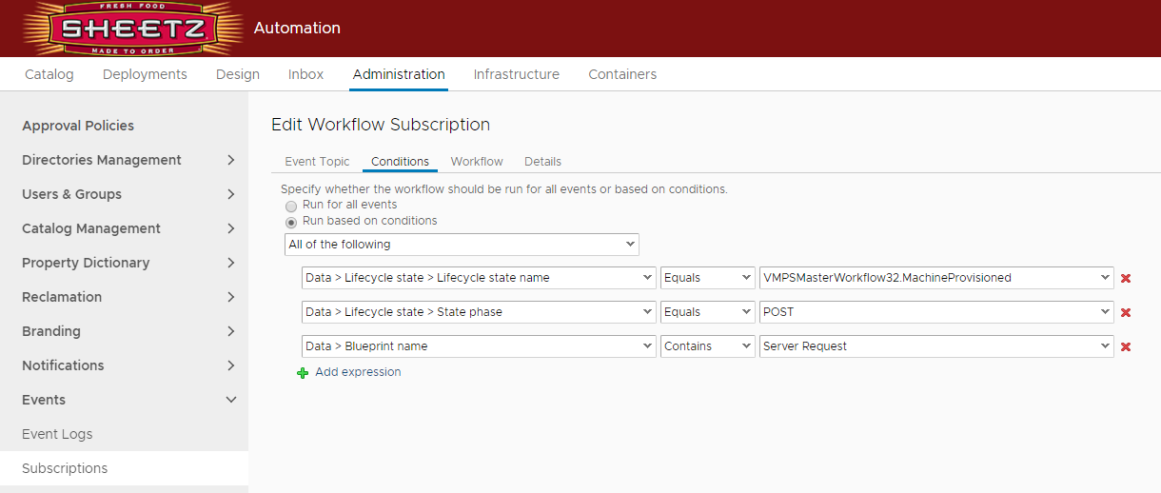
You get an event, and you get an event…
Notes:
-Willie
One of the last pieces that clicked for me was the Event Broker. It allows you to monitor the events happening in vRA and kick off a task based on criteria. We've leveraged the Event Broker to do a lot of the post provisioning tasks that happen in our process. We will do things like install antivirus and asset management agents or create and format additional hard drives based off of events happening to the VM. All of those activities are handled by vRO workflows.

Slide 19
So. Much. Work.
Done
Build VM
Customize disk layout
Pick Customization Spec
Integration with IPAM
Integration with firewalls
Install asset management agent
Set patch window
Set maintenance window
Integration with CMDB
To Do
Integrate with password vault
Add users to systems
Create mapped drives/mounts
Decommissions – everything we’ve done with builds but in reverse
Notes:
EXPLAIN
This is only for the Server Build process. We have dozens of other workflows that will be fronted with vRA to enable as much self-service automation as possible.

Slide 20
Where to find us:
https://github.com/SheetzIT
Brett
@pa_sre
Brettrath.dev
brath@sheetz.com
Willie
@AdminWillie
AdminWillie.com
thebeard@sheetz.com

