Slide 1
Ethical Student Hackers
An Introduction to our Society
www.shefesh.com

Slide 2
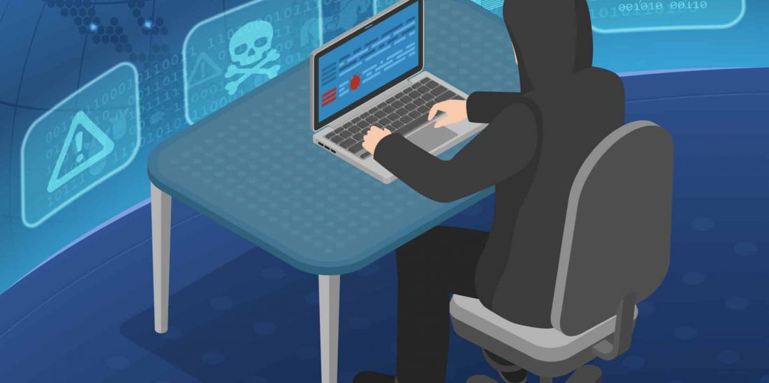
Who we Are
About Our Society
We formed in 2018
We meet every Monday, 18:00 - 20:00
We deliver regular sessions covering a variety of cybersecurity topics - right from the theory, to applying it to ethical hacking!

Slide 3
What we Do
Theory sessions and live demos
We host sessions every Monday between 18:00 and 20:00 on Blackboard Collaborate that include theory as well as walkthroughs and live demos.
Worksheets
After our sessions we release optional worksheets that can help you further learn about content that we have covered - in your own time, at your own pace.
Guest talks
There will be guest talks from industry specialists such as YHROCU (Yorkshire and Humber Regional Organised Crime Unit).

Slide 4
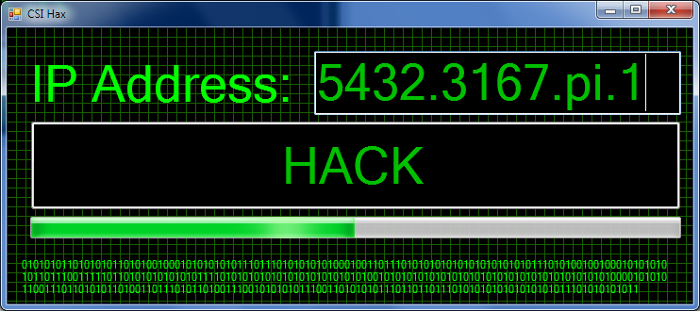
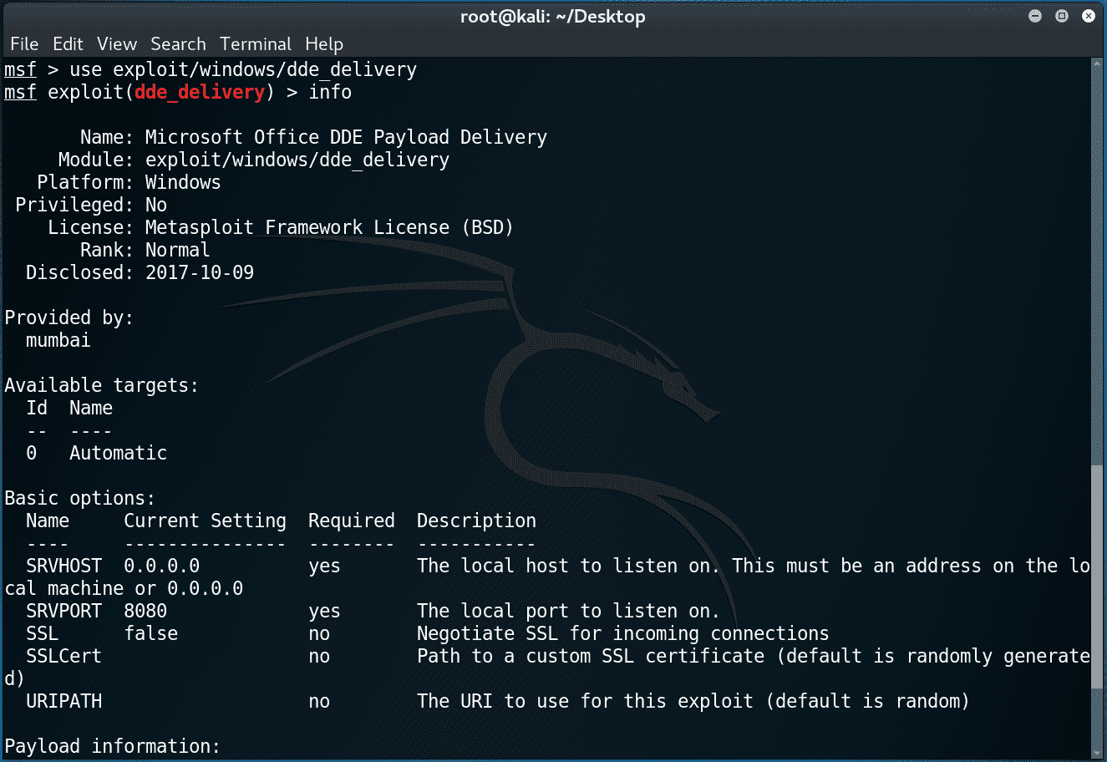
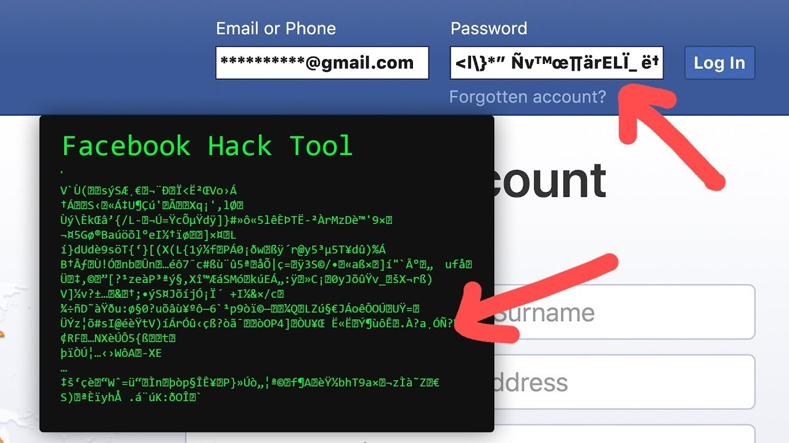
What is Hacking?
What it is:
lots of googling, experimentation, reading code, and fast learning!
lots of patience, curiosity, and persistence
lots of new skills - reconnaissance, enumeration, and persistence on a target
What hacking isn’t:

Slide 5
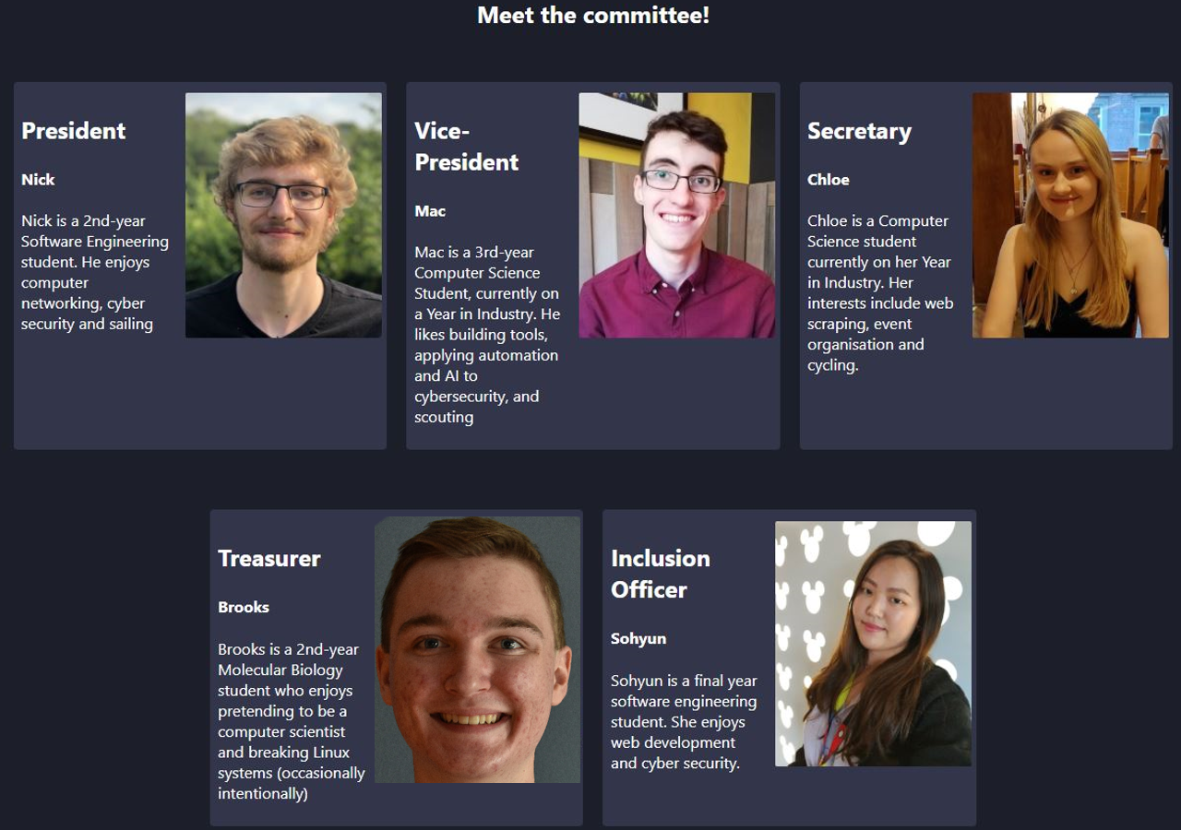
Meet the Committee

Slide 6
Our plan for the year
Engagement
More interactive sessions
Better learning curve
Accessibility
We cater to newcomers as well as advanced hackers
No matter your skill set we should have something to keep you entertained with!
There will be plenty of slides and extra resources on our site
Publicity
Increase our presence on social media
Post lots of useful resources
Maybe even some Cyber blogs!
Industry Links
We are growing our industry links this year
We’re looking to partner with the best cyber security organisations for job opportunities and industry talks!

Slide 7
Upcoming Sessions
Juice Shop
Basics of Linux
Juice Shop (again!)
Special Guest Talk
Automation in Python
What you can expect in the first few weeks

Slide 8
Join us!
Get yourself a membership here:
https://su.sheffield.ac.uk/activities/view/ethical-student-hackers-society
Or search for ‘Ethical Hackers’ on the SU website
Our memberships:
Mailing list Only: £0.00
1 Year membership: £4.00
2 Year membership: £7.00

Slide 9

Any Questions?
www.shefesh.com

